Slide 1
Time Series Analysis of Liquidity
Presented By:
Dipesh Poudel
Roll No: 10
MDS, SMS, TU

Slide 2
Liquidity
Liquidity is the measure of how quickly and easily an asset or security can be converted into cash without impacting its market value.
Cash is considered the most liquid asset as it can be readily used to purchase goods or services.
A financial system with high liquidity means that there is plenty of cash available, making it easier for banks and other financial institutions to lend money to borrowers.
A financial system with low liquidity means that there is a shortage of cash, making it harder for banks and other financial institutions to lend money
Too much liquidity can also be problematic as it can lead to inflationary pressures and asset bubbles.
Maintaining an appropriate level of liquidity is essential for a healthy and stable economy

Slide 3
Few Terms to Understand
Fractional Reserve System: Banking system in which banks are required to hold only a fraction of their deposits as reserves and can lend out the remainder.
Cash Reserve Ratio (CRR): Amount of money that commercial banks are required to hold as reserves in their vaults or with the central bank (NRB).
For Fiscal Year 2022/23 NRB has increased the CRR from 3% to 4%

Slide 4
Objective
The Objectives of this analysis is follows
Analyze the trend of Balance at NRB minus CRR
Make forecast for next 30 days using ARIMA

Slide 5
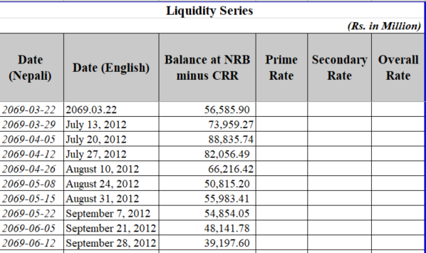
Understanding the Data
Data Source: NRB Database on Nepalese Economy
https://www.nrb.org.np/contents/uploads/2023/05/Liquidity-and-interbank-rate.xlsx
Raw Data Sample

Slide 6
Data Preprocessing Steps
Data Cleaning and Filtering:
Take English Date and Balance at NRB minus CRR
Take Data from 2016-08-09 onwards only
Convert the English date to YYYY-MM-DD format

Slide 7
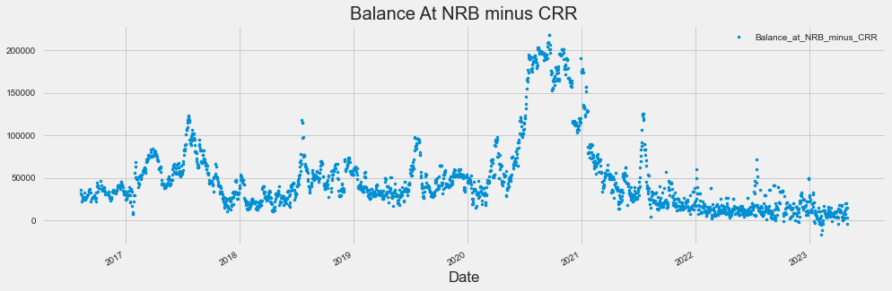
Exploratory Data Analysis

Slide 8
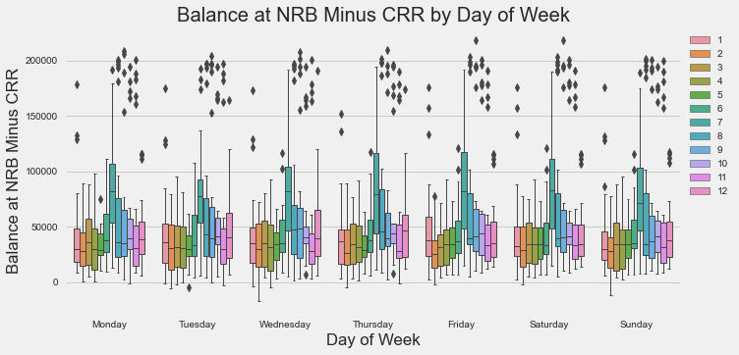
Balance at NRB Minus CRR by Day of Week

Slide 9
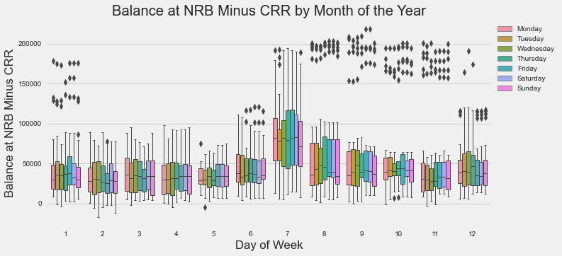
Balance at NRB Minus CRR by Month of the Year

Slide 10
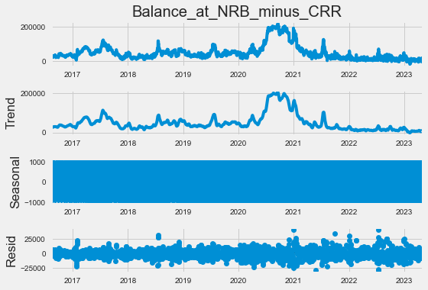
Time Series Decomposition

Slide 11
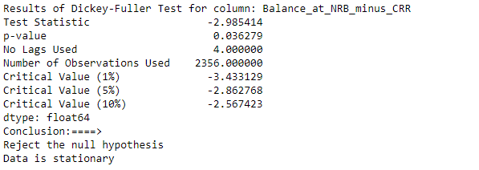
Test for Stationary

Slide 12
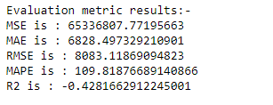
Model Evaluation

Slide 13
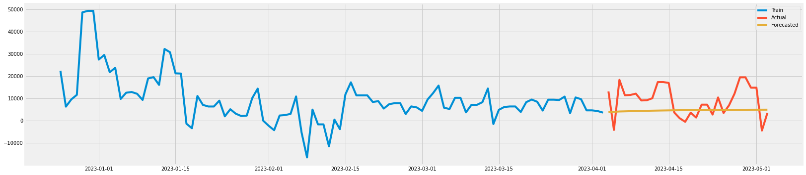
Forecast Result

Slide 14
Conclusion
The trend shows the balance at NRB going down.
ARIMA Model was not a good fit

Slide 15

Thank You

