Slide 1
Hate Speech Detection on Twitter Using Multinomial Logistic Regression Classification Method
Name: Dipesh Poudel
Roll No: 10

Slide 2
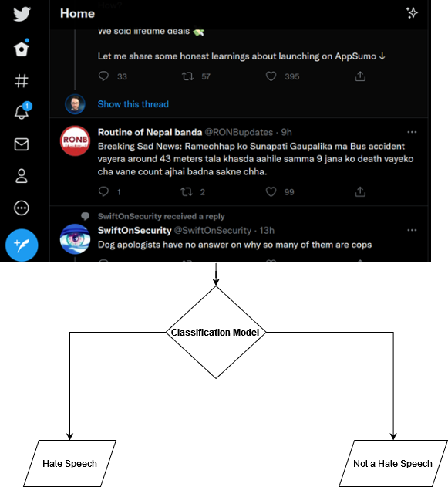
Introduction

Slide 3
How Hate Speech is Defined?
Dictionary Definition:
speech or writing that attacks or threatens a particular group of people
Article 28 of Electronic Information and Transactions (ITE) Law
(1) Any Person who knowingly and without authority disseminates false and misleading information resulting in consumer loss in Electronic Transactions.
(2) Any Person who knowingly and without authority disseminates information aimed at inflicting hatred or dissension on individuals and/or certain groups of community based on ethnic groups, religions, races, and inter-groups (SARA).

Slide 4
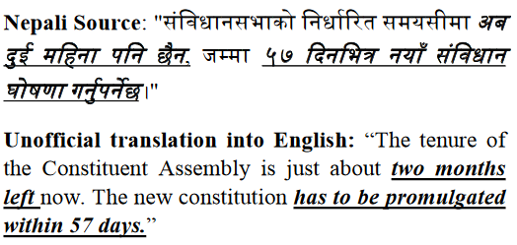
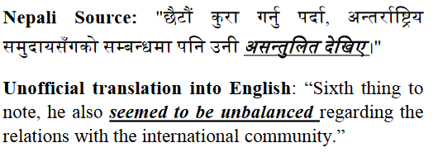
Related Work
[1] Analyzing Facts and Opinions in Nepali Subjective Texts (Santosh Regmi, Bal Krishna Bal, Marina Kultsova)
Three Supervised Machine Learning Classifiers: (Logistic Regression, Multinomial Naïve Bayes, and Support Vector Machine) and conduct a comparative study based on the metrics: Accuracy, Precision, Recall and F-Measure.
Average Accuracy Across Models: 70%

Slide 5
Related Work
2. Sentiment Analysis Using Multinomial Logistic Regression (Ramadhan WP, Astri Novianty, S.T., M.T, Casi Setianingsih S.T., M.T, 2017)
Sentiment Analysis of Tweets made by Candidates of Jakarta Governor Election
Sentiment analysis or so-called opinion mining is a field of study that analyzes opinions, sentiments, evaluations, judgments, attitudes, and emotions on an entity such as products, services, organizations, individuals, problems, events, topics and their attributes.
Multinomial Logistic Regression is chosen for its performance in terms of CPU and memory consumption.
Got Average of 74% Accuracy in 90:10 Split using K-Fold Cross Validation

Slide 6
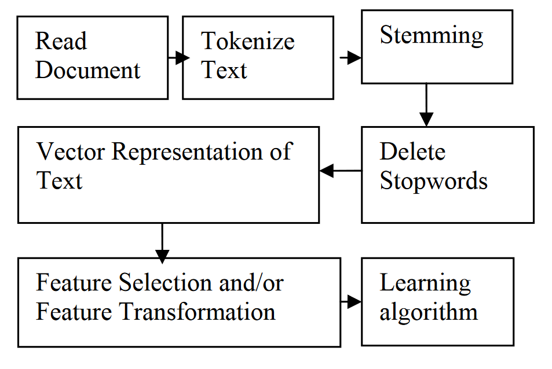
RELATED Work
3. Text Classification Using Machine Learning Techniques (Emmanoui K.Ikonomakis, V.Tampakas, Sotiris Kotsiantis)

Slide 7
System Overview
Data Collection
Pre-Processing
Case Folding
Tokenizing
Filtering
Stemming
Feature Extraction (TF-IDF)
Train Test Split
Model Training and Evaluation Under Various Conditions (Hyper-Parameter)

Slide 8
Explanation By DEMO

Slide 9
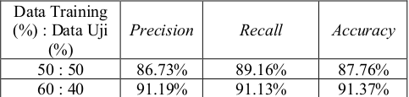
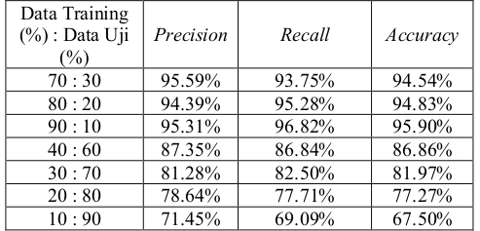
Result Discussion
Partition of Testing Data

Slide 10
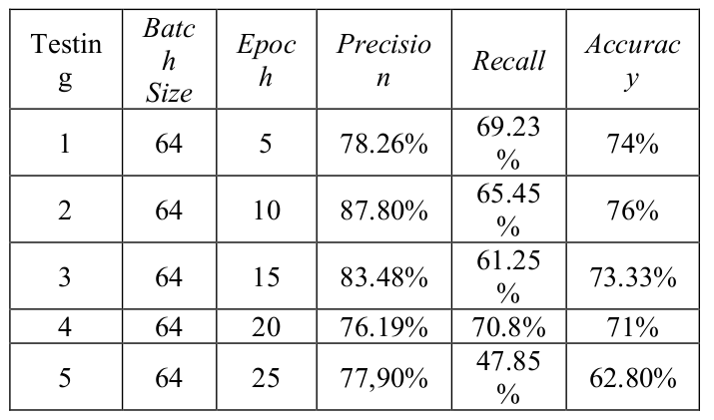
Result Discussion
EPOCH TESTING

Slide 11
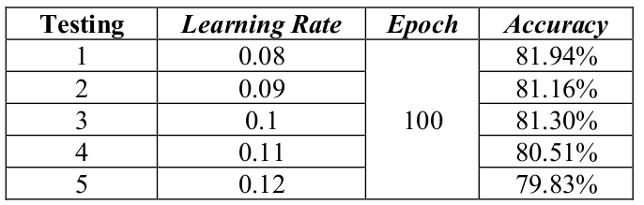
Result Discussion
Learning Rate TESTING

Slide 12
Conclusion
Multinomial Logistic Regression is a good classification method for text classification.
The best result:
84% accuracy
90% of training data and 10% test data
number of epochs = 20
learning rate = 0.08.

Slide 13
Future Research opportunities
Further research can focus on experiment with other feature extraction methods with Multinomial Logistic Regression to see the best performance.
Further research can focus on experiment with other classification algorithms to compare the performance of different algorithms to find the best performing one

Slide 14
References
Regmi, S., Bal, B., & Kultsova, M. (2017). Analyzing facts and opinions in Nepali subjective texts. 2017 8Th International Conference On Information, Intelligence, Systems &Amp; Applications (IISA). doi: 10.1109/iisa.2017.8316445
W. P. Ramadhan, S. T. M. T. Astri Novianty and S. T. M. T. Casi Setianingsih, "Sentiment analysis using multinomial logistic regression," 2017 International Conference on Control, Electronics, Renewable Energy and Communications (ICCREC), 2017, pp. 46-49, doi: 10.1109/ICCEREC.2017.8226700.
Ikonomakis, M., Kotsiantis, S., & Tampakas, V. (2005). Text classification using machine learning techniques. WSEAS transactions on computers, 4(8), 966-974.
Scott, W. (2019, February 15). TF-IDF from scratch in python on a real-world dataset. Towards Data Science. Retrieved July 5, 2022, from https://towardsdatascience.com/tf-idf-for-document-ranking-from-scratch-in-python-on-real-world-dataset-796d339a4089

Slide 15

Thank you

