Slide 1
Introduction
Sports Science

Slide 2
Introduction to Badminton
Badminton is a racquet sport played using racquets to hit a shuttlecock across a net. Although it may be played with larger teams, the most common forms of the game are "singles" (with one player per side) and "doubles" (with two players per side). Badminton is often played as a casual outdoor activity in a yard or on a beach; formal games are played on a rectangular indoor court. Points are scored by striking the shuttlecock with the racquet and landing it within the opposing side's half of the court.

Slide 3
History of Badminton
The modern game of badminton developed in the mid-19th century among the British as a variant of the earlier game of battledore and shuttlecock. ("Battledore" was an older term for "racquet")
The name derives from the Duke of Beaufort's Badminton House in Gloucestershire, but why or when remains unclear.

Slide 4
History of Badminton
The game may have originally developed among expatriate officers in British India, where it was very popular by the 1870s.
Early on, the game was also known as Poona or Poonah after the garrison town of Pune, where it was particularly popular and where the first rules for the game were drawn up in 1873.

Slide 5
Court Measurement

Slide 6
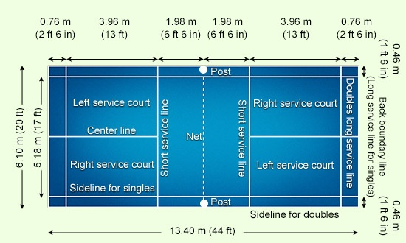
Badminton

