Slide 1

Presentation on
THE EASY FINDINGS-
JFP

Slide 2

Submitted To:
AHSANULLAH UNIVERSITY OF SCIENCE AND TECHNOLOGY
Course No: CSE 2200
Course Title: Software Development Lab III
Developed By:
1.Dipesh Shome
ID:16.02.04.045
Mr. Murad Hassan Anik
2. Mr. Sadik

Slide 3
INTRODUCTION:
THE EASY FINDINGS-JFP is a android application that generally based on biggest shopping mall in our county “Jamuna Future Park” . It is a shop categorized application and it contains details about a shop and location
Purpose:
Purpose behind the application is finding a desire shop and location and details about the shop in shortest period of time . It will save time and energy of a user. There is also a TO DO LIST system where user can save their plans . The extra advantage is user can use this application without using internet.

Slide 4
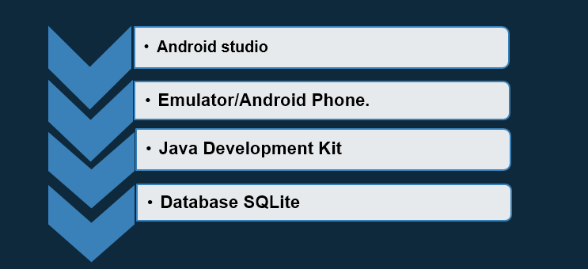
Software and Hardware:

Slide 5
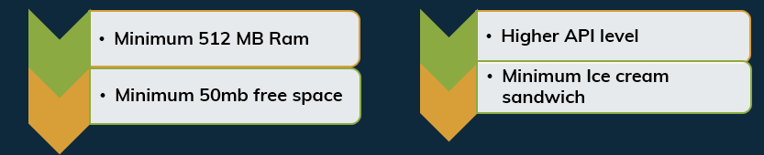
Requirements For
Hardware:
Software

Slide 6
……Features and Diagrams
Find categorized shop
Find details about shop
Admin Login
Find location on google map
Change Database if needed
USER
ADMIN
TO DO LIST

Slide 7

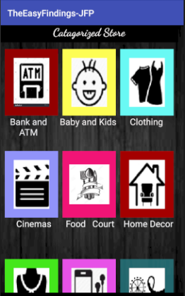
Screenshot Dashboard………
Clicking center of the front page the application will start
UI design is done by XML layout and the function of a button and other things are done in java class. Here we use 27 java class and 35 xml layout for this app and two class for database
Front Page
Second Page

Slide 8
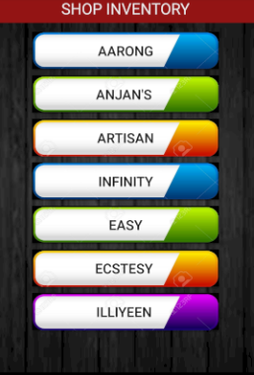

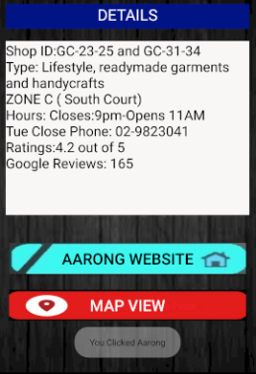
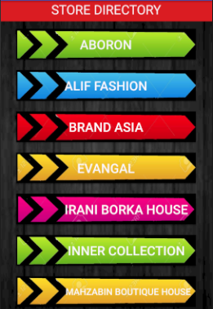
Screenshot Dashboard…….
Shop details , website and Location
Catagorized Shop

Slide 9
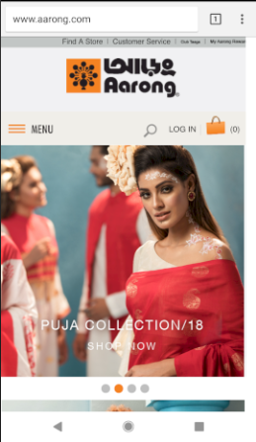
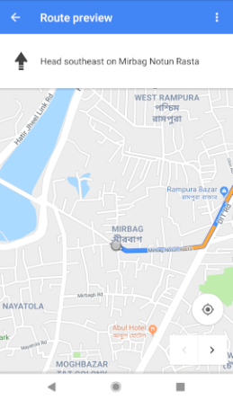
Continues………..
Shop’s Website
Google Navigation

Slide 10
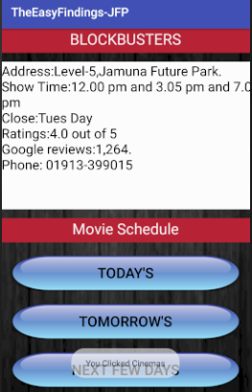
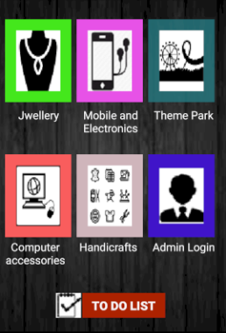
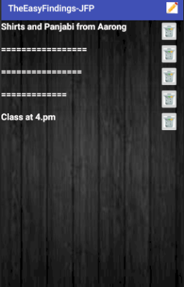
Continues………
Special feature “To Do List.”
One can save their plans and important data
It’s done by sqlite Database.
It has edit delete and add option
Cinemas
List

Slide 11
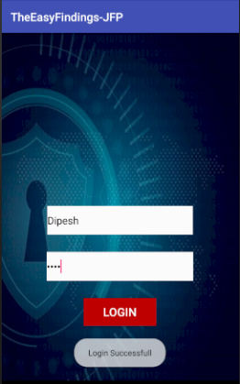
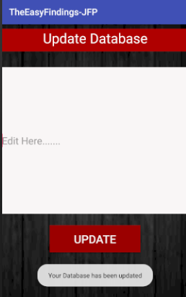
Continues……….
By logging in using unique name and password admin can change any data
Admin Login

Slide 12
Conclusion………….
Overall we have created in focus of saving time and energy of a user by finding his/her desire shop easily.
As there provide catagorized shop facility one can easily find their desire things and desire shop name.
TO DO LIST app also add extra benefit to the user.

Slide 13
THANK YOU

