Slide 1
ASSIGNMENT 1 Software Product Management

Slide 2
PARTICIPANTS
Shelke Dipika Tukaram - 2023MT93010
Shawayar Fatma - 2022MT93760
Sharmila K A - 2022MT93743
Shatya Hariharan S – 2023MT93155
Shembavanekar Pradny – 2022MT93735

Slide 3
PRODUCT TITLE
Product - CrafterGenie
Product-In-Sense – Web Application

Slide 4
PRODUCT DESCRIPTION
Product Description
CrafterGenie is a paid email marketing platform that provides an entry level solution to businesses and individuals who are looking to create and manage their email marketing campaigns.
This platform will provide a range of basic features and tools for email marketing and audience management.
30 days free trial offered and the pricing details for subscription after free trail is given below.
Rs.1999 per month
Rs.20999 per year

Slide 5
PAIN POINTS
Businesses struggle with reaching their target audience effectively, resulting in low engagement and conversion rates.
Solution: Email marketing helps improve communication by sending targeted, personalized messages to subscribers' inboxes.
Companies have scattered customer data across different systems, making it challenging to understand their audience.
Solution: Audience management streamlines customer data, allowing businesses to segment and target their audience more precisely.
Businesses face difficulties in converting website visitors into leads or customers due to unoptimized landing pages.
Solution: Landing pages provide a dedicated, optimized space for specific campaigns or offers, increasing conversion rates.
Companies struggle to capture potential customer information, leading to missed opportunities for engagement.
Solution: Signup forms help gather contact information from website visitors, building a database of leads for future marketing efforts.
Businesses often use multiple tools and platforms for marketing, resulting in data silos and inefficiencies.
Solution: Third-party integrations allow for seamless data flow between different marketing tools, enhancing automation and data consistency.

Slide 6
PRODUCT OFFERINGS
Email Marketing
Audience Management
Marketing Automation
Landing Pages
Signup Forms
Third Party Integration

Slide 7
Product Market Fit
UX
Feature Set
Value Proposition
Underserved Needs
Target Customer
Product Market Fit
P
R
O
D
U
C
T
MA
R
K
E
T

Slide 8
PRODUCT-MARKET FIT
Product Market fit of CrafterGenie
CrafterGenie is an excellent fit for small businesses and start-ups with limited budgets. It allows them to access essential email marketing tools and capabilities.
Individuals running their businesses or personal brands can benefit deeply from CrafterGenie. It provides them with the ability to create signup form and attractive landing pages.
CrafterGenie has a user friendly interface along with intuitive design making it easily usable for everyone including those with limited technical expertise.
CrafterGenie will make it easier for local businesses, such as restaurants, cafes, and service providers, keep their local customer base informed about events, discounts and updates, hence increasing customer satisfaction and retention

Slide 9
VALUE PROPOSITION
Email Marketing: CrafterGenie provides a comprehensive suite of email marketing tools. Users can design eye-catching email campaigns, segment their audience for targeted messaging, schedule emails for optimal delivery times, and track campaign performance through detailed analytics.
Marketing Automation: With CrafterGenie's marketing automation features, users can create automated workflows that nurture leads, engage customers, and drive conversions. This includes automated welcome emails, abandoned cart recovery, and personalized product recommendations.
Audience Management: CrafterGenie offers robust audience management capabilities, allowing users to import, organize, and segment their contact lists. This ensures that the right message reaches the right people at the right time.
Templates and Design Tools: Users can choose from a variety of professionally designed templates or create custom email templates using CrafterGenie's drag-and-drop builder. This helps businesses maintain a consistent and visually appealing brand image.
Data Analytics: CrafterGenie provides in-depth analytics and reporting tools to track the success of email campaigns. Users can monitor open rates, click-through rates, conversion rates, and more, enabling data-driven decision-making and continuous improvement.

Slide 10
VALUE PROPOSITION
Integration Ecosystem: CrafterGenie integrates with a wide range of third-party applications and services, allowing users to connect their email marketing efforts with other tools they use, such as e-commerce platforms, CRM systems, and social media.
Scalability: CrafterGenie caters to businesses of all sizes, from small start-ups to large enterprises. It offers pricing plans that scale with your needs, making it suitable for businesses at various stages of growth.
Educational Resources: CrafterGenie provides users with valuable educational resources, including guides, webinars, and tutorials, to help them improve their email marketing and digital marketing skills.
Compliance and Security: CrafterGenie places a strong emphasis on data security and compliance with email marketing regulations, giving users peace of mind when it comes to protecting customer data and maintaining email deliverability.
Personalization: CrafterGenie allows users to create personalized email content and recommendations based on customer data, enhancing engagement and driving conversions.

Slide 11
CUSTOMER FEEDBACK ON OUR IDEA
Avinash Venugopal
“I appreciate CrafterGenie's user-friendly and intuitive interface, which makes it easy for both beginners and experienced marketers to create and manage email campaigns.”
Siva Perumal
“As a small business owner, I find CrafterGenie’s pricing to be a bit high, especially as their subscriber lists grow. Pricing changes in the past have generated mixed feedback.”
Saurav Guha
“I often praise CrafterGenie for its selection of professionally designed templates and the flexibility to create custom designs. The drag-and-drop email builder is frequently cited as a valuable feature”
Sudhindra Ramesh Arsikere
“My personal favourite is CrafterGenie's extensive integration options, which enable them to connect their email marketing with other tools and platforms, such as e-commerce systems, CRMs, and social media”
Rahul Sabnis
“CrafterGenie's landing pages have strong CTA(call to action). Customers appreciate when the landing page communicates its message clearly and concisely. I instantly understood what this page was offering”

Slide 12
REVISED VALUE PROPOSITION
After considering our customer’s feedback on pricing, we have reduced our effective price by 25%
Below are the pricing details
Old Pricing for Subscription
Rs.1999 per month
Rs.20999 per year
New Pricing for Subscription
Rs.1499 per month
Rs. 15,749 per year

Slide 13
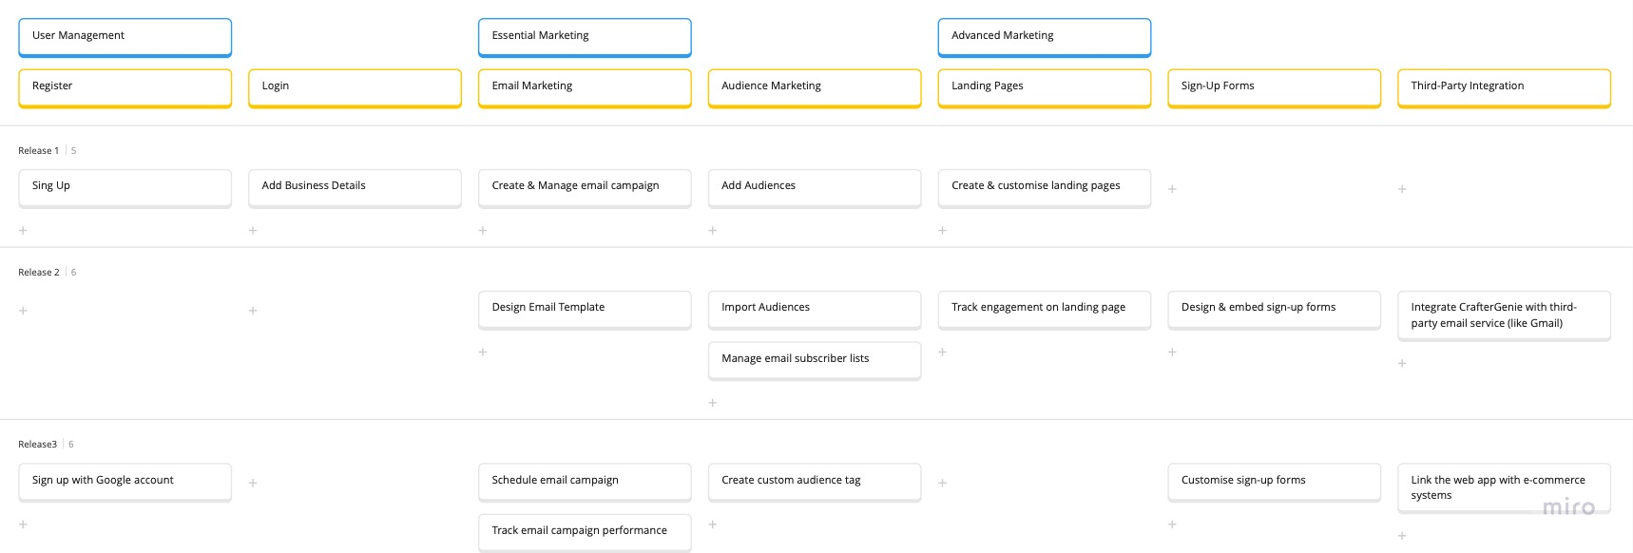
Story Map – CrafterGenie
User Activities
(backbone)
User Tasks
(Skeleton)
User Stories

Slide 14
Business Plan using Lean Canvas
Problem Small and Medium-sized Businesses (SMBs) struggle with managing effective email marketing campaigns due to limited budgets and resources. E-commerce stores need tools to automate and personalize email communication to boost sales and customer engagement. | Solution Provide a user-friendly email marketing and automation platform with competitive pricing. Offer customizable templates, automated workflows, and advanced personalization features | Unique value proposition Affordable, user-friendly email marketing automation for SMBs and e-commerce stores. | Unfair advantage Extensive Feature Set: crafterGenie's offers a comprehensive suite of email marketing and marketing automation features, making it a one-stop solution for many businesses. This includes customizable templates, automation workflows, A/B testing, analytics, and more | Customer segments Small and Medium-sized Businesses (SMBs): Targeting companies with limited marketing resources seeking cost-effective email marketing and automation solutions. E-commerce Stores: Providing tailored services for online retailers looking to enhance their email marketing efforts.
 | Key metrics Customer Acquisition Cost (CAC): Calculate the cost to acquire each new customer. Customer Lifetime Value (CLV): Measure the total revenue generated from an average customer over their lifetime. Churn Rate: Track the percentage of customers who cancel their subscriptions. Email Open Rates and Click-Through Rates: Monitor the effectiveness of email campaigns.
 | Key metrics Customer Acquisition Cost (CAC): Calculate the cost to acquire each new customer. Customer Lifetime Value (CLV): Measure the total revenue generated from an average customer over their lifetime. Churn Rate: Track the percentage of customers who cancel their subscriptions. Email Open Rates and Click-Through Rates: Monitor the effectiveness of email campaigns. |  | Channels Online Advertising: Utilize Google Ads and social media platforms for customer acquisition. Content Marketing: Publish blog posts and educational content on email marketing best practices. Referral Program: Encourage existing customers to refer new users in exchange for incentives.
Cost structure Technology Costs: Expenses related to server maintenance, software development, and security. Marketing Costs: Budget for online advertising, content creation, and promotional activities. Customer Support Costs: Salaries and tools for supporting users. |  |  | Product revenue Subscription Model: Fixed plan after 30 days of free trial

Slide 15
KEY LEARNINGS FROM THIS ASSIGNMENT
This assignment involves user testing and feedback collection to validate product assumptions and make data-driven decisions. Learning how to design and conduct user tests is valuable.
I learnt to Set clear goals, defining the product vision, and outlining the high-level roadmap for achieving those objectives.

