Slide 1
Cloudformation and Terraform

Slide 2
Introducing Pods
Basic building block in K8s

Slide 3
At the heart of Kubernetes
Represents the basic building block
Co-located group of containers
Common to have one pod per container but not mandatory
Everything else either manages, exposes or used by Pods
Pods cannot span across nodes
Introducing Pods

Slide 4
Containers are designed to run only a single process per container
Best of both the worlds, You get the coherent of related group of process and yet treat individual process as isolated units.
Difficult to manage the logs since all the process with dump the logs on the same container
Norm of working with Kubernetes is to use single process per container
Containers in the pod run under the same IPC namespace and communicate via the IPC
Pod of containers runs a closely group of containers and run them as if they were running in a isolated environment.
Pods are other resources can be created by posting the json or YAML file to K8s REST API endpoint
Why not Containers ?

Slide 5
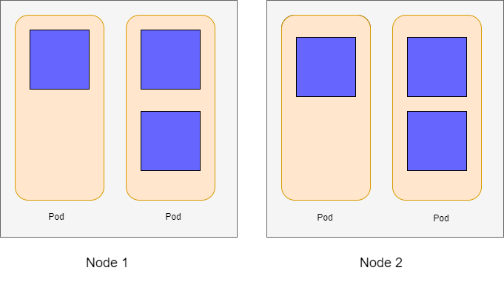

Slide 6
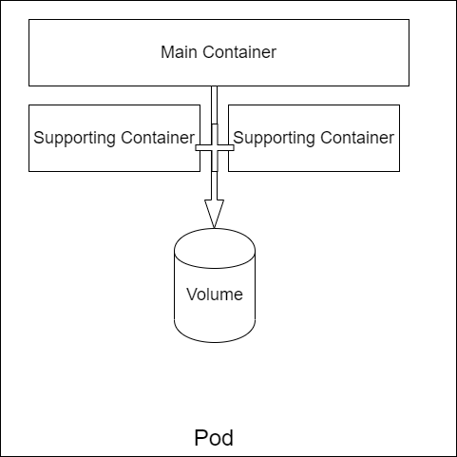

Slide 7
Metadata
Specification
Status
Pod definition

Slide 8
Pod definition in YAML file
Pod creation from YAML manifest file
Explain command to display the resource
Fetch the existing pod resources
Fetch specific pod by pod name
Printing the output in JSON/YAML format
Pod
Commands

Slide 9
Log the output using docker logs command
Log the output using Kubernetes logs command
Log the output of a specific container inside a Pod
Port forwarding to the Pods from the host
Pod
Commands

Slide 10
labels

Slide 11
Without Labels
Order-UI
Order-UI
Catalog-DB
Order-UI
Order-API
Catalog-UI
Order-UI
Order-DB
Catalog-API
Order-DB
Catalog-UI

Slide 12
To organize resources in general – including Pods
A set of key-value pairs – attaching to resources
Used to select resources using the label selectors
Resources can have more than one label, dev, prod, pre-prod
Keys should be unique, value can be duplicate
Can be created during creation time, but can also be added later without recreating the resource
Labels

Slide 13
With Labels
Order-UI
Order-UI
Order-API
Order-DB
Order-DB
Order-UI
Catalog-API
Catalog-DB
Order-UI
Catalog-DB
Catalog-UI
dev
qa

Slide 14
Can perform actions by selecting the subset of pods
Acts like filter criteria to shortlist Pods
Label selector can select Pods based on
Contains or not a label with a key
Contains a label with key and value
Contains a label with key and not matching value
Use comma separated label to apply multiple filters
Labels are defined at the worker node level
Label Selector

Slide 15
Label Selector
Commands
Listing all the Pods by label name
Adding labels after pod creation
Overriding existing label values

Slide 16
Annotations

Slide 17
Key-Value pairs like Labels
Aren't meant to hold information
Cannot select Pods unlike Labels
Primarily meant to be parsed by tools
K8s also adds some default annotations to pods
Used to introduced new features in the spec and delete the old ones in a graceful manner
Annotations

Slide 18
Annotations Commands
Adding annotations
View the annotations
Delete the annotations

Slide 19
Namespaces

Slide 20
Grouping of resources can be done using Labels
Labels can overlap since multiple resources can have many labels
NS are used to split resources into non-overlapping groups
Common use cases involve splitting based on env, tenants etc
Resources within the NS should be unique
Works like packages in Java language
Namespaces

Slide 21
Creating a namespace
List all namespace
List all resources specific to namespace
Deleting a namespace
Namespace Commands

Slide 22
Deleting pod by name
Deleting multiple pods
Deleting pods by label
Deleting all resources including pods in a namespace
Deleting pods by retaining the namespace
Deleting pods, RC and namespace
Pod Deletion Commands

Slide 23
Pods- Lab
Lab exercises – 30 mins

Slide 24
Replication controller & ReplicaSets
Managing Pods with ReplicaController/ReplicaSets

Slide 25
Pods are scheduled to the worker node
Kubelet on the Node is responsible for creating the containers
Kubelet keeps the containers running as long as pod exists
In case of Process crash, the Kubelet recreates the container
Liveness checks the state of the container outside of application
Restarts if the process is unhealthy
Three types of Liveness probe and their successful criteria
HTTP GET probe (2xx and 3xx status codes)
TCP Socket (Successful connection establishment)
Exec (Exit code should be 0)
Liveness Probe

Slide 26
Liveness Probe should be light
Should not contain any business logic
Definition of a healthy Process should be implemented here
No retry loops. K8s will manage internally
Should not take long time to complete. (< 1 sec)
Should not be CPU intensive process
Liveness Probe
(Points to consider)

Slide 27
Replication controller

Slide 28
Is a first class K8s resource
Ensures that the desired numbers of pods are always running
Creates pod in case the desired count do not match actual count
Continuously monitor the running pods
If more number of pods are running, deletes the excess pods
Replication Controller

Slide 29
How there can be more pods than the actual definition?

Slide 30
Answer
01
Static Pods
Pods can be created manually and hence the actual count can differ from desired count
03
Pod template
Changing the Pod template will make the desired count differ from actual count
02
Pod definition
Changing the Pod’s definition will make the desired pods count differ from actual count

Slide 31
Pods created by RC is not tied up to RC in any way
Pod contains metadata.ownerReferences pointing to RC
Changing the label of pod makes it unmanaged by RC
And is as good as creating the pod manually
Adding additional labels does not impact RC as long as RC matches the Pod labels
Replication Controller

Slide 32
Works on a set of pods matching labels
Ensures actual no. of running pods matches the label-selector
Reconcile the desired count
Three essential parts
Label selector - matching pods
Replica count - desired count
Pod template – manifest file
Only replica count affects the current pods
Changing the label selectors makes existing pods out of scope
Controller does not care about the pods which are out of scope
Operations
of
Replication Controller

Slide 33
Sustains even the Node failure
Enables horizontal scaling of Pods
Declaratively manages the desired number of running pods
Works like a cookie cutter to manage number of pods
Benefits
of
Replication Controller

Slide 34
Points to remember
If the selector does not match the pod selector, API server validates and will not accept if it is misconfigured
K8s will automatically extract the label selector, if it is not part of the replication controller
Use this approach and do not specify the label selector in the Replication controller

Slide 35
Replication Sets

Slide 36
ReplicaSets replaces the RC
Only different is the selector compared to a RC
More expressive pod selectors
Only different is the selector compared to a RC
If multiple selectors exists, all should resolve to true
ReplicaSets

Slide 37
Daemon sets

Slide 38
Like RS and RC
Pods will be deployed on all nodes
Replicas does not have any meaning in this context
Can be deployed on a subset of nodes using node-selector
Meant to run system level services at node level
DaemonSets

Slide 39
Job resource

Slide 40
In case of completable task after which the process stops
Does not start again after the process is successfully completed
In case of Job failure can either set to RESTART or FAIL
Can configure to run Jobs in Parallel
Can also configure to execute Cron-Jobs.
In case of CronJob, the resource will be CronJob
Job Resource

Slide 41
Replication controller Lab
Lab exercises – 30 mins

Slide 42
Services
Exposing Pods outside the Cluster

Slide 43
It’s a standard K8 resource
Provides single point of entry to a group of Pods
Uses label selectors to group Pods under service
Has a constant IP address
Provides Load balancing and allow adding/removing pods
Everything else either manages, exposes or used by Pods
Services

