Slide 1

Singapore Airline Travel Safety
Dipika Sharma
Bellevue University
DSC640 T301 Data Presentation & Visualization

Slide 2
Introduction
Due to recent unfortunate airline crashes, the passenger is in state of panic. The purpose of the presentation is to make sure Singapore Airline is safe for passenger and crew. Investigate to understand what can change in future to ensure safe travel.
Airline Safety analysis is performed using Aviation Safety Network database along with airplane crashes and Airline Revenue data from Kaggle.

Slide 3
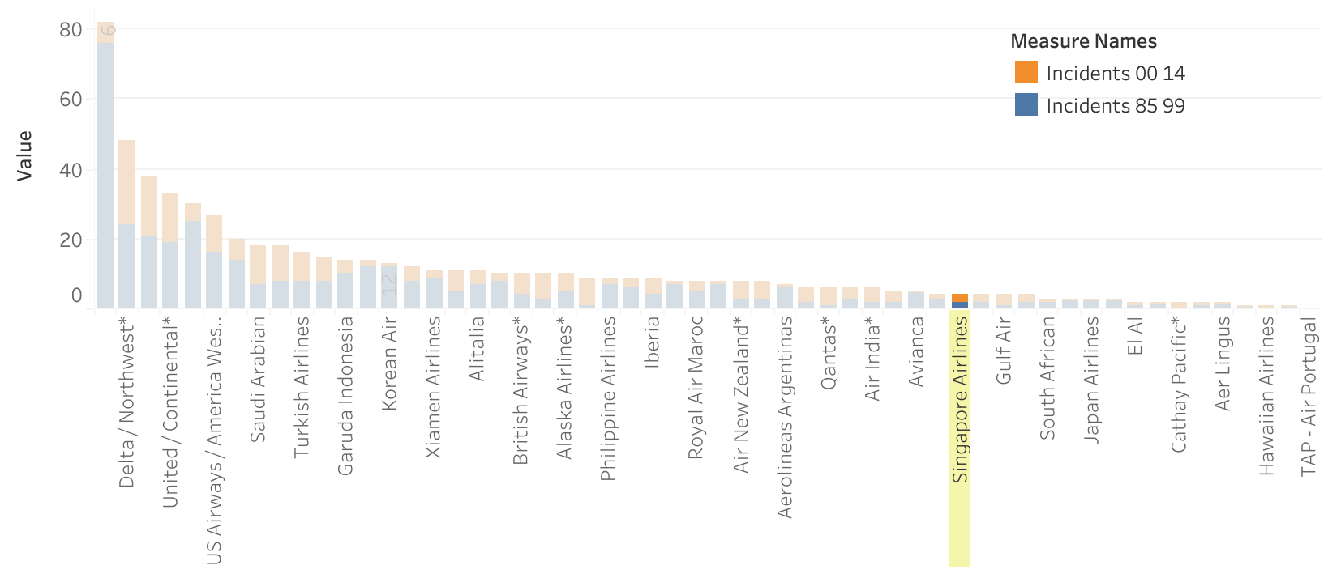
Total Incidents 1985 – 2014 by Airline
This chart is created to compare the Singapore Airline total incidents with others Airline.
We can clearly see the rate of incidents is lower from others Airline.
Aeroflot and Delta/Northwest Airline have most incidents between years 1985 to 2014.

Slide 4
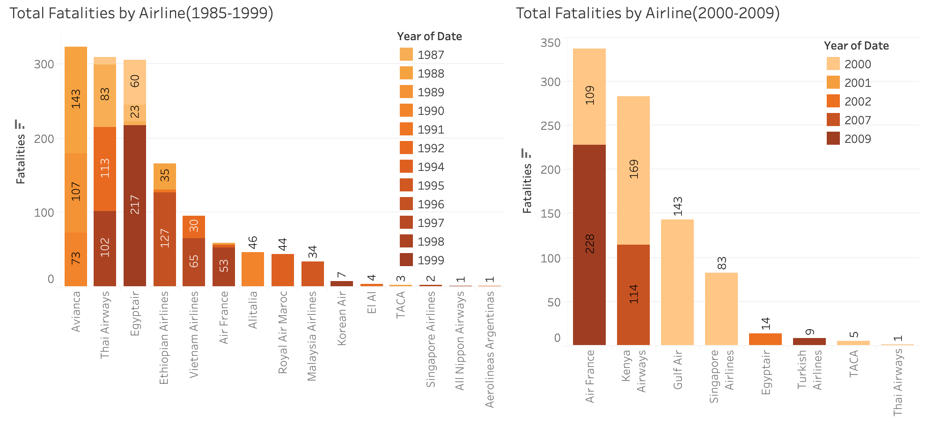
Total Fatalities 1985 – 2009 by Airline
Looking at the charts above we can clearly see the fatalities rates are lower for Singapore Airline compared to Avianca and Air France Airline.
For Singapore Airline, most of the fatalities happened before year 2000.
No Fatalities recorded since 2001 – 2009 for Singapore Airline.

Slide 5
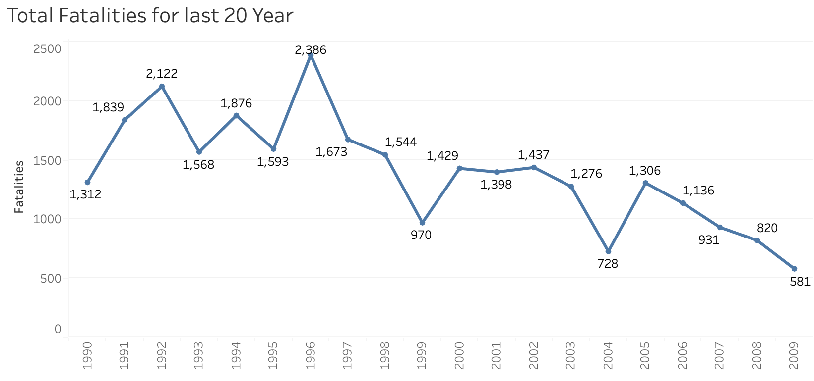
Total Fatalities by Year
Looking total fatalities for last 20 years, I noticed that the fatalities rate is decreasing.
The Fatalities rate went down to 44% in year 2009.
Fatalities rate were higher in year 1996 with 2386 total fatalities.

Slide 6
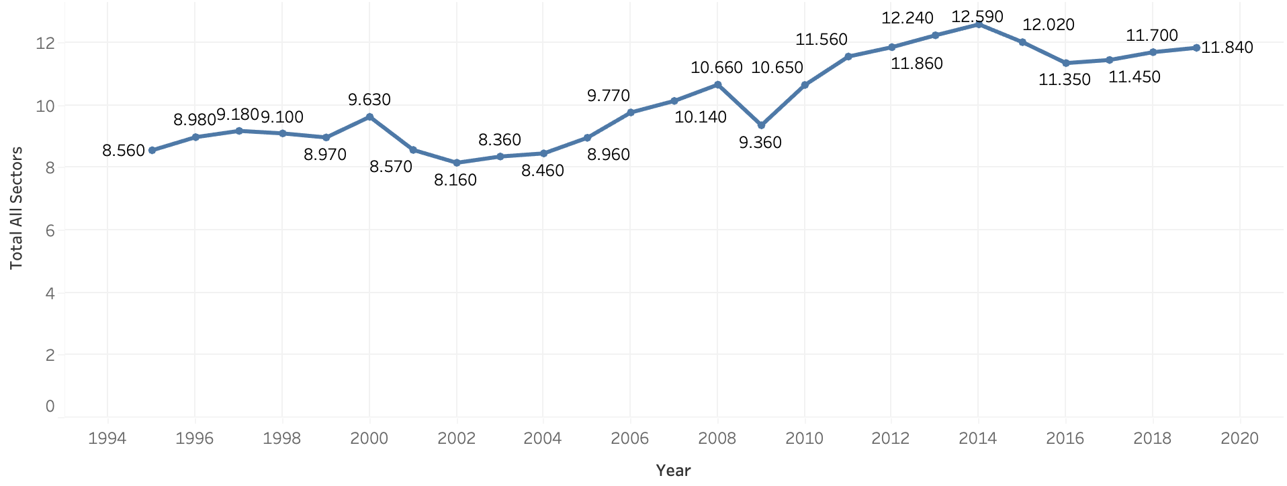
Airline Revenue by year
The line graph above shows that despite of negative news by media on fatalities, the Airline revenue is increasing.
The positive rate indicate that passengers are increasing every year indicating the trust they have on Airline travel.
The revenue increase rate is 38% from 1994 to 2020.

Slide 7
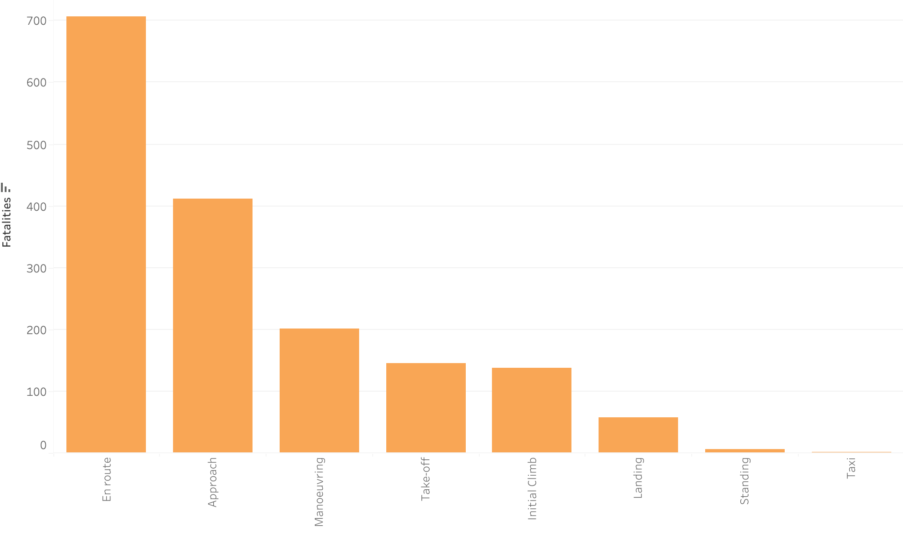
Fatalities by Flight Phase
En Route flight phase has most fatalities.
Standing and Taxi flight phases have minimum fatalities.
We can work on the flight phase with maximum fatalities by arranging proper training and adding some safety measure.

Slide 8
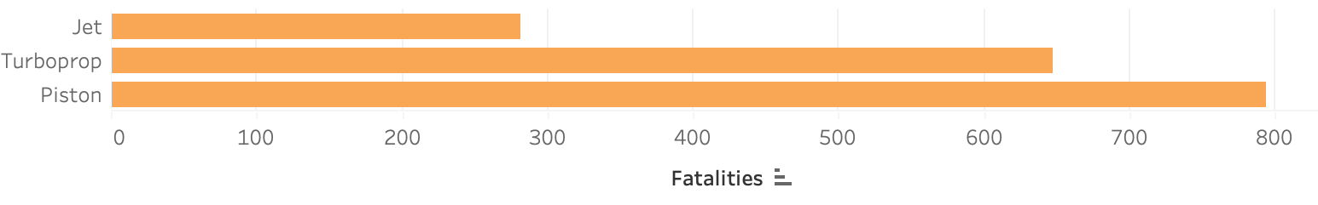
Fatalities by Engine Type
Jet Engine have less fatalities compared to others Engine type.
Piston has most fatalities count.
Singapore Airline can plan to use more jet engine and can avoid using piston.

Slide 9
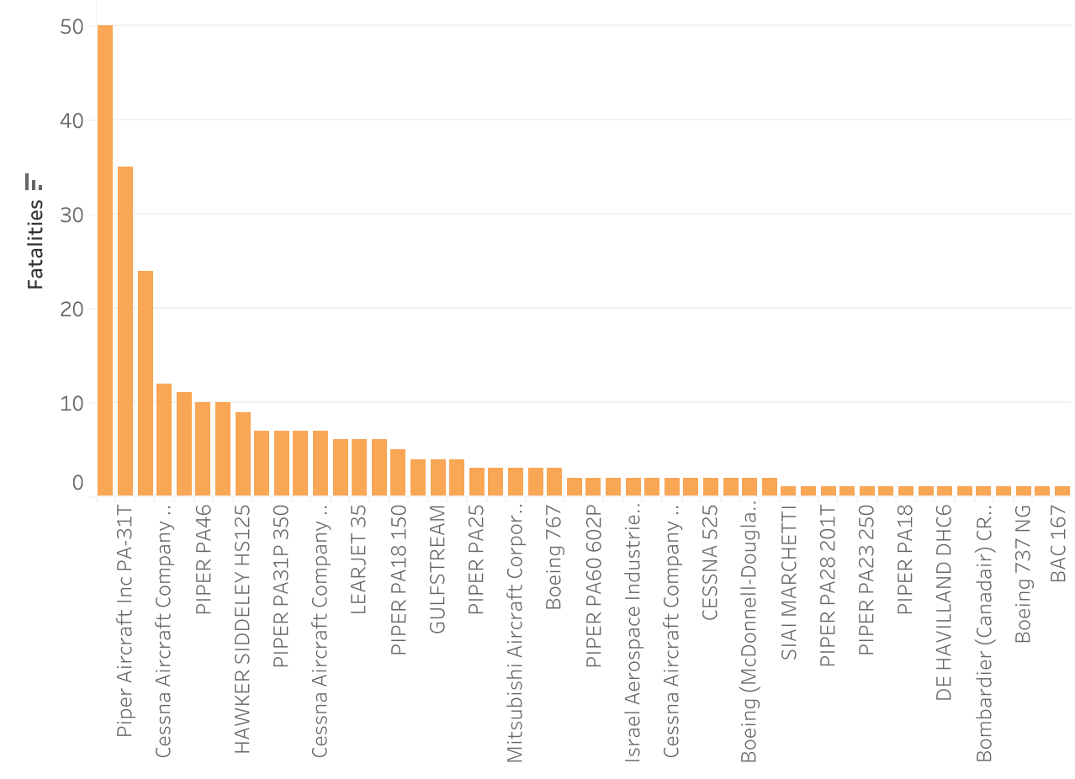
Fatalities by Jet Engine Model
Piper Aircraft Jet Engine model has higher fatalities.
We have 280 Jet Engine type.
To reduce the fatalities rate we can try avoid these Jet Engine model which have maximum fatalities rate compared to others.

Slide 10
Summary
Current Scenario:
Singapore Airline incident and fatalities rate is lower compared to other Airlines.
The Fatalities rate went down to 44% in year 2009.
Although Media reported airline travel unsafe, but we can still see that the revenue increased to 38% from 1994 to 2020.
Recommendation:
Arrange proper training and guidance for flight phase with maximum fatalities.
Add more safety procedure to improve Airline performance.
Prefer using the jet engine as it has minimum fatalities.
Avoid using jet engine model with maximum fatalities.
Next step:
Investigate further to understand if Engine is responsible for fatalities.
What other factors can also increase fatalities rate like location, weather and other.

Slide 11
Reference:
Airline Safety dataset - https://aviation-safety.net/
Airplane Crashes Since 1908: https://www.kaggle.com/datasets/saurograndi/airplane- crashes-since-1908

