Slide 1
PREDICTOPS
CROP PREDICTION SYSTEM
Guided By:
Prof. Mehul Raval
Jay Patel
Arpit Patel

Slide 2

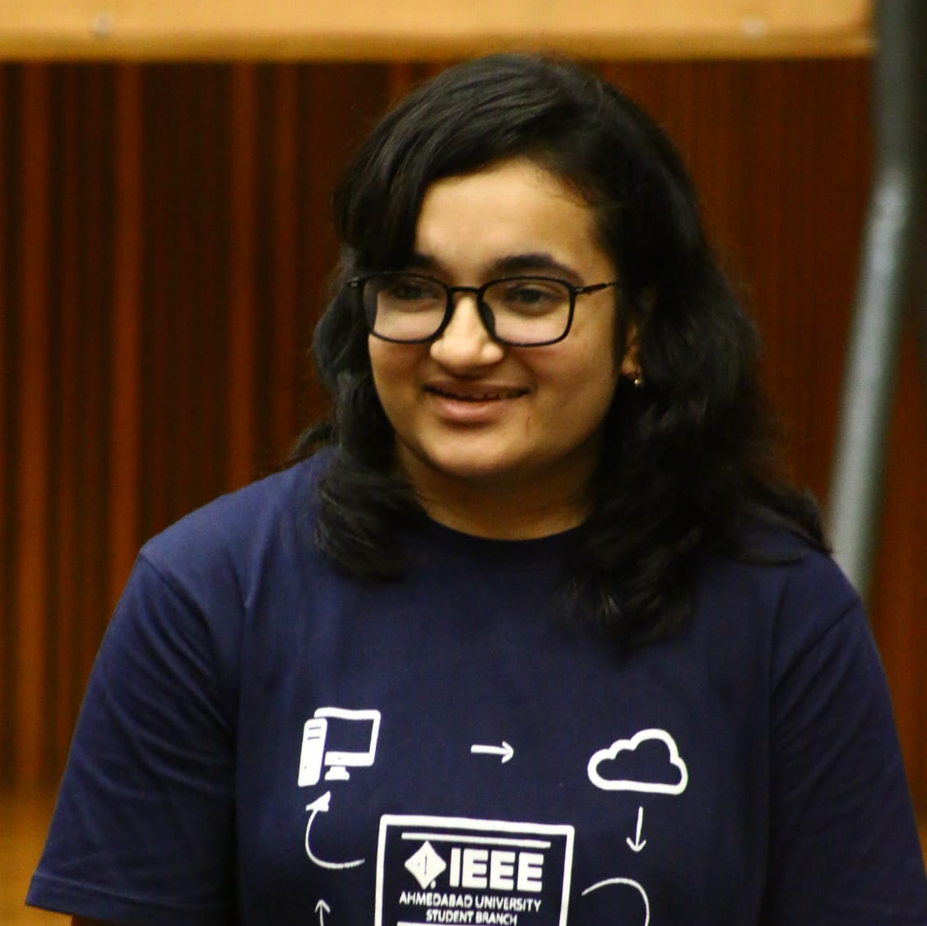


BeMAD TEAM
Aanshi Patwari B.Tech ICT
Semester 6
AU1841004
Miracle Rindani B.Tech ICT
Semester 6
AU1841017
Bhumiti Gohel B.Tech ICT
Semester 6
AU1841051
Dipika Pawar B.Tech ICT
Semester 6
AU1841052

Slide 3
ROADMAP OF CONTENTS
Introduction
And
Problem Statement
Existing Work
Results
1
3
5
2
4
6
GANTT Chart
Dataset
And
Our approach
Conclusion

Slide 4

INTRODUCTION
Agriculture - Backbone of our country
Current scenario
Weather Conditions
Problems faced
Need of a system

Slide 5
PROBLEM STATEMENT
SOLUTION
Propose a system that can predict which crop to grow based on weather and soil inputs
WHY
Due to unpredictable climate changes
WHERE
On a particular land(farm) based on the soil conditions
WHEN
During season change
WHAT
Cannot predict which crop to grow
WHO
Farmers and agriculture industrialists

Slide 6
GANTT CHART
 | Before Mid sem |  |  |  |  | After Mid Sem
 | Week 1 | Week 2 | Week 3 | Week 4 | Week 5 | Week 6 | Week 7 | Week 8 | Week 9
Literature Review
Dataset Preparation
Data Pre-process and Analysis
Inbuilt Algorithm Implementation
SVM Implementation |  |  |  |  |  |  | ◆
Hyper-Parameter Tuning
Improvement in the model
Documentation( Apart from Weekly Report)

Slide 7
EXISTING BODY OF WORK
Crop Recommendation System for prediction agriculture
Precision Agriculture principle is applied on small, open farms . Crop Selection Method(CSM) helps to solve problem of crop selection as well as improve the net yield rate of the crop.
Crop Prediction System using ML algorithms
Some methods to find most correlated features for the target column like Gini index, Entropy and Information Gain are discussed. KNN algorithm is used to predict the rainfall and weather report.
Crop Prediction using Machine Learning
Dataset contains soil parameters as the main attributes like Nitrogen, Phosphorus, Potassium and pH values of soil where KNN with cross validation gives best accuracy.
Design of Hybrid Crop Recommendation System using ML algorithms
Soil quality is determined based on soil’s NPK values, soil-PH value, crop disease and pesticides, seasonal parameters such as Kharif, rabbi, and summer crops.
Evolutionary Tuning of SVM parameters
The value of the hyperparameters determined by the grid search algorithm are much more reliable and optimum as compared to the values obtained through the gradient descent methods as they need the kernel and score function to be differentiable.

Slide 8
DATASET
Features: Soil(N,P,K,ph),Weather(Rainfall,Temperature,Humidity)
Target: Crop type(22 categories mainly including pulses and fruits)
Datapoints: 2200
Collected on yearly basis
Need of preprocessing

Slide 9
OUR APPROACH
Data Preprocessing
Removing null values
Equalising the rows
Forming train and test dataset
Identification of classification algorithm
Preference of SVM over others
Implementation of algorithms
Comparison of results

Slide 10
SVM ALGORITHM
Defining the type of kernel
Use of function in kernel
Mathematics of SVM
Theory of multipliers
Parameters used

Slide 11
OTHER ALGORITHMS
KNN
The algorithm tries to find k nearest data points to the test data given to the classifier.
In our project, we have found the value of k = 8 or 10 to be giving the best test accuracy.
Naive Bayes
It assumes that all the features are independent of each other (i.i.d).
The classification is done using the conditional probabilistic approach by applying the Bayes Theorem.
In our project, Naive Bayes has provided the maximum accuracy.
SVM
Plot each data item as a point in n-dimensional space (n = number of features) with each feature being the value of a particular coordinate.
Then perform classification by finding the hyper-plane that differentiates the two classes.

Slide 12
HYPERPARAMETER TUNING AND IMPROVISATION
Kernel type
The type of kernel helps in computing the similarity among the points at a low cost in a higher dimensional vector spaces.
Degree of polynomial
It helps in controlling the flexibility of the decision boundary. So,more the degree of the polynomial more the flexibility.
Tolerance value
The smaller the value, the faster the convergence which can degrade the performance, so larger value is preferred.
Number of iterations
The loss decreases as the number of iterations increases.
Regularization parameter
As lambda becomes larger less wrongly classified examples are allowed and vice versa.

Slide 13
RESULTS - TABLE
 | Before mid sem |  | After mid sem
 | Training Accuracy | Testing Accuracy | Training Accuracy | Testing Accuracy
SVM scratch | 94.74% | 92.87% | 96.66% | 94.18%
SVM inbuilt | 98.92% | 97.95% | 99.71% | 98.36%
KNN | 95.15% | 93.63% | 95.15% | 93.63%
Naive Bayes | 99.61% | 99.09% | 99.61% | 99.09%

Slide 14
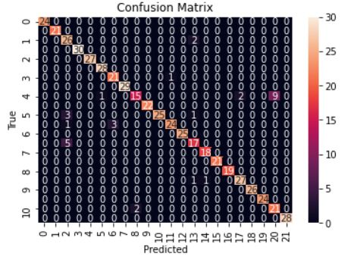
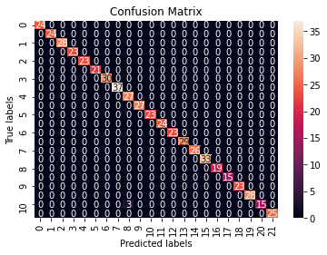
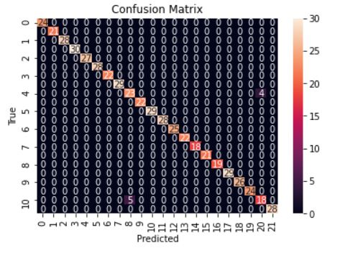
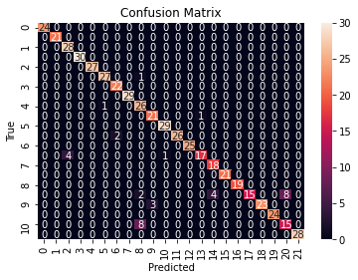
RESULTS
SVM Scratch
Naive Bayes
first
first
SVM Inbuilt
first
first
KNN

Slide 15

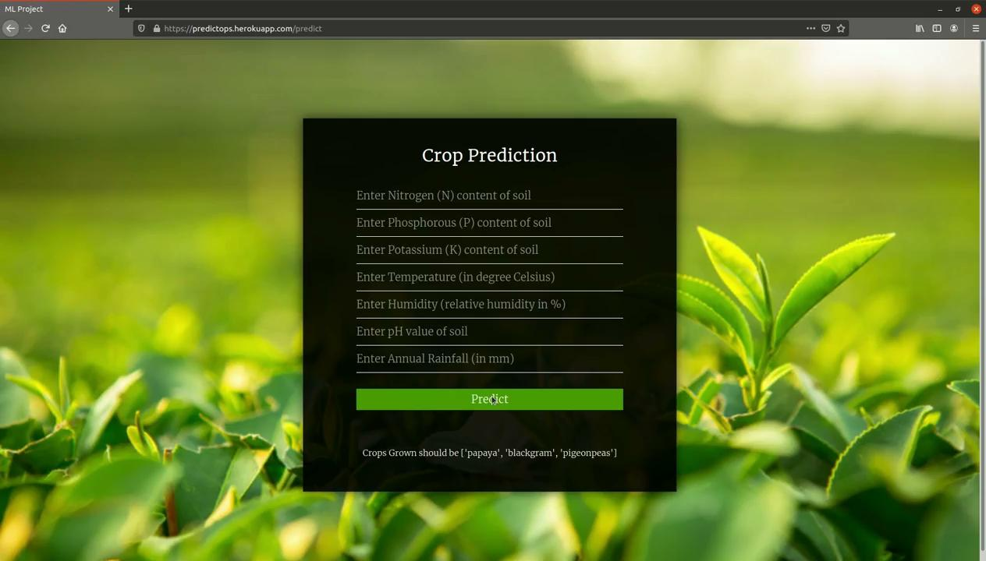
RESULTS - Website Deployment

Slide 16
REFERENCES
https://dag.gujarat.gov.in/estimate.htm
https://1library.net/document/dzx1ldny-design-hybrid-crop-recommendation-using-machine-learning-algorithms.html
https://towardsdatascience.com/multiclass-classification-with-support-vector-machines-svm-kernel-trick-kernel-functions-f9d5377d6f02
https://www.irjet.net/archives/V7/i2/IRJET-V7I2163.pdf
https://www.baeldung.com/cs/svm-multiclass-classification
https://towardsdatascience.com/support-vector-machine-introduction-to-machine-learning-algorithms-934a444fca47

Slide 17
ROLE OF EACH MEMBER
Literature Review
Hyperparameter Tuning
Performance Improvisation
Final Documentation
Literature Review
User Interface Development
Model Deployment
Aanshi Patwari
Miracle Rindani
Literature Review
User Interface Development
Model Deployment
Literature Review
Hyperparameter Tuning
Performance Improvisation
Final Documentation
Bhumiti Gohel
Dipika Pawar

Slide 18

THANK YOU

