Slide 1
COMPUTER ORGANIZATION LAB
Thursday Batch
Group 08
Aanshi Patwari : AU1841004
Dipika Pawar : AU1841052
Miracle Rindani : AU1841017
Akshay Bhimani : AU1841126

Slide 2
Specifications
These are the specifications which are used for building all the individual blocks and combining all of them into one main module which performs all the operations:
Software : Xilinx Co. 14.7
Language : Verilog
Databus: 16 bits
Frequency: 100MHz
RISC based
Pipeline Architecture
5 stage pipeline
Parallel Input/Output
65536 X 32 program memory
65536 X 16 data memory

Slide 3
Name of Blocks used
The blocks used in the MIPS structure are:
Program memory block
Register bank
Dependency check block
Execution block(ALU block)
Data memory block
Stall control(SC) block
Jump control(JC) block
Write back(WB) block

Slide 4
Program Memory Block
16
jmp_loc
32
ins
pc_mux_sel
16
current_address
stall
stall_pm
clk
reset
The objective of this block is to generate instructions for decode, execution and data
memory blocks, and also take care of different controls

Slide 5
Register Bank Block
clk
reset
ans_ex
ans_dm
16
16
ans_wb
A
RA
16
B
5
RB
RW_dm
mul_sel_A
mul_sel_B
2
imm_sel
imm
16
This block generates operands (A) and (B) for Execution block based on the instruction generated from Instruction Memory block. Input RA is used as first operand (A) address and input RB is used as second operand (B) address.

Slide 6
Dependency Check Block
16
imm
6
op_dec
5
RW_dm
32
2
ins
mux_sel_A
2
mux_sel_B
1
imm_sel
1
clk
mem_rw_ex
reset
1
mem_en_ex
1
mem_mux_sel_dm
Dependency check block handles data hazard in pipeline processor. It can check dependency of current instruction with previous three instructions and enables data forwarding in pipeline by generating ‘mux_sel_A’ and ‘mux_sel_B’ signals. This block is also generates memory control and immediate control signals. All outputs of this block are generated at the positive edge of clock.

Slide 7
Execution Block(ALU Module)
16
data_in
16
6
ans_ex
op_dec
16
data_out
16
A
16
DM_data
16
2
B
flag_ex
clk
reset
Main objective of this block is to perform various operations like mathematical operations, logical operations etc. and also generate flag which is used to determine Jump Location.

Slide 8
Data Memory Block
mem_mux_sel_dm
16
ans_ex
16
16
ans_dm
DM_data
mem_rw_ex
mem_en_ex
clk
reset
The main objective of this block is to store data and can also perform read and write operation.

Slide 9
Stall Control (SC) Block
1
stall
op
6
1
stall_pm
clk
reset
Some instructions like ‘Load’ and ‘Conditional Jump’ are creating control hazard in pipeline
processor. To overcome this problem, we need to stall pipeline for one or two clock cycles. Stall
Control block decides when to stall a pipeline. Also, this block will stall pipeline forever when
‘HLT’ instruction will execute.

Slide 10
Jump Control (JC) Block
16
jmp_address_pm
16
current_address
16
jmp_loc
6
op
1
2
pc_mux_sel
flag_ex
1
interrupt
clk
reset
Jump control block generates jump location address (jmp_loc) and mux control signal
(pc_mux_sel) for program memory block, based on jump conditions and value of interrupt.

Slide 11
Write Back (WB) Block
16
16
ans_dm
ans_wb
clk
reset
Write Back block is used to delay ‘ans_dm’ for one clock cycle. This block helps to resolve “Read After Write Hazard” in the IDOF (Instruction Decode and Operand Fetch) stage.

Slide 12
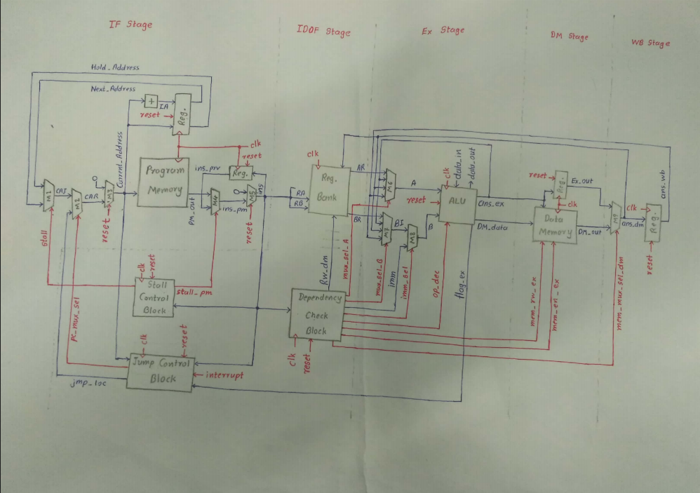
Complete Block Diagram

Slide 13
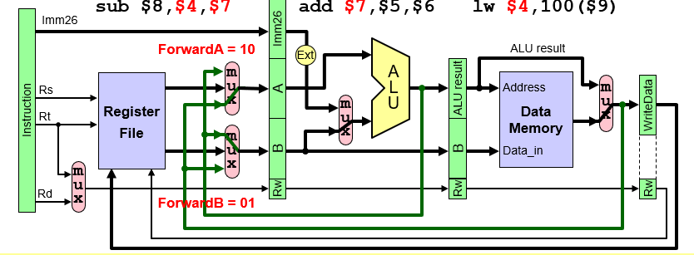
MIPS architecture

Slide 14
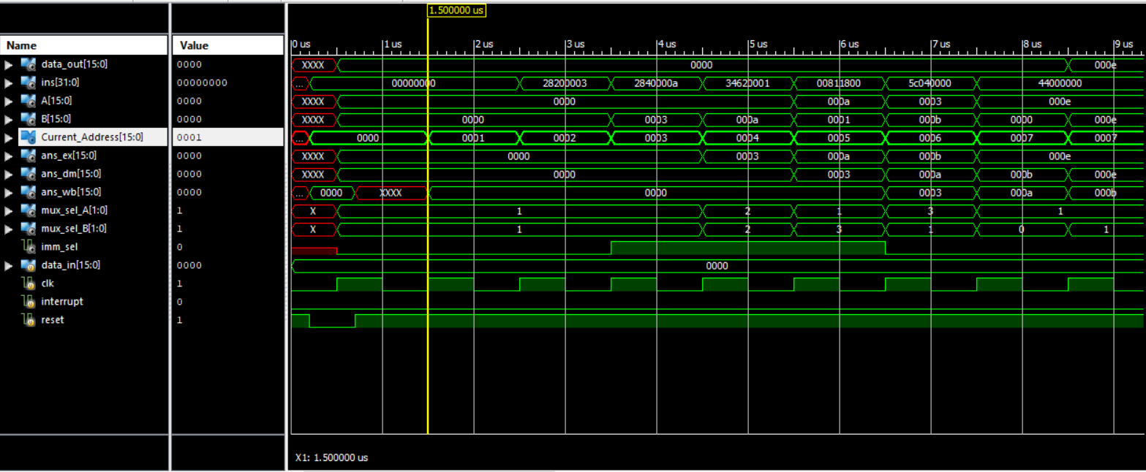
Results - Addition Output
Screenshots

Slide 15
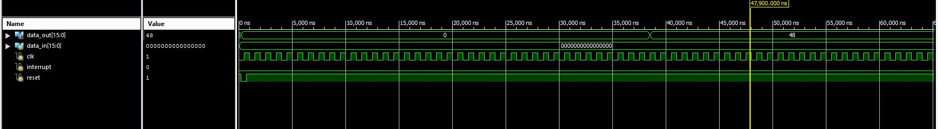
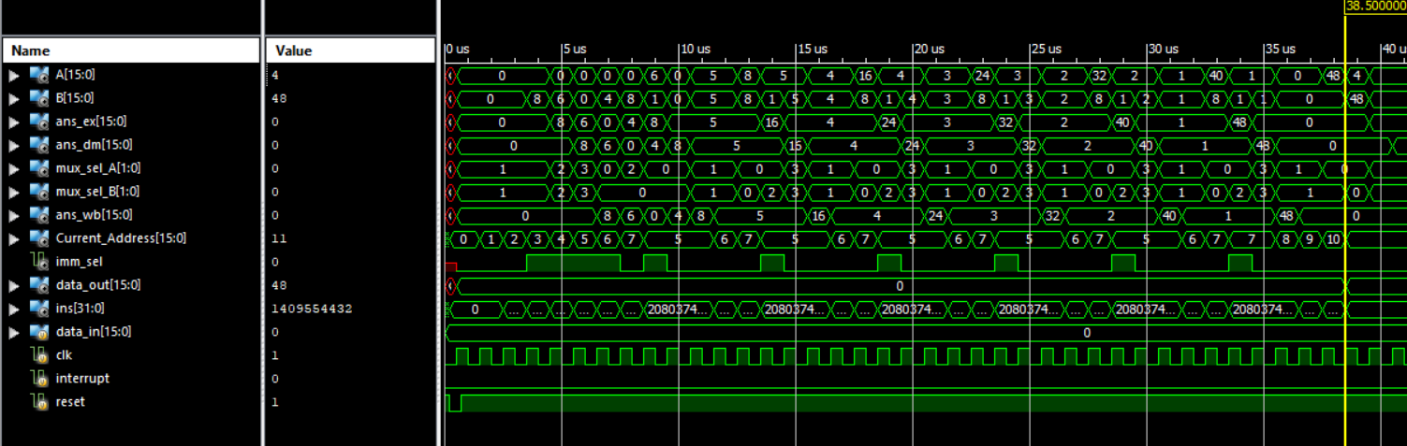
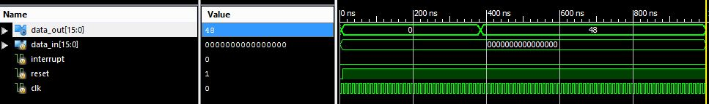
Results - Multiplication Output

Slide 16
Challenges faced
Jump instruction is used in the multiplication operation and in Dependency Check Block op_dec is received after 1’ clock cycle, because of this, there is a delay of 1’ clock cycle. So, the output coming was wrong.
For example : To perform 8 x 6, we added 8 six times and it required Jump instruction (for creating a decrementing loop). We did not receive correct answer.
There were other warnings while merging all the modules into one single module as follows:

Slide 17
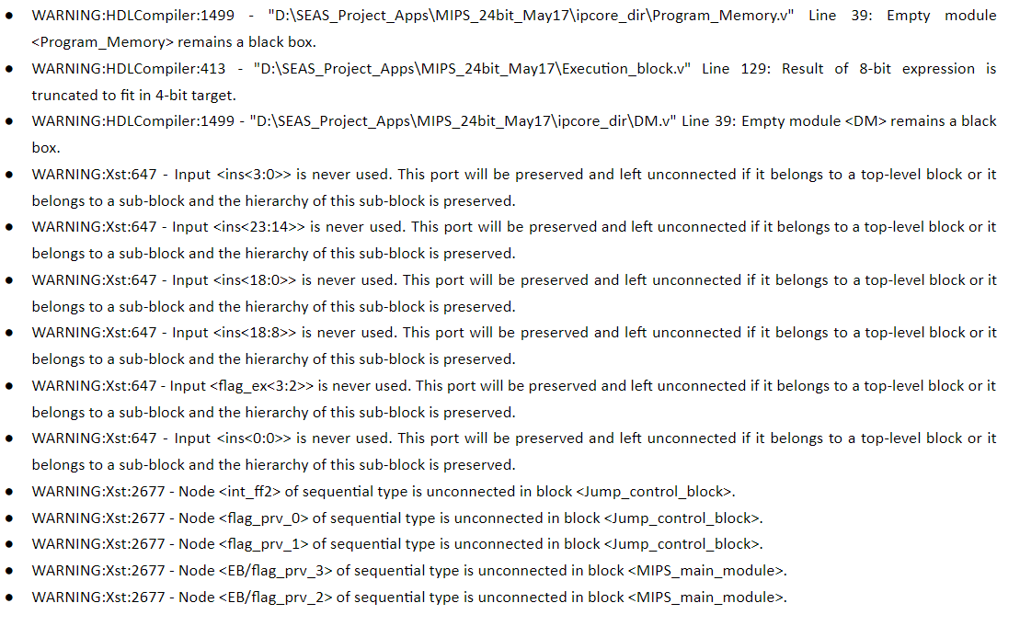
Challenges Faced

Slide 18
Solutions
In Dependency Check Block, we are getting op_dec as output, which is 1’ clock cycle delayed.
This op_dec is used as input in Stall Control Block.
To decrease 1’ clock cycle delay from Jump Instruction, we pass op_dec as ins[31:26].
Thus, we got correct answer.

Slide 19
Comparisons with 8085
8085 Microprocessor
Databus : 8-bits
Frequency : 3-6 Mhz
ALU : 8-bits
Memory Size : 64 Kb
Semi-Cisc
Non-pipeline architecture
6 Registers
Single Cycle
Serial Input/Output
Special Register:Accumulator
Immediate addressing mode
Answer register fixed
MIPS
Databus : 16-bits
Frequency : 100 Mhz
ALU : 16-bits
Memory Size : 128 Kb
RISC
Pipeline architecture
32 Registers
5 stage
Parallel Input/Output
No such special register
Answer register can be chosen

Slide 20
Motivation(Additional Features)
The main aim of including the feature of booth algorithm is that it performs the multiplication fast.
The number of steps required for the product calculation of two numbers are reduced significantly.
The reduction in the number of steps reduces the complexity thereby reducing the time for performing the multiplication algorithm.
It can be used for both positive and negative integers.
We have also tried to implement the cordic algorithm which is used for computation of trigonometric functions.
This algorithm uses simple add-shift operation with less complexity.

Slide 21
Specifications(Booth Algorithm)
Booth’s algorithm works on the theory of multiplying binary numbers in signed 2’s complement representation.
The number of steps required for the product calculation are reduced to the number of steps of the bits in the number.
In our algorithm we have used 8-bit signed number for multiplication. I.e. 7-bit number along with one bit sign.
As there is 8-bit number so there will be maximum 16 clock cycles whereas in the normal multiplication process there will be more than 16 clock cycles.

Slide 22
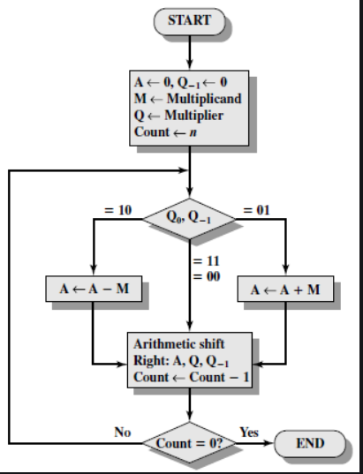
Block Diagram(Booth Algorithm)

Slide 23
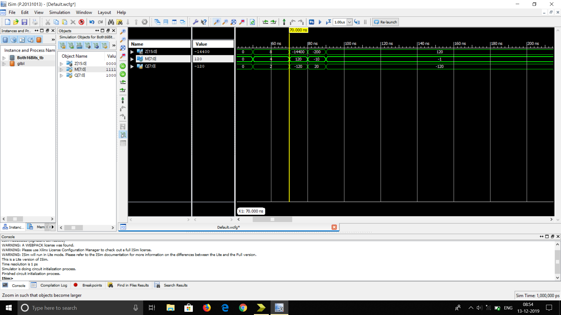
Results - Booth Algorithm

Slide 24
Specifications(Cordic Algorithm)
Cordic is used for the computing trigonometric functions through the use of additions, bit-shifts and small look-up tables.
We have implemented on 32-bit numbers.
It allows the numbers between -2 and +2 which includes the rotation between -90 degrees to +90 degrees in which all the inputs can be reduced into.
Here as the number is of 32 bits then 32 iterations are used for calculating the output.

Slide 25
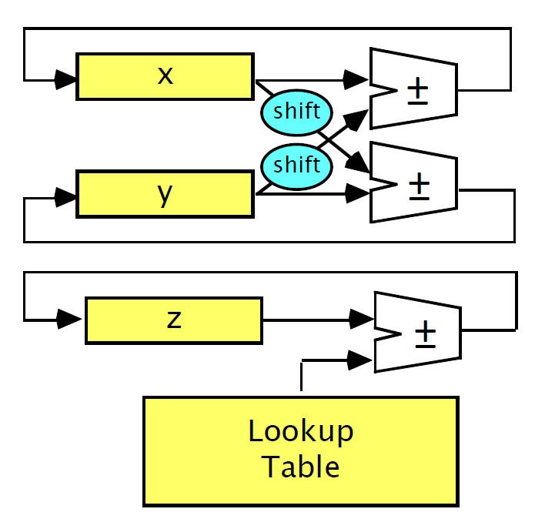
Cordic Block Diagram

Slide 26
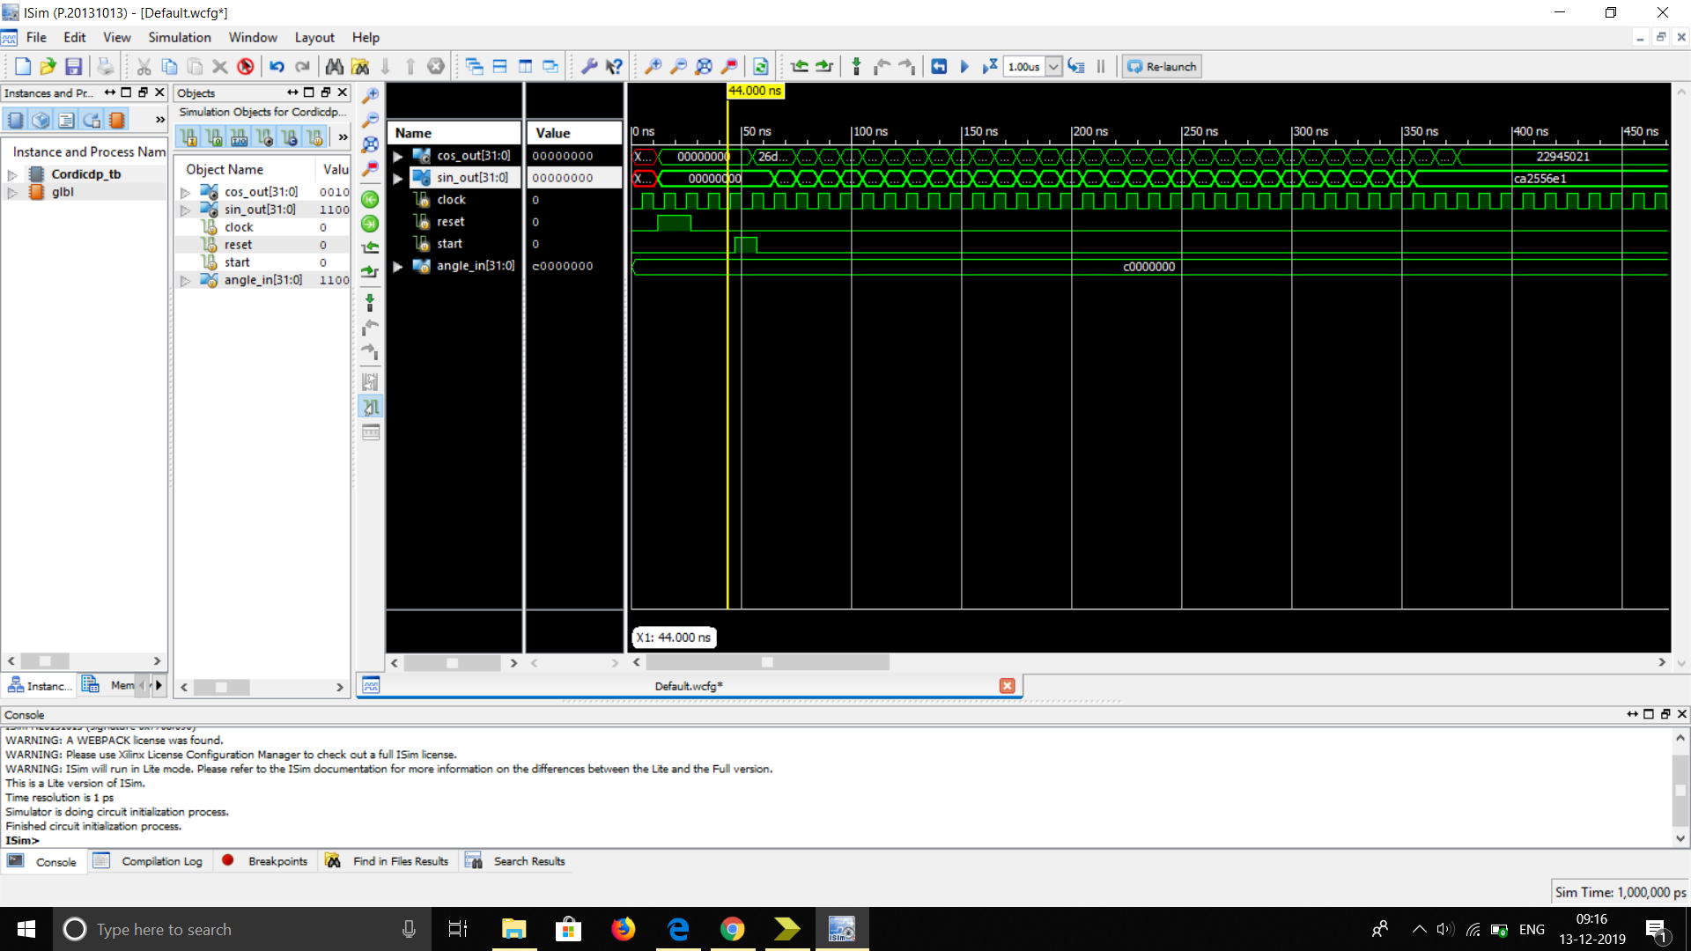
Results - Cordic Algorithm

Slide 27
References
Cordic algorithm - EE 5324 VLSI design paper -https://www.scribd.com/document/306913139/EE5324-CORDICpdf-pdf
Booth algorithm -https://www.google.com/search?q=booth+algorithm&sxsrf=ACYBGNQZ6X0NV00f0Hsb5NWYG5SCP7NRxw:1576208686650&source=lnms&tbm=isch&sa=X&ved=2ahUKEwip-O_22rHmAhUY4HMBHWwPATkQ_AUoAnoECA0QBA&biw=1536&bih=706#imgrc=VOPE2ygCPGGFWM:

