Slide 1

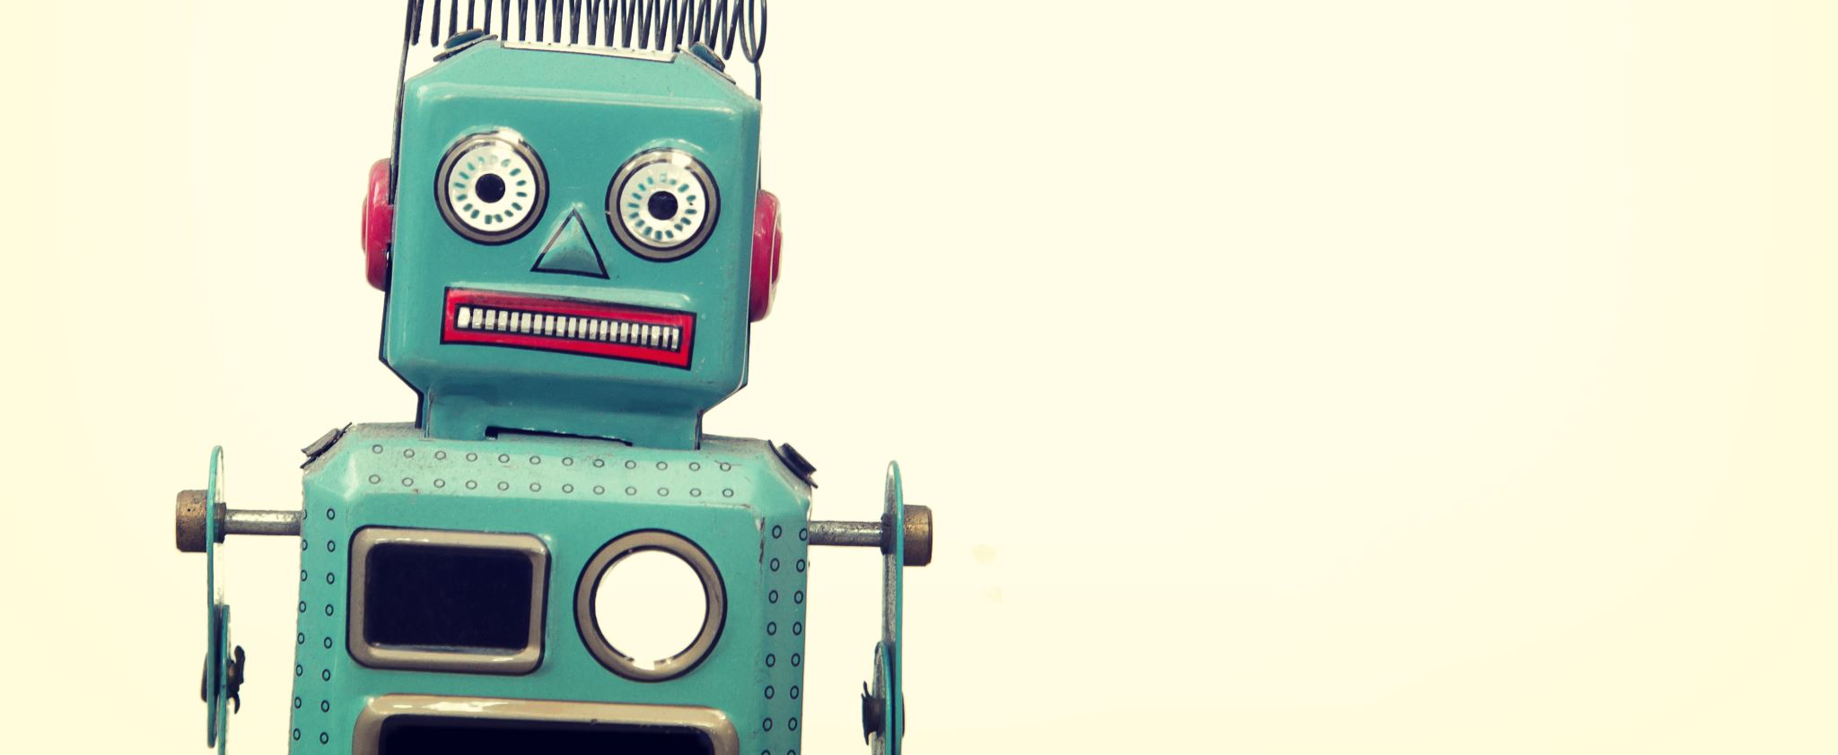
Q-Bot!

Slide 2
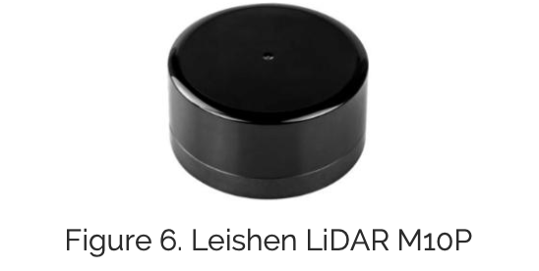
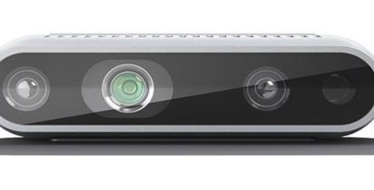
Sensors – External Environment
LiDAR (LeiShen M10P)
2D planar, 905 nm, eye-safe
10 m range, 1680 points/rev @ 10 Hz
Maps surroundings for obstacle avoidance
Intel RealSense D435 (RGB-D Camera)
RGB + depth + IR imaging
Enables 3D object detection & recognition

Slide 3
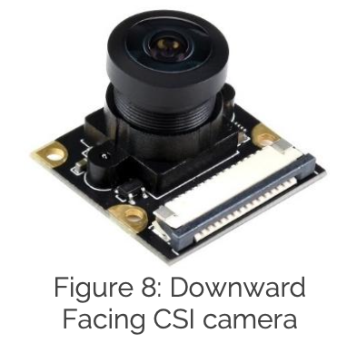
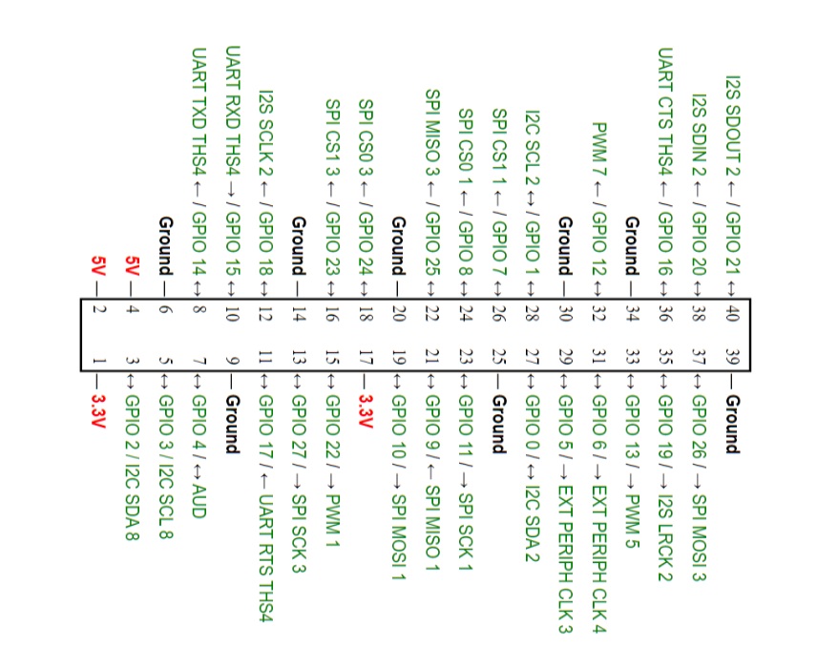
Sensors – Local Navigation & Support
Downward-Facing CSI Camera
Grayscale global shutter, 160° FOV.
High speed: up to 210 fps.
Used for line following, fiducial detection, and floor tracking.
IMU (6-axis)
3-axis accelerometer + 3-axis gyroscope.
16-bit resolution.
Provides orientation & motion feedback.
Dimensions & Payload
Size: 57.5 × 50 × 21.5 cm (with LiDAR).
Payload: up to 20 kg.
Wheel diameter: 8.9 cm.
Peripherals
Powered USB hub, HDMI, Ethernet, GPIO.
I/O’s !!

Slide 4
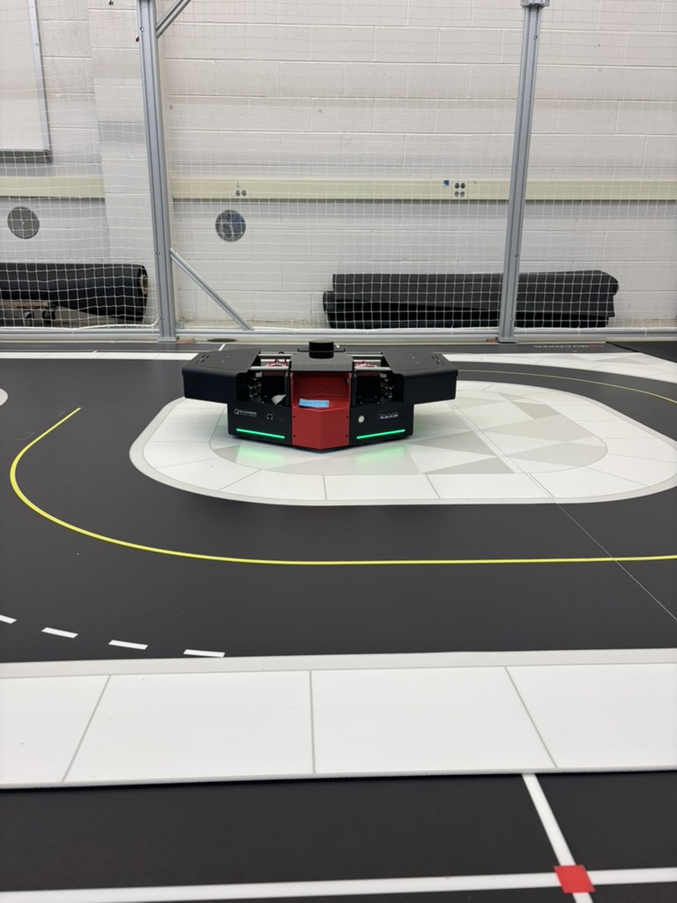
Q-Bot setup & meetings Update!
Meetings with Quanser Technicians
Held two sessions focused on setting up the Q-Bot system
Walked through hardware checks and software configuration
Software Updates
Updated all required packages to the latest versions
Ensured compatibility between drivers, firmware, and development tools
Outcome
Q-Bot system is now fully operational
Able to run custom programs and verify functionality
Platform ready for research experiments

Slide 5
NEXT-STEPS : Multi-QBot Setup & Goals
Configure & update the two additional Q-Bots.
Enable Wi-Fi/Ethernet communication between robots.
Assign unique IDs for coordination.
Goal: Train QBots to move simultaneously & interact autonomously using AI/ML.

Slide 6
Vision & Perception System
LiDAR – Maps environment, detects obstacles (SLAM).
Intel RealSense – Depth + RGB for object/robot detection.
Downward Camera – Line following & fiducial tracking.
IMU + Encoders – Motion & localization support.
Sensor fusion gives robots robust perception for navigation & learning.

Slide 7

AI/ML Training Plan
Supervised learning: line following, simple navigation
Reinforcement learning: collision avoidance, exploration
Multi-robot autonomy:
Synchronized movement
Leader–follower behavior
Run ML models

Slide 8
THANK YOU

