Slide 1

Problem Statement + Options & Approach Guide & Rubric

Slide 2
Presentation Goals
Build a 10 min professional, client-ready presentation that showcases your team’s understanding of the case background and your team’s analysis of the case through sharing solution options and detailed approach for the problem statement.
Leverage lessons learned from the Consulting 101, Business Chemistry, Intro. To People, Process, Technology class to boost the quality of your presentation.
Utilize the Problem Breakdown assignment as helpful.
Key Presentation Requirements:
Length: 10 min (max) presentation & 5 min Q&A
Professional format with informative visual aids to make presentation more enticing and attention-grabbing
Deliver content clearly and with enthusiasm, maintaining good eye contact and using appropriate gestures
Cite all non-original work using APA format

Slide 3
Problem Statement + Options & Approach Presentation
Ensure your presentation covers the following:
Company Background
Company Overview: Showcase the similarities and differences (high level) between Michigan Motors & Apollo. Who are their customers? What are the strengths/weaknesses of the two companies?
Competitors/Collaborators: Who are Michigan Motors & Apollo competitors? What are their competitor’s strengths/weaknesses? What risks do their competitors pose?
Industry/Market Environment
What are overall trends in the industry that might be relevant for Michigan Motors & Apollo?
What other background info about the auto industry/manufacturing might be relevant?
Challenges and Opportunities
What are some challenges that Michigan Motors & Apollo are facing and the opportunities for growth due to the merger?
What is the impact to business (so what?) of these challenges/opportunities?
Problem Statement
What is the core problem that Michigan Motors & Apollo are facing from this merger?

Slide 4
Problem Statement + Options & Approach Presentation Cont.
Vendor Selection
Recommend (single) ERP system most suited for client and provide sufficient reasoning and support.
Implementation Approach / Methodology*
Introduce, describe, and substantiate the approach your team chose for the technology transformation. What type of implementation approach is suitable for the project (i.e., waterfall or agile) and why?
Provide a Gantt chart view of how this will look. Showcase the key activities (e.g., requirement gathering, design, etc.) which will occur and provide a note for what type of deliverables would be provided (e.g., Requirements Document, Design Document, Test Scripts, etc.).*
Introduce, describe, and substantiate the deployment method your team chose for the technology transformation. What method is suitable for the project (i.e., Big Bang, Phased) and why?
Stakeholder Involvement
Provide a list (or org chart) of team members from Michigan Motors and Apollo whom your team believes would be needed to implement the technology initiative.
Share Estimated Timeline
Incorporating all appropriate information, create timeline-focused view of activities included in recommendation. Share any appropriate details in margins or call-outs on timeline. This is distinct from the Gantt chart since it will be an overview of the entire project, not just the initiative discussed in the Implementation Approach.
Closing Statements and Open Floor for Discussion
Share concluding remarks regarding the information covered in your presentation, touching again on timeline and seeking input from audience.
*See next slide for more information

Slide 5
Keep in mind: Logical Structuring
As you state your problem statement, ensure it follows a logical structure
Introduction/Governing thought: States the overall problem statement
Key line: Logic behind your problem statement
Supporting facts: Data and facts which support the key line

Slide 6
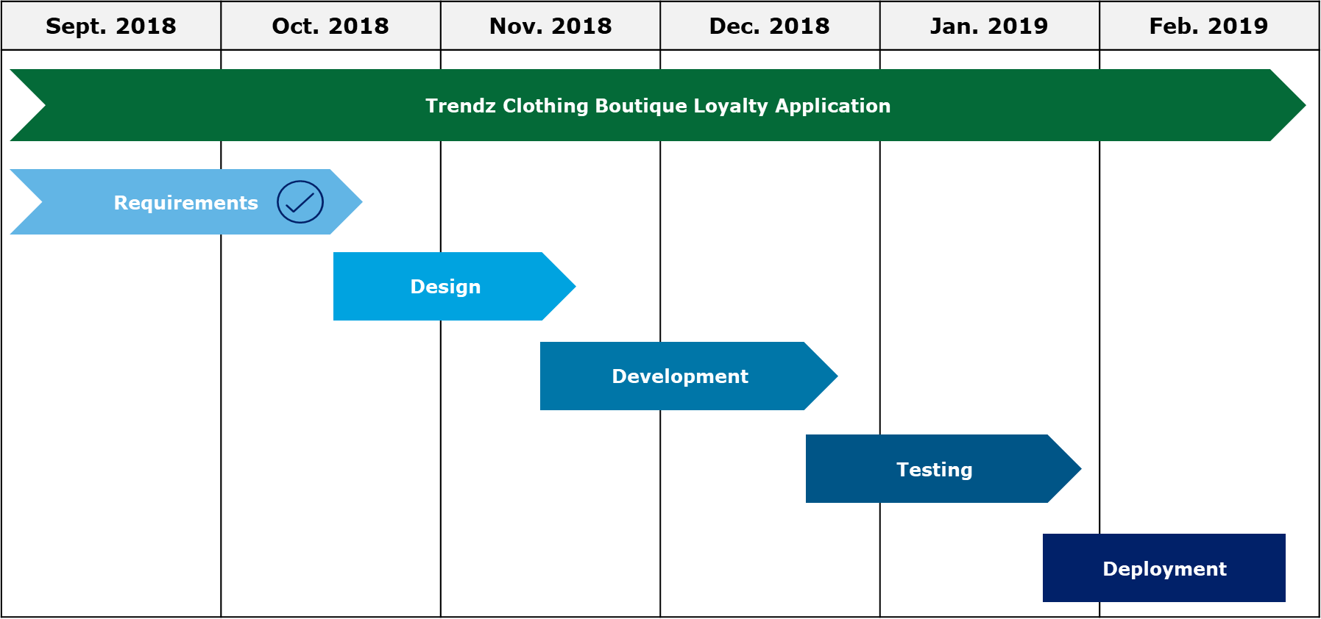
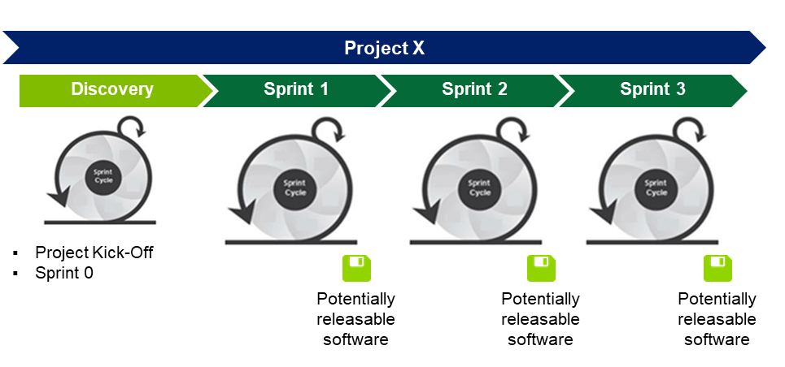

Implementation Approach/Methodology
In addition to class material, you may find it helpful to utilize your mentor for questions pertaining to this section
Implementation Approach
Waterfall
Agile
Deployment Method
Big Bang
What type of deployment strategy is recommended
(i.e., Big Bang, Phased) and why?
How does this preferred option depict project
success and effective delivery?
What were the determining factors for selecting this?
Phased

Slide 7
Grading Rubric
A: 90-100% | B: 80-89% | C: 70-79% | D: 60-69% | F: 0-59%
Criteria | Description | Total Points | Evaluator Notes | Score
Organization | Presentation preparedness (e.g., notes, quality of deck, etc.) Information and arguments were arranged in logical flow Material included is relevant to the overall message/purpose All sections were completed and constructed thoughtfully | 20
Content | Team provided a concise summary of the problem statement presented in their previous presentation Problem Statement section points to the biggest effects of the merger using strong support statements Team provided an overview of the recommended ERP solution with sufficient reasoning and support Team provided implementation approach recommendation (i.e., Waterfall or Agile) and substantiated their choice given the broader case (feasibility given timeframe, complexities between companies, etc.) Team provided technology implementation Gantt Chart, showcasing key activities and deliverables Team presented team structure to support client throughout technology implementation Team provided deployment method recommendation and strong supporting details Team presented project timeline through an illustrative graphic that reflects time required for each activity (timeline, flow chart, etc.) as well as appropriate details regarding the proposed solution | 35
Presentation | Students entered the presentation professionally and shared agenda to level-set with audience Students exhibited the ability to think critically and portray their thoughts clearly, concisely, and professionally Slides and any visual aids were well prepared, informative, and effective at delivering message Speakers delivered presentation clearly, professionally, and in logical flow Presentation utilized the time allotted without spending too much time re-hashing the entire background and problem statement background Presentation had a smooth flow from beginning to end, using subtle transitions Any references used were properly cited and followed APA format | 45
Total |  | 100

