Slide 1
Towards Accurate Seizure Detection: Machine
Learning Model for Wearable Technology
PID: 338
Presented by:
Dipin Raj
18 August 2023

Slide 2
Towards Accurate Seizure Detection: Machine
Learning Model for Wearable Technology
CREATED BY
DIPIN RAJ
JEEVAN A J
AKSHAY S
RHISHITHA T S
RASHAZ RAFEEQUE
MERRY K P

Slide 3
SEIZURE & SUDEP
A seizure is a sudden uncontrolled burst of electrical activity in the brain.It affects about 50 million individuals, making it one of the most prevalent neurological conditions worldwide.
S - Sudden
U - Unexpected
D - Death in
EP - EPilepsy

Slide 4
INNOVATION
ELECTRODERMAL ACTIVITY
ACCELEROMETER SENSOR
EDA sensor is capable of accurately measuring the electrical properties of the skin which changes.
ACC sensor measures the movement of our body, tracks the sleeping pattern and precisely measures heartbeat.
. . . .

Slide 5
SMART APPROACH
The existing smart-watches use shake detectors and irregular heart beats to predict seizure.
Can AI&ML be the solution?
Real time data collection using EDA & ACC sensors.
Machine learning algorithms.
Real time monitoring and alert system.

Slide 6
PROJECT TIMELINE
STAGE 02
STAGE 04
STAGE 01
STAGE 03
LITERATURE REVIEW
DRAFTING
Drafting the manuscript including abstract introduction conclusion and subtopics
Conducting a literature review for the background information
DATA COLLECTION
SUBMISSION
Submitting the drafted manuscript to a suitable journal.
Collecting the required data and cleansing it for the research work

Slide 7
PROJECT SCOPE
SYSTEM DESIGN
DATA ACQUISITION
DATA ANALYSIS
The first step in developing a seizure detection system is to design the system architecture and determine the components that will be required.
The seizure detection system must be able to acquire data from the patient in real-time.This typically involves the use of sensors like EDA and ACC.
The seizure detection system must be able to analyse the collected data to detect seizures. This typically involves the use of machine learning algorithms.

Slide 8
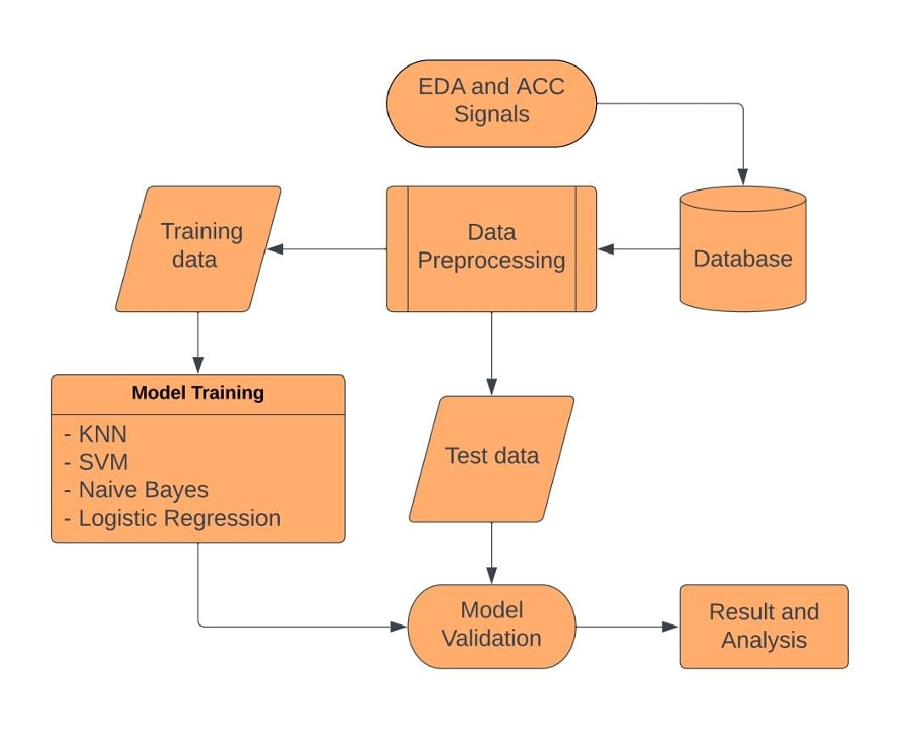
PRELIMINARY DESIGN
Collecting high-quality data from sensors in a real-world
Once the data is collected, it must be processed to extract relevant features that can be used to identify when a seizure is occurring.
The extracted features must then be used to classify whether a seizure is occurring or not.
Finally, the system must be able to operate in real-time, providing alerts within seconds of a seizure onset.

Slide 9
METHODOLOGY USED
01
02
03
04
EXTRACTION
PREPROCESSING
Dataset consisting of values from EDA(ElectroDermal Activity) and ACC(Accelerometer) sensors are acquired.
The dataset undergoes preprocessing and necessary features are selected.
ALGORITHMS
EVALUATION
Machine learning classification algorithms such as KNN, SVM, Naive Bayes, and Logistic Regression will be applied on the dataset.
The results of these techniques will be compared and reviewed based on metric scores such as Accuracy, Precision,etc .

Slide 10
ANALYSIS OF FEATURE
ELECTRODERMAL ACTIVITY
Every human being has a certain range of skin conductance which is considered to be normal
Seizures occur when the skin conductance crosses the maximum threshold value
EDA sensors can help in collecting the skin conductance levels during the occurrence of seizures and help the system to determine if it’s a false seizure or not.
ACCELEROMETER SENSOR
During the occurrence of seizures, patients would have vigorous movements
ACC sensors can be used to detect these vigorous movements
By relating to the EDA values, ACC can help in differentiating seizures from normal day to day activities

Slide 11
IMPLEMENTATION PLANNING
DEFINING
VALIDATION
Defining the problem statement and finding the appropriate ways to solve.
validating the research work and analyzing the accuracy from the data.
DEVELOPMENT
DEPLOYMENT
Design and develop a mission learning model which can detect seizure.
Deploying research paper to the intended audience after getting approved.

Slide 12
CONSTRAINTS
DATA AVAILABILITY
SENSOR LIMITATION
TECHNICAL LIMITATION
The accuracy and effectiveness of the proposed system depend on the quality and quantity of data.
The proposed system relies on wearable sensors to collect data on physiological parameters.
Developing a sensitive and specific ML model that can accurately detect seizures could be challenging.
REGULATORY
COST CONSTRAINTS
ETHICAL CONSTRAINTS
The proposed system must comply with regulatory requirements and standards.
The development and implementation of the proposed system could be costly.
The collection and use of patient data must adhere to ethical and privacy guidelines.

Slide 13
DESIGN SELECTION
Design selection
Model Architecture
Training and Validation
Selection
Of
Algorithm
Data
Visualization
Data
Preprocessing
Selection
Of
Dataset
Model Complexity
Model Evaluation
Machine Learning Model

Slide 14
FINALIZATION OF FEATURES & CONSTRAINTS
FEATURES
CONSTRAINTS
Wearable sensors for real-time monitoring of physiological data.
Machine learning algorithms to detect seizures accurately.
Customizable thresholds for tailoring detection to individual patients' needs.
Data visualization for monitoring changes in health status over time.
Ethical considerations regarding data privacy and security.
Technical limitations of wearable sensors and machine learning algorithms.
Validation and generalizability of the model across different patient populations and settings.
Regulatory requirements for medical devices and data management.

Slide 15
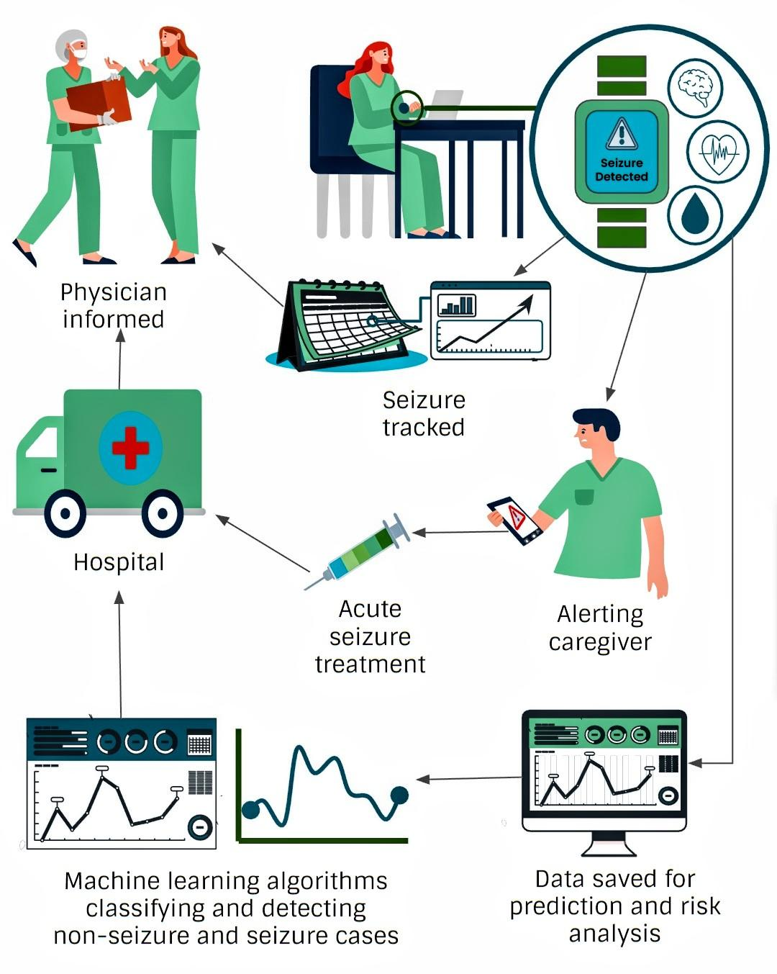
SEIZURE DETECTION AND INTERVENTION CYCLE
Seizure Detection: Biosensors and wearable devices detect changes in physiological parameters (ACC, PCG, EDA) indicative of a seizure.
Physician Notification: When a seizure is detected, the system alerts the physician or healthcare professional in real-time.
Seizure Tracking: The system tracks the duration and intensity of the seizure.
Hospital Integration: The system integrates with the hospital's electronic health record (EHR) system.
Acute Seizure Treatment: Based on the seizure data and patient's medical history, the system provides immediate guidance to healthcare professionals.
Caregiver Alert: The system sends alerts and notifications to the designated caregiver.
Data Storage and Analysis: Seizure data is securely saved in a central database for long-term storage, enabling further analysis.

Slide 16
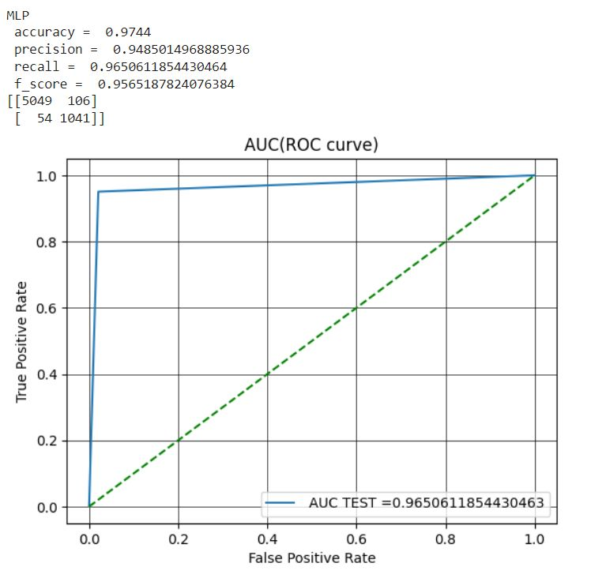
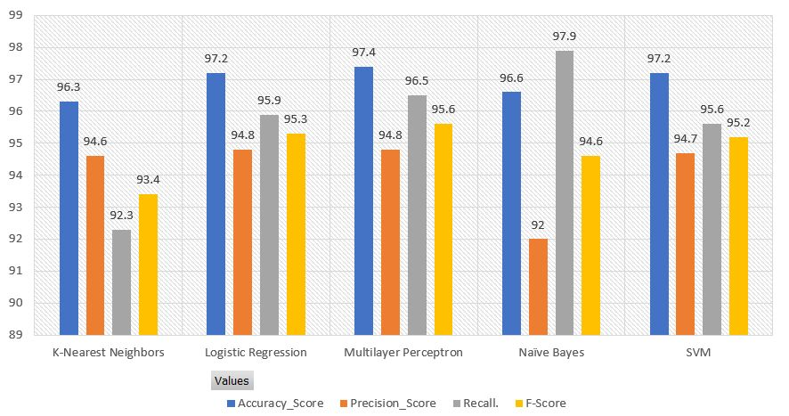
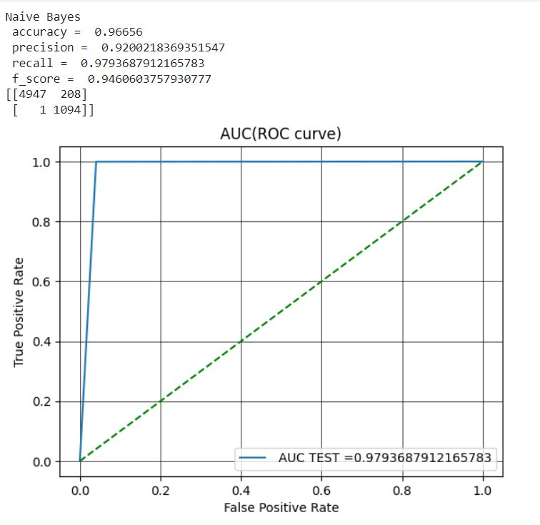
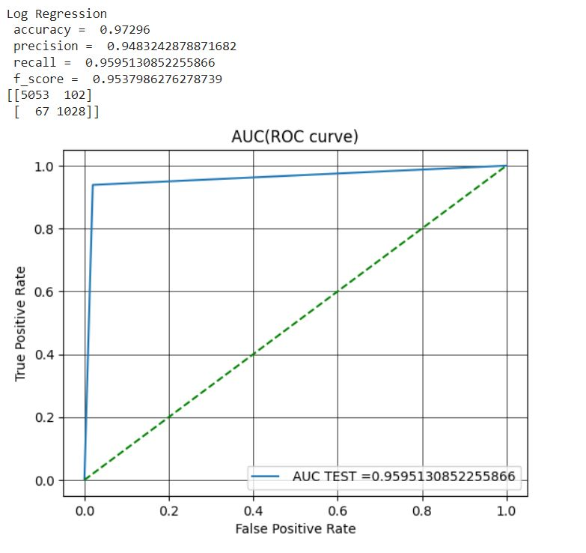
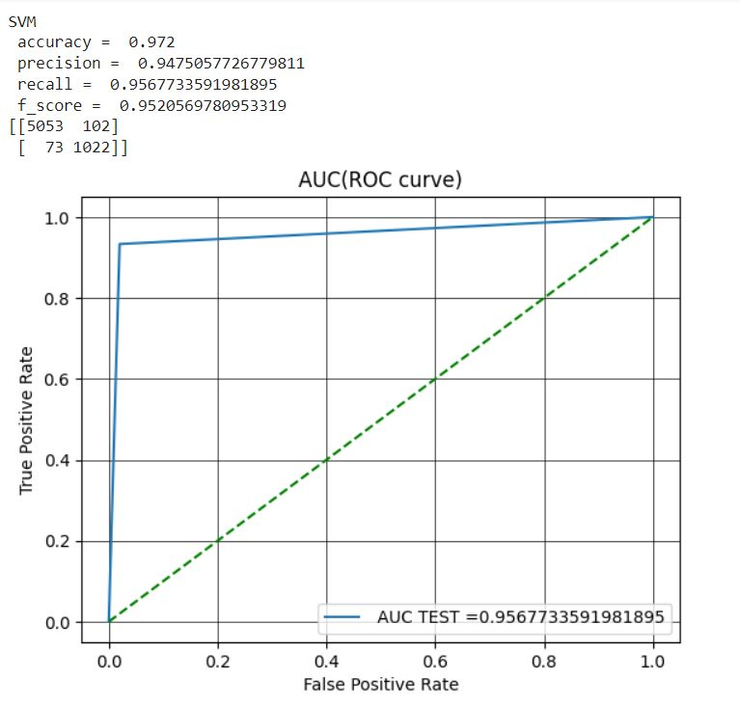
RESULTS
In the study of the multimodal datasets, among all the classifiers tested it is evident that the MLP classifier transcended in performance, as evidenced by its accuracy of 97.4%, precision of 94.8%, recall of 96.8%, and F-score of 95.6%.
The Logistic Regression approach has good accuracy, precision, recall, and F-score, measuring 97.2%, 94.8%, 95.9%, and 95.3%, respectively.
The Support Vector Machine Algorithm F-score was 95.2% because it had the best accuracy (97.2%), Recall of 95.6%, but a lesser precision (94.7%).
The K-Nearest Neighbours and Naive Bayes methods performed the worst overall, with accuracy ratings of 96.3% and 96.6%, respectively.
These findings imply that the MLP classifier performs better than other classifiers evaluated in this work and is capable of handling multimodal datasets.

Slide 17
DISCUSSION
The combination strategy works well, as seen by the high accuracy of 97.4% in seizure detection.
Correct identification permits quick action and appropriate management, lowering the risks and outcomes related to seizures.
It is essential to be able to distinguish between various seizure types since it enables customised management and treatment strategies.
Wearable technology provides a non-intrusive and simple solution, enabling users to monitor their health and carers to get timely notifications.
Sensor accuracy and reliability: Further research and development are needed to improve the accuracy and reliability of biosensors to minimize false positives or negatives.
Integration with healthcare systems: Seamless integration of wearable devices with existing healthcare systems is crucial for effective seizure detection and management.

Slide 18
REFERENCES
Beghi, E., 2020. The epidemiology of epilepsy. Neuroepidemiology, 54(2), pp.185-191.
Sarmast, S.T., Abdullahi, A.M. and Jahan, N., 2020. Current classification of seizures and epilepsies:scope, limitations and recommendations for future action. Cureus, 12(9).
Falco-Walter, J.J., Scheffer, I.E. and Fisher, R.S., 2018. The new definition and classification of seizures and epilepsy. Epilepsy research, 139, pp.73-79.
Humairah Tabasum, Nikita Gill, Rahul Mishra and Saifullah Lone. Wearable microfluidic-based e-skin sweat sensors.
Xu Zeng, Hai-Tao Deng, Dan-Liang Wen, Yao-Yao Li, Li Xu and Xiao-Sheng Zhang. Wearable Multi-Functional Sensing Technology for Healthcare Smart Detection.
Chen, F., Chen, I., Zafar, M., Sinha, S.R. and Hu, X., 2022. Seizures detection using multimodal signals: a scoping review. Physiological Measurement.
Alazzam, M.B., Alassery, F. and Almulihi, A., 2021. A novel smart healthcare monitoring system using machine learning and the Internet of Things. Wireless Communications and Mobile Computing, 2021, pp.1-7.
Rosales, M.A., Bandala, A.A., Vicerra, R.R. and Dadios, E.P., 2019, November. Physiological-Based Smart Stress Detector using Machine Learning Algorithms. In 2019 IEEE 11th International Conference on Humanoid, Nanotechnology, Information Technology, Communication and Control, Environment, and Management (HNICEM) (pp. 1-6). IEEE.
Siddiqui, M.K., Morales-Menendez, R., Huang, X. and Hussain, N., 2020. A review of epileptic seizure detection using machine learning classifiers. Brain informatics, 7(1), pp.1-18.
Jonas Munch Nielsen, Ivan C. Zibrandtsen, Paolo Masulli, Torben Lykke Sørensen, Tobias S. Andersen, Troels Wesenberg Kjær. Towards a wearable multi-modal seizure detection system in epilepsy.
Sai Manohar Beeraka, Abhash Kumar, Mustafa Sameer, Sanchita Ghosh, Bharat Gupta. Accuracy Enhancement of Epileptic Seizure Detection: A Deep Learning Approach with Hardware Realization of STFT.
Tang, J., El Atrache, R., Yu, S., Asif, U., Jackson, M., Roy, S., Mirmomeni, M., Cantley, S., Sheehan, T., Schubach, S. and Ufongene, C., 2021. Seizure detection using wearable sensors and machine learning: Setting a benchmark. Epilepsia, 62(8), pp.1807-1819

Slide 19
REFERENCES
Van Andel, J., Ungureanu, C., Aarts, R., Leijten, F. and Arends, J., 2015. Using photoplethysmography in heart rate monitoring of patients with epilepsy. Epilepsy & Behavior, 45, pp.142-145.
Nasseri, M., Pal Attia, T., Joseph, B., Gregg, N.M., Nurse, E.S., Viana, P.F., Worrell, G., Dümpelmann, M., Richardson, M.P., Freestone, D.R. and Brinkmann, B.H., 2021. Ambulatory seizure forecasting with a wrist-worn device using long-short term memory deep learning. Scientific reports, 11(1), p.21935.
Mustafa Halimeh, Yonghua Yang, Theodore Sheehan, Solveig Viieluf, Michele Jackson, Tobias Loddenkemper, Christian Meisel. Wearable device assessments of antiseizure medication effects on diurnal patterns of electrodermal activity, heart rate, and heart rate variability.
An, S., Kang, C. and Lee, H.W., 2020. Artificial intelligence and computational approaches for epilepsy. Journal of epilepsy research, 10(1), p.8.
Adwitiya, A.Y., Hareva, D.H. and Lazarusli, I.A., 2017, September. Epileptic Alert System on Smartphone. In 2017 International Conference on Soft Computing, Intelligent System and Information Technology (ICSIIT) (pp. 288-291). IEEE.
Moodbidri, A. and Shahnasser, H., 2017, January. Child safety wearable device. In 2017 International Conference on Information Networking (ICOIN) (pp. 438-444). IEEE.
Regalia, G., Onorati, F., Lai, M., Caborni, C. and Picard, R.W., 2019. Multimodal wrist-worn devices for seizure detection and advancing research: focus on the Empatica wristbands. Epilepsy research, 153, pp.79-82.
Lockman J, Fisher RS, Olson DM. Detection of seizure-like movements using a wrist accelerometer. Epilepsy Behav. 2011 Apr;20(4):63841. doi: 10.1016/j.yebeh.2011.01.019. Epub 2011 Mar 29.
Ortega, M.C., Bruno, E. and Richardson, M.P., 2022. Electrodermal activity response during seizures:A systematic review and meta-analysis. Epilepsy & Behavior, 134, p.108864.
Posada-Quintero, H.F. and Chon, K.H., 2020. Innovations in electrodermal activity data collection and signal processing: A systematic review. Sensors, 20(2), p.479.
Zangróniz, R., Martínez-Rodrigo, A., Pastor, J.M., López, M.T. and Fernández-Caballero, A., 2017. Electrodermal activity sensor for classification of calm/distress condition. Sensors, 17(10), p.2324.
Bornoiu, I.V. and Grigore, O., 2013, May. A study about feature extraction for stress detection. In 2013 8th International Symposium on Advanced Topics in Electrical Engineering (ATEE) (pp. 1-4). IEEE.
Majumder, A.K.M., ElSaadany, Y.A., Young, R. and Ucci, D.R., 2019. An energy efficient wearable smart IoT system to predict cardiac arrest. Advances in Human-Computer Interaction, 2019.

Slide 20
Together let's make the change!

Slide 21
THANKS!

