Slide 1

[REDACTED]
[REDACTED]
[REDACTED]

Slide 2
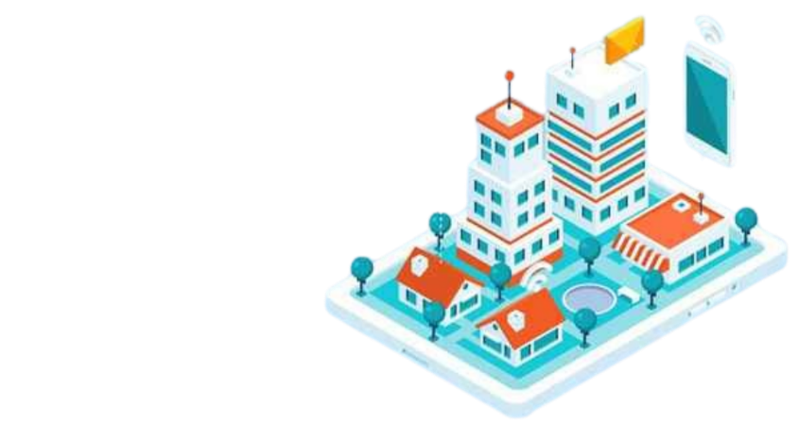
[REDACTED]
[REDACTED]

Slide 3
[REDACTED]
[REDACTED]

Slide 4
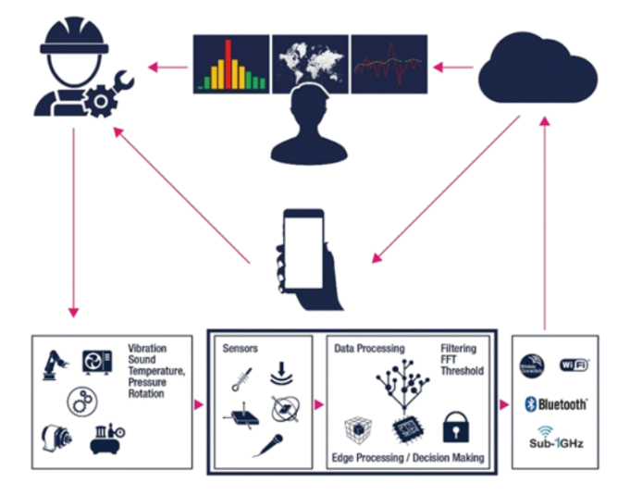
[REDACTED]
[REDACTED]

Slide 5
[REDACTED]
[REDACTED]
[REDACTED]
[REDACTED]
[REDACTED]
[REDACTED]
[REDACTED]
[REDACTED]
[REDACTED]
[REDACTED]
[REDACTED]
[REDACTED]
[REDACTED]

Slide 6
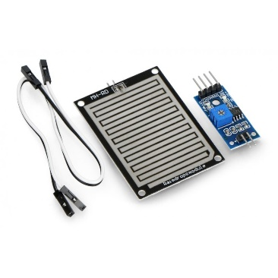
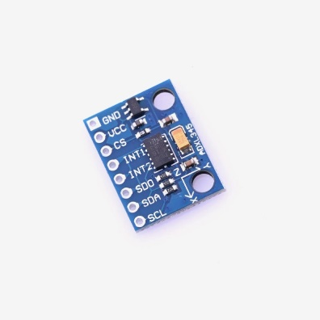
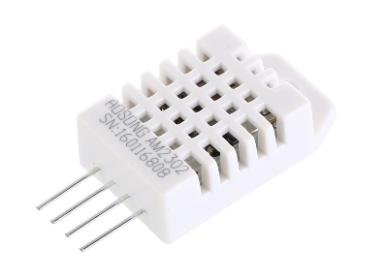
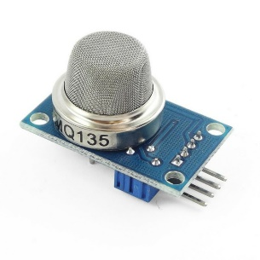
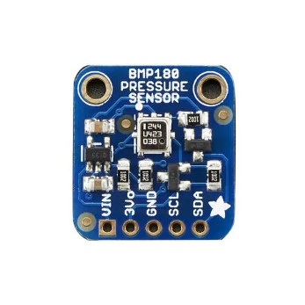
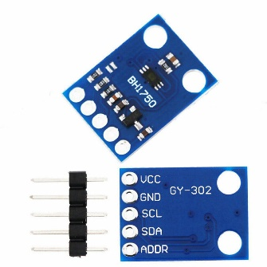
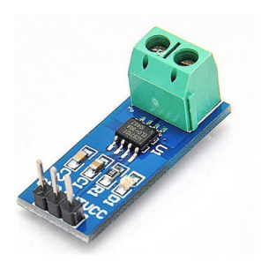
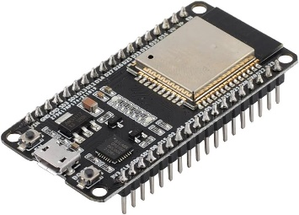
[REDACTED]
[REDACTED]
[REDACTED]
[REDACTED]
[REDACTED]
[REDACTED]
[REDACTED]
[REDACTED]
[REDACTED]

Slide 7





[REDACTED]
[REDACTED]
[REDACTED]
[REDACTED]
[REDACTED]
[REDACTED]
[REDACTED]
[REDACTED]
[REDACTED]
[REDACTED]
[REDACTED]
1
2
3
4
5
[REDACTED]
[REDACTED]
[REDACTED]
[REDACTED]
[REDACTED]
[REDACTED]
[REDACTED]
[REDACTED]
[REDACTED]

Slide 8

Proactive Maintenance:
Early detection of potential issues will enable proactive maintenance, reducing downtime and repair costs.
[REDACTED]
Improved Safety:
Timely alerts for water leaks, electrical issues, and poor air quality will enhance the safety of building occupants.
[REDACTED]
Enhanced Comfort:
Monitoring temperature, humidity, and air quality will ensure a comfortable environment for occupants.
Data-Driven Insights
Historical data analysis will provide valuable insights for long-term maintenance planning and infrastructure improvements

Slide 9
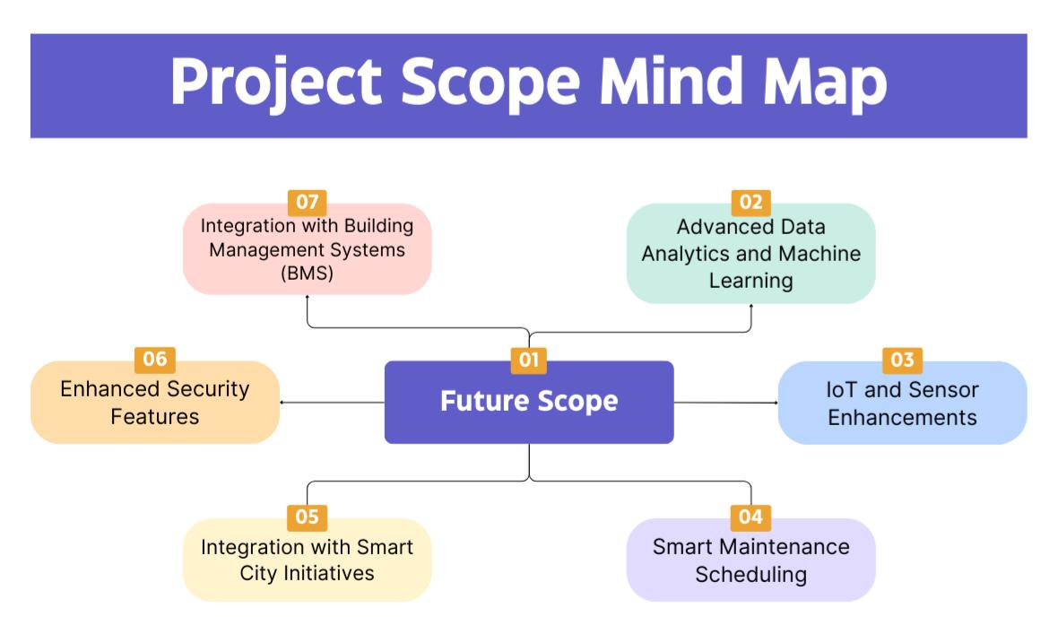

Slide 10
[REDACTED]
[REDACTED]

