Slide 1

[REDACTED] IQ : predictive [REDACTED]
[REDACTED] – [REDACTED] of [REDACTED]
-SHREEYAN M PATIL
-RAJESH B KHAVANE
-SWARALI P BEDSE
-YASH A CHORDIYA

Slide 2
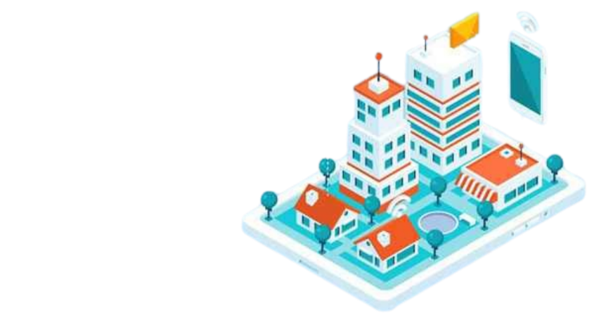
[REDACTED]
[REDACTED]: [REDACTED]
[REDACTED] an automated [REDACTED] (PdM) system for smart buildings using IoT sensors and the [REDACTED] microcontroller. [REDACTED] system will monitor environmental and operational parameters to detect potential maintenance issues early, preventing costly damages, enhancing safety, and ensuring smooth building operations.

Slide 3
[REDACTED]:
[REDACTED]: [REDACTED] leaks can cause structural damage and mold growth.
[REDACTED] and [REDACTED]: [REDACTED] can affect occupant comfort and HVAC efficiency.
[REDACTED]: [REDACTED] vibrations can indicate machinery or structural issues.
[REDACTED]: [REDACTED] air quality impacts occupant health.
[REDACTED]: [REDACTED] HVAC pressure affects performance.
[REDACTED]: [REDACTED] circuits can cause fires or equipment damage.
[REDACTED]: [REDACTED] lighting ensures safety and comfort while optimizing energy use.

Slide 4
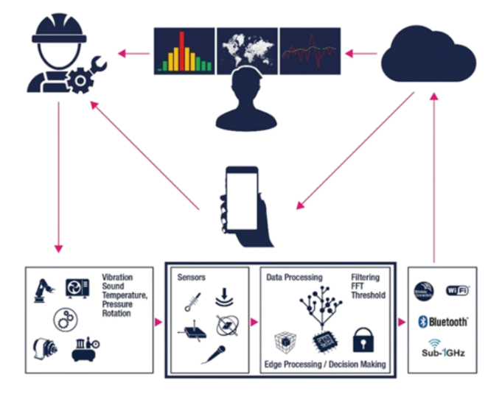
[REDACTED]:
[REDACTED] an integrated system using various sensors to continuously monitor the building’s environment and operational conditions. [REDACTED] system will use the [REDACTED] microcontroller to gather data from the sensors and communicate with a central server or cloud service for data analysis and alert generation. [REDACTED] system will provide real-time alerts and historical data to building managers, enabling timely interventions and maintenance planning.

Slide 5
[REDACTED]: [REDACTED] in sustainability and efficiency.
[REDACTED]: [REDACTED] property value and longevity
[REDACTED]
[REDACTED]
[REDACTED]
[REDACTED]: [REDACTED] operations and maintenance efficiency.
IoT [REDACTED]: [REDACTED] reliable sensors and microcontrollers
[REDACTED]
[REDACTED]
[REDACTED]
[REDACTED]
[REDACTED] ([REDACTED]/[REDACTED]): [REDACTED] with comfort and safety.
[REDACTED]: [REDACTED] repairs based on timely alerts.

Slide 6
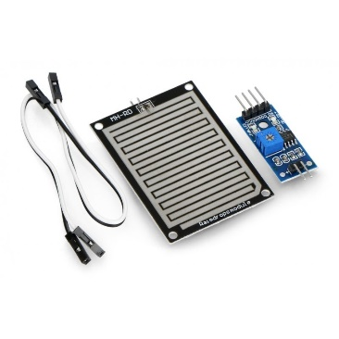
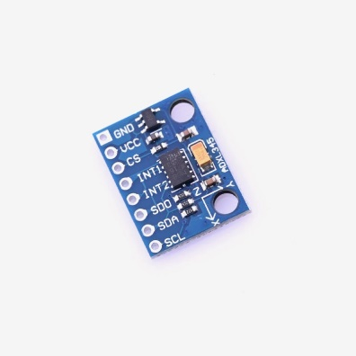
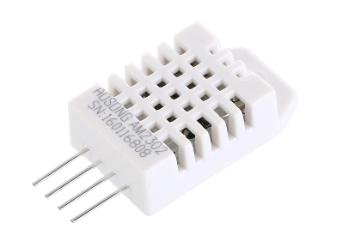
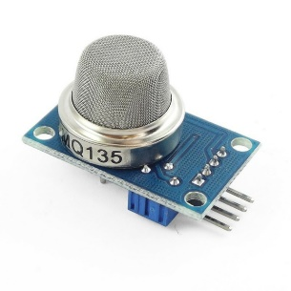
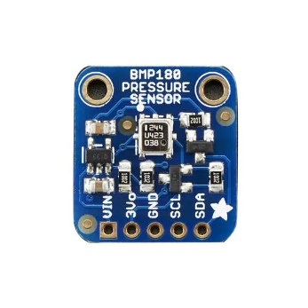
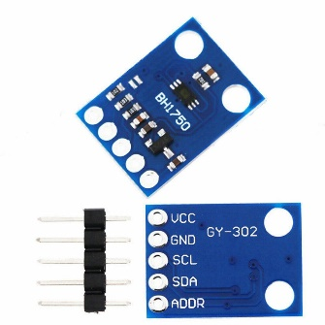
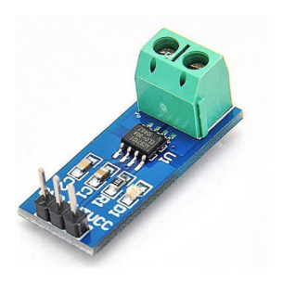
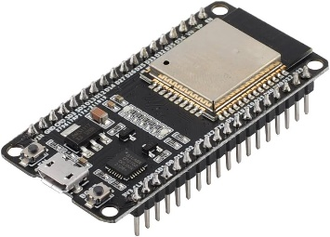
[REDACTED] :
YL-83: [REDACTED] leak detection.
DHT22/BME280: [REDACTED] and humidity monitoring..
ADXL345: [REDACTED] monitoring.
MQ135/CCS811: [REDACTED] quality monitoring.
BMP180/MPX5010: [REDACTED] monitoring.
ACS712: [REDACTED] monitoring.
BH1750: [REDACTED] intensity monitoring.
ESP32: [REDACTED] microcontroller for data collection and communication.

Slide 7





[REDACTED]
[REDACTED] and [REDACTED]
[REDACTED]
[REDACTED]
[REDACTED] and [REDACTED]
[REDACTED]
1
2
3
4
5
[REDACTED] goals and gather stakeholder requirements.
[REDACTED] feasibility study and plan resources.
[REDACTED] architecture and select components (sensors and [REDACTED]).
[REDACTED] network and user interface.
[REDACTED] hardware and develop software.
[REDACTED] components and set up databases.
[REDACTED] unit, integration, and system testing.
[REDACTED] user acceptance testing (UAT).
[REDACTED] and configure the system.
[REDACTED] users, monitor performance, and maintain the system.

Slide 8

Proactive Maintenance:
Early detection of potential issues will enable proactive maintenance, reducing downtime and repair costs.
Improved Safety:
Timely alerts for water leaks, electrical issues, and poor air quality will enhance the safety of building occupants.
[REDACTED]
Enhanced Comfort:
Monitoring temperature, humidity, and air quality will ensure a comfortable environment for occupants.
Data-Driven Insights
Historical data analysis will provide valuable insights for long-term maintenance planning and infrastructure improvements

Slide 9
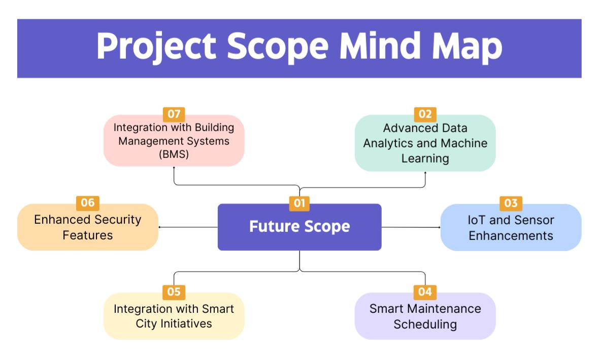

Slide 10
THANK YOU
"[REDACTED] maintenance [REDACTED] for a safer, smarter building [REDACTED]."

