Slide 1

Department of Computer Science and Engineering
Mini Project Review
on
ADVANCED BREAST CANCER DETECTION USING DEEP LEARNING
Under the Guidance Presented
of by
Dr. N. Tirupathi Rao K Durga Prasad
(Professor) (23L31D5802)

Slide 2
ABSTRACT
Advanced breast cancer detection represents a critical challenge in oncology, where early and accurate diagnosis significantly influences patient outcomes. Traditional diagnostic methods, including mammography, ultrasound, and biopsy, have limitations in sensitivity and specificity, particularly in detecting subtle or complex lesions. Recent advancements in deep learning (DL) offer promising improvements in this domain. DL models, particularly convolutional neural networks have demonstrated remarkable efficacy in identifying malignant lesions and benign lesions from mammograms, histo pathological images and other imaging modalities. These models leverage large datasets to learn intricate patterns and features that might elude human observers, thereby improving diagnostic accuracy. The CNN model, known for its balance of efficiency and accuracy, is utilized to classify the images. Innovations in transfer learning and ensemble methods have further refined these models, enabling them to generalize across diverse populations and imaging conditions. A rigorous evaluation had implemented on the current model's performance and achieved a notable accuracy rate. This makes the efficacy of our approach and its potential to support pathologists in making more precise and reliable diagnoses of breast cancer.

Slide 3
Breast Cancer
Breast cancer is a disease in which abnormal breast cells grow out of control and form tumors. If left unchecked, the tumors can spread throughout the body and become fatal. Breast cancer cells begin inside the milk ducts and/or the milk-producing lobules of the breast. Invasive cancers can spread to nearby lymph nodes or other organs (metastasize). Metastasis can be life-threatening and fatal.. This project aims to predict future breast cancer by analyzing data of patients which classifies whether they have cancer or not using Deep-learning algorithms.

Slide 4
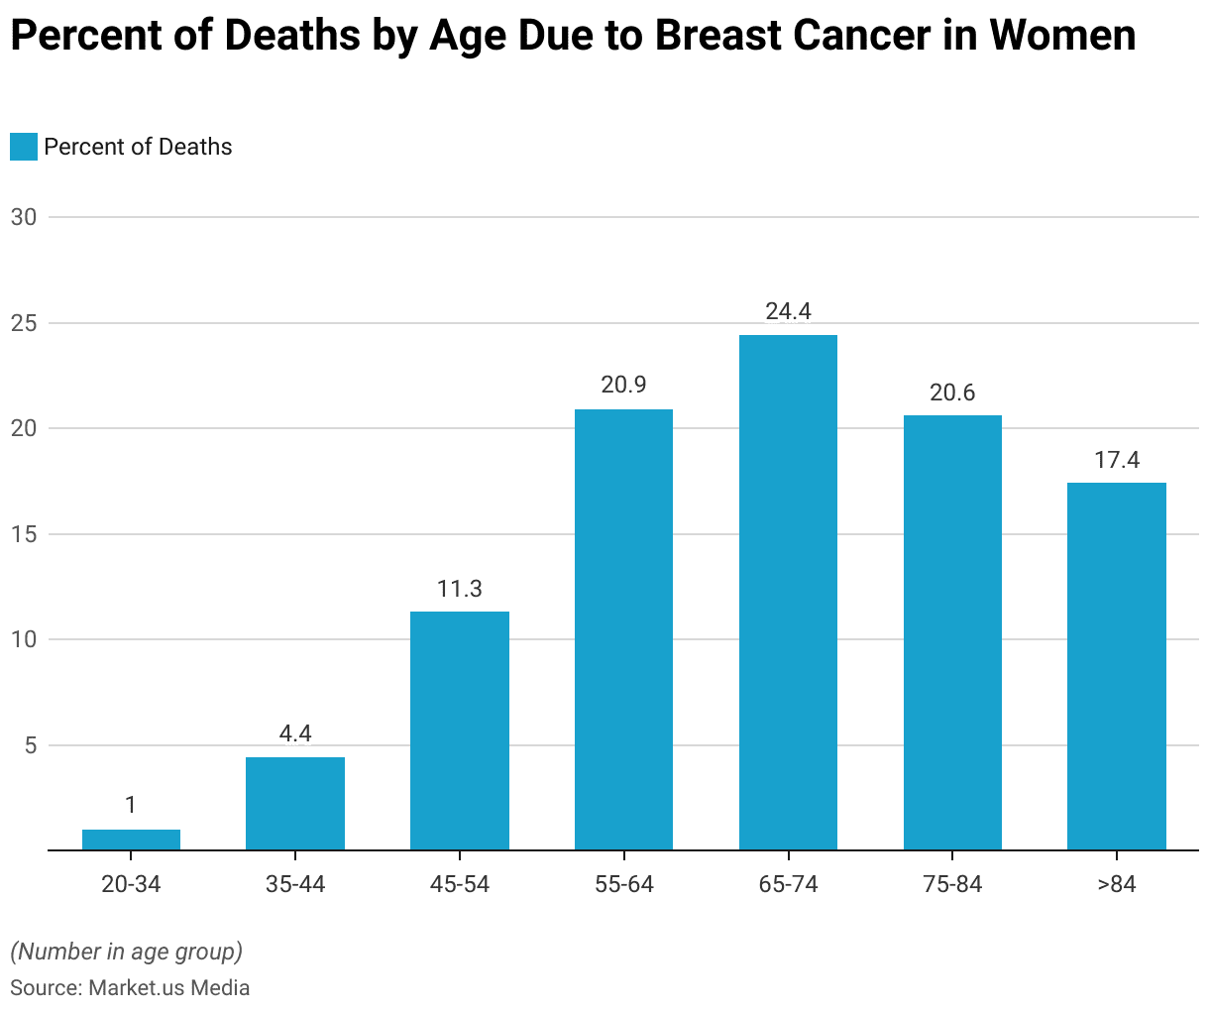
Statistics on Breast Cancer in recent years

Slide 5
EXISTING SYSTEM
There are a number of existing systems for detecting breast Cancer including are :
Mammography: The most common screening test for breast cancer, mammograms are X-rays of the breast that can detect cancer early. If a mammogram finds something concerning, a more detailed diagnostic mammogram can be performed. However, mammograms are not effective for women with dense breast tissue.
Magnetic resonance imaging (MRI): Used to screen women who have a high risk of breast cancer.
Computer-aided detection (CAD): A system that uses machine learning to detect breast cancer.
Ultrasound imaging: Used as a diagnostic tool for women with dense breast tissue.

Slide 6
PROPOSED SYSTEM
In the Proposed System, the used data collection had missing values to be removed before the algorithms were applied.
The algorithms like CNN is used to achieve better accuracy i.e. more than 90%.
CNN is a powerful Deep learning algorithm that is particularly well-suited for image recognition and processing tasks. It is made up of multiple layers, including Convolutional layers, pooling layers and fully connected layers.
In the proposed system, we had used a bigger dataset, the model may have been more adequately trained and the tests more reliably than they are now. A much wider dataset is used to boost the model and that would enhance the accuracy and accurate performance of the model.

Slide 7
SYSTEM REQUIREMENTS
Hardware Requirements:
Processor : Intel Core I3 processor
RAM : 8 GB
ROM : 256 GB
Software Requirements:
Operating system: Windows 7 or 11
Coding Language: Python
Platform : Jupyter Notebook
Back end Dataset : Collected From Kaggle Website

Slide 8
PHASES IN MODEL LEARNING
There are totally 4 modules in the current application. They are as follows:
Data Exploration
Data Visualization
Data Modeling
Predicting cancer

Slide 9
Data Exploration:
Data exploration is the process of reviewing a raw data set to understand its characteristics and patterns. It understands the quality and size of the data. It identifies relationships between data elements, files and tables.
Data Visualization:
Data visualization is the graphical representation of information and data. By using visual elements like charts, graphs, and maps, data visualization tools provide an accessible way to see and understand trends, outliers, and patterns in data.
Data Modeling:
Data modeling is the process of creating a conceptual model of data and its relationships to help organize and manage data
Predicting cancer:
Identifying whether the patient is suffering from breast cancer or not with the use of Deep Learning model.

Slide 10
CNN
A convolutional neural network is a type of Deep learning algorithm that is particularly well suited for image recognition and processing tasks. Its made up of multiple layers including convolutional layers, pooling layers, and fully connected layers.
Key components of CNN are:
Convolutional layers
Pooling layers
Activation function
Fully connected layers
Different types of CNN models are:
LeNet
AlexNet
GoogleNet
ResNet
MobileNet
VGG

Slide 11
ResNet
ResNet (short for Residual Network) is a type of neural network architecture introduced in 2015. It was designed to solve the problem of vanishing gradients in deep neural networks, which hindered their performance on large-scale image recognition tasks.
Benefits of Residual Network include:
Deeper networks
Improved accuracy
Faster convergence
Transfer learning
We have several ResNet varients, some of them are :
ResNet-18 and ResNet-34
ResNet-50 ResNet-101 and ResNet-152

Slide 12
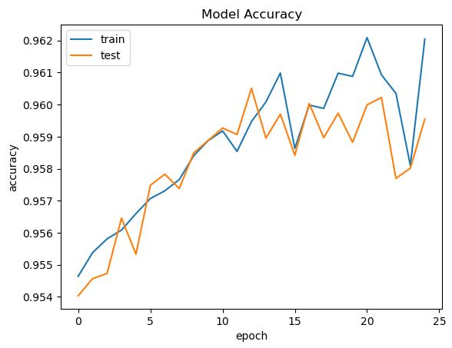

RESULTS
Confusion Matrix
TP=56473 | FP=301
FN=4732 | TN=265
Accuracy
Predicted Output

Slide 13
FUTURE ENHANCEMENT
Enhancements in advanced breast cancer detection focus on leveraging emerging technologies and innovations in medical science. Here are some potential future advancements:
1. AI-Powered Imaging Analysis
Deep Learning Algorithms: AI can enhance mammography, ultrasound, and MRI analysis by detecting patterns that may be too subtle for the human eye. These algorithms can analyze vast datasets to improve diagnostic accuracy and reduce false positives/negatives.
Predictive Analytics: AI could predict the likelihood of cancer progression or recurrence by analyzing historical patient data and identifying high-risk cases.
2. Liquid Biopsies
Circulating Tumor Cells (CTCs) and DNA (ctDNA): Instead of relying solely on imaging, liquid biopsies detect biomarkers from tumor cells or DNA fragments circulating in the bloodstream, offering a minimally invasive method to detect early metastasis or recurrence.
Real-Time Monitoring: This allows for continuous monitoring of tumor evolution and treatment response without the need for repeated imaging.

Slide 14
CONCLUSION
The application of deep learning in advanced breast cancer detection has demonstrated immense potential in transforming diagnostic processes. By leveraging convolutional neural networks (CNNs) and other sophisticated deep learning architectures, breast cancer detection systems have achieved significant improvements in terms of accuracy, sensitivity, and specificity. Deep learning models can analyze complex medical images such as mammograms, ultrasounds, and MRIs, identifying early-stage malignancies that might be missed by traditional diagnostic methods. These models have shown the ability to reduce human error, assist radiologists in decision-making, and provide faster diagnoses. In comparison to traditional machine learning approaches, deep learning does not require manual feature extraction, making it ideal for handling the complexity and variability of medical image data. Additionally, the development of transfer learning and pre-trained models has enhanced the accessibility and efficiency of breast cancer detection systems, even with smaller datasets. This automated and non-invasive approach has the potential to revolutionize how breast cancer is detected and treated, ultimately improving patient outcomes and saving lives

Slide 15
Thank You

