Slide 1


Slide 2
What is Mangkok?
Welcome to Mangkok! Our project Food Ordering website, That allows you to order from us at Mangkok.

Slide 3
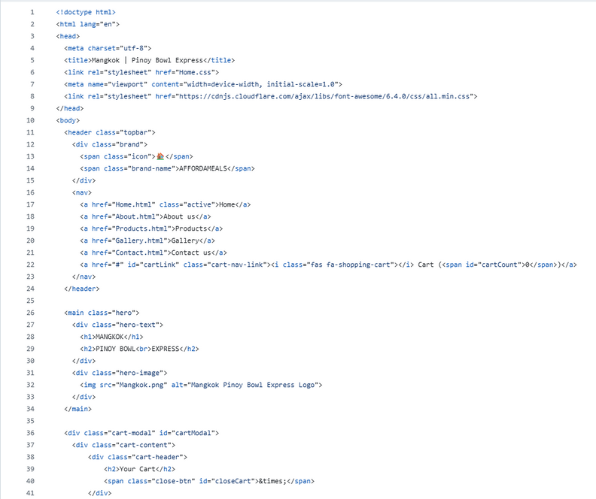
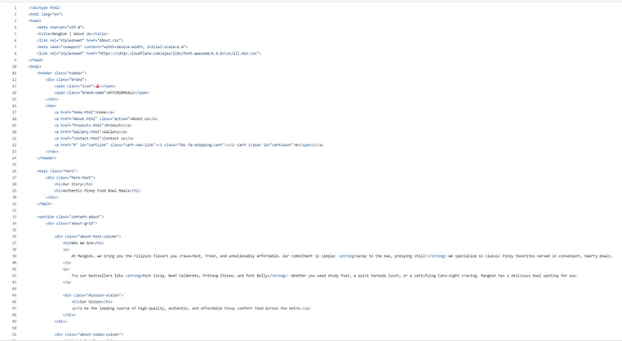

System Architecture
FRONTEND LAYER
Consists of:
Web browser (Interface)
Login/Signup UI
Store UI (Store and Cart)
Contact UI (Contact Form)
All are written in CSS

Slide 4
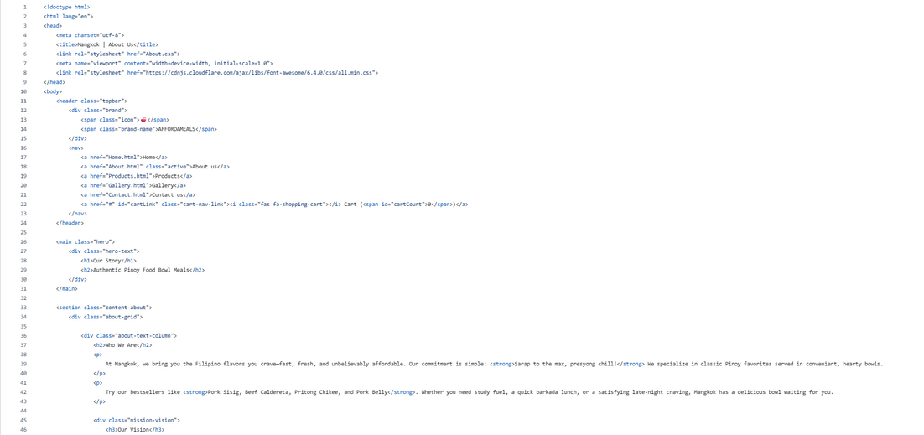
System Architecture
FRONTEND LAYER
Consists of:
Web browser (Interface)
Login/Signup UI
Store UI (Store and Cart)
Contact UI (Contact Form)
All are written in CSS

Slide 5
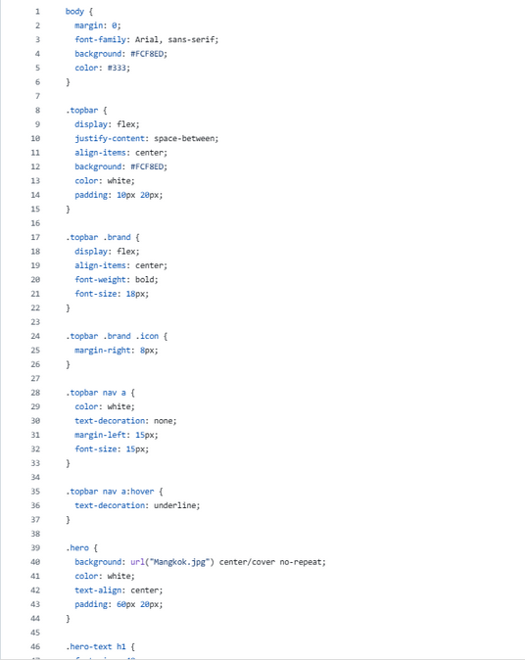
System Architecture
FRONTEND LAYER
Consists of:
Web browser (Interface)
Login/Signup UI
Store UI (Store and Cart)
Contact UI (Contact Form)
All are written in CSS

Slide 6
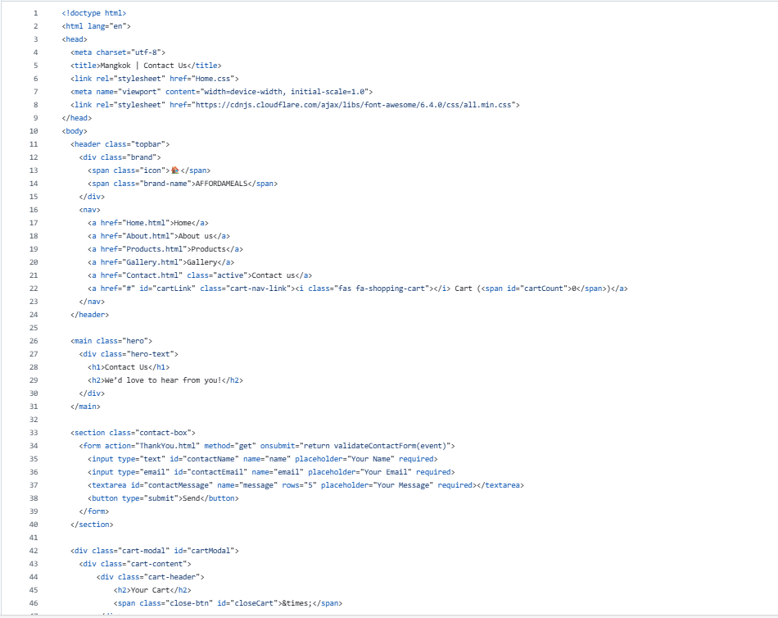
System Architecture
FRONTEND LAYER
Consists of:
Web browser (Interface)
Login/Signup UI
Store UI (Store and Cart)
Contact UI (Contact Form)
All are written in CSS

Slide 7
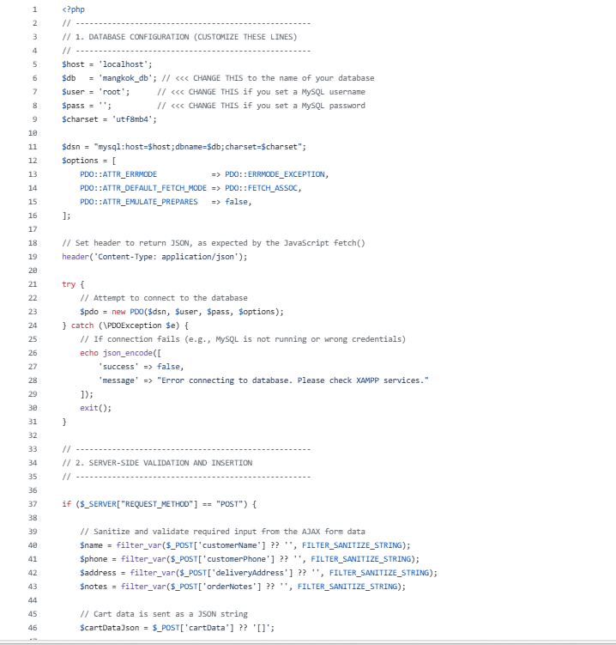
System Architecture
BACKEND LAYER
Consists of:
Product, Food
Order Service
API Gateway/Server

Slide 8
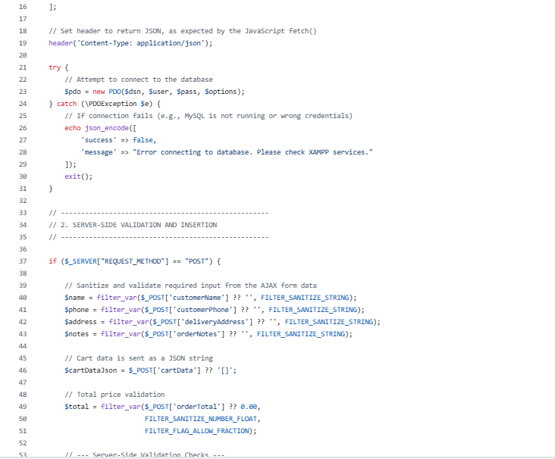
System Architecture
BACKEND LAYER
Consists of:
Product, Food
Order Service
API Gateway/Server

Slide 9
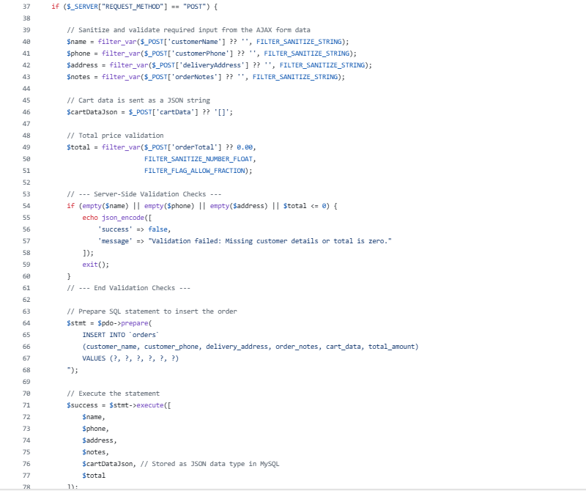
System Architecture
BACKEND LAYER
Consists of:
Product, Food
Order Service
API Gateway/Server

Slide 10
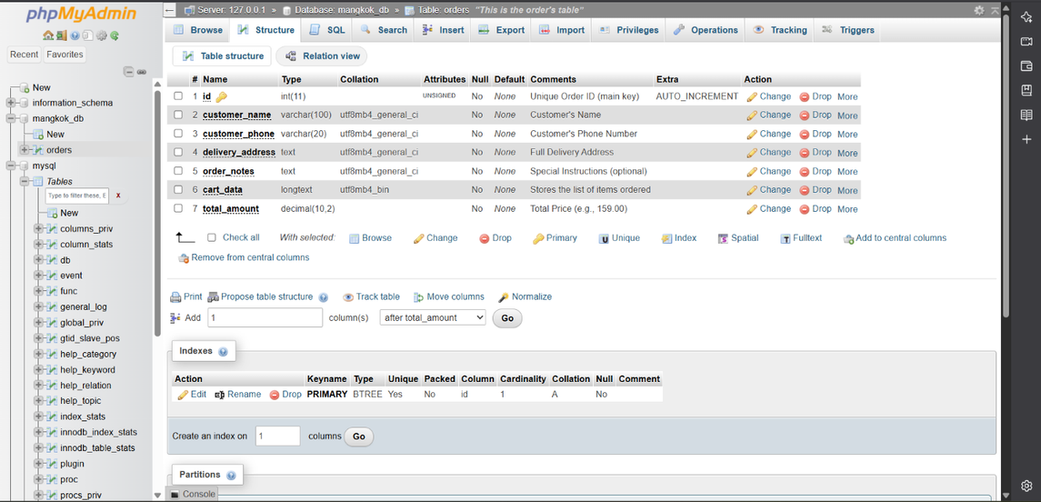
System Architecture
DATABASE LAYER
Consists of:
Data Storage
User Information
Files

Slide 11
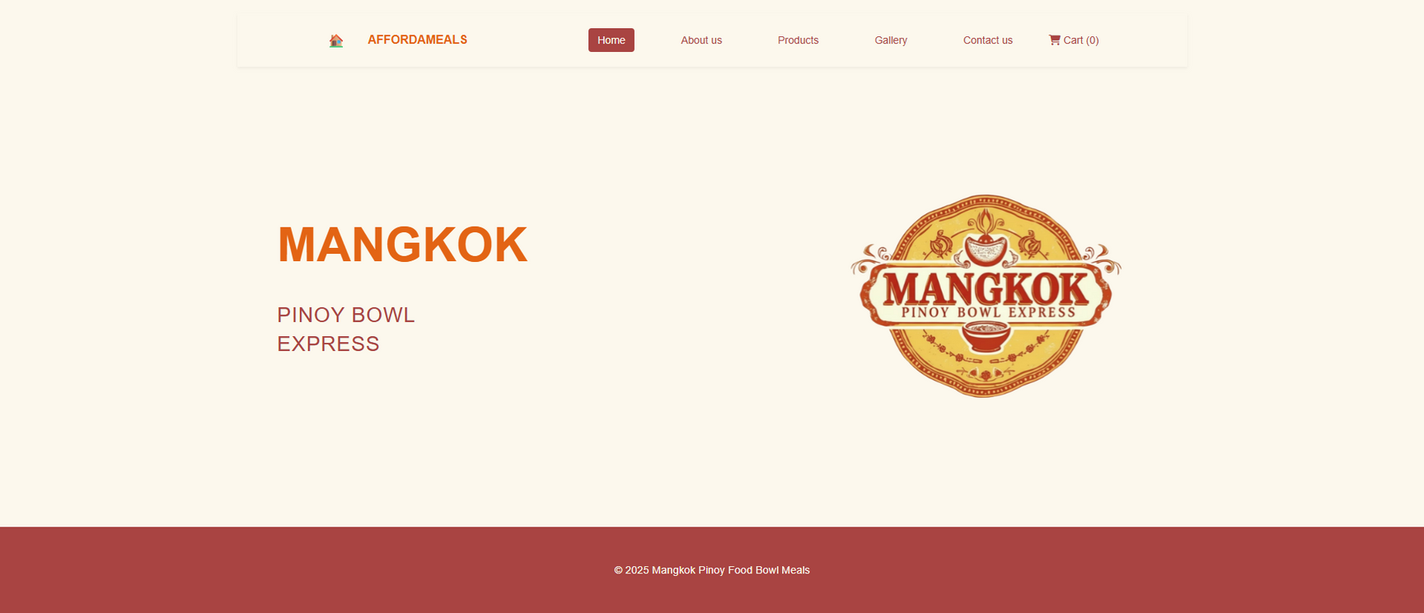
System Storyboard

Slide 12
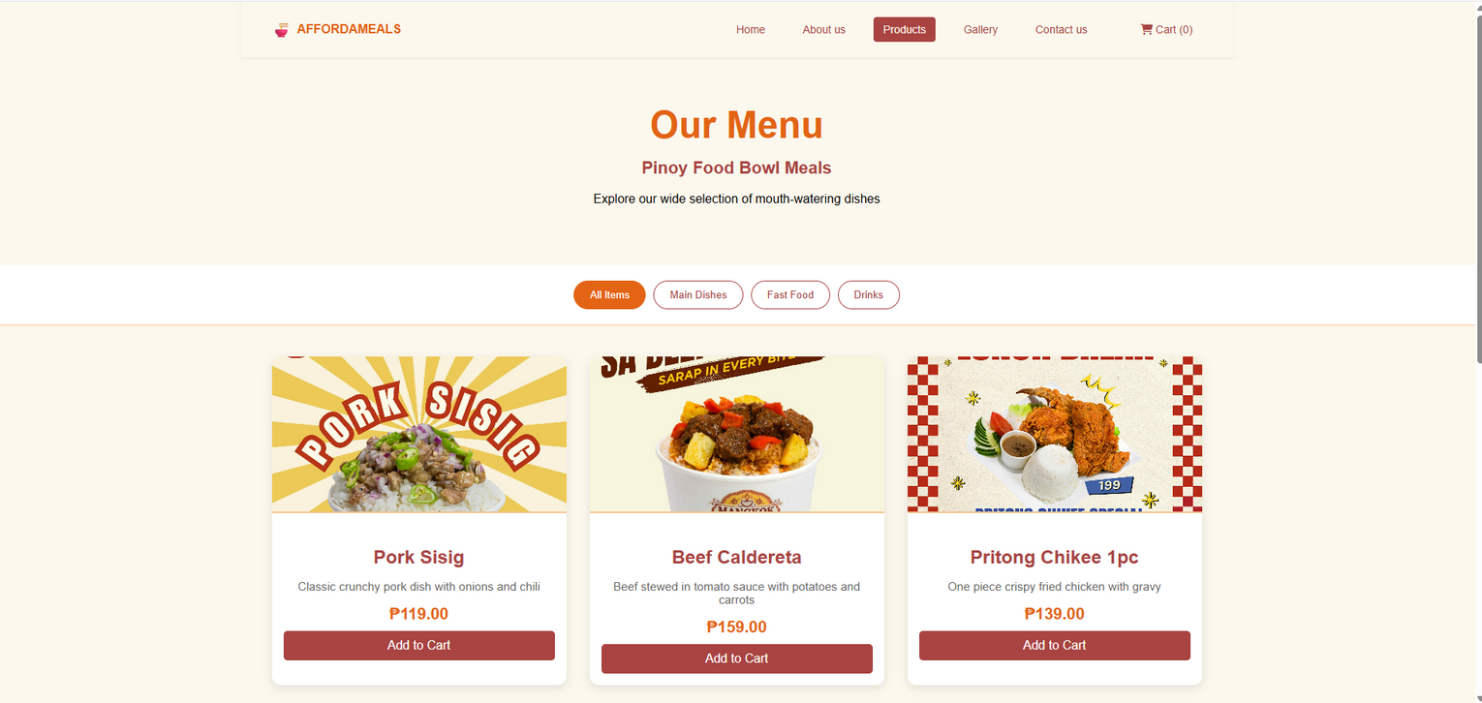
System Storyboard

Slide 13
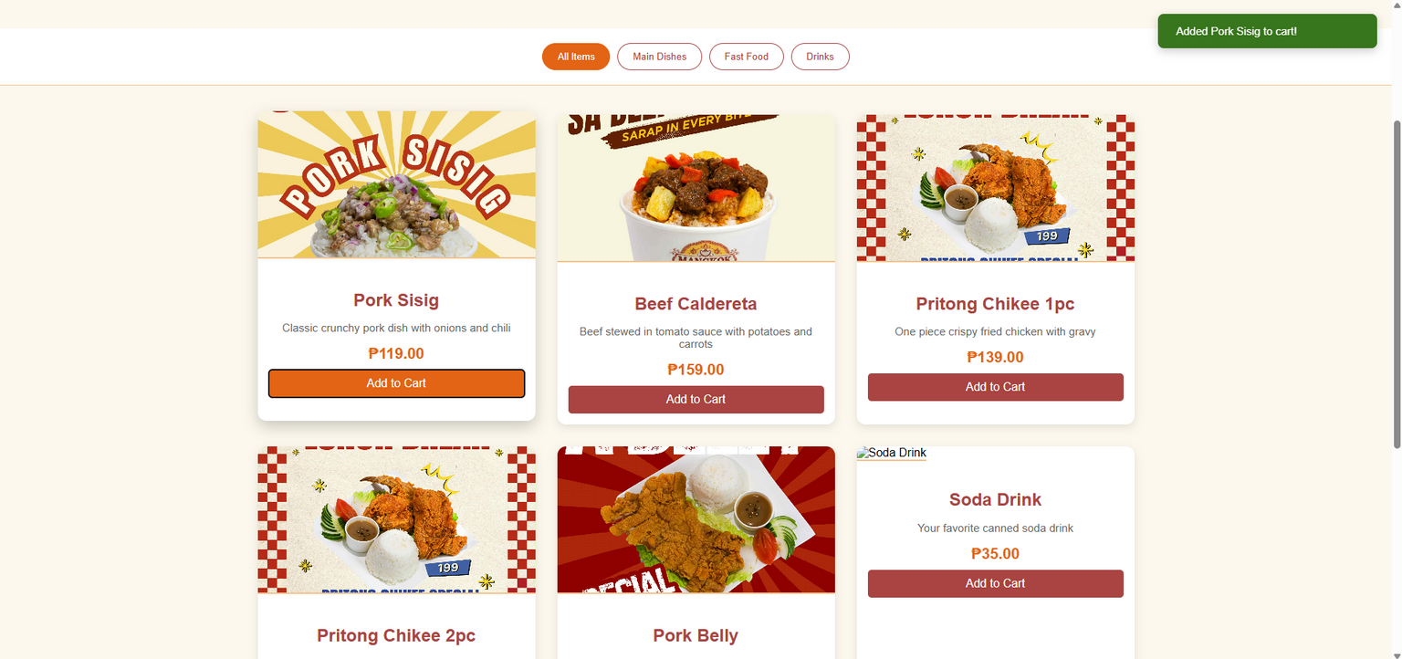
System Storyboard

Slide 14
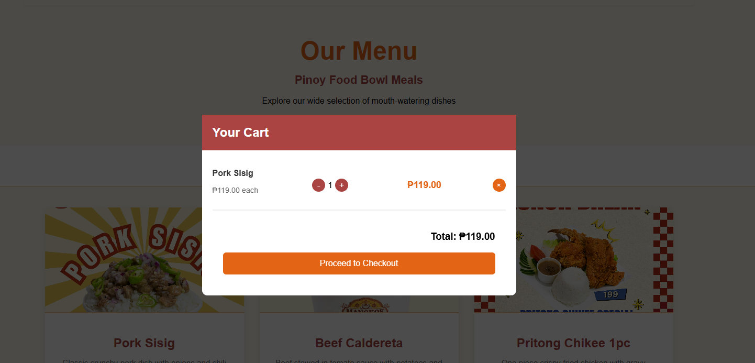
System Storyboard

Slide 15
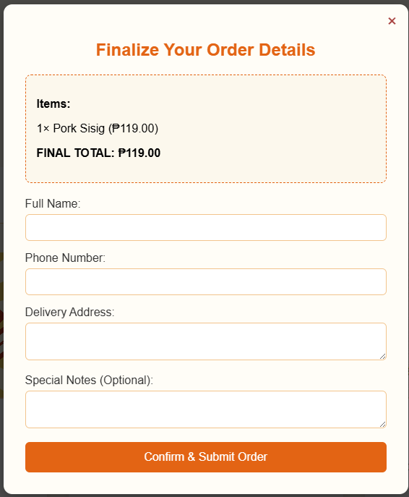
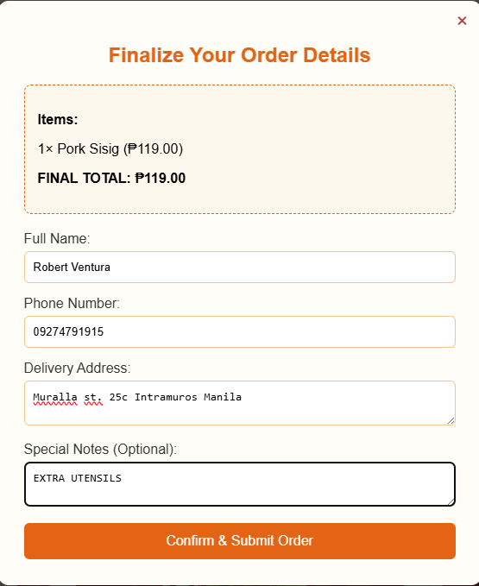
System Storyboard

Slide 16
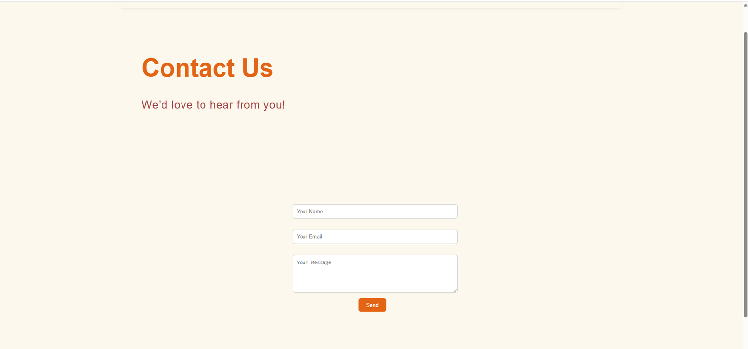
System Storyboard

Slide 17
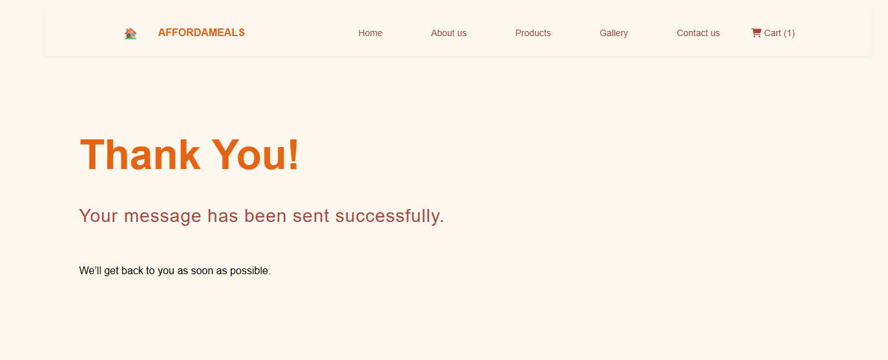
System Storyboard

Slide 18
Thank
You

