Slide 1

Panic Alarm Circuit
Presented by:
Dipra Kar : 22-46336-1
MD. Arafat Islam : 22-46436-1
Shreya Chakraborty : 23-51756-2
MD. Fahad Islam Togor : 23-50688-1 Fuad Hasan : 23-51947-2

Slide 2

What is a Panic Alarm?

Slide 3

Main aim of the project

Slide 4

Component List
1. 555 Timer IC – 1
2. Transistor BC547 – 1
3. Buzzer (6-12V) – 1
4. LED – 1
5. Tactile switch – 2
6. 9V Battery with holder – 1.
7. Resistors (10kὨ – 3; 1KὨ - 2)
8. Ceramic capacitor(0.01uF) – 1
9. ESP8266 CH340 NodeMCU Wifi Module Lua V3
10. Breadboard

Slide 5

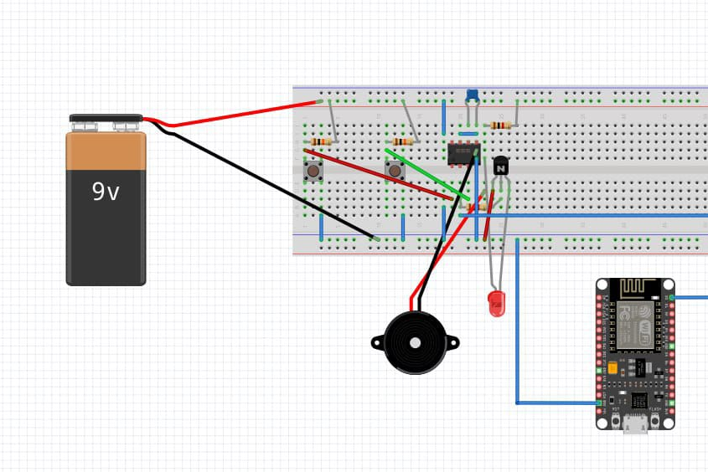
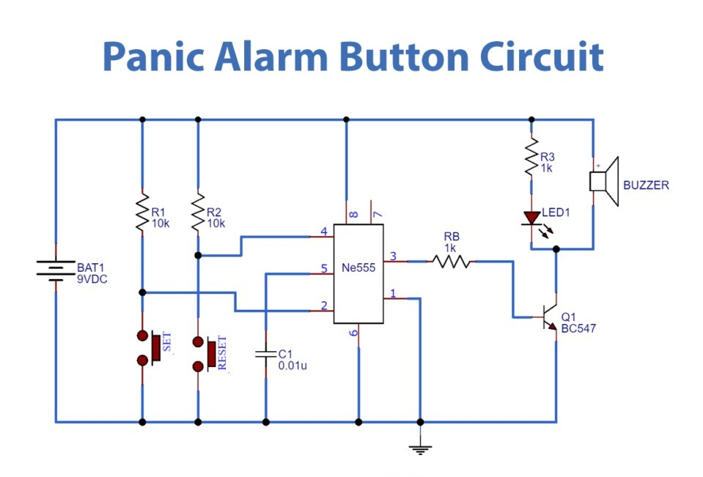
Circuit Diagram

Slide 6
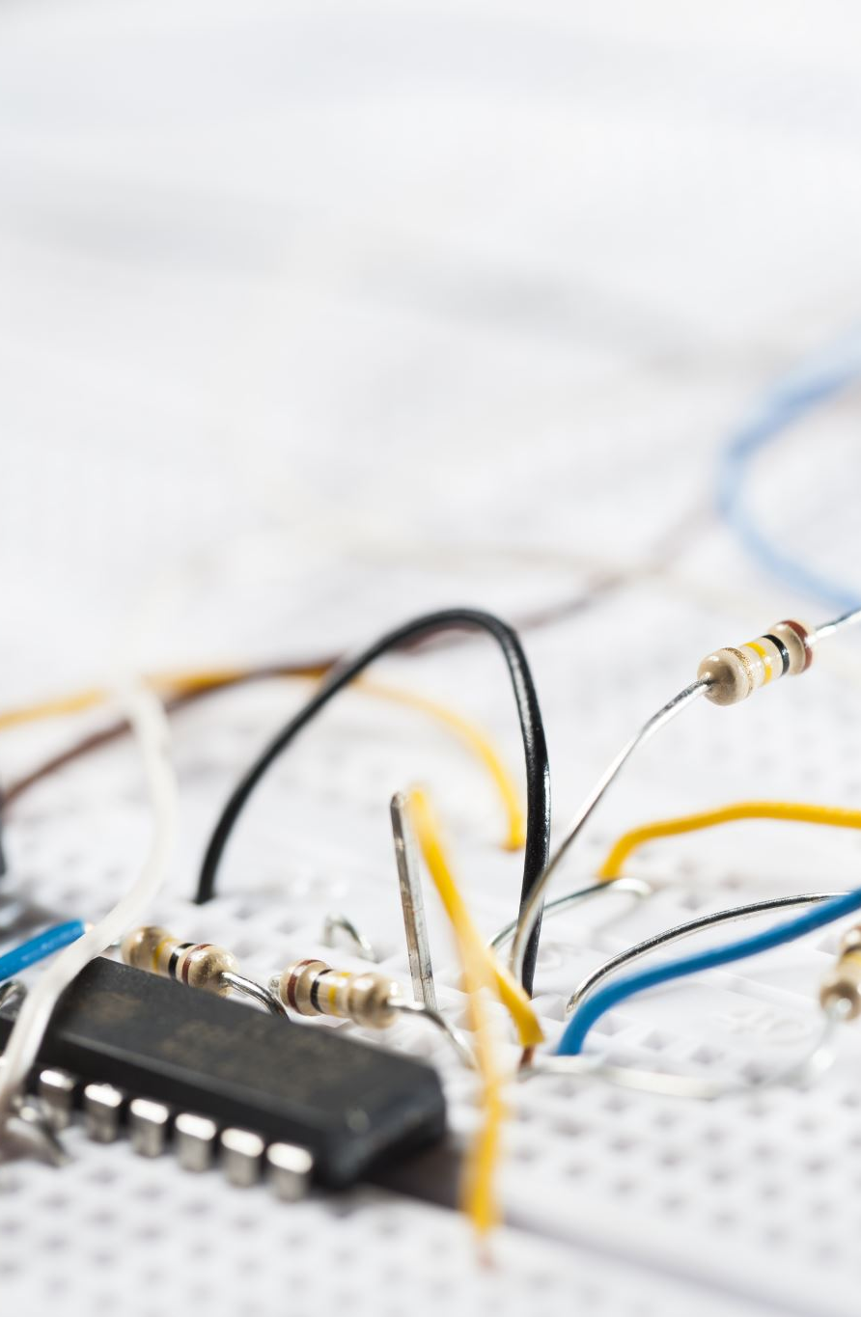
Working Principle The panic alarm circuit, centered around a 555 timer IC, operates on a simple principle. When the "SET" button is pressed, it triggers the 555 timer, causing it to enter an unstable mode and begin oscillating. This oscillation generates a continuous series of electrical pulses at the 555 timer's output. This output is then connected to an LED and a buzzer via a transistor. The continuous pulses cause the LED to blink and the buzzer to sound, providing a visual and audible alarm. To stop the alarm, a "RESET" button is pressed, which forces the 555 timer back into a stable state, thereby stopping the oscillations and deactivating both the LED and the buzzer

Slide 7
Applications
Personal safety alarms
Public emergency systems
Bank or shop security alerts
Used in homes for emergency alerts.
Useful in elderly care to request quick help.
Helpful in schools or hospitals for instant emergency notification.
Can be placed at security desks or entrances to raise alerts quickly

Slide 8
Advantages
Low-cost and easy to build.
Uses simple electronic components (555 IC, push button, buzzer).
Can send remote alerts using NodeMCU via Wi-Fi.
Works instantly when the button is pressed.
Can be powered with a simple 9V battery.

Slide 9

Limitations
May not work if the battery is low or dead.No backup alert if NodeMCU or Wi-Fi fails.
Considering the size of our object that we are proposing, the durability and impact bearable capacities of the object could be compromised.

Slide 10

Future Scope
Panic alarm have been for many years been widely used for a range of security risks across a variety of industries. Traditionally panic button are fixed devices either liked to monitoring stations or emergency services, but the functionality, flexibility and mobility can be enhanced.
Smart panic alarm system can be worn discreetly, making them fully mobile. They can include GPS tracking technology allowing ‘arrived safety’ messages to be sent in a single click. If an arrival notification is not received at the expected time an alert is sent to the pre-assigned contact. They can also be used to trigger flashlights, open or close curtains or blinds, can lock exit doors. So any safety measures like this can be integrated with the smart panic alarm system.

Slide 11

Conclusion
In conclusion, this project successfully outlines the design and implementation of a simple, low-cost, and portable panic alarm. By utilizing a 555 timer IC, the circuit effectively provides both visual (LED) and audible (buzzer) alerts upon activation, with a clear mechanism for both initiating and resetting the alarm. This type of device offers a quick and discreet method for individuals to summon help in emergencies, making it a valuable tool for personal safety and awareness in various environments

