Slide 1
BA CUSTOMER BOOKING
Dipesh Patel

Slide 2
Model Evaluation Summary
We evaluated three models to predict the booking completion:
1. Logistic Regression
2. Random Forest
3. Gradient Boosting
The performance metrics for each model are as follows:
Model | Accuracy | Precision | Recall | F1 Score
Logistic Regression | 0.8495 | 0.4816 | 0.0723 | 0.1256
Random Forest | 0.8519 | 0.5189 | 0.1308 | 0.2087
Gradient Boosting | 0.8507 | 0.5205 | 0.0265 | 0.0503

Slide 3
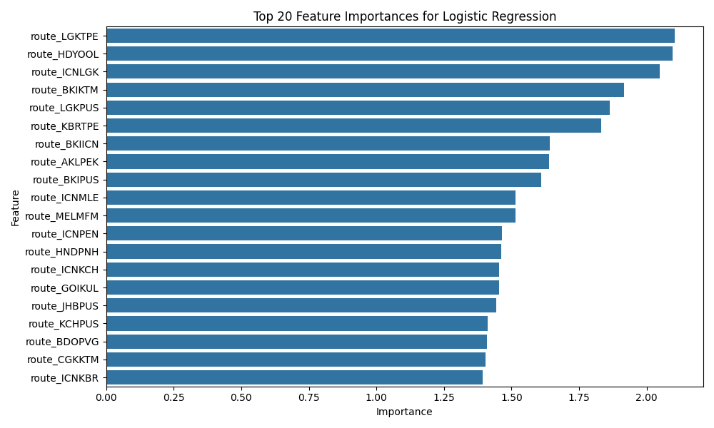
Feature Importance - Logistic Regression

Slide 4
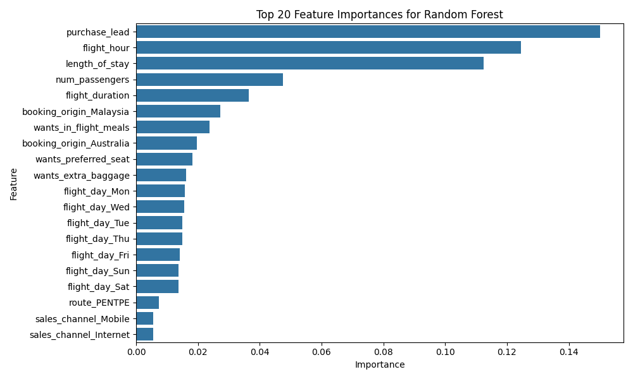
Feature Importance - Random Forest

Slide 5
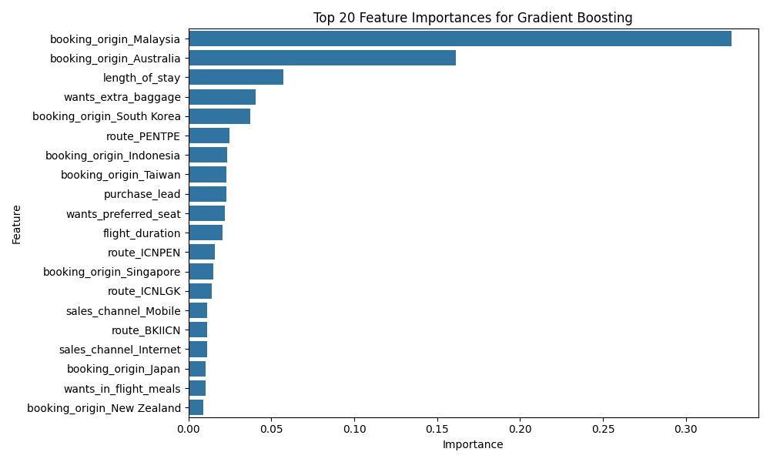
Feature Importance - Gradient Boosting

