Slide 1

World Fertility Rate Analysis
Group 1
Debarati saha
Dipsa Prusty
GAYATHRI KILARI RAVINDRANATH

Slide 2
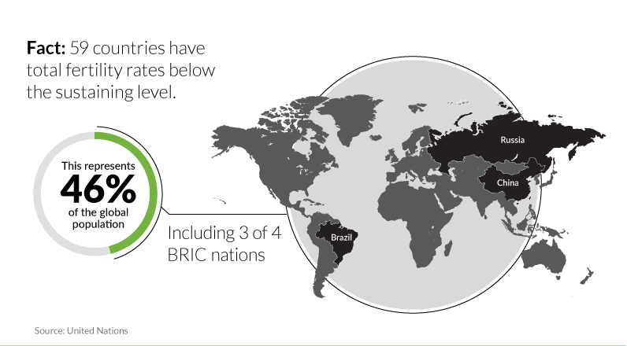
Introduction
The Total Fertility Rate (TFR) of a population is the average number of children that would be born to a woman over her lifetime. Fertility rates, whether high or low, impact economic growth, cultural stability and more.
In most developed countries, fertility rate has fallen below the necessary "replacement" fertility rate (about 2.1), whereas in less developed countries the fertility rate is higher that the replacement rate (about 2.3). At both ends, there are potential benefits and worries.
Notes:
The replacement rate is the number of children each woman needs to have to maintain current population levels or what is known as zero population growth for her and her partner.
The United States had a fertility rate of 1.88 in 2012. In Japan, women have a fertility rate of 1.39. from Niger's 6.89 down to Singapore's 0.8, based on 2014 estimates.
When fertility falls, a generation is smaller than the one that came before and struggles to support retirees. At risk is the ability to maintain their economies, pay pensions, handle health care demands and more.

Slide 3

Goals and Objectives
The goal of our project is to determine the factors affecting total fertility rate across countries worldwide, which can be used to address raising awareness at an individual, family, community, social and healthcare level.
Our objective is to determine how different controllable factors like Govt expenditure on health care, tobacco use, air pollution, mortality rate, etc. affect the overall fertility rate of different countries and to recommend corrective measures based on the analysis, in order to bring the fertility rate closer to the fertility replacement rate.

Slide 4
Data Sources
The dataset contains fertility rate and the factors affecting it for 179 countries for the year 2005
Source 1 : https://www.kaggle.com/census/international-data
Source 2: https://www.gapminder.org/data/
Number of variables in the dataset : 17
Number of records in the dataset : 179
Unique key for the dataset : county and year column
Used query in excel to perform inner join on the above datasets
Notes:
All these datasets had country and year column. We used combination of country and year column as the unique key.
We next merged all the above datasets using inner join .
This resulted in a dataset which had values for all the years ranging from 1950 to 2015.We filtered the dataset 1995-2015. Finally we selected the year 2005 as it had more data and gave us a wider window to analyze our dataset

Slide 5
Data dictionary
Sl. No | Variable Name | Description
1. | Country | Name of the Country
2. | Classification | Country classification based on Human Development Index(HDI)
3. | Alcohol_Consumption | Prevalence of alcohol consumption among adults (>=15 years) (%) female
4. | CO2 Emissions | Total amount of CO2 in 1000 metric tons emitted from the consumption of all kinds of fossil-fuels
5. | health_spndg_of_total_gov_spndg | General government expenditure on health as percentage of total government expenditure
Notes:
The Human Development Index (HDI) is a composite statistic of life expectancy, education, and per capita income indicators, which are used to rank countries into four tiers of human development which are Developed, least developed, developing , transition

Slide 6
Data dictionary(contd..)
Sl. No | Variable Name | Description
6. | Improved_sanitation_rural_per | Proportion of the population using improved sanitation facilities, rural
7. | Improved_sanitation_total_per | Proportion of the population using improved sanitation facilities, total
8. | Improved_water_source_total_per | Proportion of the population using improved drinking water sources, total
9. | Improved_water_source_rural_per | Proportion of the population using improved drinking water sources, rural
10. | Life Expectancy Female | Female life expectancy at birth (years)
11. | Infant Mortality | infant deaths per 1,000 population

Slide 7
Data dictionary(contd..)
Sl. No | Variable Name | Description
12. | Mortality Rate Under 5 | Under-5 mortality rate - probability of dying between ages 0 and 5
13. | Sex Ratio At Birth | Sex ratio at birth (male births per female birth)
14. | BMI | The mean BMI (Body Mass Index) of the female population, counted in kilogram per square meter
15. | Female_Above15_employed | Percentage of female population, age above 15, that has been employed during the given year.
16. | Tobacco_use | Prevalence of current tobacco use among adults (>=15 years) (%) female
17. | Total Fertility Rate | Lifetime births per woman

Slide 8
Data Preview

Slide 9
Exploration and Summary of Dataset

Slide 10
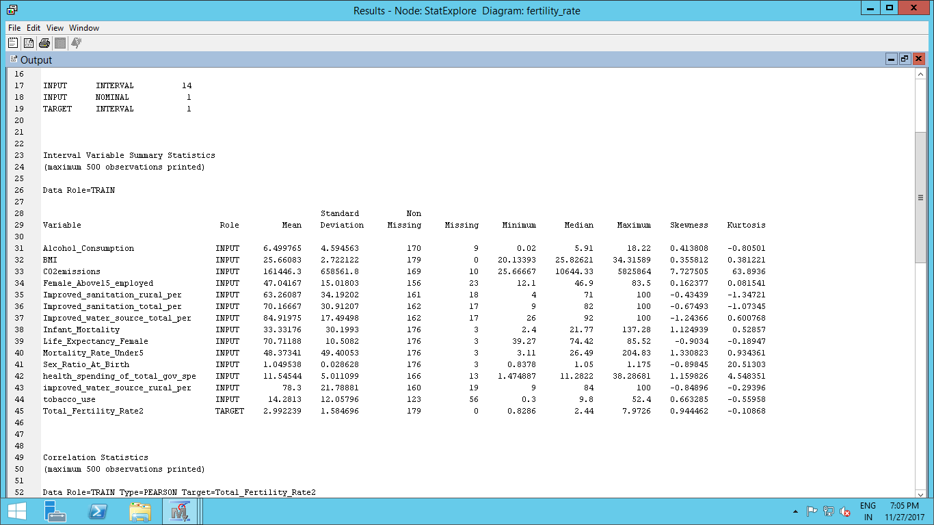
Descriptive statistics (E Miner)

Slide 11
Correlation Matrix

Slide 12
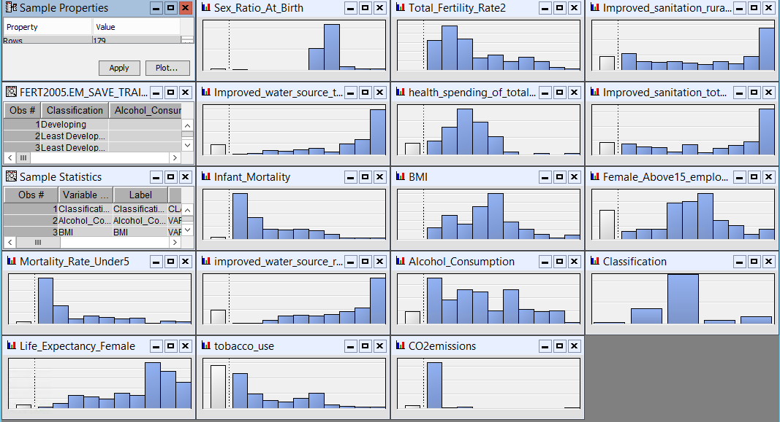
Histograms of the variables

Slide 13
Outliers, Transformations and Missing values

Slide 14
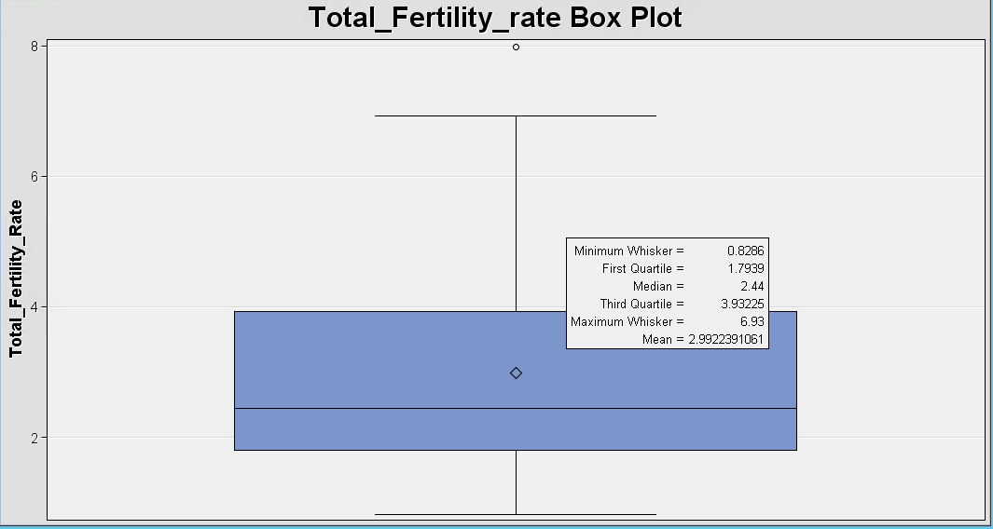
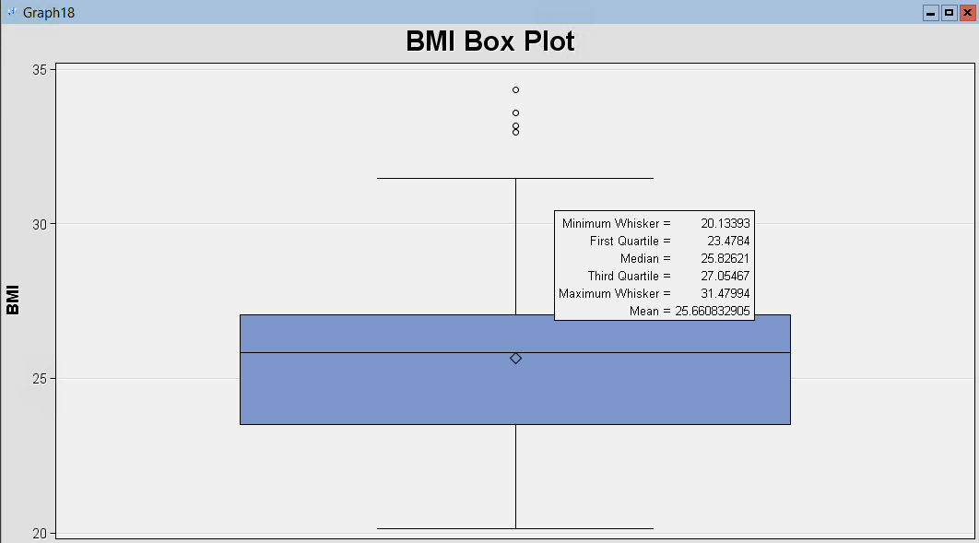
Box plots of predictors

Slide 15
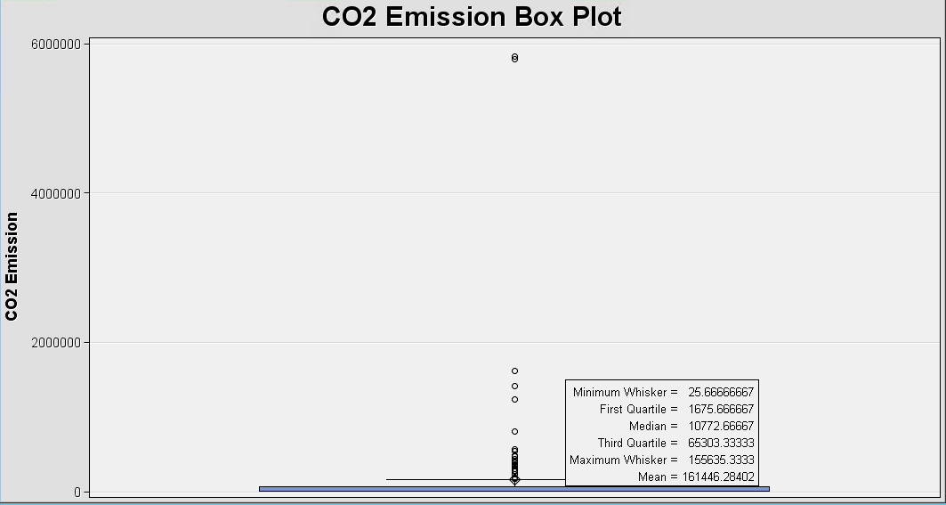
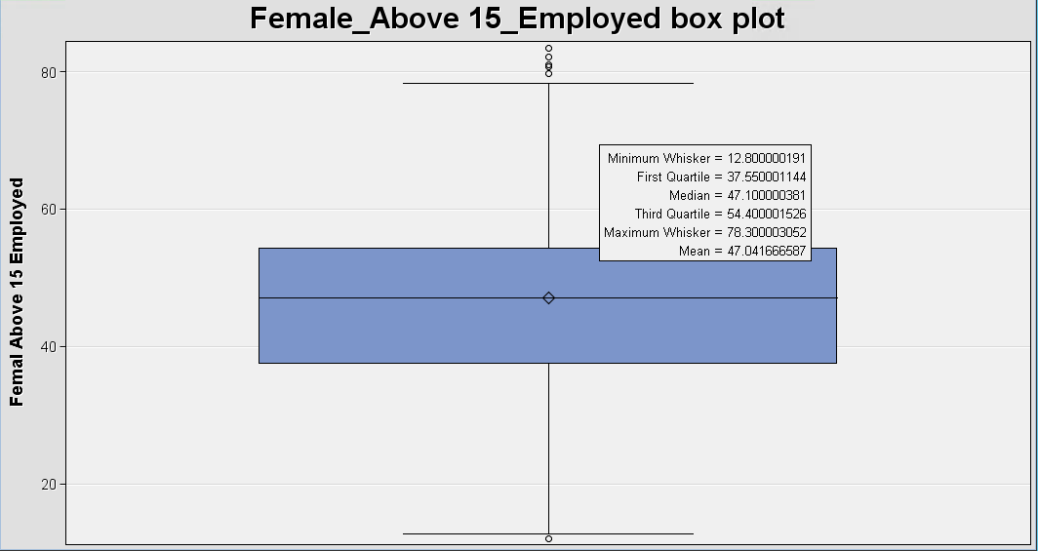
Box plots of predictors

Slide 16
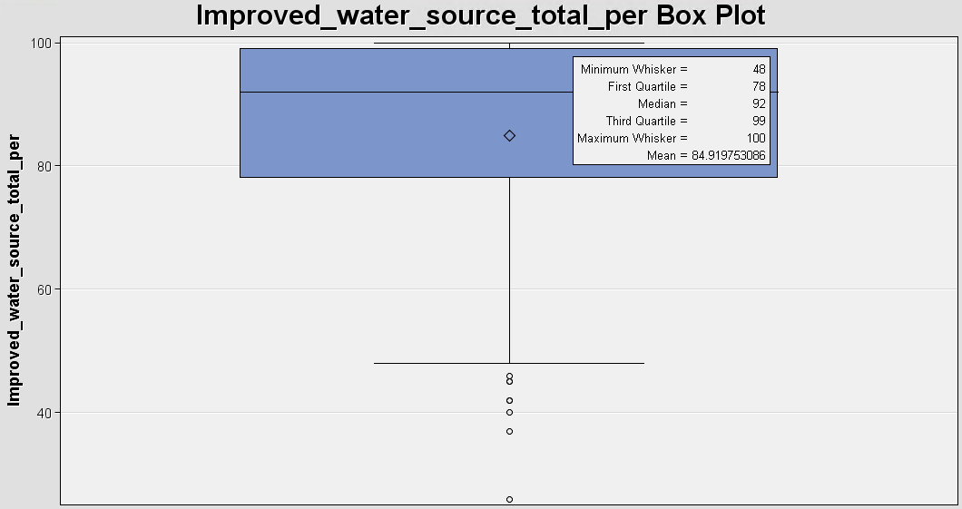
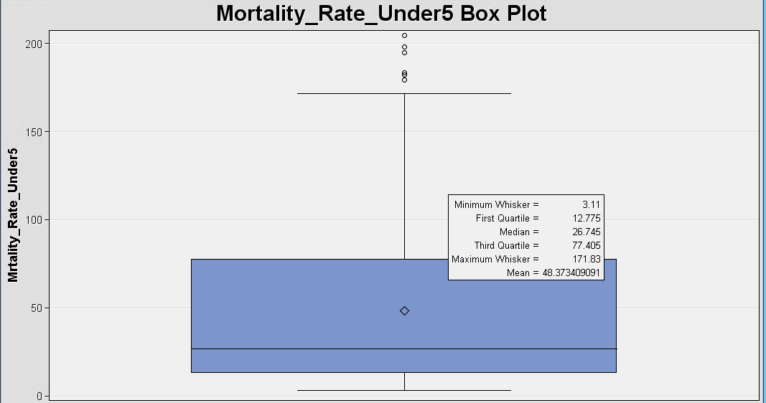
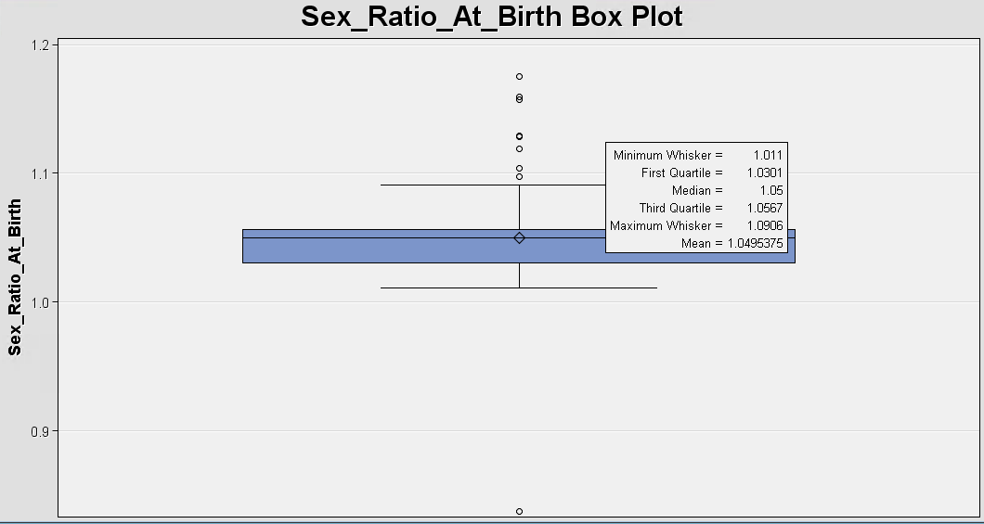
Box plots of predictors

Slide 17
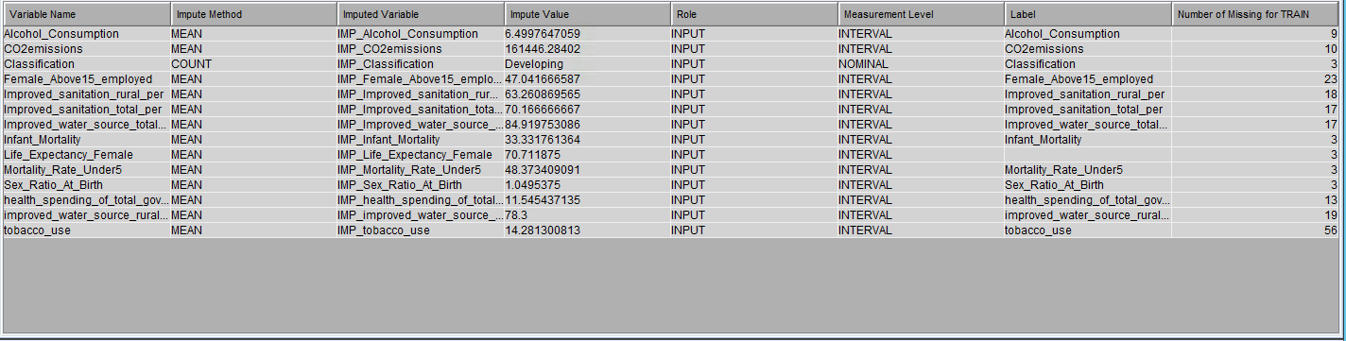
Missing values

Slide 18
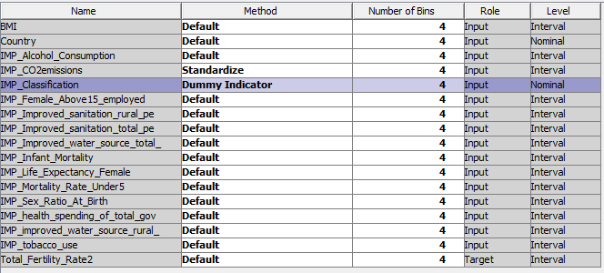
Transformation - Standardization

Slide 19
Data Modeling

Slide 20
Regression Analysis
Model that is used to fit a linear relationship between a dependent variable and a set of predictors.
Target variable is continuous so we want to know the effect (causal effect) of the input parameters on the target variable.
Explanatory modeling or Causal analysis - We want to understand the relationship between our target variable and each of the predictor/input variables
Association
Strength

Slide 21
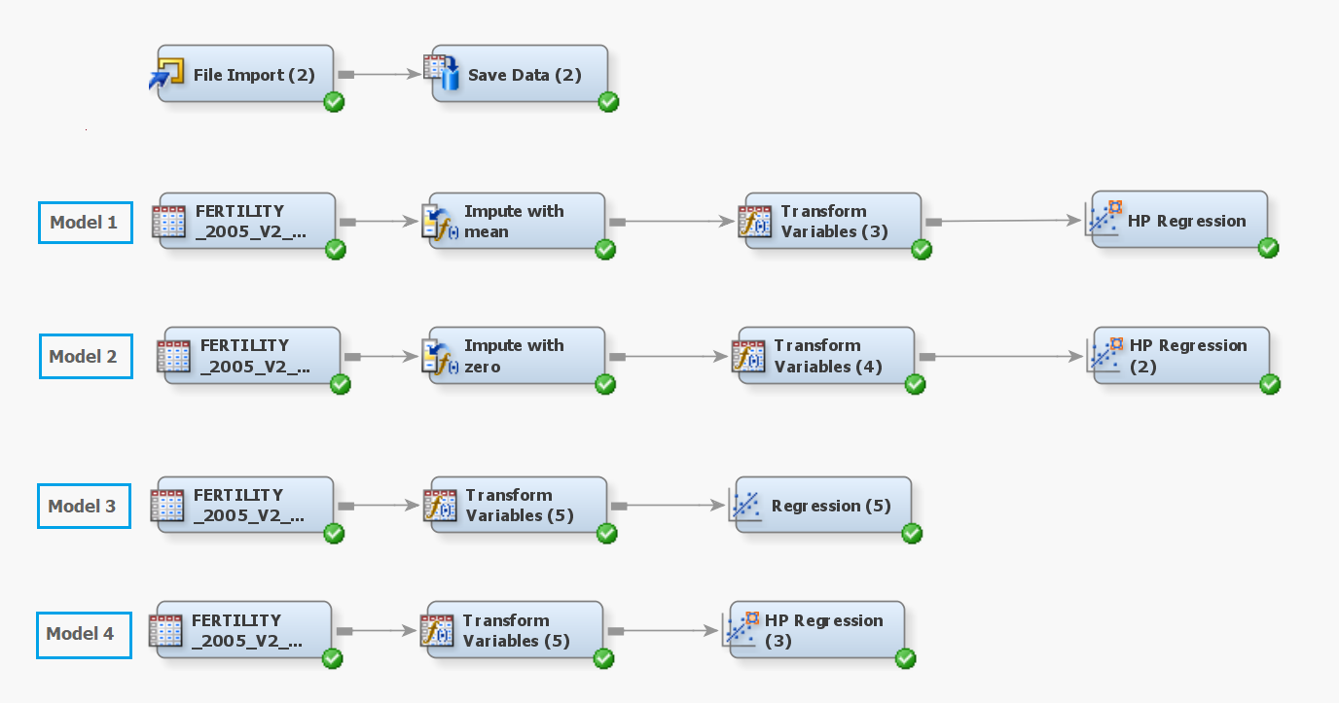
Different Regression Models Created on the Dataset

Slide 22
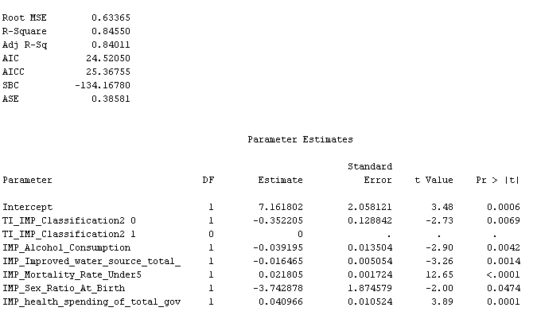
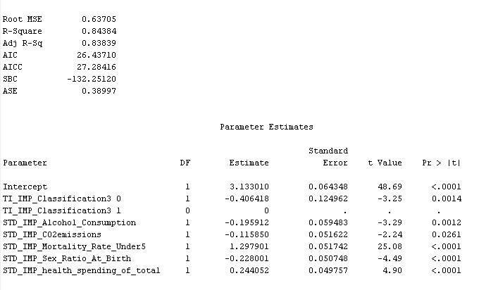
Evaluate Model Performance
Model 1
Model 2
Notes:
Model1:Standardized CO2 emissions only, Impute with Mean, HP Forward Regression
Adjusted R2 is more than the previous model which was imputed with 0.
Model2:Developing countries have 40.6% more fertility rate than other countries
In countries where fertility rate is less than replacement rate, if the Government spending towards Healthcare increases then fertility rate can be reduced based on the estimates.

Slide 23
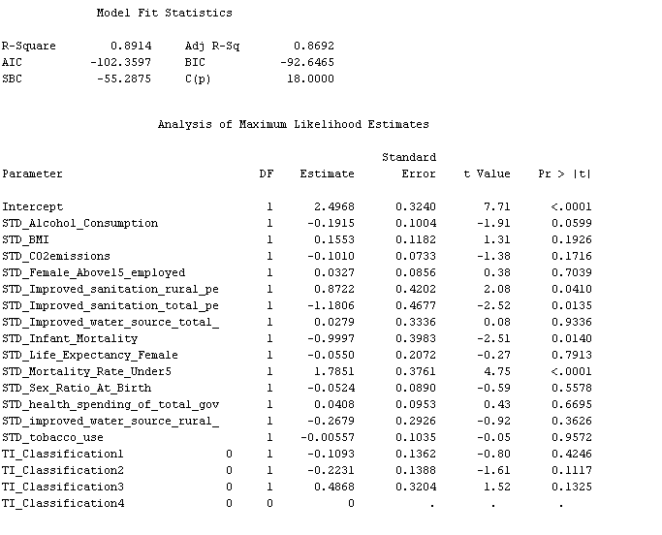
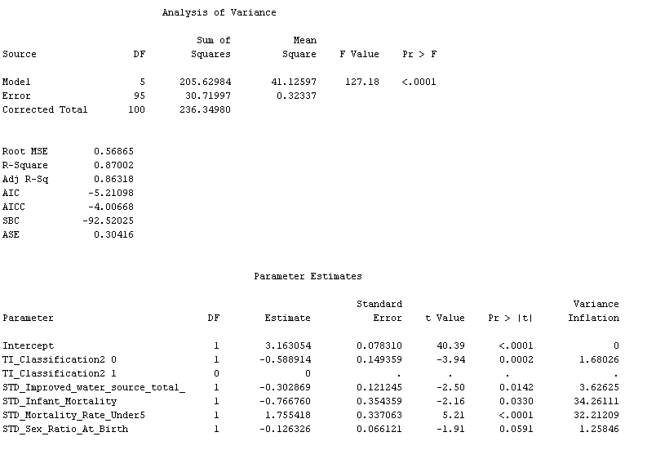
Evaluate Model Performance (Cont’d)
Model 3
Model 4
Notes:
Model3:5 significant variables
Marginal reduction in Adjusted R Square value when compared to Default regression
Model4:Highest Adjusted R square when compared to all models
But the number of significant variables is less
Improved water sanitation coefficients are positive for rural and negative for total

Slide 24
Final Model

Slide 25

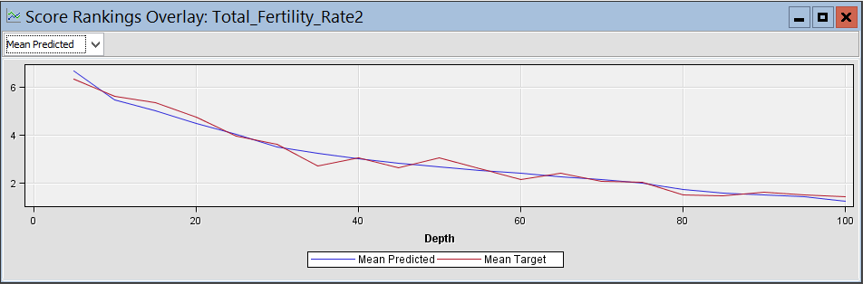
Model 1

Slide 26
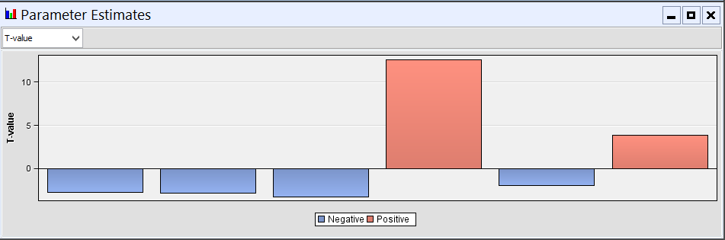
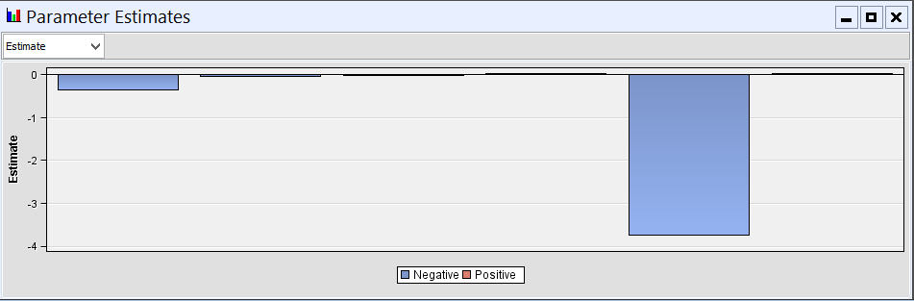
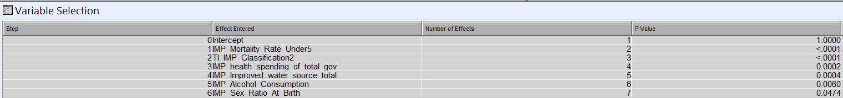
Model 1

Slide 27
Why we chose Model1
More significant variables than the Default Regression models
Missing values have been imputed
Standardized only ‘CO2 emissions’
Forward selection method gave better results since we had a large number of potential independent variables

Slide 28
Strengths of the model
Predictors account for 84.01% variation of the target variable
Forward regression runs with only the significant variables in the dataset. Once a variable is in the model, it remains in the model.
‘health_spending_of_total_govt_spending’ and ‘Mortality_Rate_Under5’ affects the Fertility rate positively. This aids in recommendations based on our model.

Slide 29
Limitations of the model
There maybe other potential predictors which we have not considered
No direct relationship between classification of countries based on economic development and the fertility rate. Clustering may have helped in segregating and finding a relationship.
Fertility rate has a high negative correlation with ‘Sex Ratio at birth’. This means in developing countries, more number of female child birth will increase the fertility rate further which is a social concern.
Fertility decreases when the ‘Improved_Sanitation_total_per’ improves. In developed countries, we cannot decrease the sanitation facilities in a country in order to improve the fertility rate.

Slide 30
Recommendations
Alcohol consumption is negatively correlated with the fertility rate. For countries where fertility rate is less, necessary measures should be taken to reduce the alcohol consumption among women
In developing countries, the fertility rate is 35.22% higher than in developed, in transition or least developed countries. A suggestive measure would be to spread awareness on birth control measures.
Based on our findings, we recommend countries world wide to implement policies to bring fertility rate closer to replacement rate

Slide 31
How can the model be improved
Include more variables
Get data for major cities worldwide
Analyze data for recent years to increase accuracy and relevance of the model

Slide 32
Questions?

