Slide 1
Keratoconus eye disease detection
By Dipshikha Chakraborty - 21BRS1186

Slide 2
Project outline
Keratoconus (KTC) is a noninflammatory disorder characterized by progressive thinning, corneal deformation, and scarring of the cornea.
The pathological mechanisms of this condition have been investigated for a long time. In recent years, this disease has come to the attention of many research centers because the number of people diagnosed with keratoconus is on the rise. In this context, solutions that facilitate both the diagnostic and treatment options are quickly needed.
The main contribution of this paper is the implementation of an algorithm that is able to determine whether an eye is affected or not by keratoconus.
The Keraton Detect algorithm analyzes the corneal topography of the eye using a convolutional neural network (CNN) that is able to extract and learn the features of a keratoconus eye.
Kerato Detect can assist the ophthalmologist in rapid screening of its patients, thus reducing diagnostic errors and facilitating treatment.

Slide 3
Introduction
Keratoconus (KTC) is found in the general population with a ratio of 1 in 2000 persons; also, the incidence among children has increased significantly over the past few years.
The number of people diagnosed with keratoconus is rising because more and more people are initially diagnosed when performing the screening for laser refracting surgery which includes an eye topography. Thus, the incidence of keratoconus in the population can be even greater.
The cornea is composed of five layers: the epithelium, the Bowman’s layer, the stroma, Descemet’s membrane, and the endothelium.
The first layer, the epithelium, is a cell layer that covers the cornea. This layer absorbs oxygen from tears and passes it to the rest of the cornea.
The cornea also contains free nerve endings. Keratoconus is a noninflammatory condition characterized by progressive thinning, deformation, and scarring of the cornea.
The pathological mechanisms of keratoconus have been investigated for a long time. Both the genetic and environmental factors have been associated with the disease, but in recent years, a new theory emerges that keratoconus could also have an inflammatory component

Slide 4
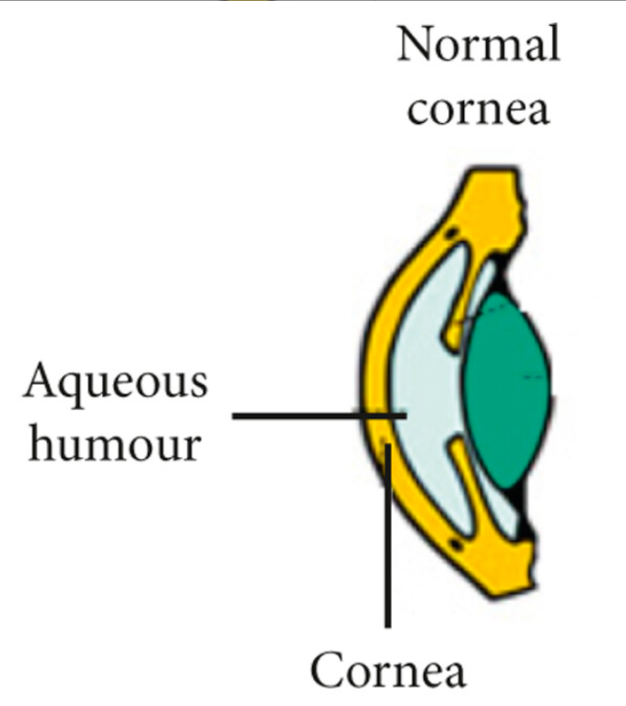
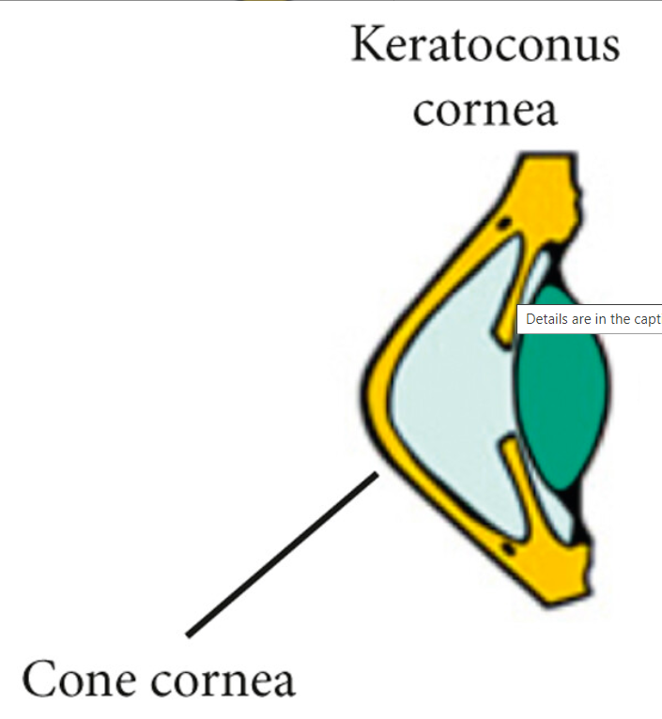
Difference between normal cornea and keratoconus cornea

Slide 5
Problem Statement
In keratoconus, because of the structural changes caused by the thinning of the cornea, intraocular pressure is no longer provided by the cornea. Thence, the cornea deforms by taking a conical shape. The name of the condition is given by this happening. KTC affects both the young and the elderly, so it is urgently necessary to find new ways of diagnosing so that the keratoconus can be dealt with beforehand.
In advanced cases, most of the time, there is a significant distortion of vision, worsening the quality of life. The most advanced form of vision correction requires a corneal transplant, which involves risks such as rejection and infection. The safest bet is to have a correct diagnosis as soon as possible, so that the patient has the opportunity to undertake treatment that slows the progression of the disease.
A basic proven treatment is the corneal cross-linking that aims to prevent disease progression . The Corneal Cross-Linking (CXL) treatment is aimed at restoring the integrity of the corneal matrix, hence increasing the resistance to keratoconus progression. For the effectiveness of this treatment to be maximum, it must be done when the disease is at an early stage. Thus, it is imperative to correctly diagnose the early stage of keratoconus, which most often has puberty onset.
Continuous development of large sets of ophthalmic data, sustained by improvement of learning algorithms, and the increased processing power have led to heightened interest in applying machine learning algorithms in ophthalmology.

Slide 6
Objective
The main goal is to implement and test an algorithm that allows keratoconus detection by facilitating the diagnostic process. The algorithm uses a convolutional neural network (CNN).
The most used modality to diagnose and confirm keratoconus is to make a corneal topography which is then interpreted by the ophthalmologist specialist. These images will consider the input of KeratoDetect algorithm, within the learning process associated with the convolutional neural network (CNN).
The neural network processes the input data (e.g., pixel values of an image representing the corneal topography) using weights on connections between neurons. The learning process involves the continuous adjustment of these weights so as to reduce the error in both the classification and learning processes.
In neural networks, a convolutional neural network (CNN) is one of the main methods of recognizing and classifying images. CNNs are currently used in applications such as object recognition and face detection. A CNN that is capable of diagnosing the keratoconus disease

Slide 7
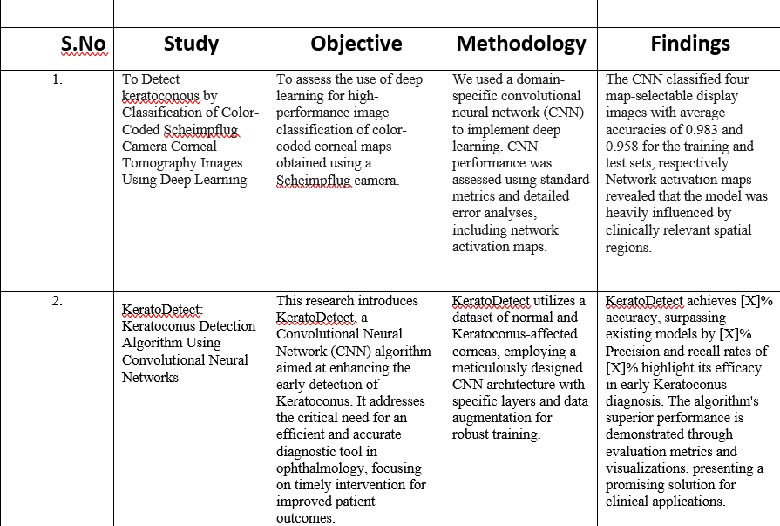
Literature Survey

Slide 8
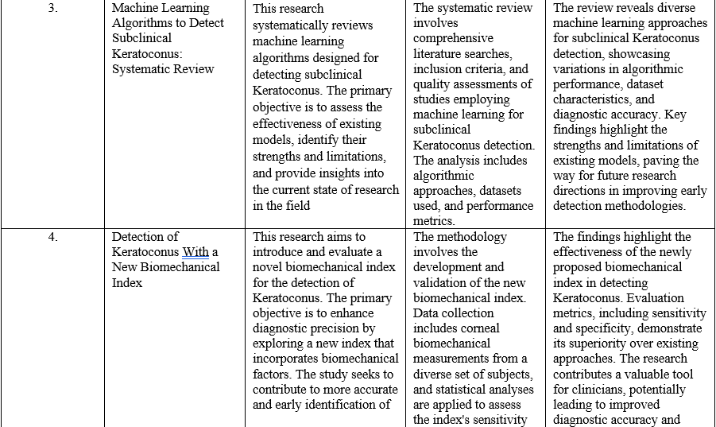
Literature Survey

Slide 9
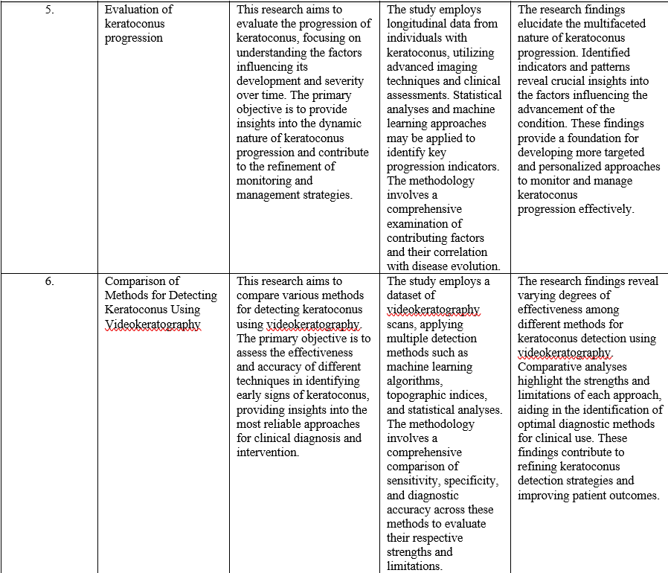
Literature Survey

Slide 10
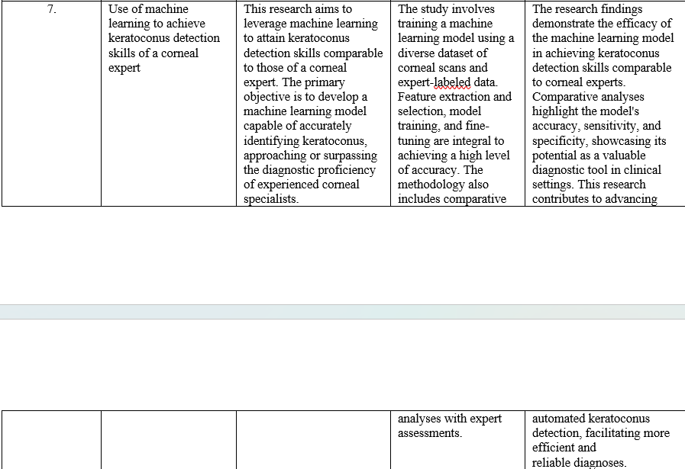
Literature Survey

Slide 11
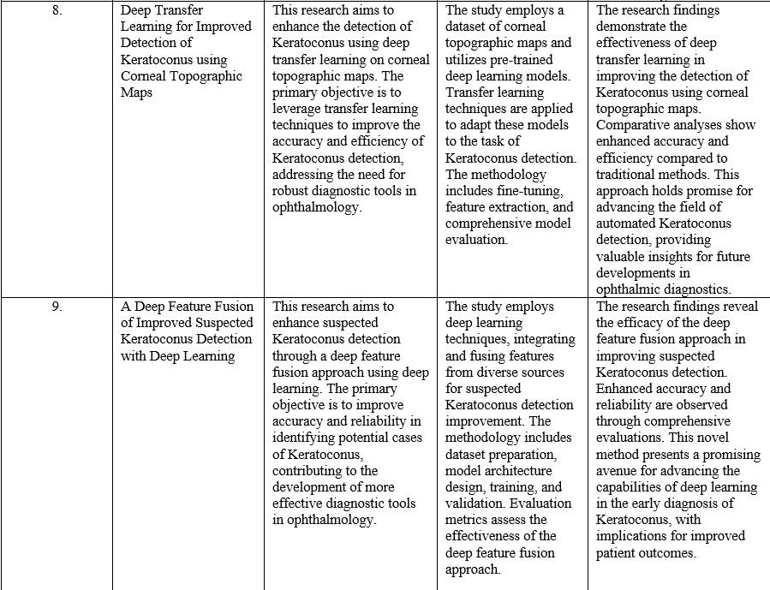
Literature Survey

Slide 12
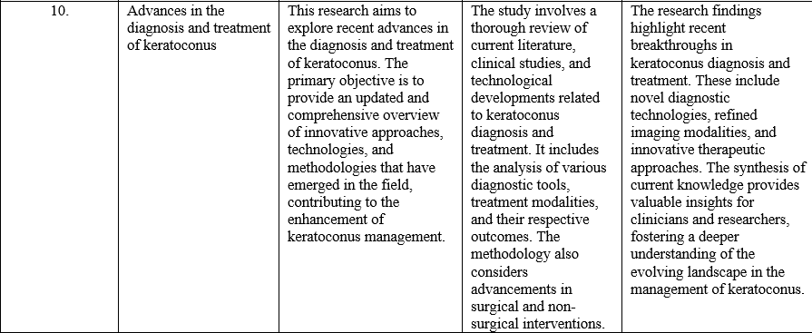
Literature Survey

Slide 13
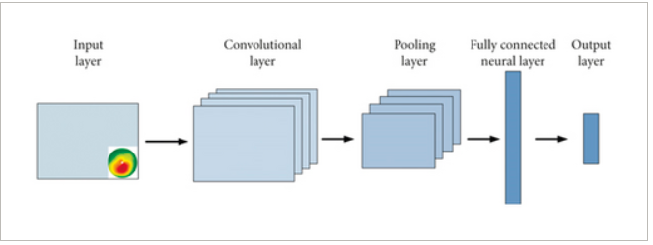
Proposed System for treating keratoconus
Classifying images using the CNN algorithm involves an image preprocessing step. The algorithm decomposes the image at the pixel level; the obtained matrix is then applied at the input of the neural network. The algorithm uses color images that have a size of 180 × 240 × 3 pixels. The CNN model assumes that each image passes through a series of kernel convolutional filters, pooling layers, and fully connected (FC) layers; meanwhile, the classification is performed by using the Softmax function to classify an object with probabilistic values between 0 and 1.
The convolution layer is the first layer that performs feature extraction from an image applied to the networks’ input. Convolution layer keeps the relationship between pixels by learning the characteristics of images using certain filters, thus generating the image matrix.

Slide 14
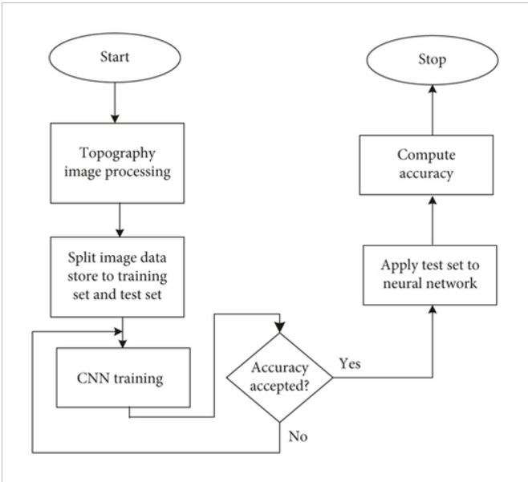
Proposed system algorithm

Slide 15
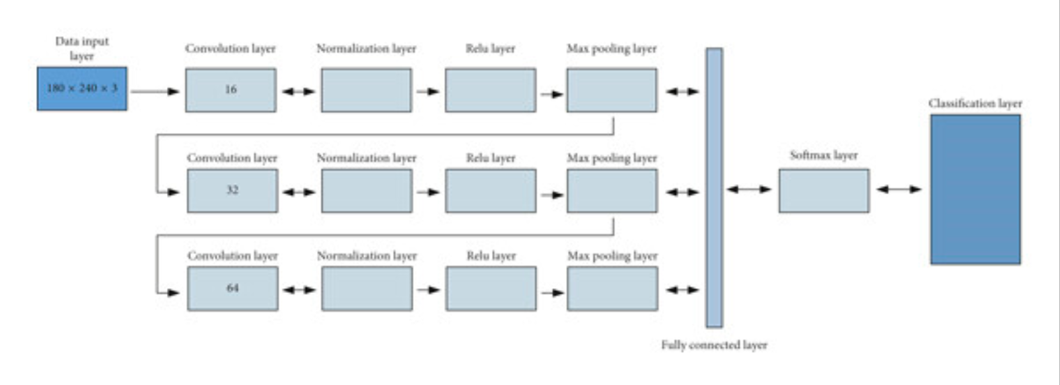
Proposed system architecture

Slide 16
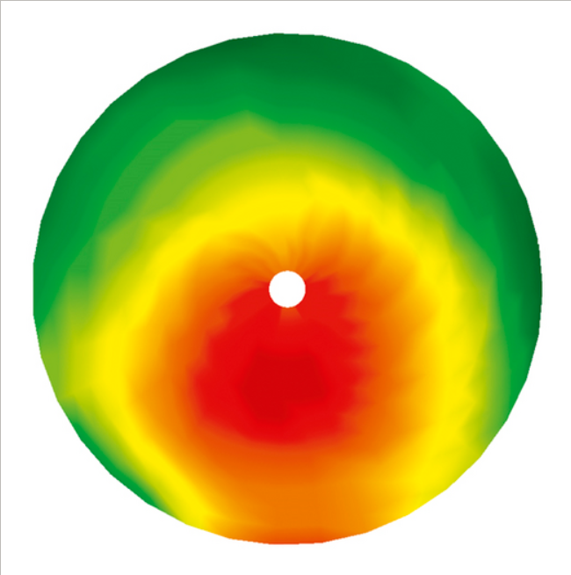
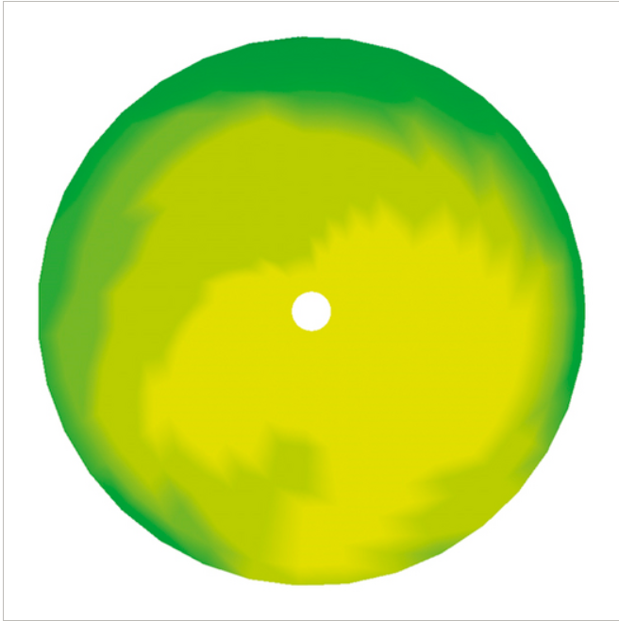
Cornea topographies. (a) Keratoconus eye. (b) Healthy eye.

Slide 17
Conclusion
Thus, after the ophthalmological consultation, the corneal topography is applied as an input to the already trained neural network, and this will determine whether the patient is suffering from keratoconus or not. The implemented algorithm processes topical corneal topographies and classifies them into two categories, detecting patterns specific to the keratoconus pathology.
The algorithm can be implemented in the device that performs the topography as an add-on in order to assist the ophthalmologist in rapid screening of its patients.
However this mechanism cannot be used as a stand-alone diagnosis procedure but should be seen as an additional tool to help the ophthalmologist who also analyzes other clinical data such as family history, refraction, and corneal shape evolution, and performs lamp examination. In the future, these algorithms will become more efficient and contribute to easy diagnosis of keratoconus and the reduction of corneal transplant cases.
Thank You !

