Slide 1
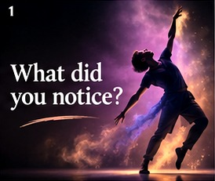
WHEN DANCE BECOMES DATA
01 / 25
WHAT DID YOU NOTICE?
WHAT DID YOU NOTICE?
Illustrative data · No pose estimation was run on the Vimeo performance
Notes:
SLIDE 01 — WHAT DID YOU NOTICE?
SPEAK:
What did you notice? Just hold on to that first impression for a moment. Before we analyse anything, remember what it felt like to watch.
CUE: Advance after this passage. Do not read the technical numbers aloud; let the slide show them.
NOTE: The opening video is played separately.

Slide 2
WHEN DANCE BECOMES DATA
02 / 25
WHAT STAYED WITH YOU?
RHYTHM
EXPRESSION
CONNECTION
TIMING
Illustrative data · No pose estimation was run on the Vimeo performance
Notes:
SLIDE 02 — WHAT STAYED WITH YOU?
SPEAK:
Was it the rhythm? The expression? Perhaps the connection between the dancers, or the way they moved together? There isn't one correct answer. That's what makes dance so personal.
CUE: Advance after this passage. Do not read the technical numbers aloud; let the slide show them.
NOTE: The opening video is played separately.

Slide 3
WHEN DANCE BECOMES DATA
03 / 25
WHEN DANCE BECOMES DATA
WHEN DANCE
BECOMES DATA
What can technology measure — and what does it miss?
Illustrative data · No pose estimation was run on the Vimeo performance
Notes:
SLIDE 03 — WHEN DANCE
BECOMES DATA
SPEAK:
And that brings me to my topic today: When Dance Becomes Data. What can technology measure, and what does it miss?
CUE: Advance after this passage. Do not read the technical numbers aloud; let the slide show them.
NOTE: The opening video is played separately.

Slide 4
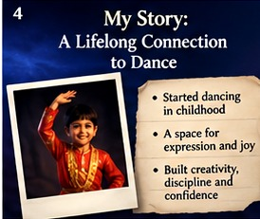
WHEN DANCE BECOMES DATA
04 / 25
A PART OF MY STORY
A lifelong connection
to dance
Illustrative data · No pose estimation was run on the Vimeo performance
Notes:
SLIDE 04 — A PART OF MY STORY
SPEAK:
Dance has been close to my heart since childhood. For me, it was never just about learning steps. It was a space where I could express myself without needing the right words.
CUE: Advance after this passage. Do not read the technical numbers aloud; let the slide show them.
NOTE: The opening video is played separately.

Slide 5
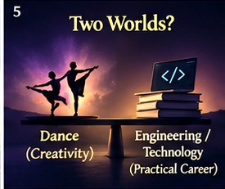
WHEN DANCE BECOMES DATA
05 / 25
TWO WORLDS
CREATIVITY
×
TECHNOLOGY
Illustrative data · No pose estimation was run on the Vimeo performance
Notes:
SLIDE 05 — TWO WORLDS
SPEAK:
At the same time, I grew up surrounded by the idea that practical careers—engineering, medicine, law—were the safer path. Creativity and career didn't always seem to belong together.
CUE: Advance after this passage. Do not read the technical numbers aloud; let the slide show them.
NOTE: The opening video is played separately.

Slide 6

WHEN DANCE BECOMES DATA
06 / 25
LET ME SHOW YOU ANOTHER VIEW
Human experience
→
Computer observation
Illustrative data · No pose estimation was run on the Vimeo performance
Notes:
SLIDE 06 — LET ME SHOW YOU ANOTHER VIEW
SPEAK:
But studying technology has changed how I see that divide. Today, I want to bring those two worlds together. You've seen the dance through your eyes. Now, let me show you another view.
CUE: Advance after this passage. Do not read the technical numbers aloud; let the slide show them.
NOTE: The opening video is played separately.

Slide 7
WHEN DANCE BECOMES DATA
07 / 25
A COMPUTER SEES FRAMES
FRAME 001
FRAME 002
FRAME 003
Three images, three moments
Illustrative data · No pose estimation was run on the Vimeo performance
Notes:
SLIDE 07 — A COMPUTER SEES FRAMES
SPEAK:
A computer doesn't begin with the feeling of a performance. It begins with a sequence of images—tiny moments captured one after another.
CUE: Advance after this passage. Do not read the technical numbers aloud; let the slide show them.
NOTE: The opening video is played separately.

Slide 8
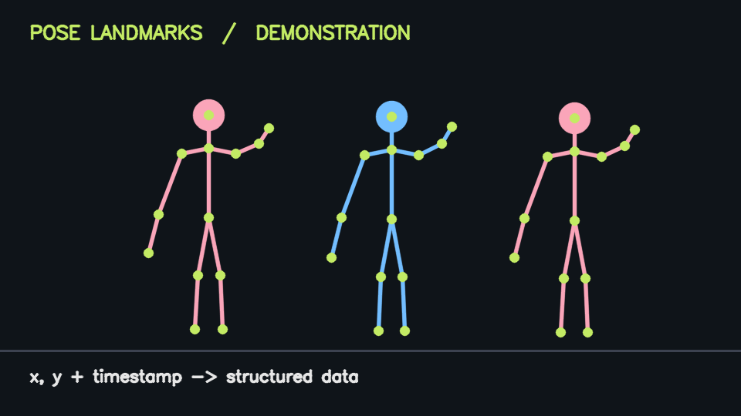
WHEN DANCE BECOMES DATA
08 / 25
FROM MOVEMENT TO LANDMARKS
WRIST
ELBOW
SHOULDER
KNEE
Illustrative data · No pose estimation was run on the Vimeo performance
Notes:
SLIDE 08 — FROM MOVEMENT TO LANDMARKS
SPEAK:
With computer vision, those images can become a map of the body. The points follow joints as the dancer moves. It's a fascinating translation—but notice what's already missing: the expression behind the movement.
CUE: Advance after this passage. Do not read the technical numbers aloud; let the slide show them.
NOTE: The opening video is played separately.

Slide 9
WHEN DANCE BECOMES DATA
09 / 25
A WRIST BECOMES COORDINATES
WRIST
x = 0.42
y = 0.71
Illustrative data · No pose estimation was run on the Vimeo performance
Notes:
SLIDE 09 — A WRIST BECOMES COORDINATES
SPEAK:
Each point now has a position. On the slide, you can see how even one wrist becomes information a system can work with.
CUE: Advance after this passage. Do not read the technical numbers aloud; let the slide show them.
NOTE: The opening video is played separately.

Slide 10
WHEN DANCE BECOMES DATA
10 / 25
WHEN DID IT HAPPEN?
0 ms
33 ms
67 ms
30 frames / second ≈ 33 ms / frame
Illustrative data · No pose estimation was run on the Vimeo performance
Notes:
SLIDE 10 — WHEN DID IT HAPPEN?
SPEAK:
And movement is not only about where something happens. It's also about when. That's why every observation needs its place in time.
CUE: Advance after this passage. Do not read the technical numbers aloud; let the slide show them.
NOTE: The opening video is played separately.

Slide 11
WHEN DANCE BECOMES DATA
11 / 25
MOVEMENT BECOMES RECORDS
dancer
frame
time_ms
joint
x
y
A
1
0
wrist
0.42
0.71
A
2
33
wrist
0.44
0.69
Illustrative data · No pose estimation was run on the Vimeo performance
Notes:
SLIDE 11 — MOVEMENT BECOMES RECORDS
SPEAK:
Suddenly, what looked like one continuous gesture becomes a sequence of records. We can follow how a movement develops instead of relying only on memory.
CUE: Advance after this passage. Do not read the technical numbers aloud; let the slide show them.
NOTE: The opening video is played separately.

Slide 12
WHEN DANCE BECOMES DATA
12 / 25
THREE FORMS OF DATA
VIDEO
unstructured
JSON
semi-structured
TABLE
structured
Illustrative data · No pose estimation was run on the Vimeo performance
Notes:
SLIDE 12 — THREE FORMS OF DATA
SPEAK:
The original performance is still a video. But the information extracted from it can take different forms, until we have something we can organize and explore.
CUE: Advance after this passage. Do not read the technical numbers aloud; let the slide show them.
NOTE: The opening video is played separately.

Slide 13
WHEN DANCE BECOMES DATA
13 / 25
BUT RAW DATA IS NOT AN ANSWER
RAW DATA
≠
TRUSTED INSIGHT
Illustrative data · No pose estimation was run on the Vimeo performance
Notes:
SLIDE 13 — BUT RAW DATA IS NOT AN ANSWER
SPEAK:
Here's the important part: collecting data doesn't automatically give us understanding. The records have to be trustworthy before we ask them questions.
CUE: Advance after this passage. Do not read the technical numbers aloud; let the slide show them.
NOTE: The opening video is played separately.

Slide 14
WHEN DANCE BECOMES DATA
14 / 25
STEP 1 · INGEST AND PRESERVE
INGEST
→
RAW
→
VALIDATE
→
CLEAN
→
TRANSFORM
→
CURATE
Preserve source records for auditing and reprocessing
Illustrative data · No pose estimation was run on the Vimeo performance
Notes:
SLIDE 14 — STEP 1 · INGEST AND PRESERVE
SPEAK:
First, we bring the observations into our system and keep the original version. That way, if something goes wrong, we can always return to the source.
CUE: Advance after this passage. Do not read the technical numbers aloud; let the slide show them.
NOTE: The opening video is played separately.

Slide 15
WHEN DANCE BECOMES DATA
15 / 25
STEP 2 · VALIDATE
INGEST
→
RAW
→
VALIDATE
→
CLEAN
→
TRANSFORM
→
CURATE
record
time_ms
joint
x
status
A-01
1200
wrist
0.42
VALID
A-02
—
wrist
0.46
MISSING TIME
A-03
1233
wrist
1.20
INVALID X
Illustrative data · No pose estimation was run on the Vimeo performance
Notes:
SLIDE 15 — STEP 2 · VALIDATE
SPEAK:
Then we check the quality. What if a joint disappears behind another dancer? What if an observation is repeated or simply doesn't make sense?
CUE: Advance after this passage. Do not read the technical numbers aloud; let the slide show them.
NOTE: The opening video is played separately.

Slide 16
WHEN DANCE BECOMES DATA
16 / 25
STEP 3 · CLEAN AND TRANSFORM
INGEST
→
RAW
→
VALIDATE
→
CLEAN
→
TRANSFORM
→
CURATE
Clean carefully → detect arm-raise event
Illustrative data · No pose estimation was run on the Vimeo performance
Notes:
SLIDE 16 — STEP 3 · CLEAN AND TRANSFORM
SPEAK:
Next, we clean and prepare the information. Instead of staring at thousands of positions, we can identify meaningful moments—like an arm being raised.
CUE: Advance after this passage. Do not read the technical numbers aloud; let the slide show them.
NOTE: The opening video is played separately.

Slide 17
WHEN DANCE BECOMES DATA
17 / 25
STEP 4 · CURATE AND QUERY
INGEST
→
RAW
→
VALIDATE
→
CLEAN
→
TRANSFORM
→
CURATE
VIDEOS → EVENTS ← DANCERS
Illustrative data · No pose estimation was run on the Vimeo performance
Notes:
SLIDE 17 — STEP 4 · CURATE AND QUERY
SPEAK:
We organize those moments into tables that connect the dancers, the performance and the events. Now SQL can help us ask a precise question.
CUE: Advance after this passage. Do not read the technical numbers aloud; let the slide show them.
NOTE: The opening video is played separately.

Slide 18
WHEN DANCE BECOMES DATA
18 / 25
ONE QUESTION WE CAN ASK
DANCER A
DANCER B
SAME MOVEMENT · MATCHED EVENT
Illustrative data · No pose estimation was run on the Vimeo performance
Notes:
SLIDE 18 — ONE QUESTION WE CAN ASK
SPEAK:
For example: when two dancers perform the same movement, how close together do those moments happen? Let's look at a simple illustration.
CUE: Advance after this passage. Do not read the technical numbers aloud; let the slide show them.
NOTE: The opening video is played separately.

Slide 19
WHEN DANCE BECOMES DATA
19 / 25
DANCER A · 1.20 SECONDS
1,200 ms
DANCER A
Illustrative data · No pose estimation was run on the Vimeo performance
Notes:
SLIDE 19 — DANCER A · 1.20 SECONDS
SPEAK:
Here is the first dancer's moment. You don't need to remember the timestamp—just notice where it sits on our timeline.
CUE: Advance after this passage. Do not read the technical numbers aloud; let the slide show them.
NOTE: The opening video is played separately.

Slide 20
WHEN DANCE BECOMES DATA
20 / 25
DANCER B · 1.35 SECONDS
1,350 ms
DANCER B
Illustrative data · No pose estimation was run on the Vimeo performance
Notes:
SLIDE 20 — DANCER B · 1.35 SECONDS
SPEAK:
And here is the corresponding moment for the second dancer. The two observations give us something concrete to compare.
CUE: Advance after this passage. Do not read the technical numbers aloud; let the slide show them.
NOTE: The opening video is played separately.

Slide 21
WHEN DANCE BECOMES DATA
21 / 25
THE GAP · 150 MILLISECONDS
1,350 − 1,200 = 150 ms
Illustrative data · No pose estimation was run on the Vimeo performance
Notes:
SLIDE 21 — THE GAP · 150 MILLISECONDS
SPEAK:
The calculation appears on screen. We can now describe the difference in timing, instead of simply saying the dancers looked synchronized.
CUE: Advance after this passage. Do not read the technical numbers aloud; let the slide show them.
NOTE: The opening video is played separately.

Slide 22
WHEN DANCE BECOMES DATA
22 / 25
ANOTHER EVENT · 80 MILLISECONDS
matched event
Dancer A
Dancer B
gap
arm raise 1
1200 ms
1350 ms
150 ms
arm raise 2
920 ms
1000 ms
80 ms
Match corresponding events before joining
Illustrative data · No pose estimation was run on the Vimeo performance
Notes:
SLIDE 22 — ANOTHER EVENT · 80 MILLISECONDS
SPEAK:
Now compare that with another movement. SQL can match corresponding events and reveal patterns across a performance, rather than leaving us with a single impression.
CUE: Advance after this passage. Do not read the technical numbers aloud; let the slide show them.
NOTE: The opening video is played separately.

Slide 23
WHEN DANCE BECOMES DATA
23 / 25
WHAT DOES THE NUMBER MEAN?
MEASURABLE TIMING
ARTISTIC QUALITY
Not the same thing
Illustrative data · No pose estimation was run on the Vimeo performance
Notes:
SLIDE 23 — WHAT DOES THE NUMBER MEAN?
SPEAK:
But this is where I want to be careful. Does a smaller timing gap automatically mean better dancing? Of course not. A pause, a delay, even a mismatch might be exactly what the choreography intends.
CUE: Advance after this passage. Do not read the technical numbers aloud; let the slide show them.
NOTE: The opening video is played separately.

Slide 24
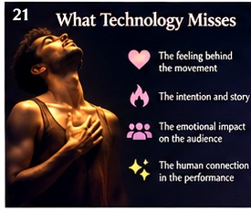
WHEN DANCE BECOMES DATA
24 / 25
BACK TO THE HUMAN EXPERIENCE
WHAT WE FELT
WAS MORE THAN
A NUMBER
Illustrative data · No pose estimation was run on the Vimeo performance
Notes:
SLIDE 24 — BACK TO THE HUMAN EXPERIENCE
SPEAK:
Think back to the beginning. We noticed rhythm, expression, connection and timing. Technology can help us examine some of those patterns. But it cannot directly tell us what the dancers felt—or what you felt watching them.
CUE: Advance after this passage. Do not read the technical numbers aloud; let the slide show them.
NOTE: The opening video is played separately.

Slide 25
WHEN DANCE BECOMES DATA
25 / 25
THE QUESTION I WANT TO LEAVE YOU WITH
ARE WE COLLECTING
WHAT TRULY MATTERS?
Or only what we know how to measure?
Illustrative data · No pose estimation was run on the Vimeo performance
Notes:
SLIDE 25 — THE QUESTION I WANT TO LEAVE YOU WITH
SPEAK:
So I'll leave you with one question: are we collecting what truly matters, or only what we know how to measure? Thank you.
CUE: Advance after this passage. Do not read the technical numbers aloud; let the slide show them.
NOTE: The opening video is played separately.

