Slide 1
AIML Bootcamp
System Domain

Slide 2
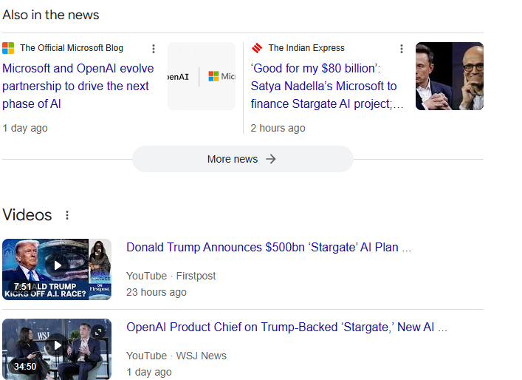



The interesting world of AI

Slide 3
Introduction to Artificial Intelligence (AI)
Artificial Intelligence(AI) is the branch of computer science focused on creating systems that can perform tasks that would typically require human intelligence. These tasks include decision-making, pattern recognition, language understanding, and problem-solving.
Key capabilities of AI:
Problem-solving: AI can make decisions and solve complex problems.
Learning and adaptation: AI systems improve their performance by learning from data.
Perception: AI can understand and interpret sensory information, such as images, sounds, and text.
Natural Language Processing (NLP): AI systems can understand and generate human language.
Examples of AI in Use:
Virtual Assistants: Siri, Alexa, Google Assistant use AI to interact and respond to human queries.
Autonomous Vehicles: Self-driving cars use AI to navigate, detect obstacles, and make decisions in real time.
Recommendation Systems: AI powers the recommendation engines on platforms like Netflix, Amazon, and YouTube.

Slide 4
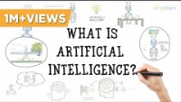
Introduction to Artificial Intelligence (AI)

Slide 5
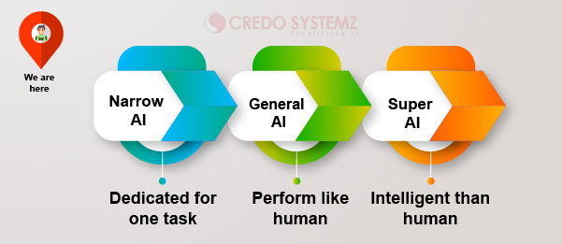
Types of AI
Pic courtesy :https://medium.com/@cs.venkatesh95/types-of-artificial-intelligence-6b2578eee2e1

Slide 6
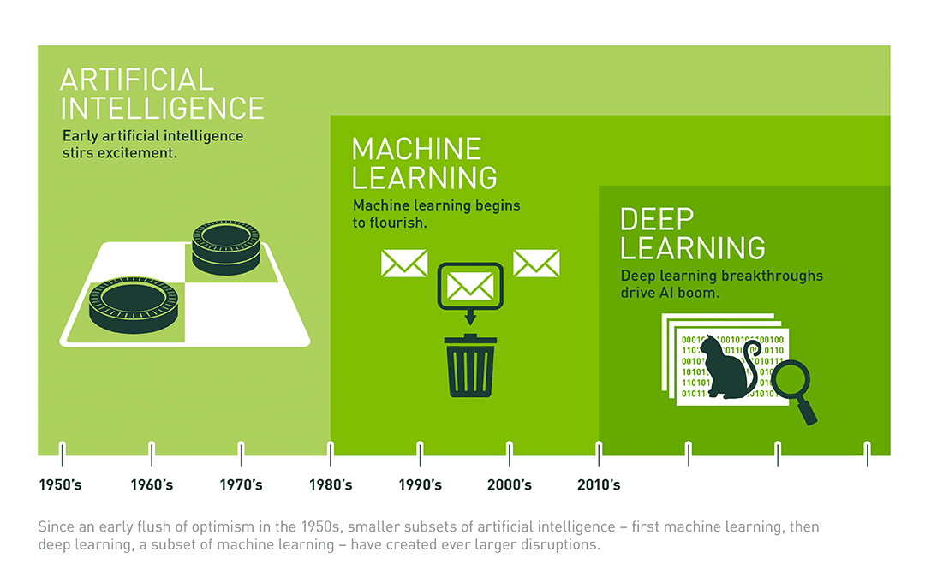
Machine Learning: A subset of AI
Pic courtesy : https://blogs.nvidia.com/blog/whats-difference-artificial-intelligence-machine-learning-deep-learning-ai/

Slide 7
Machine Learning: A subset of AI
What is Machine Learning? Machine Learning is a subset of AI that allows computers to learn from and make decisions based on data, without explicit programming. It involves training algorithms to recognize patterns and improve from experience over time.
How ML Relates to AI:
Machine Learning is a part of AI that deals specifically with creating systems that can learn from data.
While AI involves creating intelligent behavior in machines, ML focuses on the algorithms that allow these machines to automatically improve from data.

Slide 8
Types of Machine Learning
Supervised Learning:
The model learns from labeled data and makes predictions based on it.
Example: Predicting house prices using known data (features like size, location, etc.).
Unsupervised Learning:
The model identifies patterns in data without predefined labels.
Example: Customer segmentation using purchase history.
Semi Supervised Learning:
Semi-supervised learning is a type of machine learning that lies between supervised learning and unsupervised learning. In this approach:
Some of the data is labeled, meaning it has associated target/output values.
The rest of the data is unlabeled, meaning it has no associated target/output values.
Reinforcement Learning:
The model learns by interacting with its environment and receiving feedback through rewards or penalties.
Example: Training an AI to play a game like chess or Go.

Slide 9
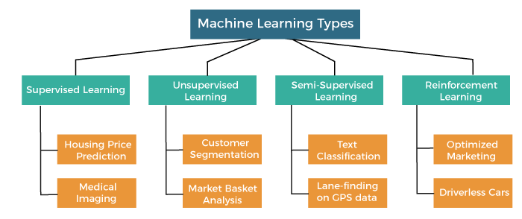
Machine Learning: A subset of AI

Slide 10
Machine Learning: A subset of AI
Applications of Machine Learning:
Fraud Detection: Banks use ML to detect unusual patterns in transactions that may indicate fraud.
Image Recognition: Used in applications like facial recognition or diagnosing medical images.
Predictive Analytics: ML models predict future outcomes based on historical data (e.g., sales forecasts).
Disease prediction.
Weather Forecasting.
Agriculture : Pest detection.
Traffic control.
Etc Etc Etc!!

Slide 11
Use case : AIML and Swiggy
Personalized Recommendations
How it works: Swiggy uses ML algorithms to analyze customer behavior, order history, location, and preferences to recommend personalized restaurant options or dishes.
Key Techniques:
Collaborative Filtering: Suggests dishes based on similar user profiles.
Content-Based Filtering: Recommends items similar to those a customer has previously ordered or searched for.
Deep Learning Models: Enhance accuracy in understanding user preferences.

Slide 12
Use case : AIML and Swiggy
Delivery Time Prediction (ETA Calculation)
How it works: Swiggy predicts the Estimated Time of Arrival (ETA) for orders using ML models that consider:
Restaurant preparation time.
Distance between the customer and restaurant.
Traffic conditions and road networks.
Rider availability and location.
Key Techniques:
Gradient Boosted Decision Trees (GBDTs) or Neural Networks for ETA prediction.
Real-time traffic data integration for dynamic updates.

Slide 13
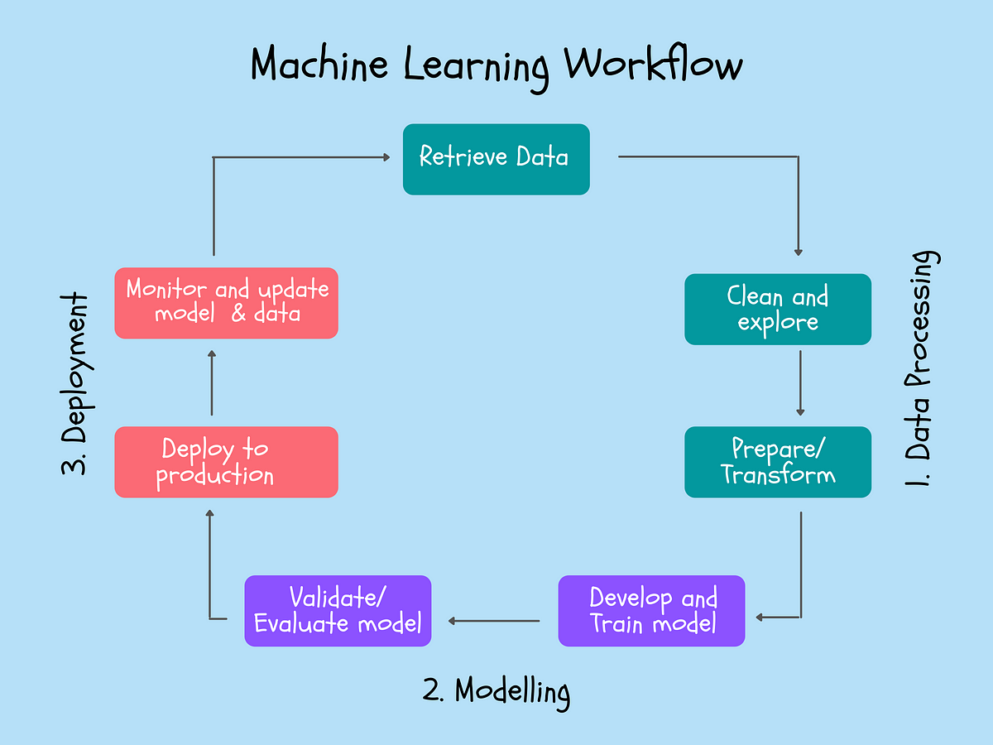
Basic Machine learning workflow

Slide 14
Basic Machine learning workflow
1. Data Collection: Gather relevant data that will be used to train the machine learning model. This data can come from various sources, such as databases, sensors, or surveys.
Example: Collecting data on house features for a price prediction model (e.g., size, location, number of rooms).
2. Data Preprocessing: Clean and format the data to remove errors, fill in missing values, and convert it into a usable format. This step may include data normalization, encoding categorical variables, and removing outliers.
Example: Converting categorical data like "Yes" and "No" into numerical values (1, 0).
3. Model Training: Select a suitable machine learning algorithm and train it using the processed data. During this step, the model learns from the data by adjusting its parameters to minimize error.
Example: Training a regression model to predict house prices.
4. Model Evaluation: Assess the model's performance using metrics like accuracy, precision, recall, and F1-score. This step involves testing the model with new data to ensure it generalizes well.
Example: Evaluating how well a model predicts house prices on a test set of data it hasn't seen before.

Slide 15
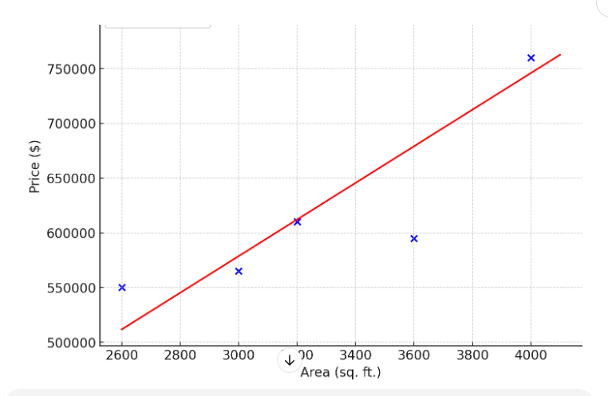


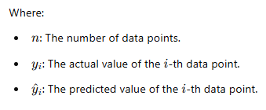







Linear Regression
Area(Sq FT) | Price($)
2600 | 550,000
3000 | 565,000
3200 | 610,000
3600 | 595,000
4000 | 760,000
4100 | 810,000

Slide 16
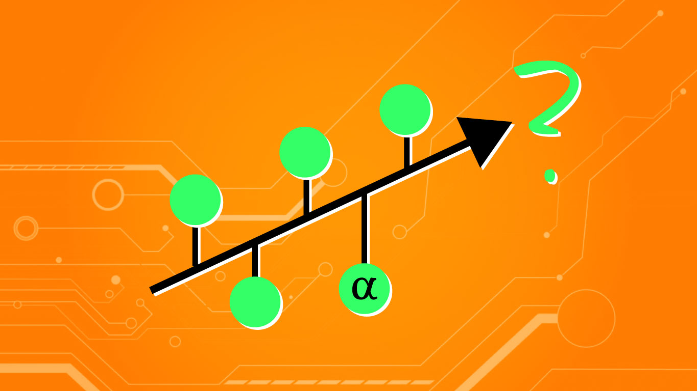
Equation of a line
Y = mx+b
Where:
y: The dependent variable (output or target).
x: The independent variable (input or predictor).
m: The slope of the line (how much y changes for a unit change in x).
b: The y-intercept (the value of y when x=).
Image courtesy : https://www.alpharithms.com/

Slide 17
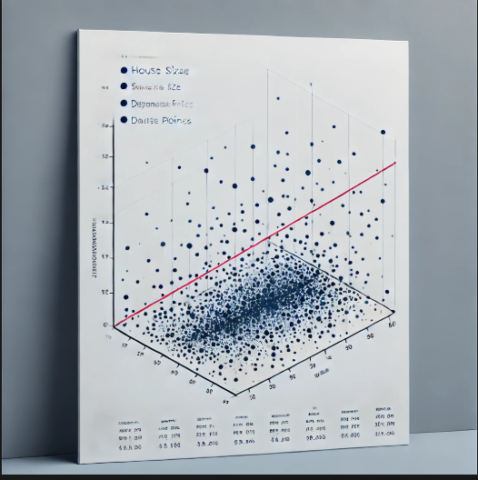
Multi Linear regression – House prices
Area(Sq FT) | No of bedrooms | Age | Price($)
2600 | 3 | 20 | 550,000
3000 | 4 | 15 | 565,000
3200 |  | 18 | 610,000
3600 | 3 | 30 | 595,000
4000 | 5 | 8 | 760,000
4100 | 6 | 8 | 810,000

