Slide 1
Flask
Web Application framework

Slide 2
Introduction
Flask is a web application framework written in Python. Armin Ronacher, who leads an international group of Python enthusiasts named Pocco, develops it. Flask is based on Werkzeug WSGI toolkit and Jinja2 template engine. Both are Pocco projects.
Web Application Framework or simply Web Framework represents a collection of libraries and modules that enables a web application developer to write applications without having to bother about low-level details such as protocols, thread management etc.

Slide 3
Few Key terms
Web Server Gateway Interface(WSGI):
WSGI, which stands for Web Server Gateway Interface, is a specification for a simple and universal interface between web servers and web applications or frameworks written in Python. It is a Python standard described in PEP 3333. Here's a breakdown of what WSGI is and its rKey Points about WSGI
Purpose:
WSGI serves as a standard interface between web servers and Python web applications or frameworks.
It enables the portability of web applications across different web servers.
How WSGI Works:
WSGI separates the web server and the web application.
The web server handles the HTTP requests, and the WSGI application processes these requests and returns the response.
The interface ensures that any WSGI-compliant web application can run on any WSGI-compliant web server.

Slide 4
Few Key terms
WSGI Components:
WSGI Server: The server that receives the HTTP requests from clients (e.g., browsers) and passes them to the application. Examples include Gunicorn, uWSGI, and the built-in WSGI server in Python's wsgiref module.
WSGI Application: The web application or framework that processes the requests and generates the responses. Flask and Django are examples of WSGI applications.

Slide 5
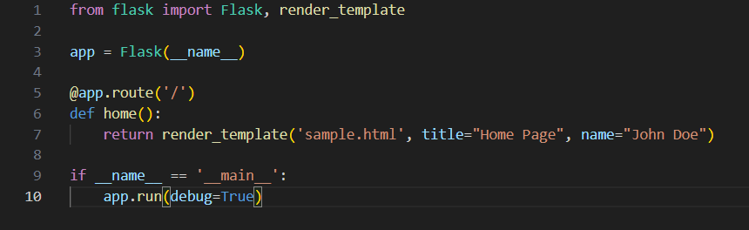
Few Key terms
Jinja2 Templates:
Jinja2 is a popular templating engine for Python, often used with the Flask web framework to render dynamic web pages. Flask is a micro-framework that keeps the core of an application simple and extensible by using extensions for added functionality. In Flask, you can define routes and use Jinja2 templates to dynamically generate HTML based on data.
Here’s a basic example:

Slide 6
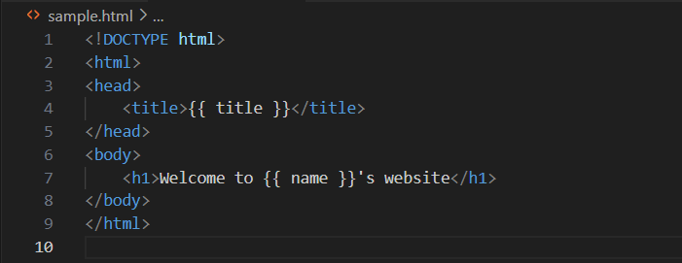
Few Key terms
Jinja2 Templates:
home.html (placed in a templates directory)
In this example, Flask handles the routing and request, while Jinja2 dynamically injects the title and name
variables into the HTML template.

Slide 7
Basic Architecture of Flask
Flask Application Instance:
The core of a Flask application is the Flask object. This instance is responsible for handling requests, routing,
and other functionalities.
Routing:
Flask uses decorators to associate URL patterns with view functions. These functions are executed when a
Matching URL is requested.
View Functions:
These functions contain the logic for handling requests and returning responses. They can return
HTML, JSON, or other response types.
Templates:
Flask uses the Jinja2 templating engine to render HTML templates dynamically. Templates are stored in the templates
directory.
Static Files:
Static files (CSS, JavaScript, images) are served from the static directory.
Extensions:
Flask can be extended with various extensions for added functionality, such as database integration, form handling,
authentication, and more.
Middleware:
Middleware can be used to process requests before they reach the view functions and responses before
they are sent to the client.

Slide 8
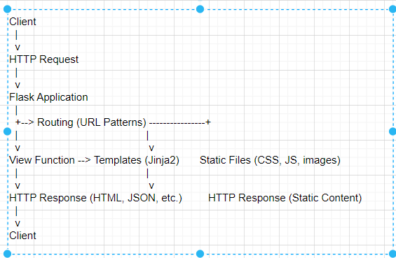
Basic Architecture of Flask
Here’s an example of a basic Flask application structure:

Slide 9
MVC Model
Model:
The part of the application that handles the data. This typically includes database models and the logic for interacting with the database.
In Flask, this can be managed using extensions like SQLAlchemy.
View:
The part of the application that handles the user interface and presentation logic.
In Flask, this corresponds to the HTML templates rendered by Jinja2.

Slide 10
MVC Model
Controller:
The part of the application that handles user input, manipulates the model, and updates the view.In Flask, this role is played by the view functions defined in the routes. These functions take HTTP requests, process them (potentially involving models), and return HTTP responses.

Slide 11
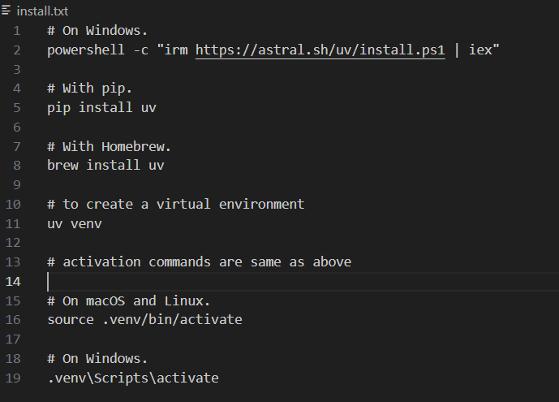
Flask – Creating a Virtual Environment
Create a Virtual Environment where you will install Flask.
I use a utility called uv to manage virtual environments. Its extremely fast and versatile to download packages.

Slide 12
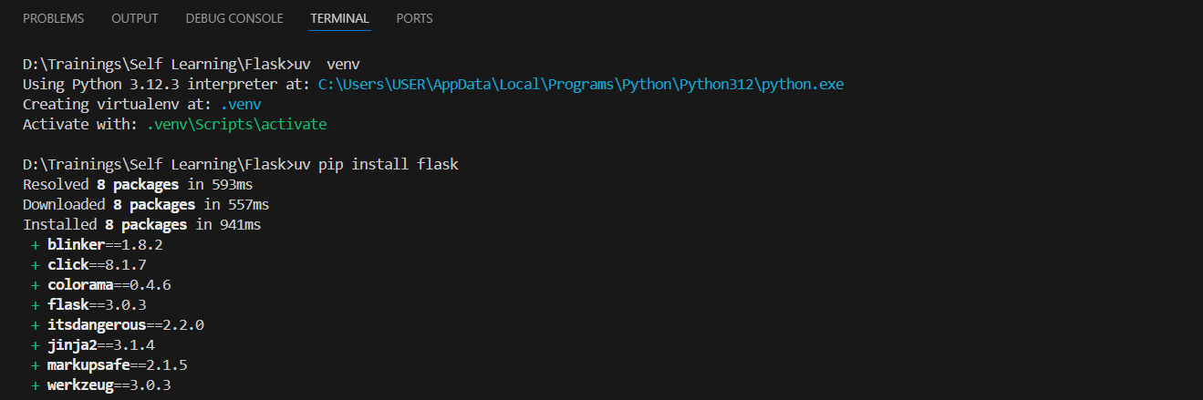
Flask – Creating a Virtual Environment
Now for all installations, you can use uv pip install command. For example, to install Flask , run the following command:
Note : Please set the virtual env first using the command .venv\Scripts\activate

Slide 13
Flask – Creating a Virtual Environment
Now for all installations, you can use uv pip install command. For example, to install Flask , run the following command:

Slide 14
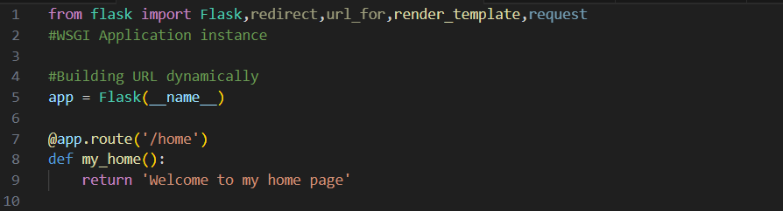
Our First Application
Let’s write the first bit of code here in our IDE and analyse it:
Importing flask module in the project is mandatory. An object of Flask class is our WSGI application.
Flask constructor takes the name of current module (__name__) as argument.
The route() function of the Flask class is a decorator, which tells the application which URL should call the associated function.

Slide 15
Our First Application
Let’s write the first bit of code here in our IDE and analyse it:
Importing flask module in the project is mandatory. An object of Flask class is our WSGI application.
Flask constructor takes the name of current module (__name__) as argument.
The route() function of the Flask class is a decorator, which tells the application which URL should call the associated function.

Slide 16
Our First Application
In the above example, ‘/home’ URL is bound with my_home() function. Hence, when the home page of web server is opened in browser, the output of this function will be rendered.
Finally the run() method of Flask class runs the application on the local development server. Now here’s the snippet of code for running the application.
app.route(rule,options)
The rule parameter represents URL binding with the function.
The options is a list of parameters to be forwarded to the underlying Rule object.

Slide 17

Our First Application
Run the Application and start the local development server. Let’s understand the above code a bit before we actually start the server. Let’s analyze the below command which actually starts the server when the Flask application is run.
app.run(host,port,debug,options)
Run the Application and start the local development server. Let’s understand the above code a bit before we actually start the server. Let’s analyze the below command which actually starts the server when the Flask application is run.

Slide 18
Our First Application
All parameters are optional
Sr.No. | Parameters & Description
1 | host Hostname to listen on. Defaults to 127.0.0.1 (localhost). Set to ‘0.0.0.0’ to have server available externally
2 | port Defaults to 5000
3 | debug Defaults to false. If set to true, provides a debug information
4 | options To be forwarded to underlying Werkzeug server.

Slide 19
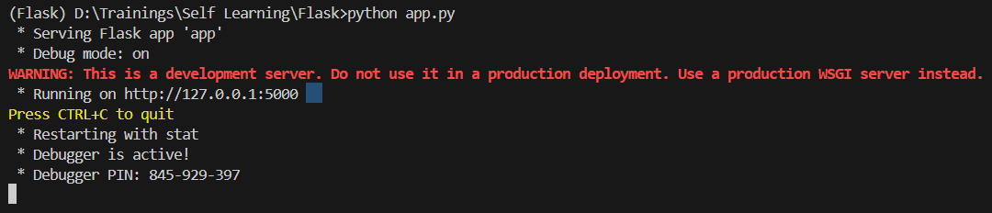
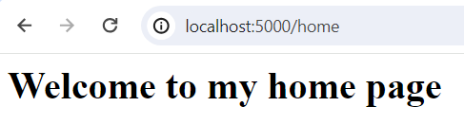
Our First Application
Now lets execute the script from our VS Code Terminal.
Open your web browser and open the URL. This is how your webpage will look like.

Slide 20
A closer look at routing
Modern web frameworks use the routing technique to help a user remember application URLs. It is useful to access the desired page directly without having to navigate from the home page.
The route() decorator in Flask is used to bind URL to a function. For example −

Slide 21
A closer look at routing
Here, URL ‘/home’ rule is bound to the my_home() function. As a result, if a user visits http://localhost:5000/hello URL, the output of the my_home() function will be rendered in the browser.

Slide 22
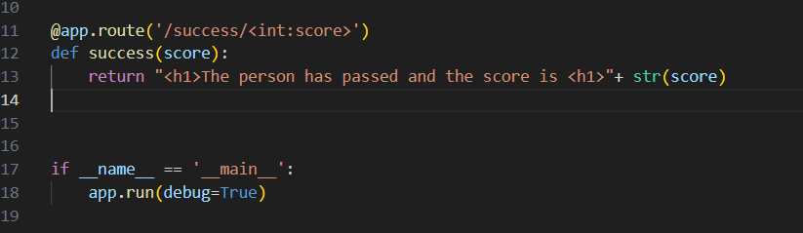
Variable Rules
It is possible to build a URL dynamically, by adding variable parts to the rule parameter. This variable part is marked as <variable-name>. It is passed as a keyword argument to the function with which the rule is associated.
In the following example, the rule parameter of route() decorator contains <score> variable part attached to URL ‘/success.

Slide 23
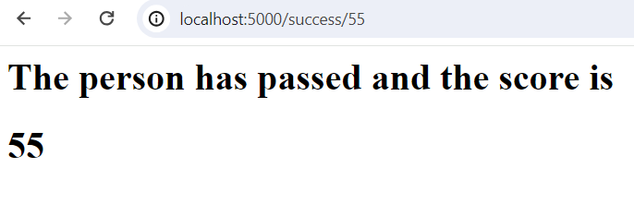
Variable Rules
Run the script and open the browser.
Ensure that the routing occurs to the /success route.

Slide 24
Dynamically building URL(s)
Now lets take the use case of dynamically building URLs.
Use case is as follows: A student result display system , displays if the student has passed or failed as per the scored marks.
If student has passed, the display will say that “You have passed”, else it will display that “You have failed”.
Let’s first analyze the code :
We have to import two new functions . They are redirect and url_for.
url_for will dynamically create the URL.
Redirect will redirect to the invoked URL.
Now let’s create three view functions :
results
success
fail
Results : Marks display calls redirected to results
Success: Passed marks students redirected to Success display view.
Fail : Fail marks students redirected to Fail display view.

Slide 25
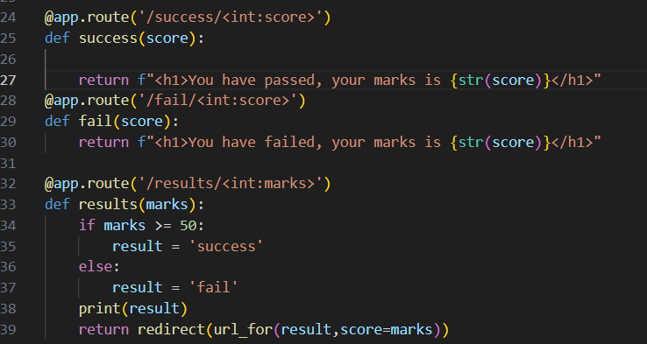
Dynamically building URL(s)
Run the script:
>> python app.py

Slide 26
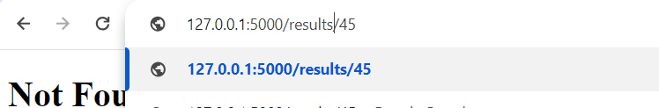
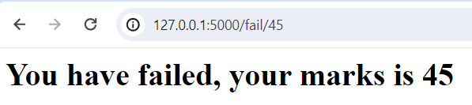
Dynamically building URL(s)

Slide 27
Integrating Flask with HTML

Slide 28
HTTP Methods and integrating with HTML
Http protocol is the foundation of data communication in world wide web. Different methods of data retrieval from specified URL are defined in this protocol.
The following table summarizes different http methods −
Sl.No | Methods & Description
1 | GET Sends data in unencrypted form to the server. Most common method.
2 | HEAD Same as GET, but without response body
3 | POST Used to send HTML form data to server. Data received by POST method is not cached by server.
4 | PUT Replaces all current representations of the target resource with the uploaded content.
5 | DELETE Removes all current representations of the target resource given by a URL

Slide 29
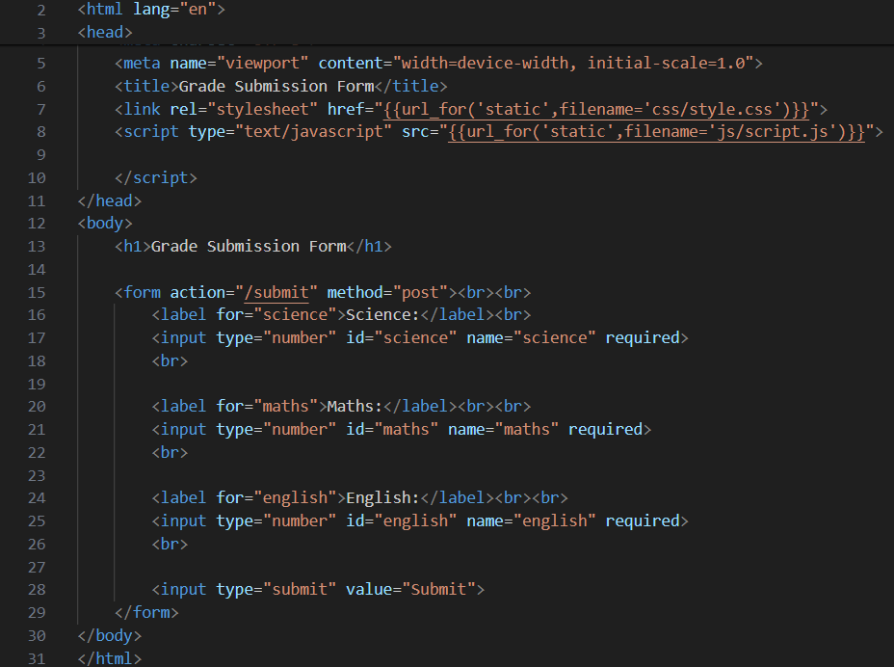
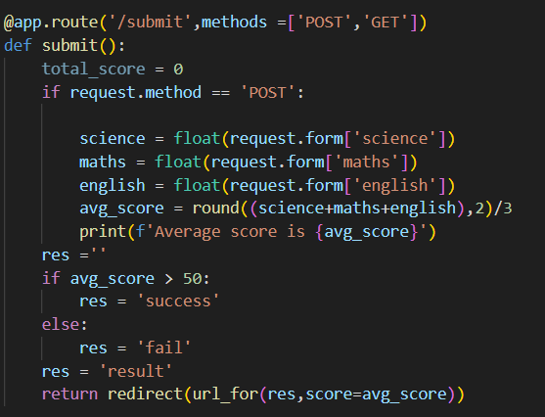

HTTP Methods and integrating with HTML
By default, the Flask route responds to the GET requests. However, this preference can be altered by providing methods argument to route() decorator.
In order to demonstrate the use of POST method in URL routing, first let us create an HTML form and use the POST method to send form data to a URL.

Slide 30
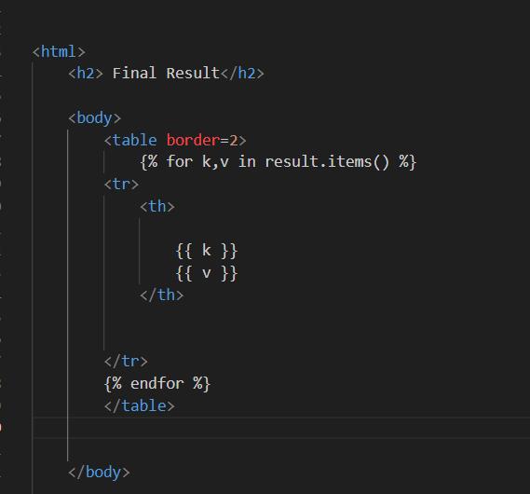
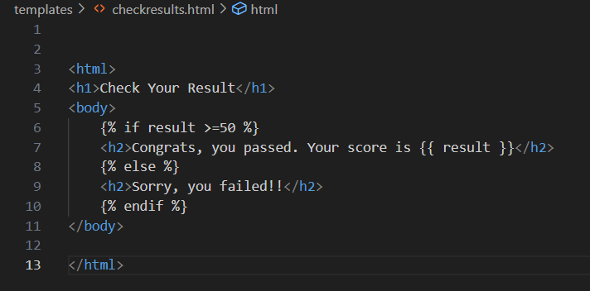
Web Templating Systems & Jinja2 Templates
The term ‘web templating system’ refers to designing an HTML script in which the variable data can be inserted dynamically. A web template system comprises of a template engine, some kind of data source and a template processor.
Flask uses jinja2 template engine. A web template contains HTML syntax interspersed placeholders for variables and expressions (in these case Python expressions) which are replaced values when the template is rendered.
For Example, the below are examples of Jinja2 Templates.

