Slide 1
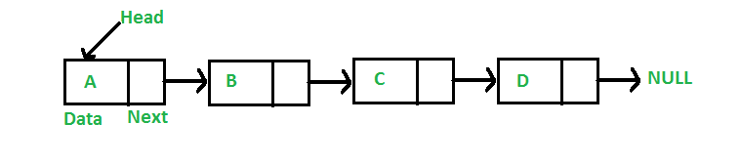
Linked List
A linked list is a linear data structure, in which the elements are not stored at contiguous memory locations. The elements in a linked list are linked using pointers as shown in the below image:
A linked list is represented by a pointer to the first node of the linked list. The first node is called the head. If the linked list is empty, then the value of the head is NULL. Each node in a list consists of at least two parts:
Data
Pointer (Or Reference) to the next node

Slide 2
STACKS
A Stack is a linear data structure that follows a particular order in which the operations are performed. The order may be LIFO(Last In First Out) or FILO(First In Last Out). LIFO implies that the element that is inserted last, comes out first and FILO implies that the element that is inserted first, comes out last.

Slide 3
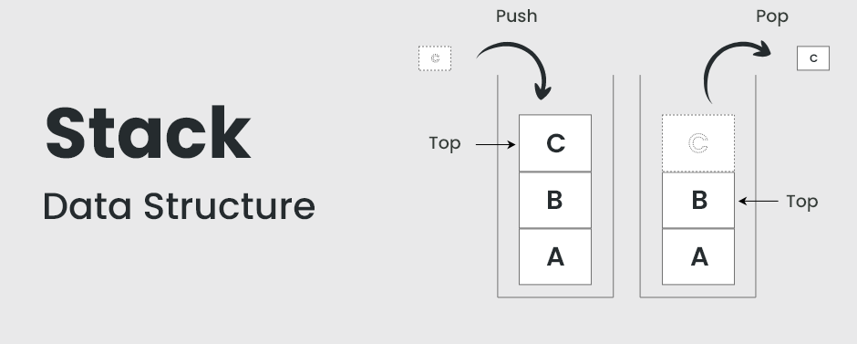
STACKS

Slide 4
STACKS
Think of it this way:
Pushing an element onto the stack is like adding a new plate on top.
Popping an element removes the top plate from the stack.
Key Operations on Stack Data Structures
Push: Adds an element to the top of the stack.
Pop: Removes the top element from the stack.
Peek: Returns the top element without removing it.
IsEmpty: Checks if the stack is empty.
IsFull: Checks if the stack is full (in case of fixed-size arrays).
Applications of Stack Data Structures
Recursion
Expression Evaluation and Parsing
Depth-First Search (DFS)
Undo/Redo Operations
Browser History
Function Calls

Slide 5
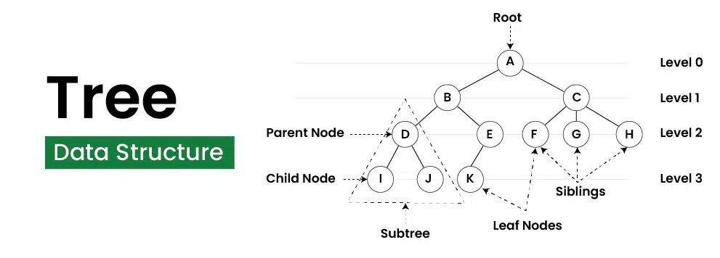
Tree Data Structure
Tree Data Structure is a non-linear data structure in which a collection of elements known as nodes are connected to each other via edges such that there exists exactly one path between any two nodes.

Slide 6
Tree Data Structure
A tree data structure is a hierarchical structure that is used to represent and organize data in a way that is easy to navigate and search. It is a collection of nodes that are connected by edges and has a hierarchical relationship between the nodes.
The topmost node of the tree is called the root, and the nodes below it are called the child nodes. Each node can have multiple child nodes, and these child nodes can also have their own child nodes, forming a recursive structure.

Slide 7
Terminologies In Tree Data Structure
Parent Node: The node which is a predecessor of a node is called the parent node of that node. {B} is the parent node of {D, E}.
Child Node: The node which is the immediate successor of a node is called the child node of that node. Examples: {D, E} are the child nodes of {B}.
Root Node: The topmost node of a tree or the node which does not have any parent node is called the root node. {A} is the root node of the tree. A non-empty tree must contain exactly one root node and exactly one path from the root to all other nodes of the tree.
Leaf Node or External Node: The nodes which do not have any child nodes are called leaf nodes. {K, L, M, N, O, P, G} are the leaf nodes of the tree.
Ancestor of a Node: Any predecessor nodes on the path of the root to that node are called Ancestors of that node. {A,B} are the ancestor nodes of the node {E}
Descendant: A node x is a descendant of another node y if and only if y is an ancestor of y.
Sibling: Children of the same parent node are called siblings. {D,E} are called siblings.
Level of a node: The count of edges on the path from the root node to that node. The root node has level 0.
Internal node: A node with at least one child is called Internal Node.
Neighbor of a Node: Parent or child nodes of that node are called neighbors of that node.
Subtree: Any node of the tree along with its descendant.

Slide 8
Types of Tree Data Structure
Binary tree: In a binary tree, each node can have a maximum of two children linked to it. Some common types of binary trees include full binary trees, complete binary trees, balanced binary trees, and degenerate or pathological binary trees.
Ternary Tree: A Ternary Tree is a tree data structure in which each node has at most three child nodes, usually distinguished as “left”, “mid” and “right”.
N-ary Tree or Generic Tree: Generic trees are a collection of nodes where each node is a data structure that consists of records and a list of references to its children(duplicate references are not allowed). Unlike the linked list, each node stores the address of multiple nodes.

Slide 9
Applications of Tree Data Structure
File System: This allows for efficient navigation and organization of files.
Data Compression: Huffman coding is a popular technique for data compression that involves constructing a binary tree where the leaves represent characters and their frequency of occurrence. The resulting tree is used to encode the data in a way that minimizes the amount of storage required.
Compiler Design: In compiler design, a syntax tree is used to represent the structure of a program.
Database Indexing: B-trees and other tree structures are used in database indexing to efficiently search for and retrieve data.

Slide 10
Binary Search Tree
A Binary Search Tree is a data structure used in computer science for organizing and storing data in a sorted manner. Each node in a Binary Search Tree has at most two children, a left child and a right child, with the left child containing values less than the parent node and the right child containing values greater than the parent node. This hierarchical structure allows for efficient searching, insertion, and deletion operations on the data stored in the tree.

Slide 11
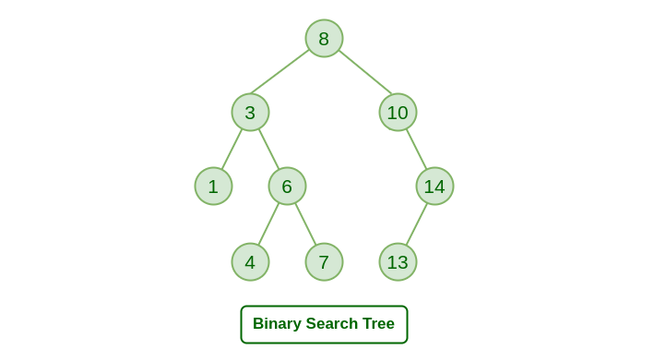
Binary search tree

Slide 12
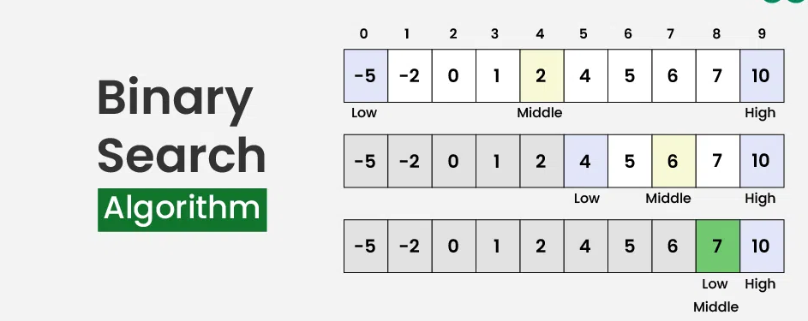
Binary Search Algorithm
Binary Search Algorithm is a searching algorithm used in a sorted array by repeatedly dividing the search interval in half. The idea of binary search is to use the information that the array is sorted and reduce the time complexity to O(log N).

Slide 13
Binary Search Algorithm
What is Binary Search Algorithm?
Binary search is a search algorithm used to find the position of a target value within a sorted array. It works by repeatedly dividing the search interval in half until the target value is found or the interval is empty. The search interval is halved by comparing the target element with the middle value of the search space.
Conditions to apply Binary Search Algorithm in a Data Structure:
To apply Binary Search algorithm:
The data structure must be sorted.
Access to any element of the data structure takes constant time.

Slide 14
Bubble sort
Bubble Sort is a simple comparison-based sorting algorithm. It repeatedly steps through the list, compares adjacent elements, and swaps them if they are in the wrong order. The process is repeated until the list is sorted. Although it is not the most efficient sorting algorithm for large datasets, it is easy to understand and implement.
How Bubble Sort Works
Initialization:
Start with an unsorted list.
Set a flag to track whether any elements were swapped during the pass.
Pass Through the List:
For each element in the list (except the last one), compare it with the next element.
If the current element is greater than the next element, swap them.
Set the flag to indicate a swap occurred.
Repeat:
Repeat the process for each pass until no swaps are needed.
After each pass, the largest unsorted element is moved to its correct position.

Slide 15
Bubble sort(Illustration)
Initial List: [5, 1, 4, 2, 8]
Pass 1:
(5, 1, 4, 2, 8) -> (1, 5, 4, 2, 8) -> (1, 4, 5, 2, 8) -> (1, 4, 2, 5, 8) -> (1, 4, 2, 5, 8)
Pass 2:
(1, 4, 2, 5, 8) -> (1, 4, 2, 5, 8) -> (1, 2, 4, 5, 8) -> (1, 2, 4, 5, 8) -> (1, 2, 4, 5, 8)
Pass 3:
(1, 2, 4, 5, 8) -> (1, 2, 4, 5, 8) -> (1, 2, 4, 5, 8) -> (1, 2, 4, 5, 8) -> (1, 2, 4, 5, 8)
Final Sorted List: [1, 2, 4, 5, 8]

Slide 16
Insertion Sort
Insertion sort is a simple sorting algorithm that works by iteratively inserting each element of an unsorted list into its correct position in a sorted portion of the list. It is a stable sorting algorithm, meaning that elements with equal values maintain their relative order in the sorted output.
Insertion sort is like sorting playing cards in your hands. You split the cards into two groups: the sorted cards and the unsorted cards. Then, you pick a card from the unsorted group and put it in the right place in the sorted group.
Insertion Sort Algorithm:
Insertion sort is a simple sorting algorithm that works by building a sorted array one element at a time. It is considered an “in-place” sorting algorithm, meaning it doesn’t require any additional memory space beyond the original array.

Slide 17
Insertion Sort
To achieve insertion sort, follow these steps:
We have to start with second element of the array as first element in the array is assumed to be sorted.
Compare second element with the first element and check if the second element is smaller then swap them.
Move to the third element and compare it with the second element, then the first element and swap as necessary to put it in the correct position among the first three elements.
Continue this process, comparing each element with the ones before it and swapping as needed to place it in the correct position among the sorted elements.
Repeat until the entire array is sorted.

Slide 18
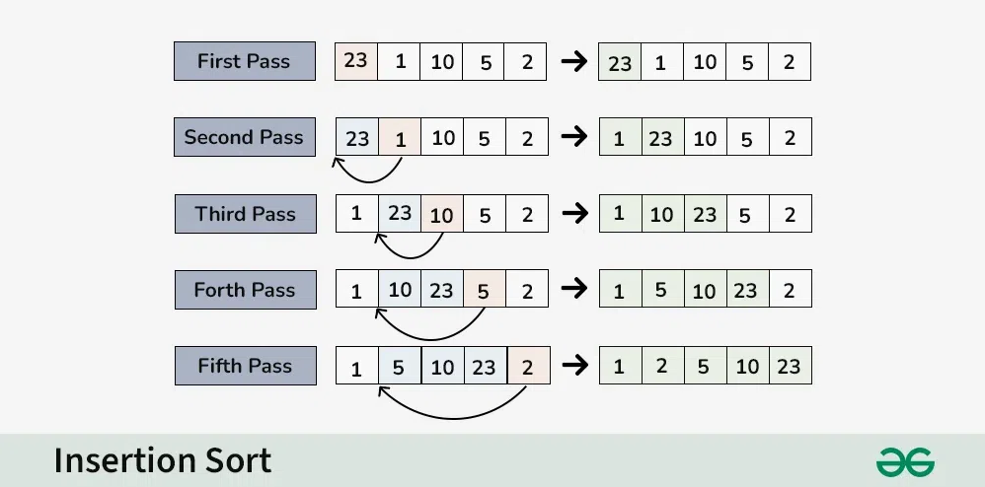
Insertion Sort

Slide 19
Acknowledgements
GeekForGeeks
CodeBasics

