Slide 1
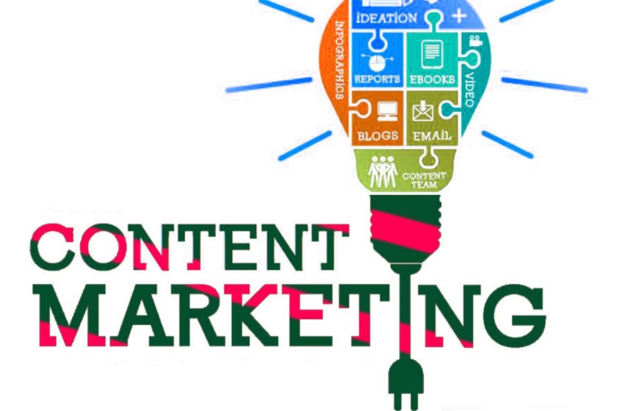
Content marketing

Slide 2
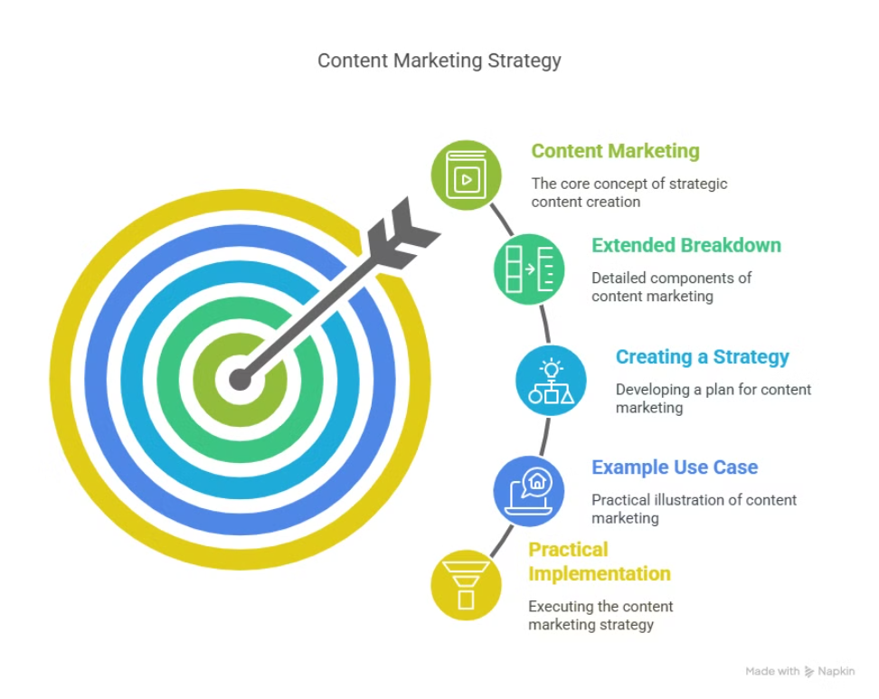
Agenda

Slide 3
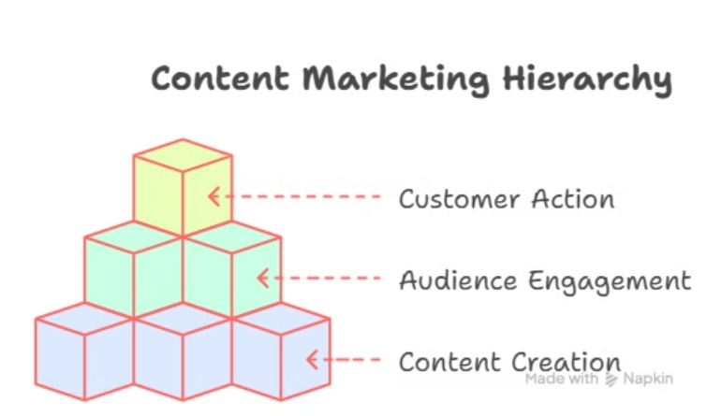
What?: A strategic approach to creating, publishing, and distributing valuable, relevant, and consistent content.
What is content marketing?
Goal: Attract and engage a defined audience to drive profitable customer action.
Focus: Provide value, build trust,
and establish authority.

Slide 4
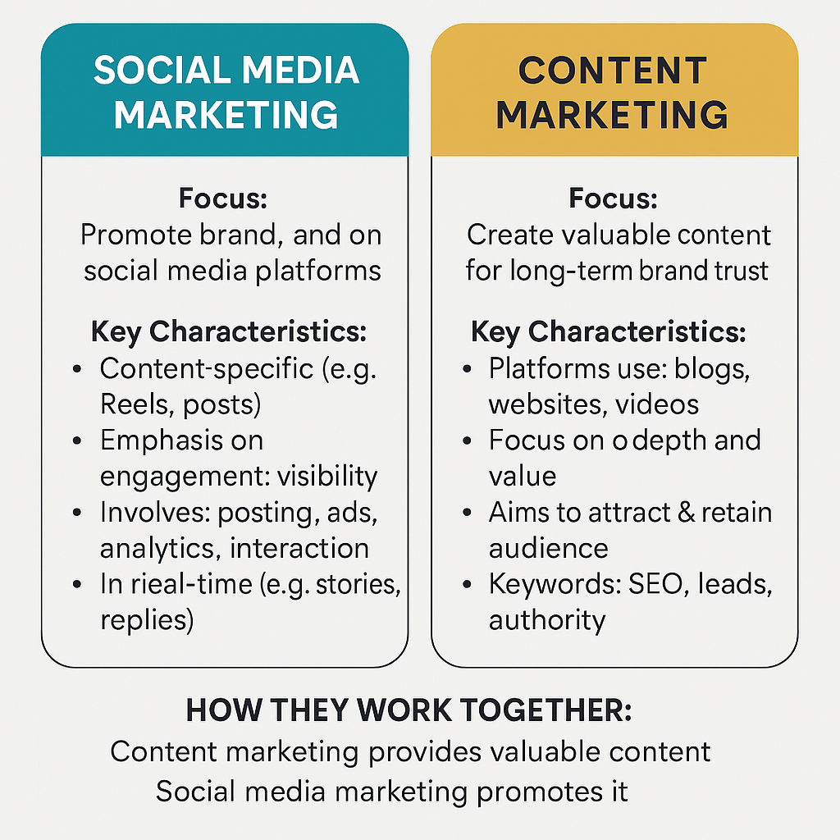
Difference between Content and Social media Marketing

Slide 5
Use Case
Content marketing isn’t about direct selling; it’s about creating content that your audience
finds genuinely useful or entertaining, which in turn builds a relationship with your brand.
A fitness brand sharing workout tips to attract health enthusiasts.
A software company publishing a guide on “How to Improve Productivity” to build trust.
A local bakery posting recipes to establish authority in baking.
Examples
Fitness Brand (Provide Value): A company like Decathlon might create a blog series on “10-Minute Workouts for Busy Professionals.” This provides value to their audience (health-conscious people with limited time), attracting them to the brand without directly selling their equipment. Over time, these readers may trust Decathlon enough to purchase a bike or subscription.
Software Company (Build Trust): A company like Asana, which offers project management tools, might publish an e-book titled “How to Improve Productivity in Remote Teams.” This content helps their target audience (businesses and team leaders) solve a real problem, building trust in Asana as a knowledgeable leader in the space. Readers are more likely to try Asana’s software because they’ve already benefited from their content.
Local Bakery (Establish Authority): A small bakery in a community might post weekly recipes on Instagram, like “How to Make the Perfect Sourdough at Home.” By sharing expertise, they position themselves as the go-to authority on baking in their area, encouraging followers to visit the bakery for fresh bread or baking classes.

Slide 6

Brainstorm Content Types
Interactive
Short-Form Video
Quizzes, challenges.
Behind-the-scenes.
User-Generated
UGC campaigns.

Slide 7
Assignment : Brainstorm the following scenarios
Think of a small business (e.g., a local bakery or tech startup).
• Brainstorm 3 types of content you can create to attract customers.
• Share your ideas with the group.
Present your idea in the form of a PPT/PDF document
Max Time: 15 minutes
Max marks : 20

Slide 8
#Inspirations
Interactive Instagram Stories Quiz: Create a “What’s Your Perfect Pastry?” quiz where followers answer questions (e.g., “Sweet or savory?” “Morning or evening treat?”) and get a personalized pastry recommendation linked to the bakery’s menu. This engages followers and drives traffic to the bakery.
Behind-the-Scenes Video Series: Film short videos showing the baking process (e.g., “How We Make Our Famous Cinnamon Rolls”) and share them on TikTok or YouTube Shorts. This builds transparency and trust while showcasing expertise.
User-Generated Content Campaign: Launch a campaign asking customers to share photos of their bakery purchases with a hashtag (e.g., #MyBakeryMoment) and feature the best ones on the bakery’s social media. This fosters community and provides authentic testimonials.(You can add a Bakery photo on Instagram)

Slide 9

Extended Breakdown of Content Marketing

Slide 10
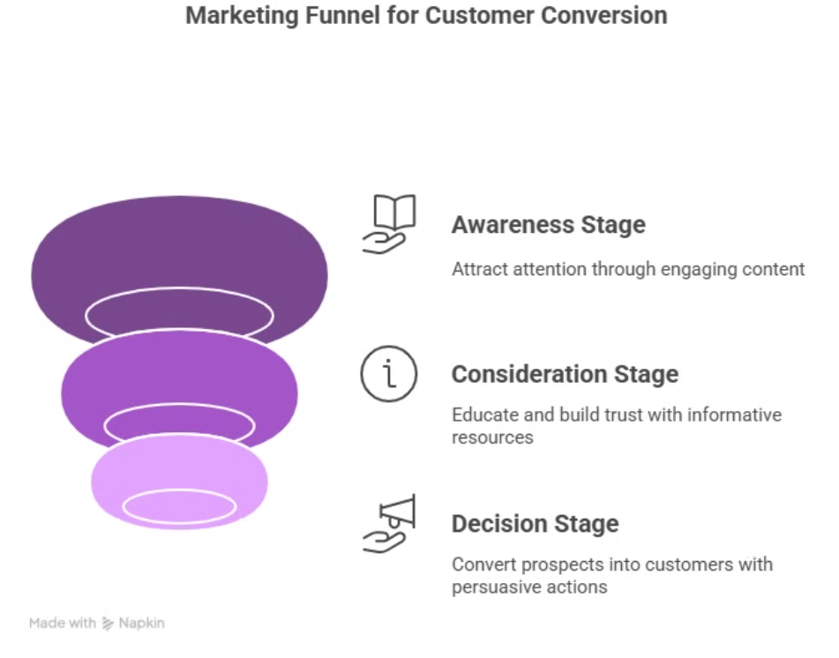
The Content Marketing Funnel
Awareness Stage: Attract attention (e.g., blog posts, social media, infographics).
Consideration Stage: Educate and build trust (e.g., case studies, webinars, how-to guides).
Decision Stage: Convert (e.g., product demos, testimonials, free trials).

Slide 11

Types of Content
Written: Blogs, whitepapers, e-books.
Purpose: Educate, inform, or establish thought leadership.
Examples: A blog post on “How to Train Your Puppy” (pet brand), a whitepaper on “The Future of Remote Work” (tech company), an e-book on “Healthy Meal Prep Ideas” (nutrition brand).
Visual: Infographics, videos, memes.
Purpose: Engage, entertain, or simplify complex information.
Examples: An infographic on “The Benefits of Organic Pet Food” (pet brand), a video tutorial on “Setting Up Your First Project in Our Software” (tech company), a meme about “Monday Morning Struggles” (relatable for any brand).
Interactive: Quizzes, polls, calculators.
Purpose: Increase engagement, personalize experiences, or
collect data.
Examples: A quiz on “What’s Your Dog’s Personality Type?” (pet brand), a poll on “What’s Your Biggest Work Challenge?” (tech company), a calculator for “How Much Can You Save with Our Software?” (SaaS company).

Slide 12
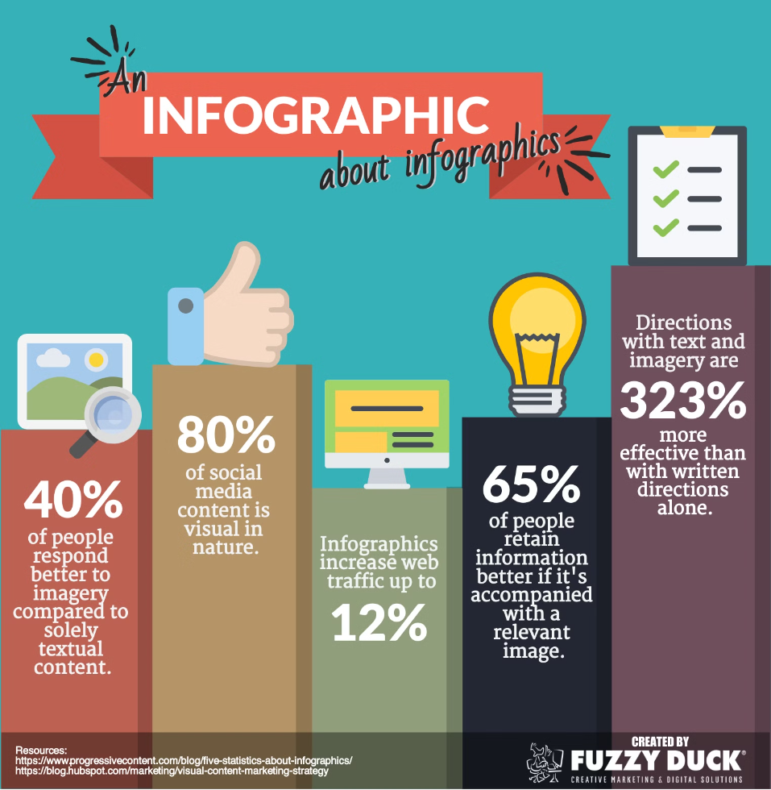
Detailed breakdown of Content types
Written Content:
Why it’s effective: Written content is great for in-depth education and SEO (e.g., blogs rank well on Google). It’s also versatile for
repurposing (e.g., a whitepaper can be turned into blog posts).W
Example :
Audience fit: Blogs work well for audiences seeking detailed information (e.g., professionals, researchers), while e-books appeal to those looking
for comprehensive guides (e.g., hobbyists, learners).
Blue Tokai Blog : https://bluetokaicoffee.com/blogs
Visual Content:
Why it’s effective: Visuals are highly shareable and digestible, making them ideal for social media. They can also evoke emotions
(e.g., a funny meme) or simplify data (e.g., an infographic).
Example
Audience fit: Videos and memes resonate with younger audiences (e.g., Gen Z on TikTok), while infographics
appeal to busy professionals who want quick insights.
Interactive: Quizzes, polls, calculators.
Purpose: Increase engagement, personalize experiences, or collect data.
Examples: A quiz on “What’s Your Dog’s Personality Type?” (pet brand), a poll on “What’s Your Biggest Work Challenge?” (tech company), a calculator for “How Much Can You Save with Our Software?” (SaaS company). Visual: Examples of each type (e.g., screenshot of a blog, an infographic, a quiz interface)

Slide 13
Use case : Content Marketing Strategy for
" GreenThreads " – A Sustainable Fashion Brand.
Business Overview: GreenThreads is a newly launched sustainable fashion startup based in your city. The brand specializes in eco-friendly casual wear made from organic materials and is committed to zero-waste packaging. With minimal online presence and low brand awareness, GreenThreads is looking to grow its customer base by leveraging content marketing strategies.

