Slide 1
SALES & MARKETING with AI

Slide 2
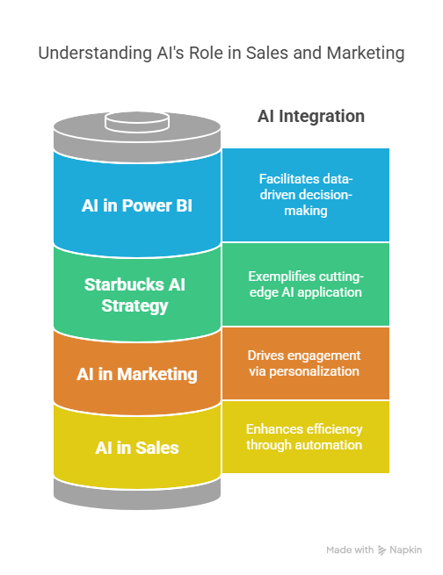

Slide 3
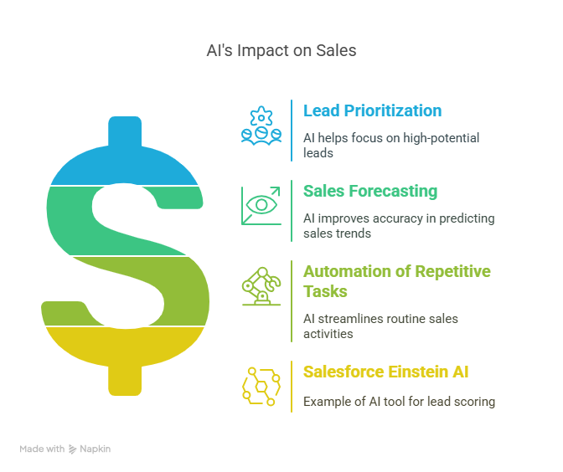

Slide 4
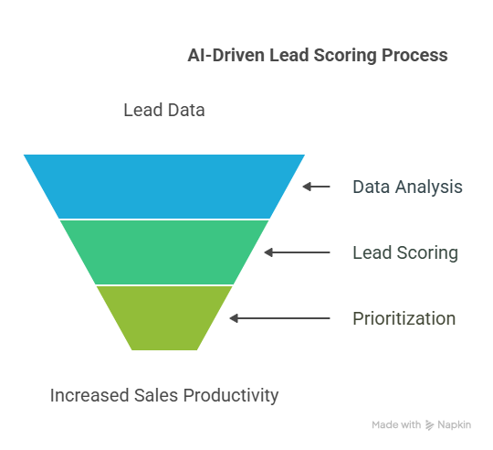
What is Lead Scoring?
Ranking leads based on conversion likelihood
AI analyzes:
Past deal closures
Email interactions
Demographics and behavior
Case Study:
Company: HubSpot
Problem: Too many leads to manually assess
AI Solution: Used AI to automatically score leads based on CRM interaction data
Results: 40% increase in sales productivity, faster response to hot leads.

Slide 5
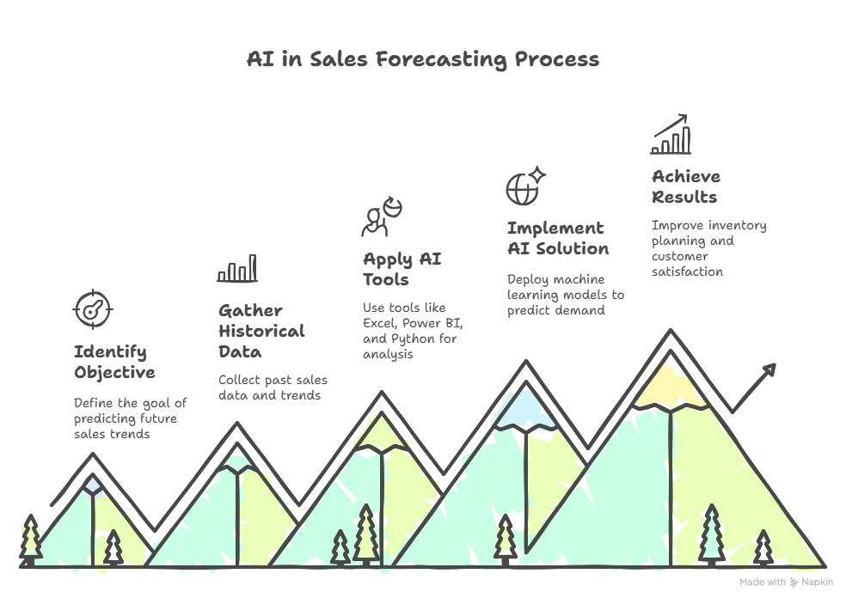

Slide 6
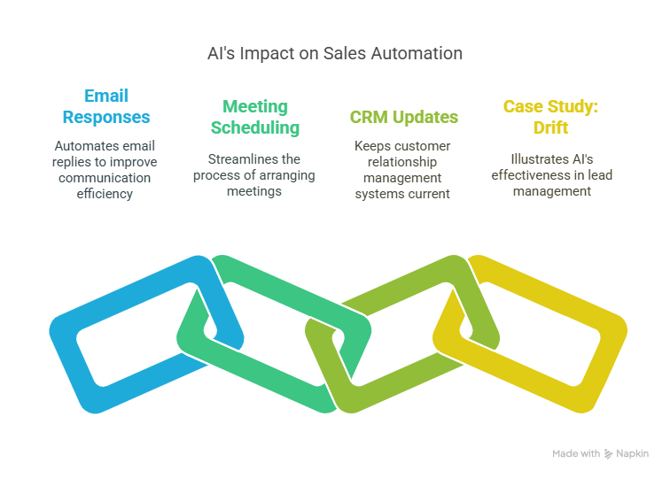
Case Study:
Company: Drift
Problem: Delayed responses to incoming leads on website
AI Solution: Deployed Drift chatbot to handle queries, schedule calls, qualify leads
Results: 70% faster lead response time, increased lead conversion

Slide 7
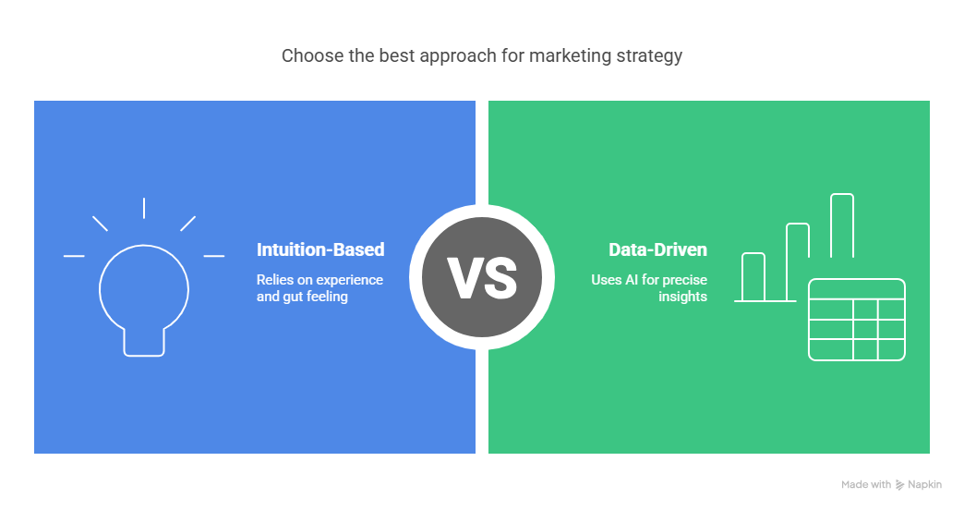
AI is key for:
Customer segmentation
Predictive content recommendations
Real-time campaign tweaks
Stat: 80% of marketers using AI report increased campaign performance

Slide 8
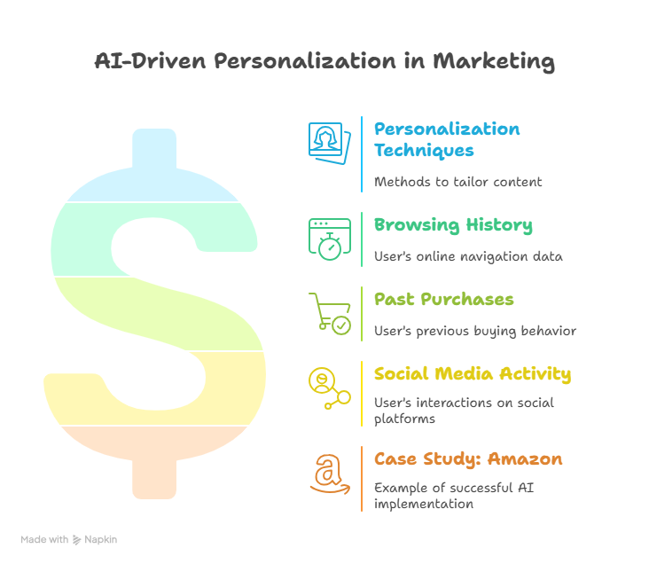
Case Study:
Company: Amazon
Problem: Generic product listings resulted in low click-through rates
AI Solution: Deployed recommendation engine based on user purchase and viewing history
Results: 35% of Amazon's revenue attributed to AI-driven personalization

Slide 9
Case Study - Starbucks AI-Powered Personalization
Problem: Low engagement with generic promotions across diverse customer base
AI Solution:
Starbucks used Deep Brew, its proprietary AI engine
Analyzed billions of data points: past purchases, seasonal preferences, local weather, and time of day
Deployed real-time decision engines to send highly customized offers
Personalized drink and food suggestions via mobile app and email
Adjusted promotion timing based on user's location and habits
Implementation Channels:
Starbucks Rewards App
In-store personalization
Email campaigns
Results:
3X higher customer engagement on personalized offers
300% growth in mobile orders
10%+ increase in revenue per customer
Key Takeaway: AI-fueled personalization is not just convenient—it’s a powerful revenue driver

Slide 10
Thank you

