Slide 1
UNIT-5: I/O Organization

Slide 2
Syllabus
Different types of I/O devices and I/O transfer schemes
Programmed Input/output
Interrupts
Direct Memory Access
Interface circuits
Standard I/O Interfaces
I/ O Processors

Slide 3
Different I/O transfer schemes

Slide 4
Different I/O transfer schemes
The data that we use is actually binary information that we send and receive between I/O device and memory storage.
Processor(CPU) executes any I/O instruction by taking data from memory and then again writing back the updated data into memory. So the source and target is memory unit.
Memory
CPU
I/O

Slide 5
Data Transfer between CPU and I/O devices may be handled in a variety of modes.
Some modes use the CPU as an intermediate path ,others transfer the data directly to and from the memory unit.
Data transfer to and from peripherals may be handled in one of three possible modes.
Programmed I/O
Interrupt- Initiated I/O
Direct Memory Access(DMA)

Slide 6
Programmed I/O
Programmed I/O: It is one simplest form of I/O where CPU has to do all the work.
This technique transfer the data between the processor and the I/O module.
It is due to the result of the I/O instruction that are written in the computer program.
Each data item transfer is initiated by an instruction in the program.
In this case it requires constant monitoring by the CPU of the peripheral devices by using interface

Slide 7
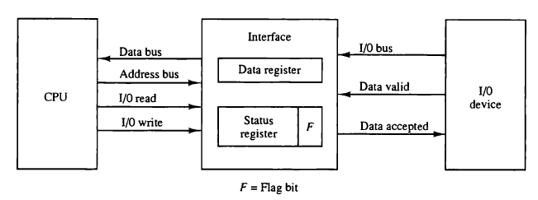

Slide 8
Example: Using Programmed I/O for Key Press Detection
CPU is waiting for you to press a button on a keyboard. The CPU is tasked with detecting this key press and responding accordingly.
Scenario:
CPU Polling: The CPU checks the keyboard status continuously, asking, "Has a key been pressed?" This status check occurs repeatedly, at high speed.
Busy-Waiting: As long as no key is pressed, the CPU is "busy-waiting." It’s in a loop, constantly checking the keyboard status rather than performing other tasks. This keeps the CPU busy but unproductive.
Key Press Detected: When a key is finally pressed, the keyboard status changes to indicate a key event. The CPU notices this change and then reads the key value (which key was pressed) from a specific memory address linked to the keyboard.
CPU Action: Once the CPU has read the key's value, it can process this input (e.g., display the character on the screen).

Slide 9



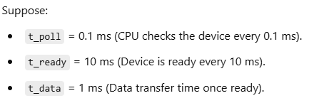
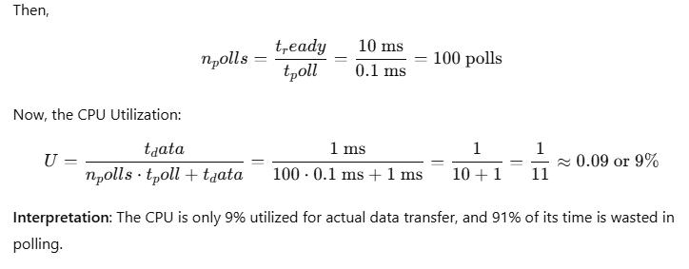
Solution 1: CPU Utilization

Slide 10
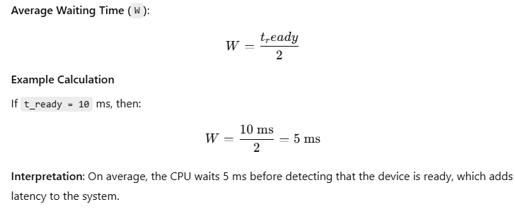
Solution 2: Average Waiting Time

Slide 11
Advantages:
Simple to implement
Very Little hardware support
Disadvantages
Busy waiting as CPU need to continuously monitor the I/O devices to check whether I/O devices are ready for transfer or not.
Ties up CPU for long period with no useful work.

Slide 12
Interrupt –initiated I/O
The disadvantage of programmed I/O(continues busy waiting of CPU) is overcome by this technique
This uses the interrupt facility
This interrupt facility along with special commands issue an interrupt request signal whenever data is ready for transfer.
Whenever interrupt is received for the data transfer by the CPU. Then the CPU performs the data transfer.
While in the other time, when data transfer is not being performed, then CPU performs some other program execution.

Slide 13
Cont..
The Interface meanwhile keeps monitoring the I/O devices.
When I/O device is ready for data transfer it initiates an interrupt request signal to the computer.
When CPU receives this “Interrupt request signal”, the CPU stops the current task and shifts to perform the I/O data transfer .
After I/O data transfer is completed then again CPU moves the previous task and continues that task.

Slide 14
Example of Interrupt-Initiated I/O
Let's imagine a keyboard sending data to a computer. Instead of the CPU constantly checking if a key is pressed (as in programmed I/O), the keyboard generates an interrupt whenever a key is pressed, signaling the CPU to read the keystroke.
Key Press: When a key is pressed, the keyboard controller sends an interrupt signal to the CPU.
Interrupt Signal: The CPU receives the interrupt, pauses its current task, and executes the interrupt handler associated with the keyboard.
Data Read: The interrupt handler reads the keystroke data from the keyboard and stores it in a buffer.
Resume Task: The CPU then resumes the task it was performing before the interrupt.

Slide 15
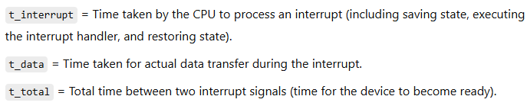

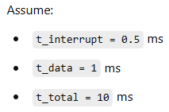
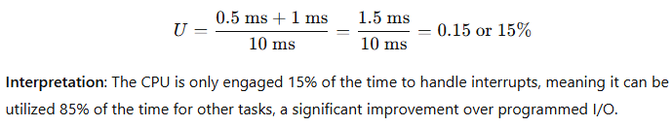
Solution 1: CPU Utilization in Interrupt-Initiated I/O

Slide 16

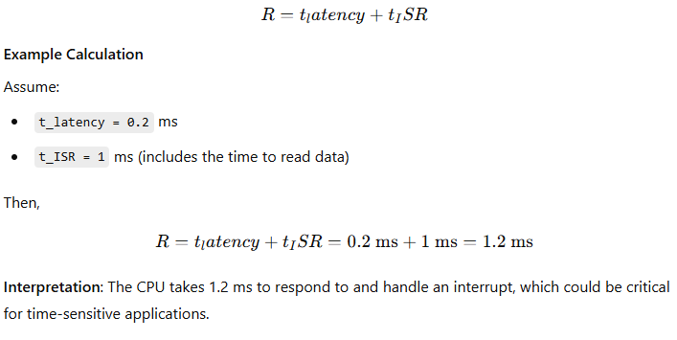
Solution 2: Response Time
Response Time is the total time taken to handle the interrupt, including latency and processing time.

Slide 17
Advantage
Fast and Efficient
Disadvantage
Even here CPU has the manage both data transfer and program execution task.
I/O devices data transfer time taking process.

Slide 18
Direct Memory Access(DMA)
This allows data transfer directly between I/O device and memory unit through the memory bus.
The CPU just initiates the data transfer by supplying interface, starting address and number of words to be transferred and then proceeds to execute other tasks.
Memory
CPU
I/O

Slide 19
When data is ready is transfer, then DMA requests memory through the memory bus.
Then memory controller grants the request and allows DMA to transfer the data directly into memory.
Then CPU stops memory access operation for some time to allow the direct memory I/O transfer.
Peripheral data transfer speed is usually slower than processor.

Slide 20
Example of DMA in Use
Let’s consider a simple example of transferring data from a disk drive to RAM. Suppose an application needs to load a large file from disk into memory. Rather than involving the CPU in each data word transfer, the DMA controller is configured to manage this task.
CPU Setup: The CPU initiates the DMA transfer by setting up the DMA controller with:
The disk’s data address (source),
The memory address in RAM (destination),
The transfer size (e.g., 1 MB).
DMA Transfer: The DMA controller enables the transfer, moving data directly from the disk to RAM without CPU intervention.
Completion: When the 1 MB transfer is complete, the DMA controller generates an interrupt to notify the CPU.

Slide 21
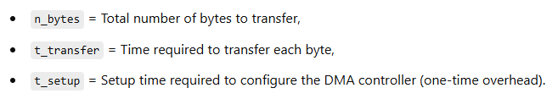
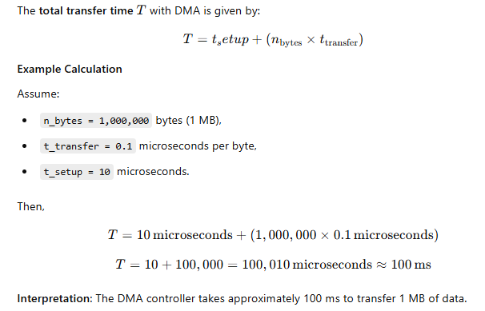
Solution 1: Data Transfer Time with DMA
Suppose we want to calculate the time taken by a DMA controller to transfer a block of data from an I/O device to memory.

Slide 22
Advantages
Allows a peripheral devices to read from/write to memory without going through the CPU.
Allows for faster processing since the processor can be working on something else while the peripheral can be populating memory.
This is highly efficient for high-volume data transfers because it offloads the data transfer work from the CPU to a specialized DMA controller, allowing the CPU to perform other tasks.
Disadvantages
Requires a DMA controller to carry out the operation which increases system cost.

Slide 23
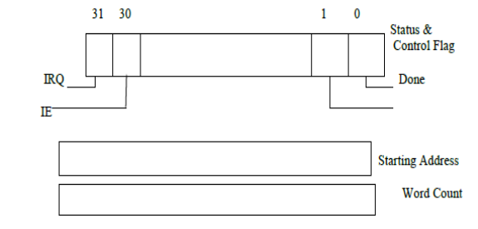
Registes in a DMA Interface
R/W → Determines the direction of transfer.
When
R/W =1, DMA controller read data from memory to I/O device.
R/W =0, DMA controller perform write operation.
Done Flag=1, the controller has completed transferring a block of data and is ready to receive another command.
IE=1, it causes the controller to raise an interrupt (interrupt Enabled) after it has completed
transferring the block of data.
IRQ=1, This signal is set when the controller has completed its task and wants the CPU to acknowledge it.

Slide 24
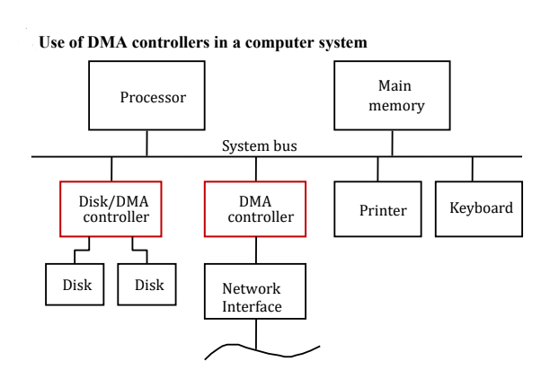
Starting the DMA Transfer:
To move a block of data from the computer's main memory to a disk, the program tells the DMA controller where to find the data in memory and how much data to transfer (word count). This information is sent to the registers of the DMA linked to the chosen disk.
DMA Transfer Process:
The DMA controller then takes over the data transfer process. It moves the data directly from memory to the disk without needing the CPU's constant involvement, freeing up the CPU for other tasks.
Completion of the Transfer:
Once the DMA transfer is finished, the controller updates its status and control registers. It sets the "done bit," and both IRQ (Interrupt Request) and IE (Interrupt Enable) signals to 1. This indicates that the transfer is complete and alerts the CPU that it can perform any next steps needed with the transferred data.

Slide 25
Types of transfers in DMA
1. Cycle Stealing
DMA (Direct Memory Access) devices uses the system bus with higher priority than the CPU, especially for high-speed peripherals like disks, network interfaces, and graphics display devices.
The DMA controller "steals" these cycles to access memory directly. This method, where DMA briefly takes control of the bus from the CPU, is called Cycle Stealing.
Example: Imagine a network interface card (NIC) that receives data packets and needs to store them in memory. During Cycle Stealing, the NIC momentarily takes control of the bus to store each packet directly in memory, pausing the CPU briefly. This allows high-priority devices like disks and NICs to function efficiently without waiting for CPU cycles.

Slide 26
2. Block Transfer Mode / Burst Mode
Concept: In Burst Mode, the DMA controller is granted uninterrupted access to the bus, allowing it to transfer an entire block of data without the CPU intervening.
Example: Suppose a hard drive is transferring a large file to memory. Instead of taking control of the bus for each piece of data, it gains exclusive bus access, moving the whole block of data in a "burst." This reduces interruptions and is faster than Cycle Stealing.
3. Bus Master
Concept: The Bus Master is the device that currently has control of the bus and can initiate data transfers. Only one device can be the bus master at any moment.
Example: In a system with a printer, disk drive, and network card, the bus master changes based on which device needs priority access. If the disk drive is transferring data, it becomes the bus master until it’s finished, after which the network card might become the master to handle incoming data packets.

Slide 27
4. Bus Arbitration
Concept: Bus Arbitration is the process of selecting which device becomes the next bus master when multiple devices request access to the bus.
Example: When both the disk drive and network card need the bus, arbitration decides which gets priority. The system will follow predefined rules or a controller to determine the bus master based on factors like device priority and task urgency.
Types of Bus Arbitration:
Centralized Arbitration: A single controller (like the CPU) decides the next bus master.
Distributed Arbitration: Devices collectively decide who becomes the next bus master without a central controller.

Slide 28
Centralized Arbitration Process
Concept: In Centralized Arbitration, the CPU is usually the main bus controller which grants bus access to a DMA controller.
Example Process:
Bus Request (BR): If a printer connected through a DMA controller needs the bus to send data to memory, it signals this by activating the Bus Request (BR) line. This BR line is shared by all devices.
Bus Grant (BGI): The CPU, noticing the BR signal, responds with a Bus Grant (BGI) signal. This grants permission to the DMA controller (for the printer) to take control of the bus when it’s free.
Daisy Chain and Bus Busy (BBSY): If the printer's DMA controller gains control, it prevents other devices from using the bus by activating a Bus Busy (BBSY) line.

Slide 29
Distributed Arbitration is a method where multiple devices collectively decide who will become the bus master without relying on a central controller. Each device participates in the arbitration process, typically based on priority levels or unique identification codes. This decentralized approach can reduce delays and allow faster access to the bus.
How Distributed Arbitration Works:
Device Priority Levels: Each device on the bus is assigned a unique priority or ID.
Request Signal: When a device needs access to the bus, it sends a request signal.
Arbitration Process: All devices monitor the request signals and follow a set protocol to determine which device will take control based on priority.
Bus Master Assignment: The device with the highest priority or ID wins the arbitration and becomes the bus master for that cycle.

Slide 30
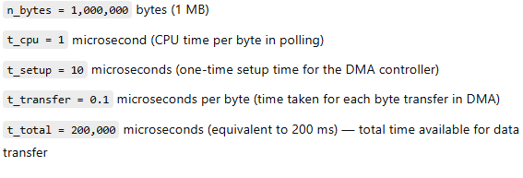
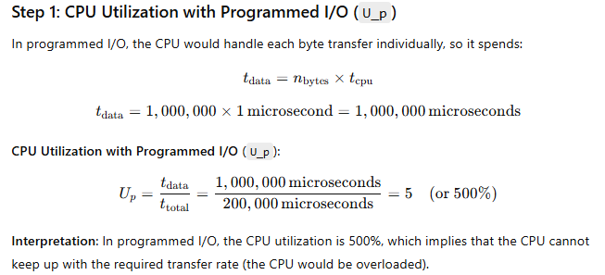
CPU Utilization with DMA vs. Programmed I/O

Slide 31
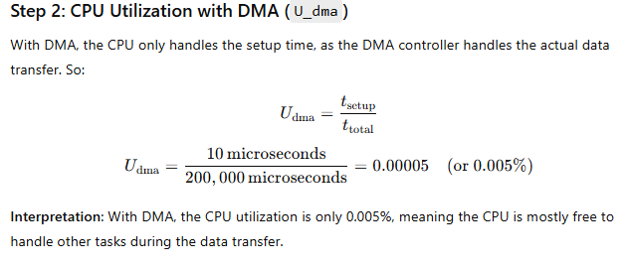
Cont…

Slide 32
Interface circuits
A mediator between the system.
How communication media is connected to sender or how communication media is connected to receiver is called interface circuit.
End Port Connectivity is called interface circuit.
Sender
Communication Media
Receiver
Communication Media
Interface Circuit
Interface Circuit

Slide 33
Port: It is a point at which external device attaches to computer system. This sents /receives the data
There are two ways we can connector interface
(i) Parallel Port
(ii) Serial Port

Slide 34
Parallel Port:
More data(8 bit or 16 bit) can be transferred between the systems simultaneously by using more number of bits.
Fast Transmission.
Only when all the systems are close to each other parallel port is possible because many wires are used.

Slide 35
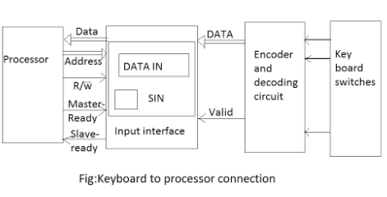
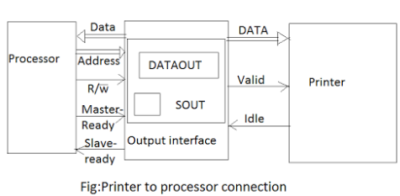

Slide 36
A typical keyboard consists of mechanical switches that are normally open. When a key is pressed, its which closes and establishes a path for an electrical signal.
This signal is detected by an encoder circuit that generates the ASCII code for the corresponding character.
The output of the encoder consists of the bits that represents the encoded character and one control signal called valid, which indicates that a key is being pressed.
This information is sent to the interface circuit, which contains a data register DATAIN, and a status flag SIN.
When a key is pressed, the valid signal changes from o to 1 causing the ASCII code to be loaded into DATAIN and SIN to be set to 1.

Slide 37
SIN is cleared to 0 when the processor reads the contents of the DATAIN register.
The interface circuit is connected to an asynchronous bus on which transfers are controlled using the handshake signals Master-ready and Slave-ready. The third control line, R/W’ distinguishes read and write transfers.
The operates under control of the handshake signals valid and idle in a manner similar to the handshake used on the bus with the Master-ready and slave-ready signals.
When it is ready to accept a character, the printer asserts its idle signal.
The interface circuit can then place a new character on the data lines and activate the valid signal. In response the printer starts printing the new character and negates the idle signal, which helps the interface to deactivate the valid signal.
The interface contains a data register, DATAOUT and a status flag, SOUT flag is set to 1 when the printer is ready to accept.

Slide 38
Serial Port:
Transfer of data is only one way is possible, two way(simultaneously) is not possible.
One bit at a time can only be transferred.
Slow Transmission.
This is applicable even when systems are loaded at longer distance.
They are not costly.

Slide 39
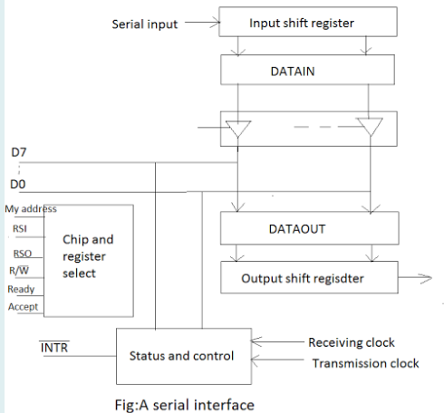

Slide 40
From the figure, the input shift register accepts bit serial input from the I/O devices. When all 8 bit have been received, the contents of this shift register are loaded in parallel into the DATAIN register.
Similarly, output data in the DATAOUT register are loaded into the DATAOUT register, i.e output registe from which the bits are shifted out and sent to the I/OM devices.
The status flags set to 1 when new data are loaded in DATAIN,it is cleared to 0 when the processor reads the contents of DATAIN.
Serial transmission is convenient for connecting devices that are physically for away from the computer.
The speed of the transmission, often given as a bit rate, depends on the nature of the devices connected.

Slide 41
Output Shift Register: It converts the data in the DATAOUT register into a serial format to be sent out.
Chip and Register Select: This block manages data routing and access, ensuring that data is read from or written to the correct location. It includes address and control signals (like R/W for read/write) to facilitate communication.
Status and Control: This component monitors and controls the status of the data transfer process. It includes the INTR (interrupt) line, which signals when data transfer is complete or when the system is ready for new data.
Clocks: Separate receiving and transmission clocks ensure synchronization for data flow in and out.

Slide 42
Key Functions of Interface Circuits
Interface circuits are crucial because they manage several aspects of communication, including:
Signal Conversion: They often need to convert signals to be compatible with different devices. For instance, digital signals may need to be converted to analog or vice versa.
Voltage Level Shifting: Different devices may operate at different voltage levels, so interface circuits adjust voltages accordingly to ensure compatibility and prevent damage.
Data Synchronization: Interface circuits handle the timing and synchronization of data transfer, as various devices can operate at different speeds.
Control and Status Signals: These circuits help in generating control signals required for data transfer, and they often manage status signals that indicate the readiness of a device to send or receive data.
Error Detection and Correction: Some interfaces include error-checking mechanisms to ensure data integrity during transfer.

Slide 43
Also learn about
Memory Interfaces, Bus Interfaces, Network Interfaces

Slide 44
Standard I/O Interface
Used to connect I/O to the computer.
Types of Standard I/O Interface
1) Peripheral Component Interconnected (PCI) Bus
2) Small Computer System Interface(SCSI) Bus
3) Universal Serial Bus(USB)

Slide 45





















1) PCI BUS

Slide 46
Host is the processor
PCI Bus is communication channel between host, main memory and all the set of I/O devices.
The data from I/O devices is send to the host and main memory using PCI Bus.
The PCI bridge deviates the data between main memory and host.
This is less expensive
It will connect only I/O devices and its corresponding memory location
Introduced in the 1990s, it serves as an internal expansion bus for connecting hardware components like graphics cards, network cards, sound cards, and other peripherals, allowing these components to communicate with the CPU and system memory efficiently.

Slide 47
Key Features of PCI Bus
High Data Transfer Speed: PCI enables faster data transfer rates compared to previous standards like ISA (Industry Standard Architecture).
Plug-and-Play: PCI supports plug-and-play, meaning that new devices can be automatically detected and configured by the system without needing manual configuration.
Multiple Device Support: PCI can support multiple devices connected to the same bus, allowing them to communicate with the CPU over shared pathways.
Supports 32-bit and 64-bit Data Widths: PCI can handle both 32-bit and 64-bit wide data paths, which affects the amount of data transferred in each clock cycle.
Parallel Communication: The bus uses parallel communication, which allows data to be sent on multiple channels simultaneously.

Slide 48
Example Scenario
Suppose we have a computer with a PCI-based graphics card (GPU) and a network card both connected to the CPU via the PCI bus. Here’s a step-by-step explanation of how the PCI bus works to manage these devices’ requests and interactions with the CPU.
1. Device Initialization and Plug-and-Play Setup
When the computer powers on, the operating system detect the connected PCI devices (graphics card and network card in this case) and assign resources.
The operating system configures each device’s I/O addresses and interrupt requests (IRQs) automatically. This is part of the PCI’s plug-and-play capability.

Slide 49
2. Bus Arbitration
Both the graphics card and network card may need to communicate with the CPU at the same time. The PCI bus arbiter (a part of the PCI controller) decides which device gets access first.
Let's say the graphics card has a higher priority than network card has a slightly lower priority as it handles less time-sensitive data.
3. Synchronous Data Transfer via Clock Signal
Once the graphics card gains access to the PCI bus, it starts communicating data to the CPU with the help of the system clock signal.
PCI uses a synchronous clock, meaning that each data transfer is synced with the clock pulse, typically at 33 MHz (or higher for newer versions).
Data moves from the graphics card to the CPU in small, timed chunks or bursts to match the clock speed. This synchronization allows reliable, predictable data transfer rates.

Slide 50
4. Data Transmission from Graphics Card to CPU
The graphics card starts a data burst to transfer image data to the CPU or memory.
The PCI controller begins the data transfer by issuing a start signal and identifying the target device's address on the PCI bus.
Each burst is a group of multiple data packets sent sequentially, allowing high-speed transmission and reducing latency.
During each data packet transfer, error-checking is performed to ensure no data corruption. If an error is detected, the packet may be retransmitted.

Slide 51
5. Network Card Request and Interrupt Handling
While the graphics card transfers data, the network card might also have data packets arriving from an internet connection that it needs to pass to the CPU.
Once the graphics card completes its data transfer, the network card requests access to the PCI bus. The bus arbiter then grants the network card access.
The network card transfers data packets to the CPU, but this time, it might generate an interrupt to notify the CPU of the data’s arrival (e.g., incoming data from an online video stream).
The CPU temporarily stops its current task to process the interrupt, retrieves data from the network card, and then resumes its regular operations.
6. Automatic Configuration and Memory Mapping
Throughout this process, the PCI bus’s configuration setup allows the CPU and devices to use I/O addresses and memory mappings for efficient communication.
The plug-and-play feature ensures that each device is correctly configured and does not interfere with others on the bus.

Slide 52
2) SCSI Bus
It was developed by American national standard interface(ANSI)
It doesnot support plug and play
Can transfer only 16 data lines
Two types
1) Narrow SCSI Bus which can hold 8 data lines
2) Wide SCSI Bus which can hold 16 data lines.

Slide 53
Key Features of SCSI
Multi-Device Support: A single SCSI bus can connect up to 8 or 16 devices (depending on the SCSI version), including the host adapter.
High-Speed Data Transfer: SCSI offers faster data transfer rates compared to older interfaces like IDE.
Daisy-Chaining: Devices are connected in series (daisy-chained) using a single cable, with termination at both ends of the chain.
Wide Compatibility: SCSI supports a variety of devices, from storage to input/output devices.
Intelligent Communication: Devices on the SCSI bus can negotiate data transfer speeds and modes for optimal performance.
Independent Operation: Devices can operate independently, allowing simultaneous data transfers between the CPU and multiple devices.

Slide 54
Example of SCSI in Action
Suppose a computer has a SCSI hard drive, a SCSI scanner, and a SCSI printer connected to a single SCSI bus.
Device Initialization:
Each device is assigned a unique SCSI ID during setup.
The host adapter scans the bus during startup to identify all connected devices.
Hard Drive Access:
The CPU, through the SCSI host adapter, issues a read command to the hard drive (target).
The hard drive reads the data and sends it back to the CPU via the SCSI bus.
Simultaneous Operations:
While the hard drive transfers data to the CPU, the scanner may begin scanning a document, and the printer can start printing a job.
The SCSI bus's capability to handle independent operations allows this parallel processing.
Bus Arbitration:
If both the scanner and printer request the bus simultaneously, the device with the higher priority (lower SCSI ID) gains access first.
Efficient Termination:
The bus is terminated at both ends, ensuring smooth communication without data corruption.

Slide 55
3) USB
Supports plug and play
Supports dual speed of operation(1.5 megabits/12 megabits)
Also supports high speed-USB(2.0)(480 megabits/s)

Slide 56
Features of USB:
Plug-and-Play: Devices are detected and configured automatically upon connection, without requiring a system restart.
Hot-Swapping: Devices can be connected or disconnected while the computer is running.
Versatility: Supports a wide range of devices, from storage to audio and video peripherals.
Power Delivery: USB can supply power to devices, eliminating the need for separate power sources for smaller peripherals.
Scalability: Supports multiple devices using hubs.

Slide 57



























Slide 58
Working of USB:
Host and Device:
USB uses a master-slave architecture where the computer acts as the host and the connected devices act as slaves.
The host controls the communication and manages data transfers.
Communication Protocols:
USB communication is based on packets containing data and instructions.
The host initiates communication and assigns bandwidth to each connected device.
Data Transfer Modes:
Control Transfers: Used for device configuration.
Bulk Transfers: For large amounts of data (e.g., file transfers to a USB drive).
Interrupt Transfers: For low-latency communication (e.g., mouse or keyboard input).
Isochronous Transfers: For real-time applications (e.g., audio and video streaming).
Bus Power:
USB provides power through the cable, allowing small devices to operate without external power supplies.
Speeds and Versions:
USB has evolved through multiple versions, each offering higher data transfer rates:
USB 1.0/1.1: 1.5 Mbps (Low Speed) / 12 Mbps (Full Speed)
USB 2.0: 480 Mbps (High Speed)
USB 3.0/3.1: 5 Gbps (SuperSpeed) / 10 Gbps (SuperSpeed+)
USB 4.0: Up to 40 Gbps (similar to Thunderbolt 3/4)

Slide 59
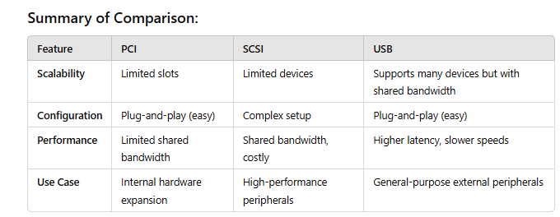

Slide 60
I/ O Processors
The concept of DMA operation can be extended to relieve the CPU further from getting involved with the execution of I/O operations.
This gives rise to the development of special purpose processors called Input-Output Processor (IOP) or IO channels.
The Input-Output Processor (IOP) is just like a CPU that handles I/O operations.
The IOP can fetch and execute instructions that are specifically related to I/O transfers.
In addition to the I/O-related tasks, it can also perform other processing tasks like arithmetic, logic, branching, and code translation.
The main memory related to this, is communicated with processor via DMA.

Slide 61
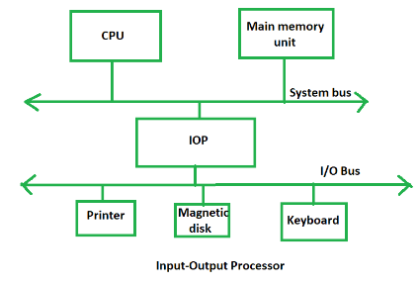
The Input-Output Processor is a specialized processor which loads and stores data in memory along with the execution of I/O instructions.
It acts as an interface between the system and devices. It involves a sequence of events to execute I/O operations and then store the results in memory.

Slide 62
Features of an Input-Output Processor
Specialized Hardware: An IOP is equipped with specialized hardware that is optimized for handling input/output operations. This hardware includes input/output ports, DMA controllers, and interrupt controllers.
DMA Capability: An IOP has the capability to perform Direct Memory Access (DMA) operations. DMA allows data to be transferred directly between peripheral devices and memory without going through the CPU, thereby freeing up the CPU for other tasks.
Interrupt Handling: An IOP can handle interrupts from peripheral devices and manage them independently of the CPU. This allows the CPU to focus on executing application programs while the IOP handles interrupts from peripheral devices.
Protocol Handling: An IOP can handle communication protocols for different types of devices such as Ethernet, USB, and SCSI. This allows the IOP to interface with a wide range of devices without requiring additional software support from the CPU.

Slide 63
Buffering: An IOP can buffer data between the CPU and peripheral devices. This allows the IOP to handle large amounts of data without overloading the CPU or the peripheral devices.
Command Processing: An IOP can process commands from peripheral devices independently of the CPU. This allows the CPU to focus on executing application programs while the IOP handles peripheral device commands.
Parallel Processing: An IOP can perform input/output operations in parallel with the CPU. This allows the system to handle multiple tasks simultaneously and improve overall system performance.

Slide 64
Applications of I/O Processors
Data Acquisition Systems: I/O processors can be used in data acquisition systems to acquire and process data from various sensors and input devices. The I/O processor can handle high-speed data transfer and perform real-time processing of the acquired data.
Industrial Control Systems: I/O processors can be used in industrial control systems to interface with various control devices and sensors. The I/O processor can provide precise timing and control signals, and can also perform local processing of the input data.
Multimedia Applications: I/O processors can be used in multimedia applications to handle the input and output of multimedia data, such as audio and video. The I/O processor can perform real-time processing of multimedia data, including decoding, encoding, and compression.
Network Communication Systems: I/O processors can be used in network communication systems to handle the input and output of data packets. The I/O processor can perform packet routing, filtering, and processing, and can also perform encryption and decryption of the data.
Storage Systems: I/O processors can be used in storage systems to handle the input and output of data to and from storage devices. The I/O processor can handle high-speed data transfer and perform data caching and prefetching operations.

Slide 65
Advantages of Input-Output Processor
The I/O devices can directly access the main memory without the intervention of the processor in I/O processor-based systems.
It is used to address the problems that arise in the Direct memory access method.
Reduced Processor Workload: With an I/O processor, the main processor doesn’t have to deal with I/O operations, allowing it to focus on other tasks. This results in more efficient use of the processor’s resources and can lead to faster overall system performance.
Improved Data Transfer Rates: Since the I/O processor can access memory directly, data transfers between I/O devices and memory can be faster and more efficient than with other methods.
Increased System Reliability: By offloading I/O tasks to a dedicated processor, the system can be made more fault-tolerant. For example, if an I/O operation fails, it won’t affect other system processes.
Scalability: I/O processor-based systems can be designed to scale easily, allowing for additional I/O processors to be added as needed. This can be particularly useful in large-scale data centres or other environments where the number of I/O devices is constantly changing.
Flexibility: I/O processor-based systems can be designed to handle a wide range of I/O devices and interfaces, providing more flexibility in system design and allowing for better customization to meet specific requirements.

Slide 66
Disadvantages of Input-Output Processor
Cost: I/O processors can add significant costs to a system due to the additional hardware and complexity required. This can be a barrier to adoption, especially for smaller systems.
Increased Complexity: The addition of an I/O processor can increase the overall complexity of a system, making it more difficult to design, build, and maintain. This can also make it harder to diagnose and troubleshoot issues.
Limited Performance Gains: While I/O processors can improve system performance by offloading I/O tasks from the main processor, the gains may not be significant in all cases. In some cases, the additional overhead of the I/O processor may actually slow down the system.
Synchronization Issues: With multiple processors accessing the same memory, synchronization issues can arise, leading to potential data corruption or other errors.
Lack of Standardization: There are many different I/O processor architectures and interfaces available, which can make it difficult to develop standardized software and hardware solutions. This can limit interoperability and make it harder for vendors to develop compatible products.

Slide 67
End of Unit-5

