Slide 1

Uber Cab Fare Prediction
Name: Dipesh Thakur
Batch : PGA-wd-28

Slide 2
Problem Statement :
The project is about on world's largest taxi company Uber inc. In this project, we're looking to predict the fare for their future transactional cases. Uber delivers service to lakhs of customers daily. Now it becomes really important to manage their data properly to come up with new business ideas to get best results. Eventually, it becomes really important to estimate the fare prices accurately.
This case study is to predict the price of the Uber ride from a given pickup point to the agreed drop-off location. Evaluating the models & compare their respective scores like R2, RMSE, etc.

Slide 3
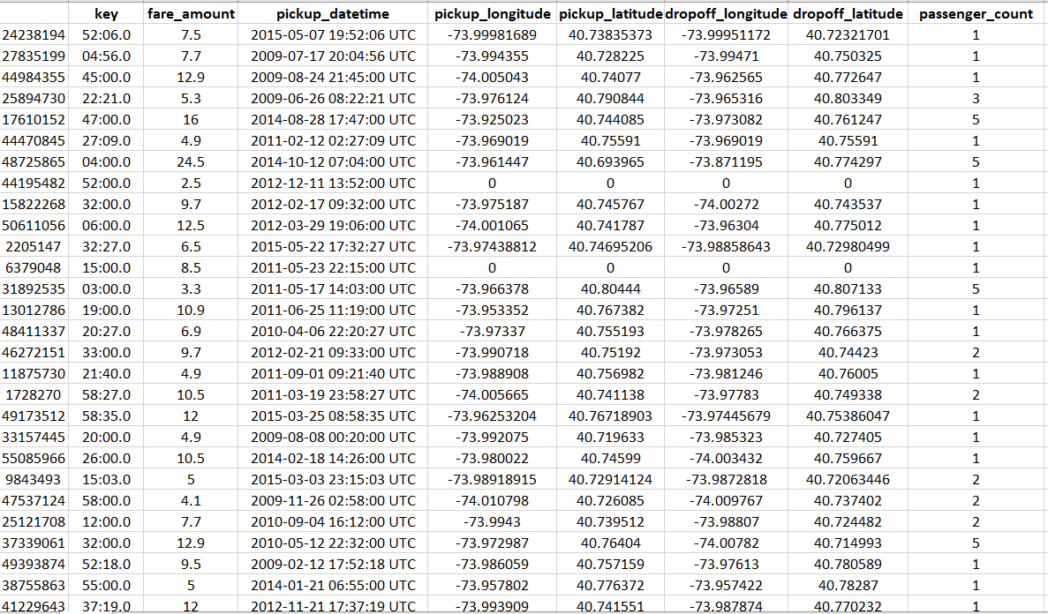
Dataset

Slide 4
Tasks:
Regression problem:
Dataset details: Uber Cab Fare
200000 Observations, 8 Independent Features, “fare_amount” Target variable
Mainly Tasks done in EDA:
Handling “Pickup datetime” data type.
There are four columns which are “Pickup Longitude”, “Pickup Latitude”, “Drop off Longitude”, &“Drop off Latitude” using Haversine Formula calculate the Distance.
Handling outliers in columns.
Check Missing values.
Checking Corelation Matrix.

Slide 5
Data Cleaning Steps
Handling “Pickup datetime” data type (object) and convert into the type of ‘datetime’
Drop unnecessary columns.
Calculating Distance by using Haversine formula.
Checking summary statistic of numeric feature.
Checking and handling Outliers.
Handling Missing values.
Check correlation between features.
Analysis of relation with target variable.

Slide 6
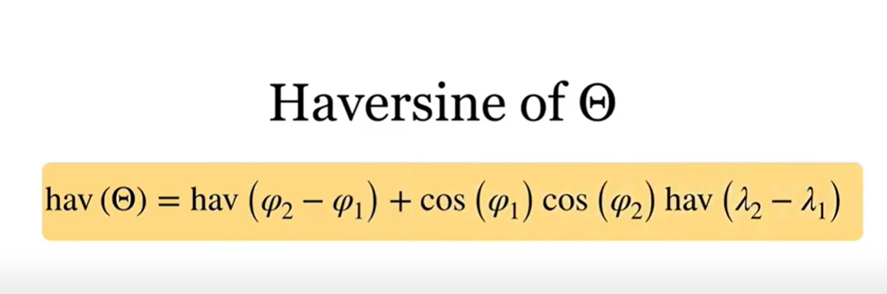
Haversine Formula –
The Haversine formula calculates the shortest distance between two points on a sphere using their latitudes and
longitudes measured along the surface.

Slide 7
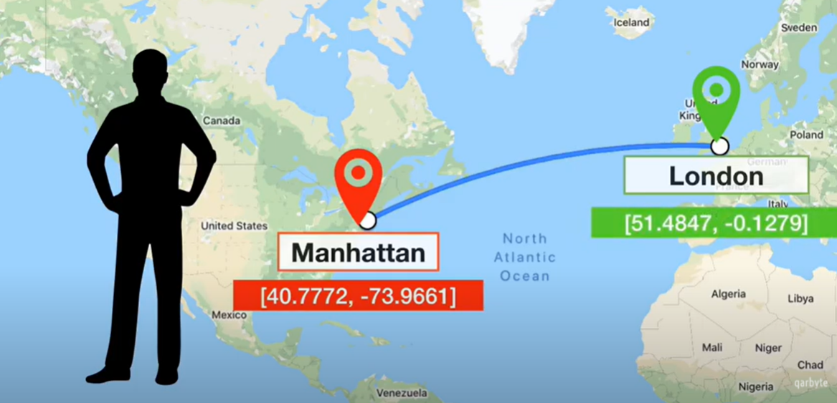

Slide 8
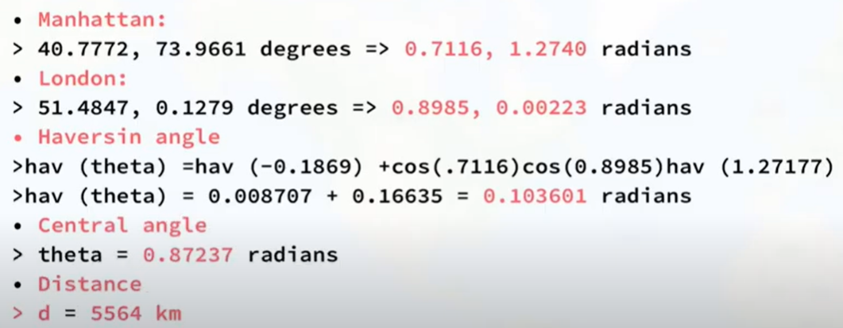
Haversine Formula link for calculating the distance.
http://www.movable-type.co.uk/scripts/latlong.html

Slide 9
Insights taken out from analysis
We have seen that there are instances of amount less that 0 as well in the data set, where as the minimum fare for any trip is -52 dollars, hence we will remove such observations. We have already seen that the max fare is 499 in the data set..
Remove the observations with travel distance more than 130 kms. As seen from descriptive stats there are obs with travel distance more than 130 km, as that is the limit for trips.
Remove the observations with unreal longitude and latitude values , that is , 90< latitude <-90, 180 < longitude < -180.

Slide 10
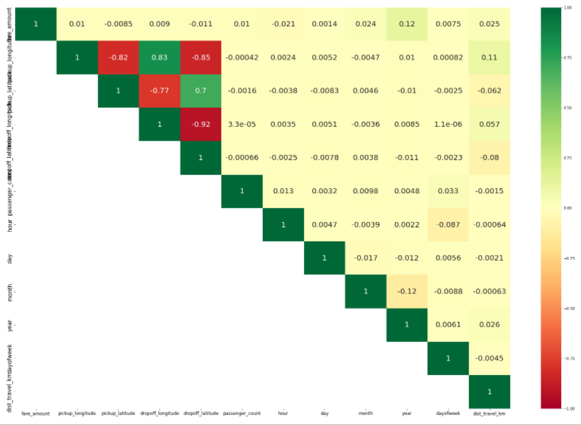
Corelation diagonal analysis
The diagonal entries are all '1' which represents the correlation of the variable with itself. The dark green squares represent the variables with strong positive correlation. The dark red squares represent the variables with strong negative correlation

Slide 11
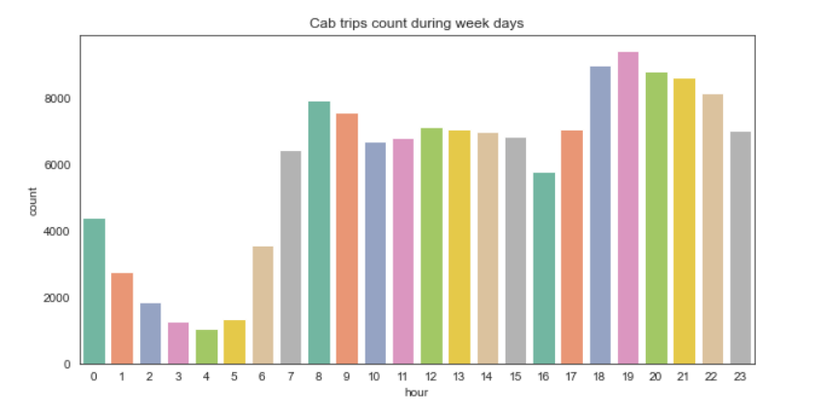
Week Days analysis

Slide 12
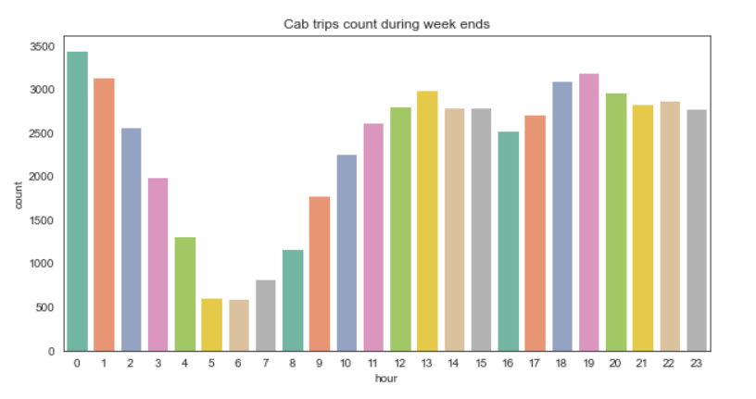
Week Ends analysis

Slide 13
Models Performed

Slide 14
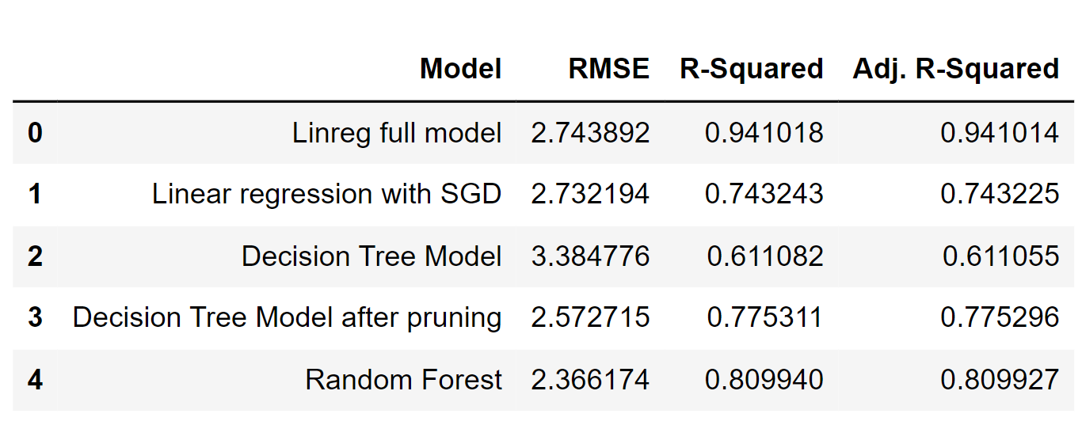
1. OLS Linear Regression 2. Linear Regression SGD 3. Decision tree Regressor 4. Decision Tree Regressor after pruning 5. Random Forest

Slide 15
Thank You

