Slide 1
POWER BI BUSINESS ANALYTICS PROJECT
TOTAL REVENUE
FINANCIAL PERFORMANCE
& BUDGET CONTROL
9.64M
TOTAL EXPENSES
6.93M
Business Problems → Dashboard Insights →
Solutions & Recommendations
NET PROFIT
2.71M
A data-driven review of revenue, expenses,
budget variance and profitability
Prepared from the supplied Power BI dashboard screenshots

Slide 2
Project Objective & Approach
01
What the dashboard is designed to help business users understand
1. Monitor performance
2. Control budget
3. Explore profitability
Bring revenue, expenses, net profit and margin into one executive view.
Compare planned budget with actual expenses and identify variance.
Drill into department/category drivers and test expense-reduction scenarios.
HOW THE REPORT SUPPORTS ANALYSIS
CORE KPI SNAPSHOT
Region, department and year slicers narrow the analysis.
Revenue
Expenses
KPI cards summarize financial performance.
9.64M
6.93M
Trend charts show changes over time.
Net Profit
Margin
2.71M
28.12%
Category, department and variance visuals help locate drivers.
Note: figures are taken from the screenshots; validate currency, reporting period and measure definitions in the source model.

Slide 3
Business Problems Identified
02
The business questions this Power BI report is intended to answer
01 COST VISIBILITY
02 BUDGET OVERRUN RISK
1
2
Managers may not quickly see which expense categories account for the largest share.
It may be difficult to spot departments spending above their allocated budget.
03 VARIANCE EXPLANATION
04 PROFITABILITY DRIVERS
3
4
A total variance alone does not explain which department drives the gap.
Revenue, expenses and profit need to be compared across departments/categories.
05 TREND & SCENARIO PLANNING
06 FILTERED DECISION-MAKING
5
6
Monthly changes and potential savings need to be reviewed over time.
Users need to focus on a region, year or department without rebuilding reports.
These are business problems the report is designed to address; the screenshots do not prove that a specific incident occurred.

Slide 4
Problem → Insight → Business Action
03
How the dashboard visuals translate into practical decisions
BUSINESS PROBLEM
INSIGHT FROM DASHBOARD
ACTION / SOLUTION
Expense mix is unclear
Treemap shows category-level expense contribution; large blocks identify categories to investigate.
Prioritize the largest controllable categories and validate the reason for high spend.
Budget overrun may go unnoticed
Budget variance chart and table show department variance, status and utilization.
Review departments flagged Over Budget, confirm causes and assign owners.
Profit drivers are hard to locate
Revenue by department and decomposition tree help explore department/category contribution.
Investigate low or negative contribution areas before changing budgets.
Performance changes are missed
Revenue and profit-margin trend visuals show movements over time.
Review monthly trends and investigate unusual spikes or dips.
Savings impact is uncertain
Expense Reduction % input and Projected Profit card model a what-if scenario.
Compare multiple reduction assumptions; treat outputs as estimates, not guarantees.
This mapping is the main business story: each visual answers a question and supports a next step.

Slide 5
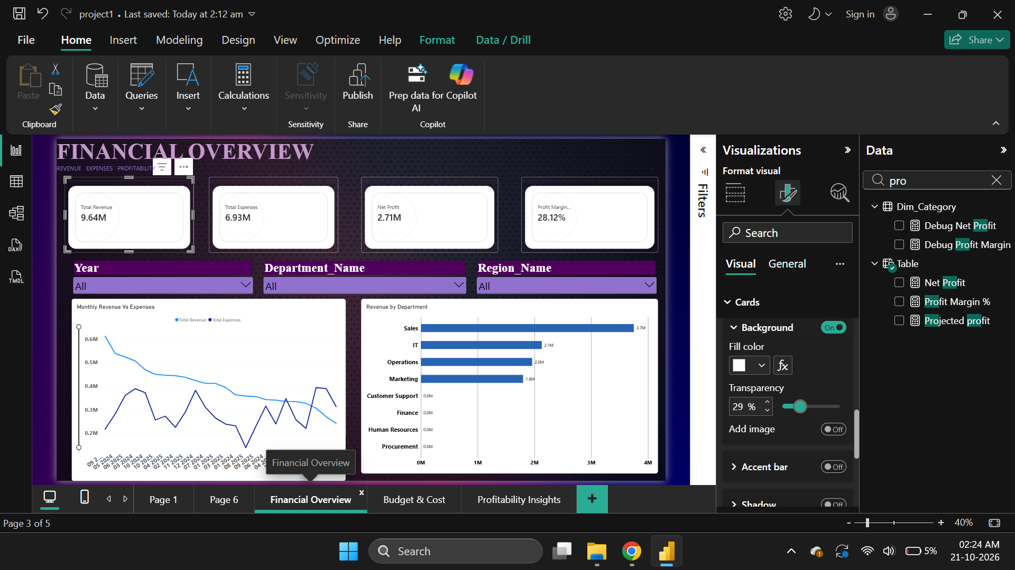
Page 1 | Financial Overview
04
Business question: Are we generating profit, and which departments contribute most?
INSIGHT & SOLUTION
Observed KPI values
Revenue: 9.64M
Expenses: 6.93M
Net profit: 2.71M
Profit margin: 28.12%
How it helps
Compare revenue with expenses at a glance.
Use department revenue chart to identify major contributors.
Use region/year filters to test whether the pattern changes.
Caution: confirm that the KPI cards and department chart respond to slicers as expected.

Slide 6
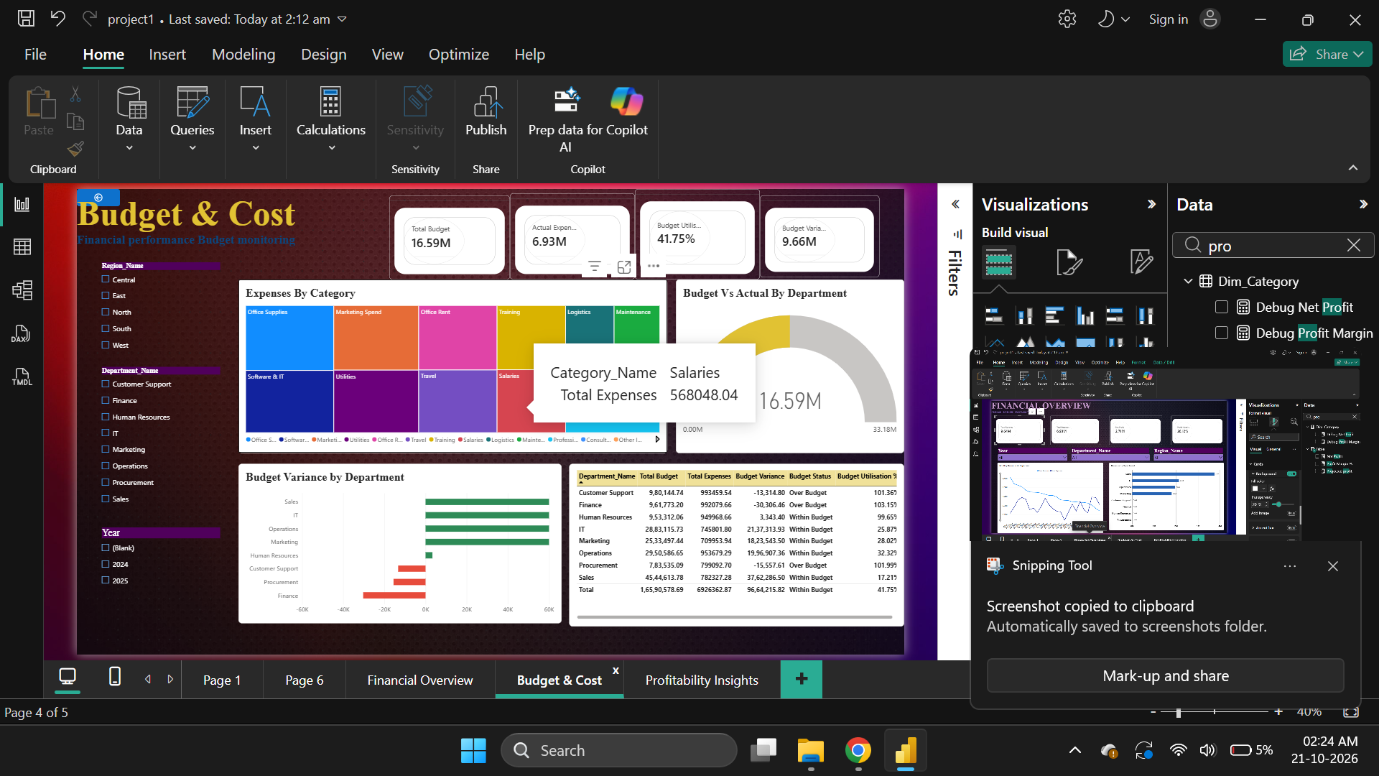
Page 2 | Budget & Cost Control
05
Business question: Are we staying within budget, and where should we investigate?
INSIGHT & SOLUTION
Observed KPI values
Total budget: 16.59M
Actual expenses: 6.93M
Budget utilization: 41.75%
Displayed variance: 9.66M
How it helps
Use variance chart to locate positive/negative gaps.
Check the table's Over Budget status and utilization above 100%.
Investigate causes before reallocating funds.
Important: confirm the variance sign convention in DAX. A positive number is not automatically favourable.

Slide 7
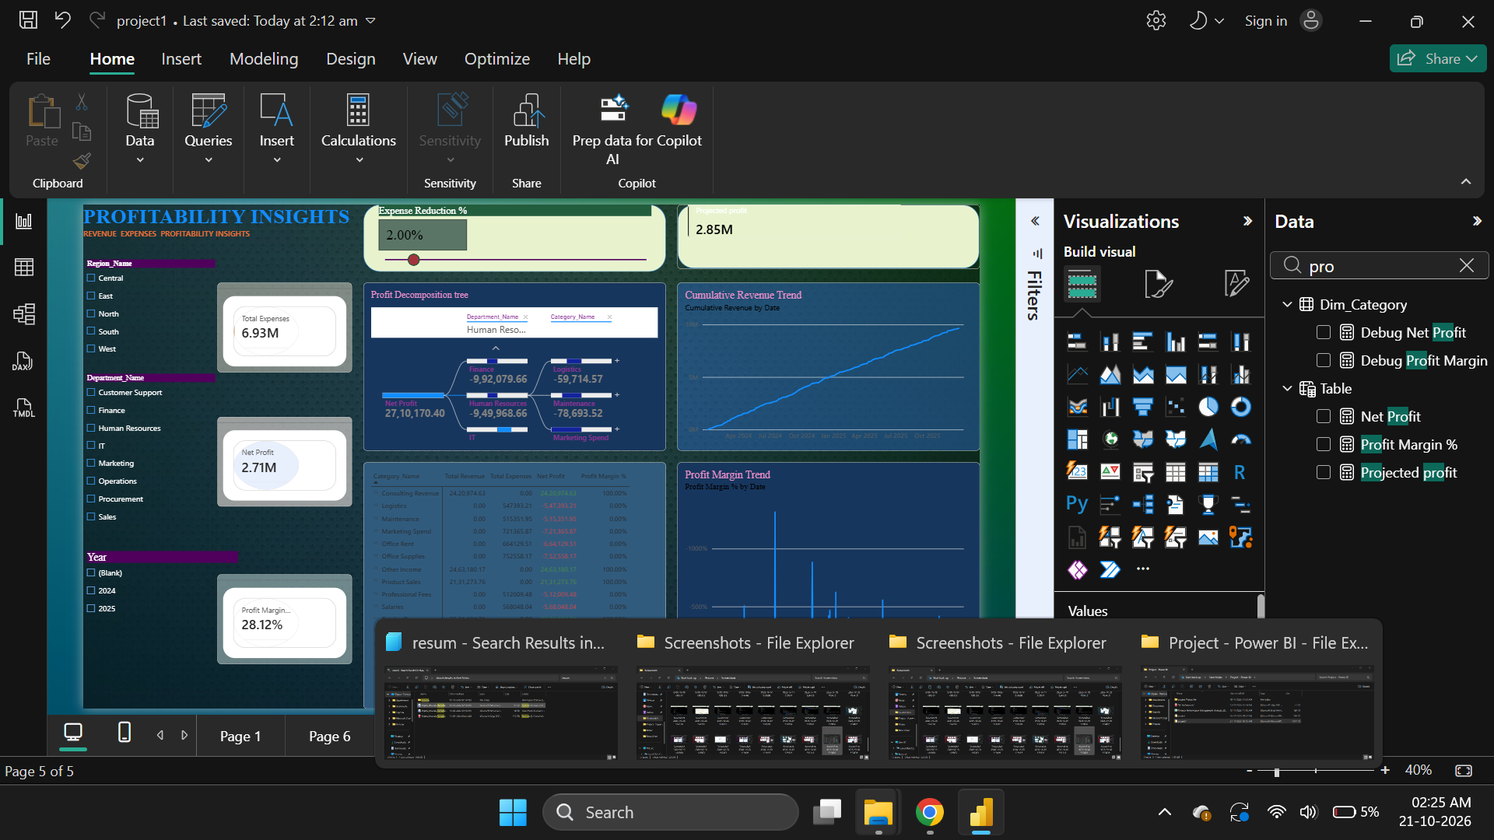
Page 3 | Profitability Insights
06
Business question: What drives profit, and what could happen if expenses are reduced?
INSIGHT & SOLUTION
Scenario shown
Expense reduction input: 2.00%
Projected profit: 2.85M
How it helps
Decomposition tree helps drill into department/category contribution.
Trend charts help identify unusual changes.
Test several reduction percentages and compare projected outcomes.
Scenario output is model-dependent; validate the projected-profit measure and the date grain of trend charts.

Slide 8
Recommended Business Actions
07
Recommended next steps linked directly to the dashboard insights
1. Control overspending
Monthly: review departments marked Over Budget or with utilization above 100%.
Budget owner + Finance
2. Reduce avoidable costs
Rank expense categories by value, then validate business necessity and supplier/process drivers.
Department leads
3. Protect profit contribution
Review department/category contribution and investigate persistent weak or negative results.
Finance + Operations
4. Track trends consistently
Compare monthly revenue, expenses and margin using a consistent date grain.
Finance analyst
5. Use scenario planning
Compare 2%, 5% and 10% reduction scenarios after validating the model assumptions.
Finance manager
Suggested management rhythm: monitor → investigate → assign an owner → track action → review next month.

Slide 9
Conclusion: From Reporting to Action
The dashboard connects financial performance with practical budget-control questions.
WHAT THE REPORT REVEALS
VALIDATION BEFORE FINAL PRESENTATION
Revenue, expenses, profit and margin are visible together.
Confirm currency and reporting period.
Department/category visuals help locate areas to investigate.
Reconcile revenue, expense and profit totals.
Budget variance and utilization support spending control.
Verify variance signs and budget status thresholds.
Scenario inputs support what-if analysis.
Check slicers, measures and trend calculations.
THANK YOU
Financial Performance & Budget Control | Microsoft Power BI

