Slide 1
NGINX

Slide 2
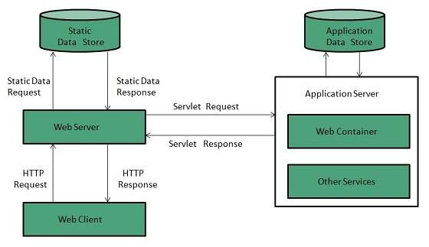
What is a Web-Server?
A web server stores and delivers the content for a website such as text, images, video, and application data to clients that request it.
Web server is a computer where the web content is stored. Basically web server is used to host the web sites
A web server communicates with a web browser using the Hypertext Transfer Protocol (HTTP).

Slide 3
Two approaches of web server architecture:
Concurrent Approach
Multi-Process
Multi-Thread
Hybrid
Single-Process-Event-Driven Approach.

Slide 4
What is Proxy Server?
Proxy server is an intermediary server between client and the internet.
Functionalities offered:
Firewall and network data filtering.
Network connection sharing
Data caching

Slide 5
Why use proxy server?
Following are the reasons to use proxy servers:
Monitoring and Filtering
Improving performance
Translation
Accessing services anonymously
Security

Slide 6
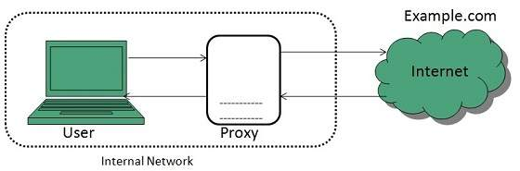
Types of proxies:
Forward Proxies
In this the client requests its internal network server to forward to the internet.

Slide 7
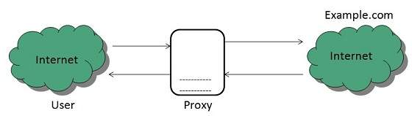
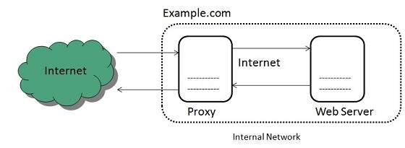
Open Proxies
Open Proxies helps the clients to conceal their IP address while browsing the web.
Reverse Proxies
In this the requests are forwarded to one or more proxy servers and the response from the proxy server is retrieved as if it came directly from the original Server.

Slide 8
What is Nginx?
Open-source, fast, lightweight and high-performance web server to serve concurrent requests.
In its initial release, NGINX functioned for HTTP web serving. Today, however, it also serves as a reverse proxy server .
It is also used for HTTP load balancer, HTTP cache.
It solves C10K problem. Hence nginx offers event-driven and asynchronous architecture.
Companies using Nginx include IBM, Google, Atlassian, facebook, intel, twitter

Slide 9
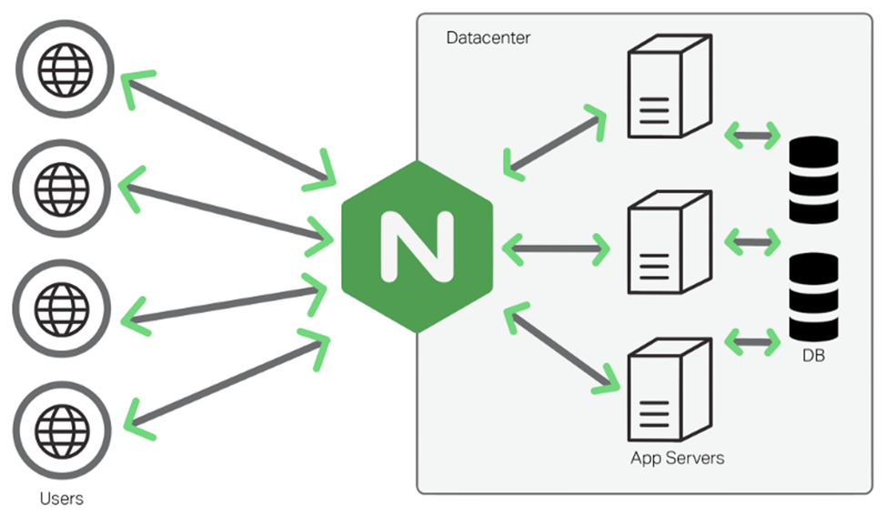
Why Nginx?
It provides service like:
reverse proxy
load balancer
rate limit network services

Slide 10
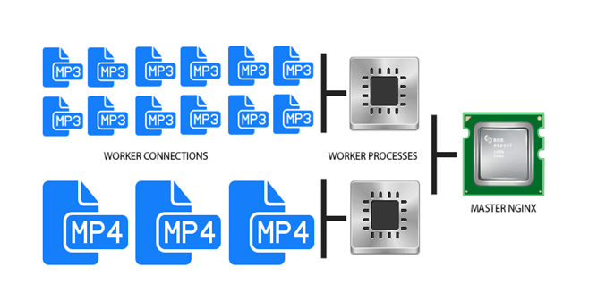
How Nginx works?

Slide 11
APACHE VS NGINX
Apache | NGINX
Apache runs on all Unix like systems such as Linux as well as completely supports Windows. | Nginx runs on modern Unix like systems; however it has limited support for Windows.
Apache uses a multi-threaded approach to process client requests. | Nginx follows an event-driven approach to serve client requests.
Apache cannot handle multiple requests concurrently with heavy web traffic. | Nginx can handle multiple client requests concurrently and efficiently with limited hardware resources.
Apache processes dynamic content within the web server itself. | Nginx can't process dynamic content natively.
Apache is designed to be a web server. | Nginx is both a web server and a proxy server.
Modules are dynamically loaded or unloaded, making it more flexible. | Since modules cannot be loaded dynamically, they must be compiled within the core software itself.
A single thread can only process one connection. | A single thread can handle multiple connections.
The performance of Apache for static content is lower than Nginx. | Nginx can simultaneously run thousands of connections of static content two times faster than Apache and uses little less memory.

Slide 12
Content caching
Caching refers to locally storing the information to speed the communication between a client such as a web server.
The cache can be located on the client-side, the server-side, or both. Caching is useful for serving repetitive requests of static or infrequently changing data.
A content cache resides in between a client and an origin server and saves copies of all the content it sees. If a client requests content that the cache has stored, it returns the content directly without contacting the origin server.
In Nginx , when caching is enabled, Nginx saves responses in a disk cache and uses them to respond to clients without having to proxy requests for the same content every time.

Slide 13
Load Balancing
Load balancing is used to prevent servers from becoming crippled when there is an overflow of requests. A load balancer sends requests to servers that can efficiently handle them to maximize speed and performance.
Load balancing is a commonly used technique and an excellent way for resource utilization, maximizing throughput, reducing latency and ensuring fault-tolerant configurations across multiple application instances.

Slide 14
