Slide 1
JAVA Scipt,
Microservices ,Async/Io Distribution Messaging
Pros-crons,Comparision and Bench-marking

Slide 2
1.Name - Pinky Biswas
Id - 1621276042
2.Name: : Dipu Chandra Malo
Id: 1712419642
3.Name: Khorshadul Islam
Id:1521333642
4.Name:FAHAD Ahmed Pranto
ID: 1612607042

Slide 3
Java Scipt
Description
JavaScript, often abbreviated as JS, is a high-level, interpreted scripting language that conforms to the ECMAScript specification. JavaScript has curly-bracket syntax, dynamic typing, prototype-based object-orientation, and first-class functions.

Slide 4
Microservices
Microservices are a software development technique—a variant of the service-oriented architecture (SOA) architectural style that structures an application as a collection of loosely coupled services. In a microservices architecture, services are fine-grained and the protocols are lightweight.

Slide 5
Async I/o
Async IO is a concurrent programming design that has received dedicated support in Python.

Slide 6
Distributed Messaging
Distributed messaging is based on the concept of reliable message queuing. Messages are queued asynchronously between client applications and messaging systems.
Most of the messaging patterns follow the publish-subscribe model (simply Pub-Sub) where the senders of the messages are called publishers and those who want to receive the messages are called subscribers.
Once the message has been published by the sender, the subscribers can receive the selected message with the help of a filtering option.
The pub-sub model can communicate only via messages. Many of the message patterns enable with message broker to exchange publish messages for timely access by many subscriber.

Slide 7
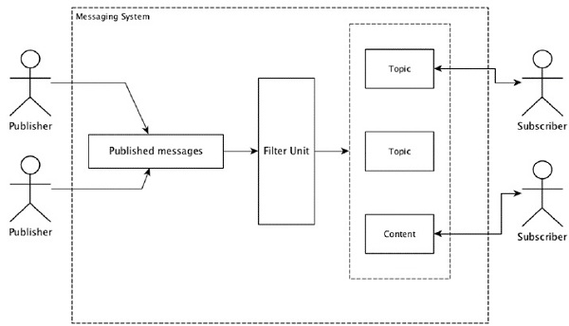

Slide 8
Goals
There are several programming languages and designing tools that exist today. However, some are used more frequently and popular than others. This is due to certain characteristics and features that they possess. Our goal is to presents a comparative study of this four JAVA Scipt,Microservices ,Async/Io Distribution Messaging and evaluate their pros and cons.we find best one for those four thing.we desides which one best for using.

