Slide 1
1.Name - Pinky Biswas
Id - 1621276042
2.Name: : Dipu Chandra Malo
Id: 1712419642
3.Name: Khorshadul Islam
Id:1521333642
4.Name:Fahad Ahmed Pranto
ID: 1612607042

Slide 2
Javascript History
Everyone knows that JavaScript is eating the world. The problem is, there are lots of developers responsible for building software with JavaScript without a particularly deep knowledge of the language. It is easy to learn the basics and be productive, but newer programmers have a tendency to misuse some of JavaScript. Asynchronous JavaScript is particularly misunderstood. In this post, I will show you the most common ways to make asynchronous JavaScript calls and when to use each one. There are a lot of idiosyncrasies when using JavaScript in the browser, so for the purposes of this post, I will be discussing JavaScript on the server using Node.

Slide 3
Callbacks (The Old Way)
The setTimeout() function’s first parameter is a function to call when the timeout finishes. This is a simple example of a callback. The function passed is known as a “callback” function and the work being done asynchronously is the timer.

Slide 4
Promises (The Newer Way)
Promises were introduced to fix a lot of the problems with using callbacks to do asynchronous operations. A promise is just that: a promise to let the calling code know when the asynchronous call has finished.

Slide 5
Async/Await (The Newest Way)
The async keyword in JavaScript adds a whole new level of cool to promises: the await keyword! This can make your code much more readable because the await keyword lets the code end up reading like traditional synchronous JavaScript.

Slide 6
Because we’re studying on what is javascript and how it works . we select one easy game that is tic tac toe game.
Tic-tac-toe Xs and Os is a paper-and-pencil game for two players, X and O, who take turns marking the spaces in a 3×3 grid. The player who succeeds in placing three of their marks in a horizontal, vertical, or diagonal row is the winner.

Slide 7

The following example game is won by the first player, X:
In tic tac toe game , we implement javascript’s oldest way (callback ) and with out any error we successfully run thi game

Slide 8
Tic tac toe –creating unbeatable ai by using minimax algorithm.

Slide 9
What is minimax algorithm:
-Minimax is a recursive algorithm which is used to choose an optimal move for a player assuming that the opponent is also playing optimally.
-its goal is to minimize the maximum loss. This algorithm sees a few steps ahead and puts itself in the shoes of its opponent. It keeps playing ahead until it reaches a terminal arrangement of the board (terminal state) resulting in a tie, a win, or a loss.
Once in a terminal state, the AI will assign an arbitrary positive score (+10) for a win, a negative score (-10) for a loss, or a neutral score (0) for a tie.

Slide 10
How it works :
-return a value if a terminal state is found (+10, 0, -10)
-go through available spots on the board
-call the minimax function on each available spot (recursion)
-evaluate returning values from function calls
-and return the best value

Slide 11
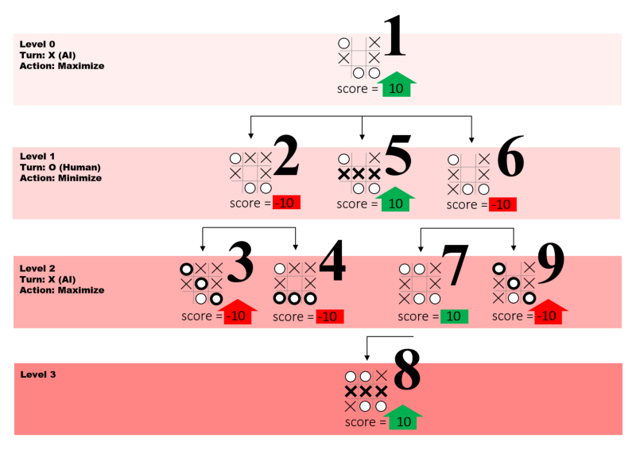
IN this FIGURE , LARGE NUMBERS REPRESENT EACH FUNCTION CALL AND LEVELS REFER TO HOW MANY STEPS AHEAD OF THE GAME THE ALGORITHM IS PLAYING.

Slide 12
Future work :
- we will build Ai vs man tic-tac-toe 5x5 where ai never lose.
- after that, compare this game with the previous one In terms of time complexity.

Slide 13
Thank you

