Slide 1
Outperforming S&P 500 and Nasdaq 100 with Portfolio Optimization
BY:
DEEPSHIKHA SARDA(24N0068)

Slide 2
Introduction
Overview of S&P 500 and Nasdaq 100:
S&P 500: Represents the performance of 500 leading U.S. companies.
Nasdaq 100: Focuses on top 100 non-financial companies, emphasizing technology.
We aim to construct an optimized portfolio to outperform these indices.

Slide 3
Key Metrics
• ROI (Return on Investment): Measures profitability.
• CAGR (Compound Annual Growth Rate): Annual growth rate with compounding.
• XIRR (Extended Internal Rate of Return): Accounts for irregular cash flows.
• PE Ratio: Valuation metric indicating price relative to earnings.

Slide 4
Project Objective
Goal: Develop and assess a U.S. equity portfolio of 20 stocks over five years.
Hypothesis: Portfolio will deliver stronger returns with a solid risk-return profile, outperforming S&P 500 and Nasdaq 100 indices.

Slide 5
Methodology
Portfolio Construction:
Selection of top 20 stocks for the portfolio construction
Portfolio A (Lump Sum): One-time investment at the beginning.
Portfolio B (Systematic Investment): Fixed annual investments.
Performance Evaluation:
Final Market Value and Returns
Beta, Alpha, and Risk-Adjusted Return (RAR)
Index Performance Comparison

Slide 6
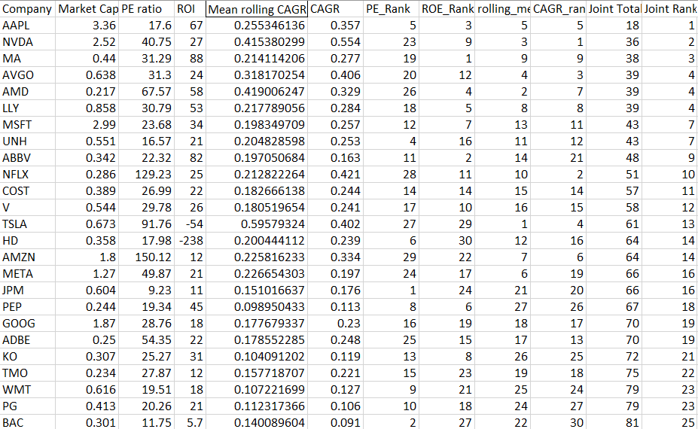
Stock Selection and Ranking
Selection Process:
• Top 30 stocks identified on the basis of market capitalization.
• Ranked the stocks using PE Ratio, ROI, and CAGR by data taken from Q3 2010 to Q2 2019.
Final Portfolio: Top 20 stocks chosen to form Portfolios A and B.

Slide 7
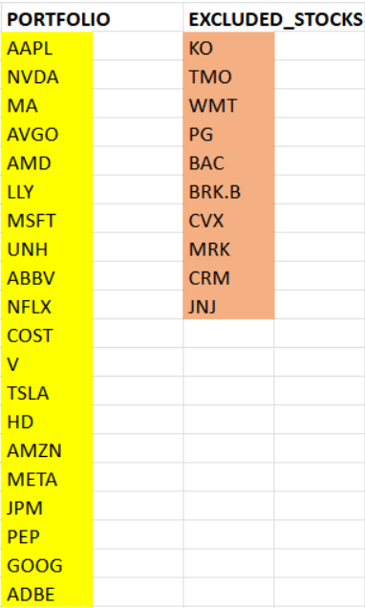
Portfolio is marked by yellow
Rest are the excluded stocks

Slide 8
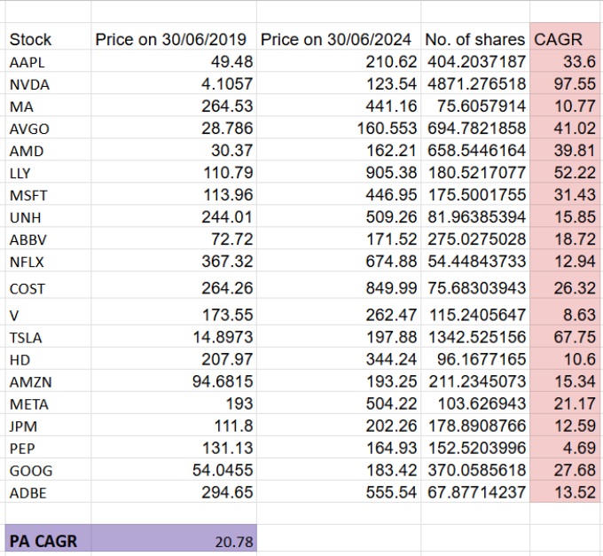

Performance of Portfolio A (Lump Sum Investment)

Slide 9
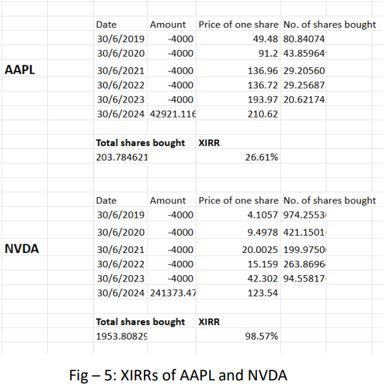
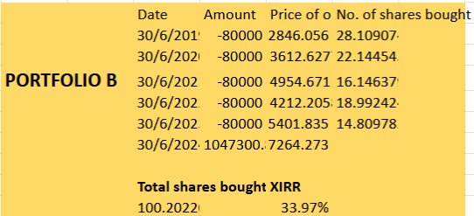
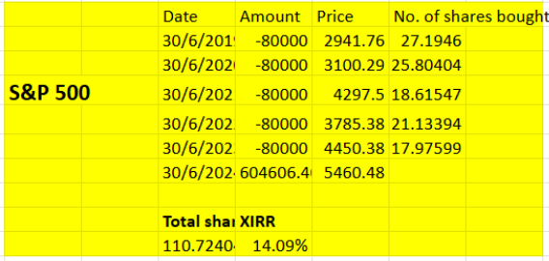
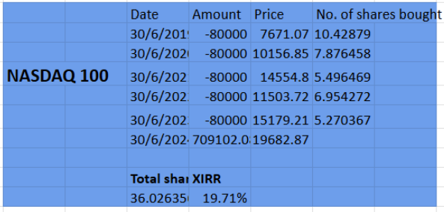
Performance of Portfolio B (Systematic Investment)

Slide 10
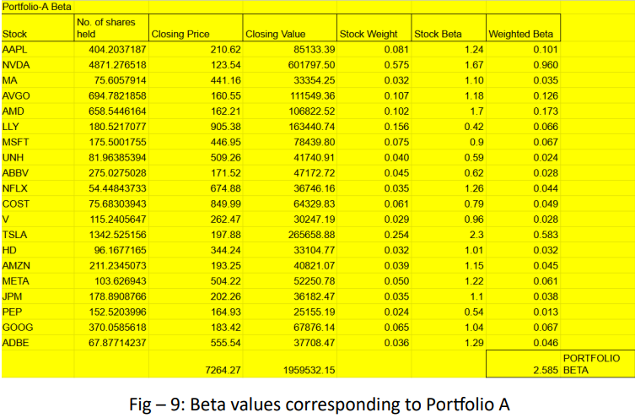
Comparison based on Alpha and Beta Values

Slide 11
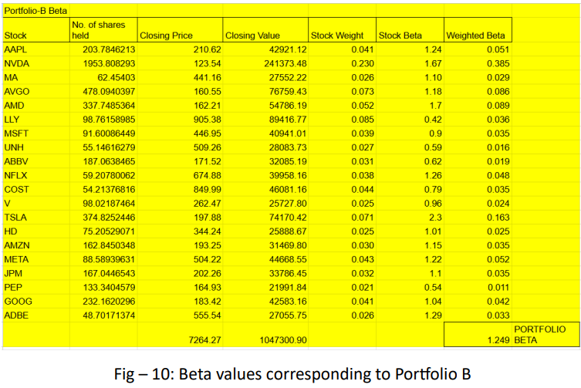
Comparison based on Alpha and Beta Values

Slide 12
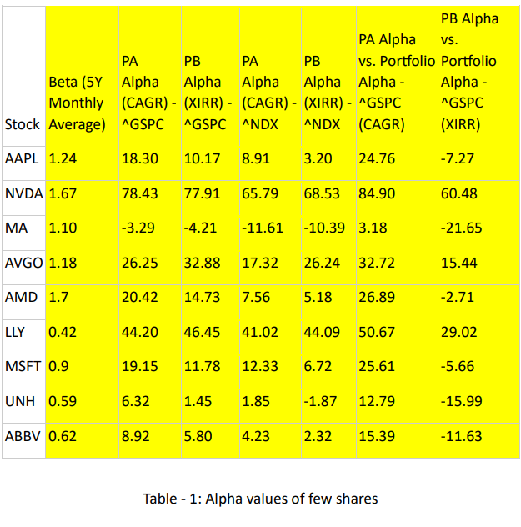
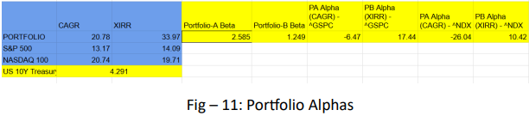
Comparison based on Alpha and Beta Values

Slide 13
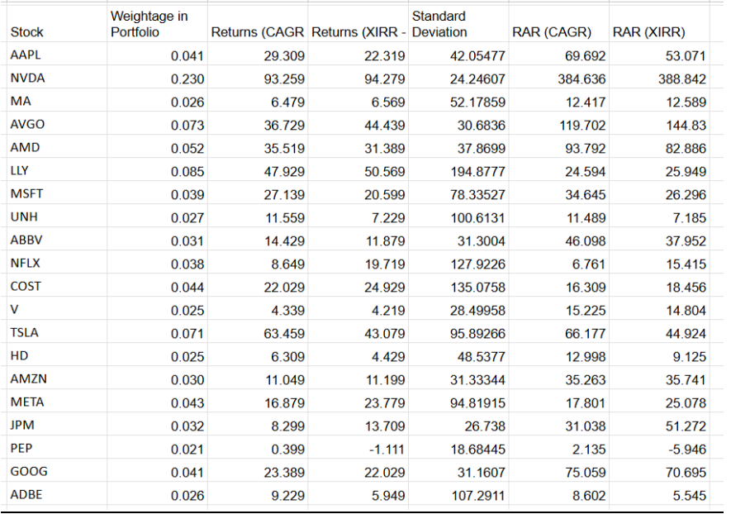
Comparison using RAR
Risk Adjusted Returns = (Return of Stock/Portfolio – Risk Free Rate)/(Standard Deviation of each stock)

Slide 14
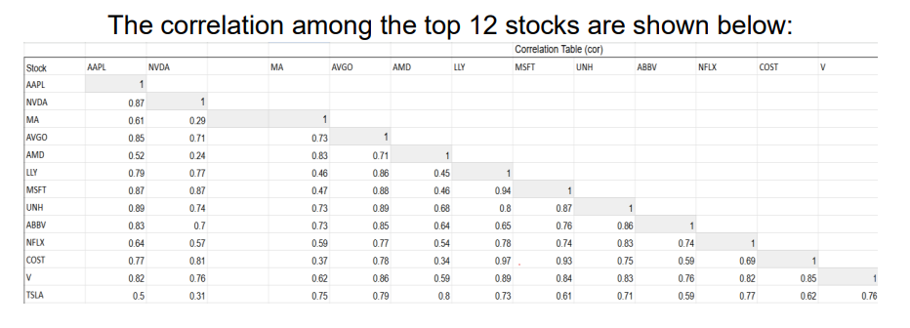
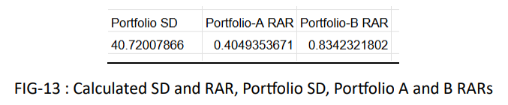
Comparison using RAR

Slide 15
Conclusion for PA and PB
As demonstrated in the previous analysis, both Portfolio A and Portfolio B yield significantly higher returns than the S&P 500 and NASDAQ 100 over a five-year investment period. The individual stocks' RARs further support this conclusion. Along with the alphas of both the individual stocks and the portfolios, the overall performance surpasses that of the benchmark indices, aligning with the initial hypothesis for the portfolio construction and objectives of the project. The constructed portfolio has therefore outperformed S&P 500 and NASDAQ 100 indices.

Slide 16
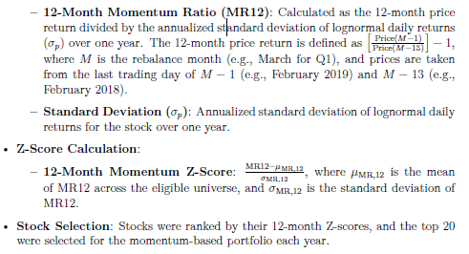
Portfolio Based on Momentum
Methodology and stock selection –

Slide 17
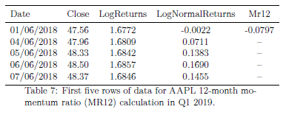
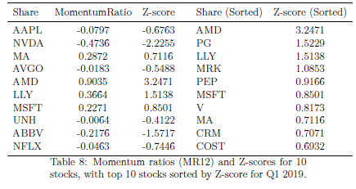
Calculation of Momentum Ratios and Z-scores

Slide 18
Momentum-based portfolio for third quarter 2019
Based on above calculations the final portfolio for first rebalancing month consists of the following shares:
AMD, PG, LLY, MRK, PEP, MSFT, V, MA, CRM, COST, TMO, WMT, KO, JNJ, AMZN, ADBE, UNH, BRK.B, AVGO, HD

Slide 19
Investment
Initially we made an investment of 1 million USD in the above portfolio. The investment was made in shares according to their rankings based on Z-score.
The table in the next slide shows the ranking and returns from the investments
The sale proceed obtained from this investment is again invested in the next rebalance month along with another 1 million USD.
We continue the investments until the third quarter of 2023 and get the final portfolio return on the third quarter of 2024

Slide 20
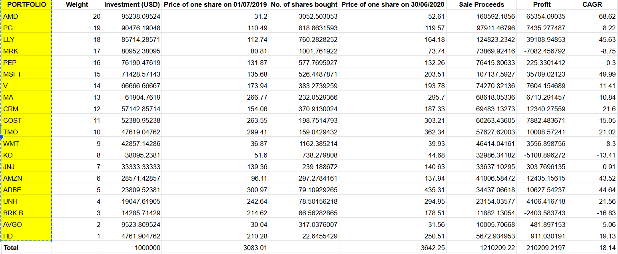

Slide 21
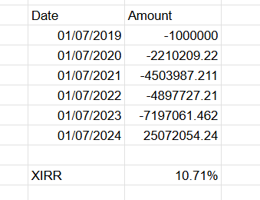
Portfolio XIRR
The following table shows the amount invested during each rebalance months and the final portfolio return

Slide 22
Conclusion
Note that the return from momentum investment is considerably lower than the other two portfolios (A and B). After adjusting the risk free return it only becomes 6.419%. This is because of the downfall of the market during 2021 to 2022 when the momentum investment resulted in a significant loss of -9.17%. Also note that between November 2021 to October 2022, S&P500 and NASDAQ 100 declined by 20% and 30% respectively. So, our investment gave us a better result than the indices. Overall, the momentum failed to beat the previous portfolios.
Portfolio B still gave us best return
🥳 🥳

