Slide 1
EDU360: VIRTUAL K–12 ACADEMY OUTCOMES
Master Knowledge Transfer (KT) Presentation
Complete System Architecture, 8 Canonical Roles & Closed-Circuit Workflows
100% Pure Online Schooling • Zero Bus/Physical Inventory Overheads • Active Outcomes Engine

Slide 2
FOUNDATIONAL PILLARS
The 3 Non-Negotiable Core Philosophies
1. Actionable Governance
Dynamic Red/Orange/Green Triage Engine pinpoints student learning drops, consecutive attendance gaps, and faculty SLA bottlenecks in real time.
2. Outcome-Oriented Co-Tracking
Anti-spam moving slider carousel for notices + 1-Week Shared Remedial Focus Sprint table with 10-minute nightly rough-work verification.
3. Zero Extra Clerical Burden
10-Minute auto-attendance webhooks, in-browser SpeedGrader canvas with digital red pen, and 1-click syllabus pacing synchronization.

Slide 3
SYSTEM SCOPE
The 8 Canonical Online Academy Roles (Zero Campus Clutter)
🛡️ Super Admin (/admin)
Institutional oversight, priority triage, compliance audit logs, and dual-signature exit vault.
🧭 Academic Coordinator (/academic_coordinator)
Curriculum pacing surveillance, AI Timetable Governor substitutions, faculty SLA relief.
📋 Exam Coordinator (/exam_coordinator)
Blueprint freezes 72h prior, accounts-gated hall tickets, and moderation roster distribution.
💳 Accounts Coordinator (/accounts_coordinator)
Arrears aging (0-15d, 16-30d, 30+d), fee waivers, bank reconciliation, instant receipts.
🎯 Admissions Coordinator (/admissions_coordinator)
Virtual intake CRM, telephonic call logs, lead temperature, and 1-click atomic SIS conversion.
✏️ Teacher Portal (/teacher)
10-Min auto-attendance, in-browser SpeedGrader red pen, 1-Week Focus Table, syllabus logging.
🎒 Student Portals (/student & /junior)
Secondary LMS with Socratic AI Doubt Tutor + Junior K–5 gamified adventure quest timetable.
👨‍👩‍👧 Parent Portal (/parent)
Anti-spam moving slider, 10-minute nightly rough-book co-tracking sign-off, live class radar.

Slide 4
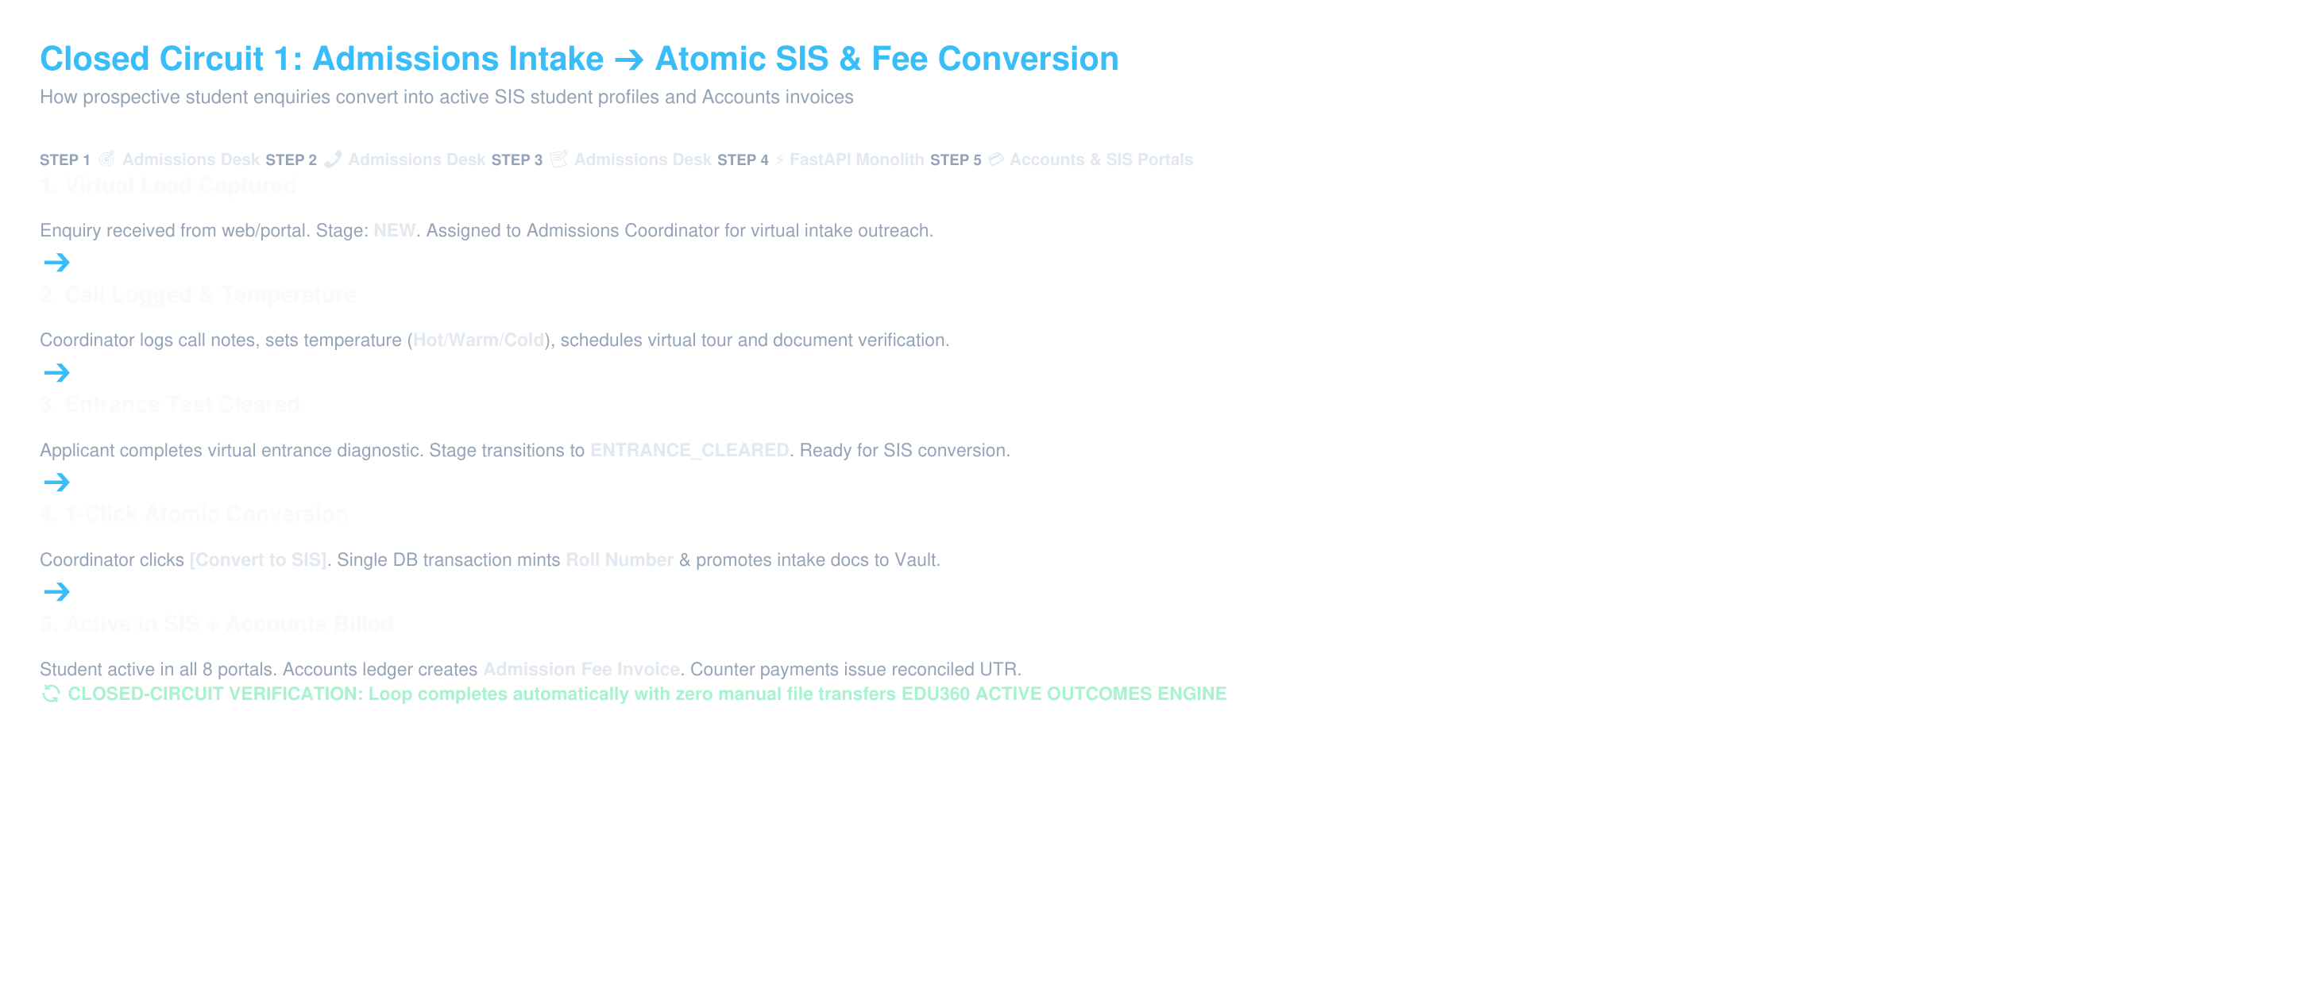
CLOSED-CIRCUIT WORKFLOW
Closed Circuit 1: Admissions Intake ➔ Atomic SIS & Fee Conversion

Slide 5
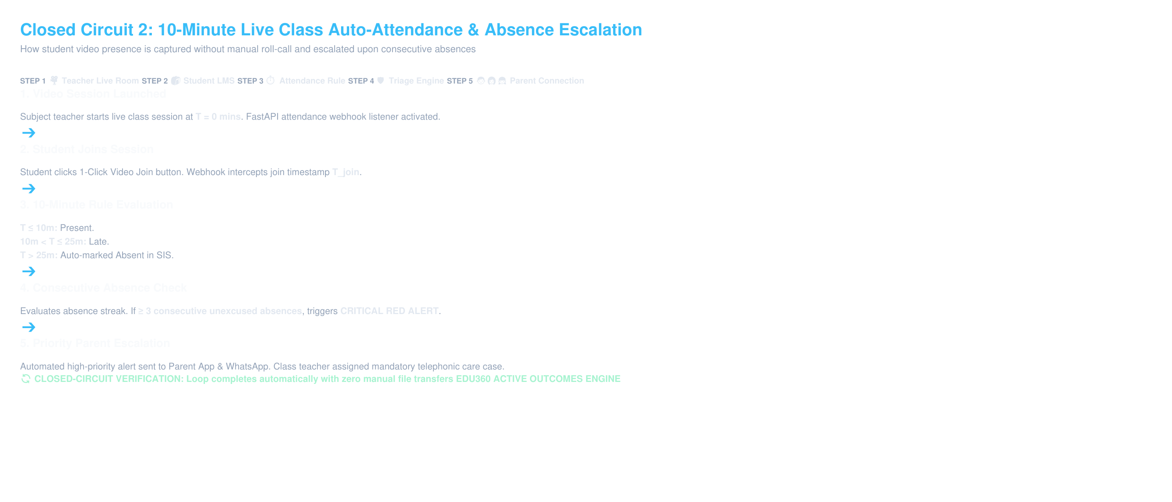
CLOSED-CIRCUIT WORKFLOW
Closed Circuit 2: 10-Minute Live Class Auto-Attendance & Absence Escalation

Slide 6
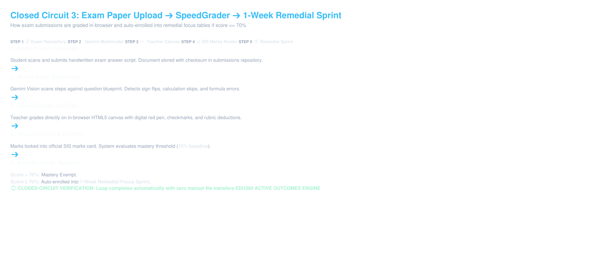
CLOSED-CIRCUIT WORKFLOW
Closed Circuit 3: Exam Paper Upload ➔ SpeedGrader ➔ 1-Week Remedial Sprint

Slide 7
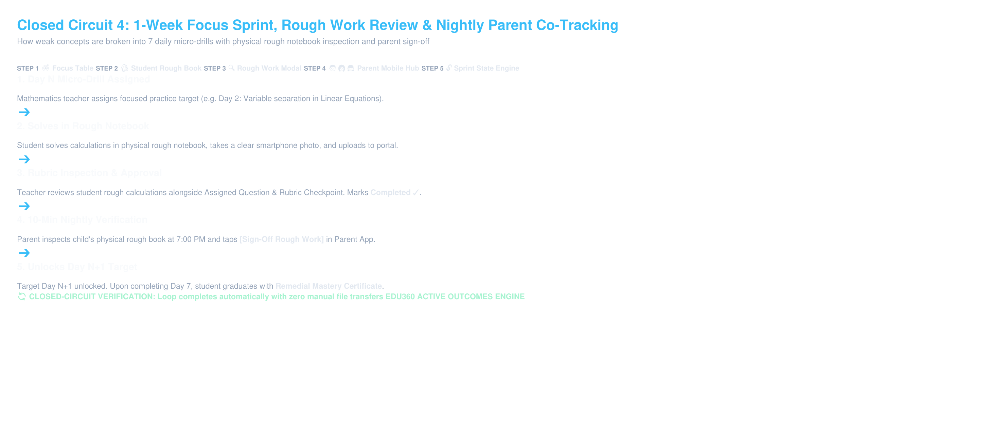
CLOSED-CIRCUIT WORKFLOW
Closed Circuit 4: 1-Week Focus Sprint, Rough Work Review & Nightly Parent Co-Tracking

Slide 8
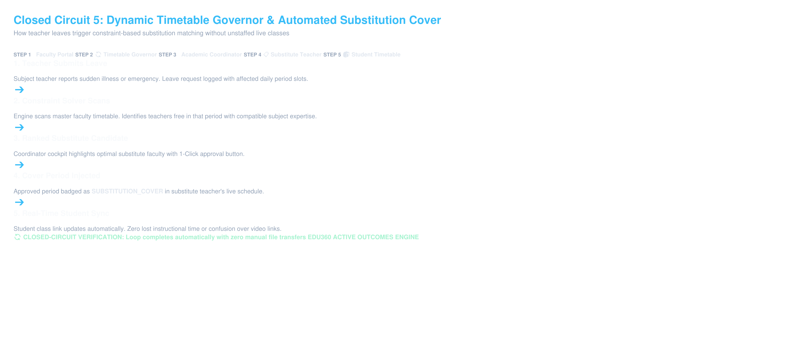
CLOSED-CIRCUIT WORKFLOW
Closed Circuit 5: Dynamic Timetable Governor & Automated Substitution Cover

Slide 9
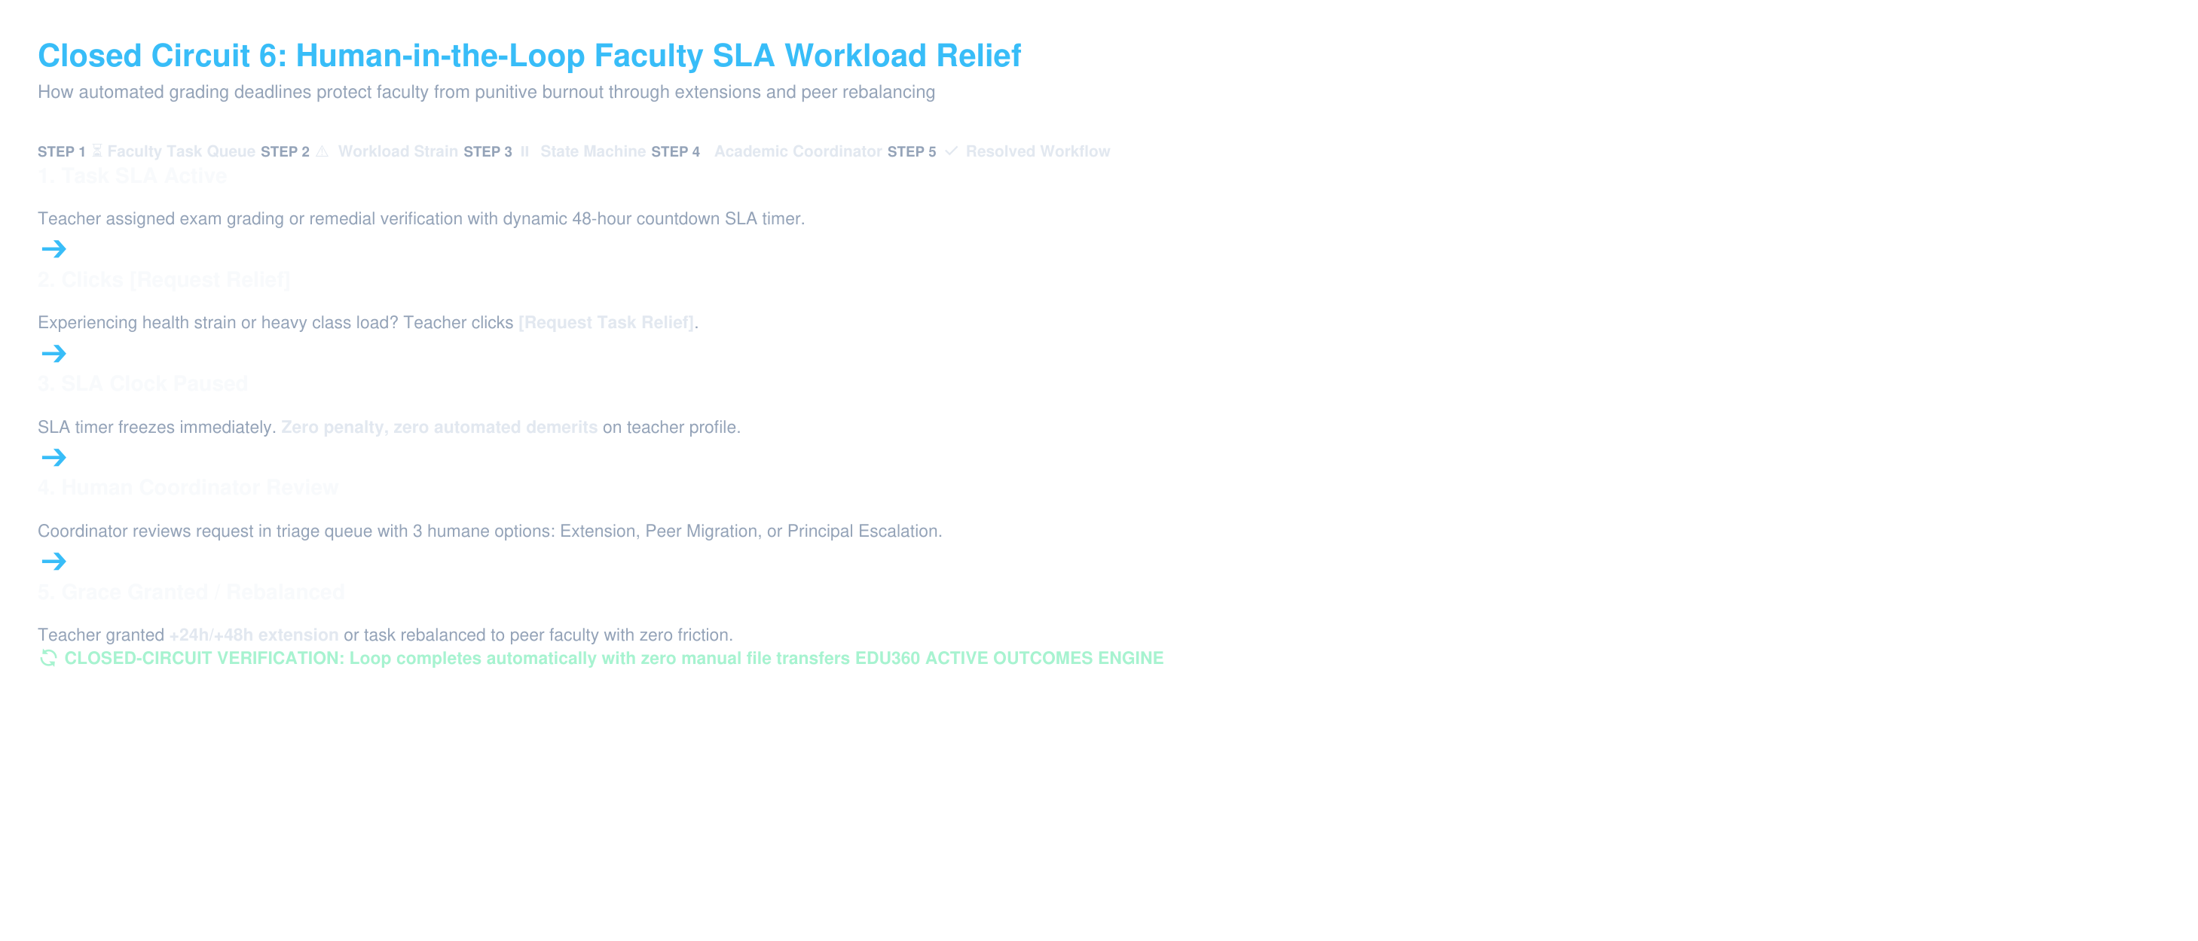
CLOSED-CIRCUIT WORKFLOW
Closed Circuit 6: Human-in-the-Loop Faculty SLA Workload Relief

Slide 10
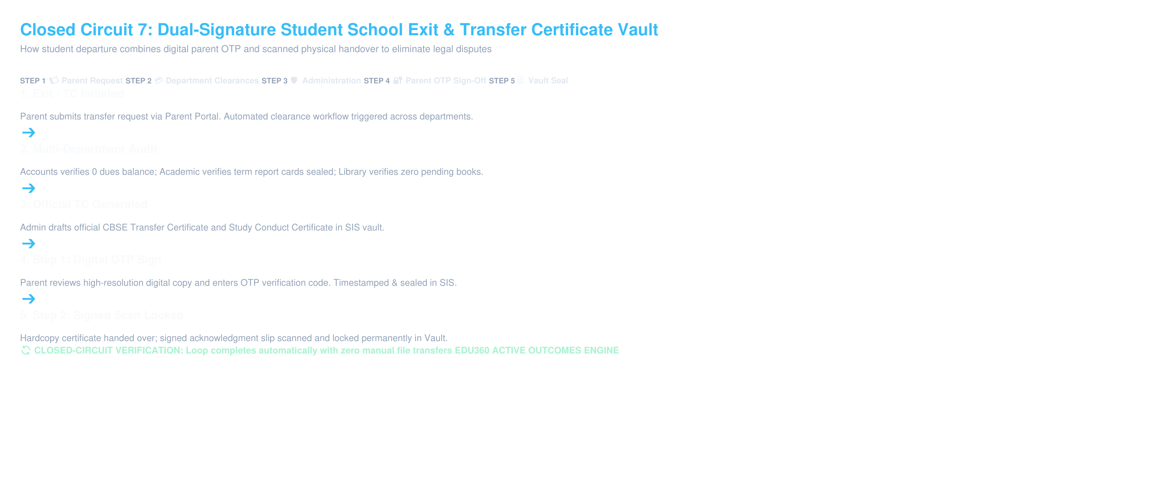
CLOSED-CIRCUIT WORKFLOW
Closed Circuit 7: Dual-Signature Student School Exit & Transfer Certificate Vault

Slide 11
TECHNICAL AUDIT
Technical Architecture: 100% Real Code vs Gemini AI vs Fallbacks
1. 100% Real Production Code
• Priority Triage Engine (60s Multi-Vector Evaluator in FastAPI)
• 10-Minute Online Class Auto-Attendance Webhook
• 15-Minute Homework Cutoff Backlog Engine (#EVD-BKLOG)
• Timetable Governor Constraint Solver (Substitutions)
• Faculty Workload Relief State Machine (SLA Pausing)
• Atomic Admissions CRM SIS Conversion Pipeline
2. Multimodal Gemini AI Vision/Chat
• 1-Week Focus Sprint 7-Day Curriculum Generator
• Rough Work Notebook Photo Step-by-Step Diagnostic
• Multimodal Exam Paper Blueprint Pre-Scanner
• Student Socratic AI Doubt Tutor (Hints without direct answers)
• AI Parent Study Companion (Nightly Coaching)
3. Deterministic Fallback Mode
• Zero Single Point of Failure Architecture
• If Gemini API Key is missing or quota/network fails:
• Chapter-specific pedagogical rule templates take over in < 1ms
• Socratic hint dictionary maintains zero user interruption
• Guaranteed 100% uptime under offline/local demos

Slide 12
INTERACTIVE WALKTHROUGH
Live Demo Cheat-Sheet (Universal Password123)
Step 1: Super Admin (/admin)
Login: admin / Password123
Show: Red Priority Triage card (Rahul Sharma 3 consecutive absences) + 1-Click CBSE Audit Log Export.
Step 2: Teacher Portal (/teacher)
Login: teacher_mat / Password123
Show: Mathematics locked section (Class 8-B). Students <= 70% in 1-Week Focus Table. Click Day 2 rough work modal.
Step 3: SpeedGrader Canvas
Open student worksheet canvas. Pick Digital Red Pen, draw checkmarks, apply -2 rubric tag, click [Finalize Grade]. Zero PDF clutter.
Step 4: Parent Portal (/parent)
Login: parent / Password123
Show: Moving notice slider, 10-Minute Nightly Co-Tracking card. Tap [Sign-Off Rough Book] to unlock Day N+1.
Step 5: Junior K-5 Portal (/junior)
Login: junior / Password123
Show: Gamified adventure quest timetable, formula chests, and live virtual class launchpad.

