Slide 1
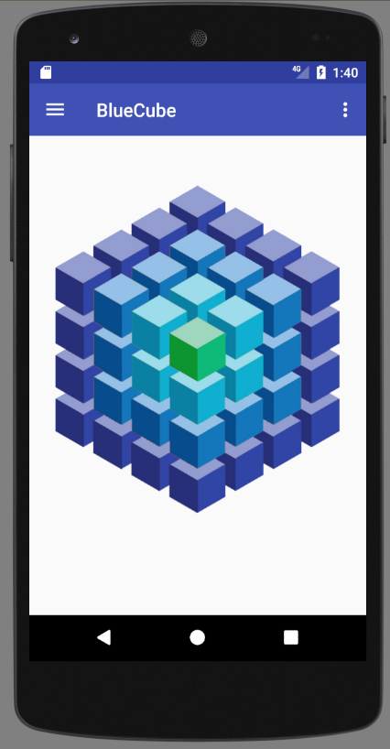
Main Menu
Make interactive
Rotate cube
Colors / pressures
Zoom

Slide 2
Saving Data
android.hardware.SensorManager manager
Start:
manager.registerListener(MainActivity.this, manager.getDefaultSensor(Sensor.TYPE_ACCELEROMETER), 0);
manager = (SensorManager) getSystemService(Context.SENSOR_SERVICE);
Stop:
manager.unregisterListener(MainActivity.this);
Storage Directory:
this.getExternalFilesDir(null).getAbsolutePath();
Java.io.FileWriter
FileWriter writer;
writer = new FileWriter(new File(getStorageDir(), "sensors_" + System.currentTimeMillis() + ".csv"));
writer.write(String.format("%d; ACC; %f; %f; %f; %f; %f; %f\n", evt.timestamp, evt.values[0], evt.values[1], evt.values[2], 0.f, 0.f, 0.f));

Slide 3
Simple DAQ
Options to add
Resize graph scale dynamically or Statically
Attach sensor name to data
Set number of points to display
Data acquisition rate
Wait for update
Sample every…
Etc.
Run in background
Styles

Slide 4
Screen to assembly data
Sql database
Fragment sensor data
Fragment camera data (2d data ?)
Fragment sql database
Save data / Load data
Collect other sensor data automatic
Location, time, temperature, pressure, etc…

Slide 5
com.example
activities
Contains all the activities. Classes are all named with Activity at the end. That way, you can immediately know what it is when reading Java code that doesn't have its full package name.
adapters
Contains all the adapters.
authenticator
Contains any class related to signing a user in. I create a local account and having all related classes together is very handy.
data
Contains all classes related to data management such as ContentProvider and SQLiteHelper.
data.migrations
Contains all of my SQLite migrations.
fragments
Contains all fragments.
helpers
Contains helper classes. A helper class is a place to put code that is used in more than one place. I have a DateHelper for instance. Most of the methods are static.
interfaces
Contains all interfaces.
models
Contains all local models. When syncing from an HTTP API I parse the JSON into these Java objects using Jackson. I also pull Cursor rows into these models as well.
preferences
Contains all classes for custom preferences. When creating the preferences I required a custom PreferenceDialog as well as a custom PreferenceCategory. They live here.
sync
Contains all classes related to syncing. I use a SyncAdapter to pull data from an HTTP API. In addition to the SyncAdapter a SyncService is required, so I created a package.
Layouts :
Activity Layout name start with activity_
Adapter Layout row name start with row_
Fragment Layout name start with fragment_

Slide 6
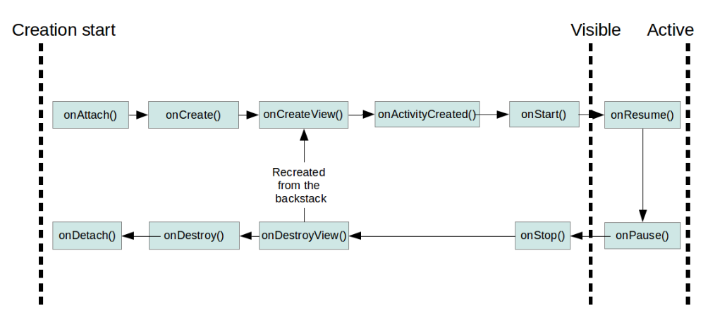
Fragment

Slide 8
Trasfer Data
On Create
//Start New Fragment
detailFragment = new DetailFragment();
// configure link
Bundle bundle = new Bundle();
bundle.putString("link", link);
detailFragment.setArguments(bundle);
@Override public void onActivityCreated(Bundle savedInstanceState)
{
super.onActivityCreated(savedInstanceState);
Bundle bundle = getArguments();
if (bundle != null)
{ setText(bundle.getString("link")); }
}

