Slide 1
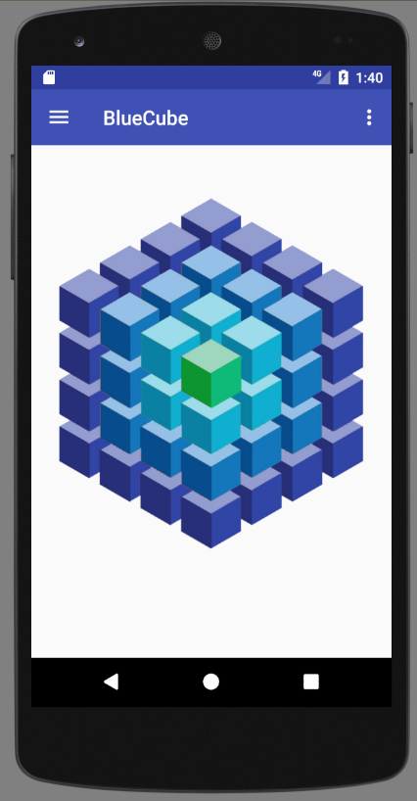
Main Menu
Make interactive
Rotate cube
Colors / pressures
Zoom

Slide 2
Saving Data
android.hardware.SensorManager manager
Start:
manager.registerListener(MainActivity.this, manager.getDefaultSensor(Sensor.TYPE_ACCELEROMETER), 0);
manager = (SensorManager) getSystemService(Context.SENSOR_SERVICE);
Stop:
manager.unregisterListener(MainActivity.this);
Storage Directory:
this.getExternalFilesDir(null).getAbsolutePath();
Java.io.FileWriter
FileWriter writer;
writer = new FileWriter(new File(getStorageDir(), "sensors_" + System.currentTimeMillis() + ".csv"));
writer.write(String.format("%d; ACC; %f; %f; %f; %f; %f; %f\n", evt.timestamp, evt.values[0], evt.values[1], evt.values[2], 0.f, 0.f, 0.f));

Slide 3
Simple DAQ
Options to add
Resize graph scale dynamically or Statically
Attach sensor name to data
Set number of points to display
Data acquisition rate
Wait for update
Sample every…
Etc.
Run in background
Styles

Slide 4
Screen to assembly data
Sql database
Fragment sensor data
Fragment camera data (2d data ?)
Fragment sql database
Save data / Load data
Collect other sensor data automatic
Location, time, temperature, pressure, etc…

Slide 5
8.27.2018
Assemble a SQL data-frame of various input data
Introduction
Experimental
Actual Data
Navigates to New Study Activity
Instantiates a filename / database in local working directory
Appends database with data
Introduction , Exp, Data, Observations, Camera, etc…
Saves SQl database as a study
Build a report of sensor data / entries
Email sensor dataset

Slide 6
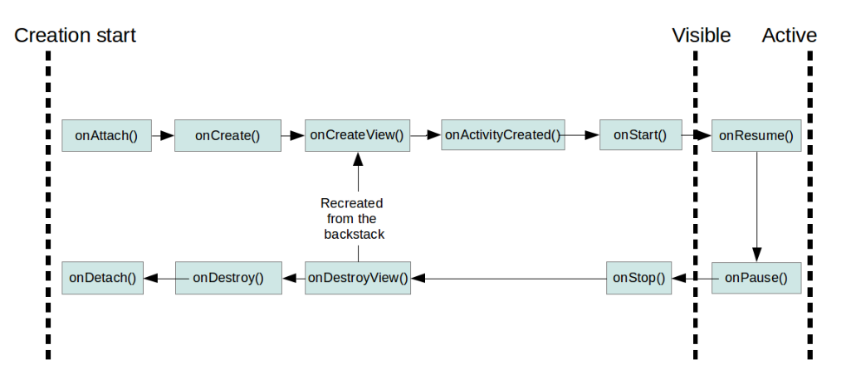
Fragment

Slide 7
Trasfer Data
On Create
//Start New Fragment
detailFragment = new DetailFragment();
// configure link
Bundle bundle = new Bundle();
bundle.putString("link", link);
detailFragment.setArguments(bundle);
@Override public void onActivityCreated(Bundle savedInstanceState)
{
super.onActivityCreated(savedInstanceState);
Bundle bundle = getArguments();
if (bundle != null)
{ setText(bundle.getString("link")); }
}

