Slide 1
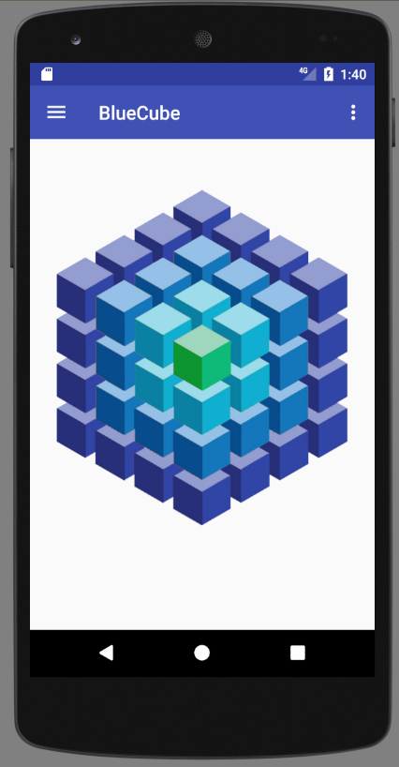
Main Menu
Make interactive
Rotate cube
Colors / pressures
Zoom

Slide 2
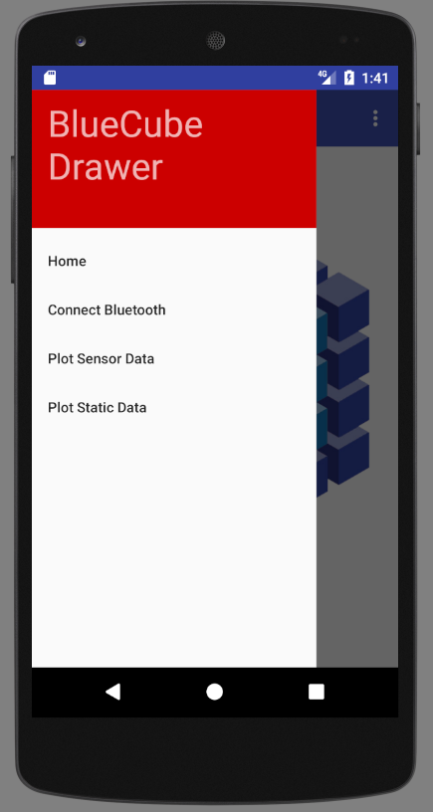
Main Activity
Home - OK
Connect blue-tooth device - Functionalize
Save Data: Write to csv.
Plot Data
TO DO : Load / Save Data

Slide 3
Connect Bluetooth
Start Bluetooth
Get Adapter
Enable Bluetooth
GATT service Intent
bindService
Search Bluetooth
mPSoCCapSenseLedService.scan()
Connect
mPSoCCapSenseLedService.connect()
Discover Services
PSoCCapSenseLedService.discoverServices();

Slide 4
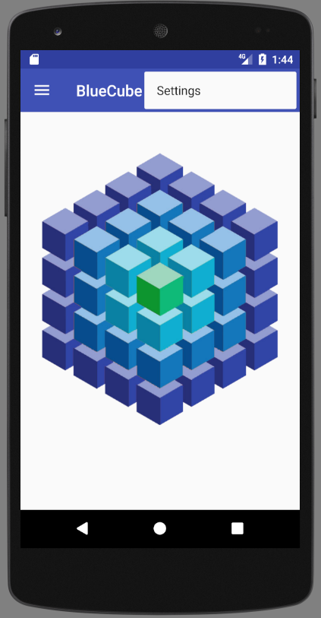
Settings
?

Slide 5
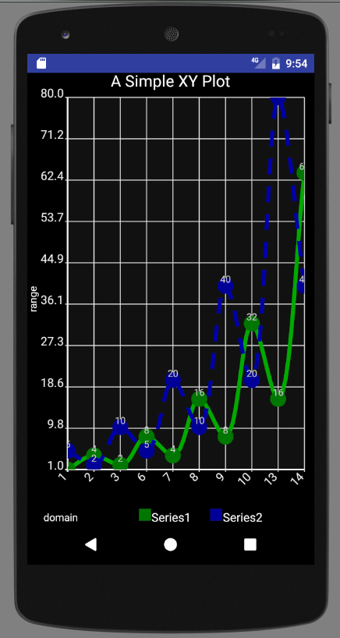
Plotting Data using
androidplot

