Slide 1
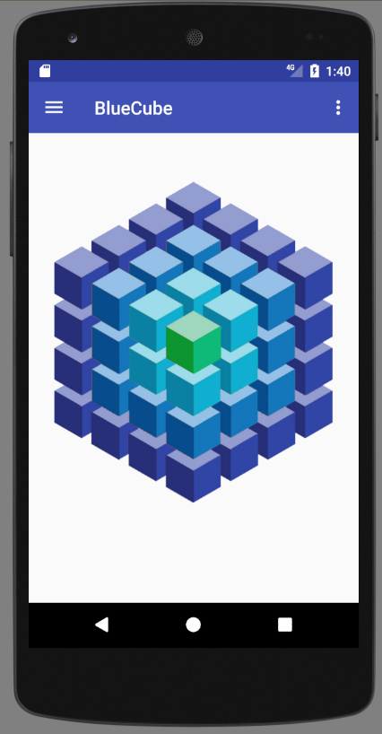
Main Menu
Make interactive
Rotate cube
Colors / pressures
Zoom

Slide 2
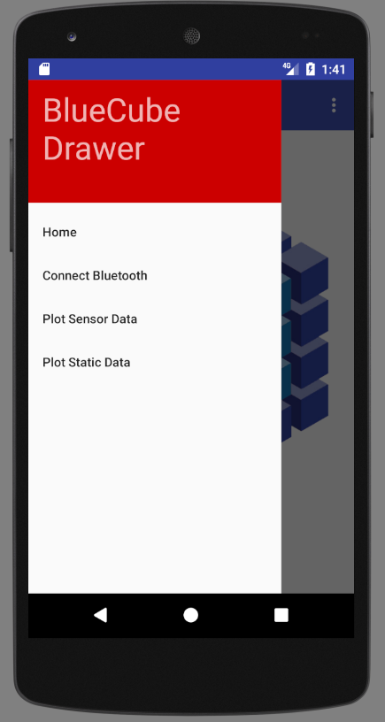
Main Activity
Home - OK
Connect blue-tooth device - Functionalize
Save Data: Write to csv.
Plot Data
TO DO : Load / Save Data

Slide 3
Connect Bluetooth
Start Bluetooth
Get Adapter
Enable Bluetooth
GATT service Intent
bindService
Search Bluetooth
mPSoCCapSenseLedService.scan()
Connect
mPSoCCapSenseLedService.connect()
Discover Services
PSoCCapSenseLedService.discoverServices();

Slide 4
Saving Data
android.hardware.SensorManager manager
Start:
manager.registerListener(MainActivity.this, manager.getDefaultSensor(Sensor.TYPE_ACCELEROMETER), 0);
manager = (SensorManager) getSystemService(Context.SENSOR_SERVICE);
Stop:
manager.unregisterListener(MainActivity.this);
Storage Directory:
this.getExternalFilesDir(null).getAbsolutePath();
Java.io.FileWriter
FileWriter writer;
writer = new FileWriter(new File(getStorageDir(), "sensors_" + System.currentTimeMillis() + ".csv"));
writer.write(String.format("%d; ACC; %f; %f; %f; %f; %f; %f\n", evt.timestamp, evt.values[0], evt.values[1], evt.values[2], 0.f, 0.f, 0.f));

Slide 5
Adding Navigation Side Bar
Activity XML File
Drawer Layout: Set Unique ID
Includes app_bar_XXX layout
Includes widgets: AppBarLayout, ToolBar
Set uniqueID to Toolbar
Set popup- theme
Navigation View
Nav_Header_Main configures sizes (Need to set ID)
Identifies Drawer (need to set buttons)
OnCreateOptionsMenu(Menu menu)

