Slide 1
ECE 4140/6240_Lab1 Environment Set Up
TA: Sichen Xin
E-mail: sxin51@gwu.edu
Office Hours: SEH5972 Tuesday 1:30 pm-3:30 pm
Keep the GITHUB address
https://github.com/DirectorChen/ECE4140-6240

Slide 2
Lab Goal
You will learn some useful tools (Cadence Virtuoso) for CHIP design
You will have 10 labs to practice CHIP design
You will make a project by the end of this semester.
You have to start to work on your final project after midterm exam. (in October)

Slide 3
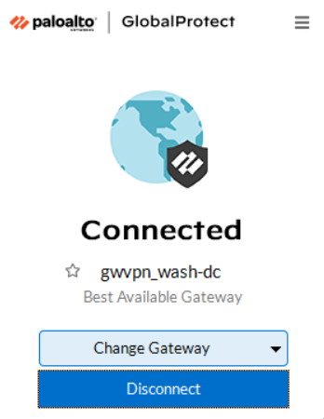
USE VPN to connect to shell Linux(Your Personal Devices)
https://ithelp.gwu.edu/en-us/article/1665784

Slide 4
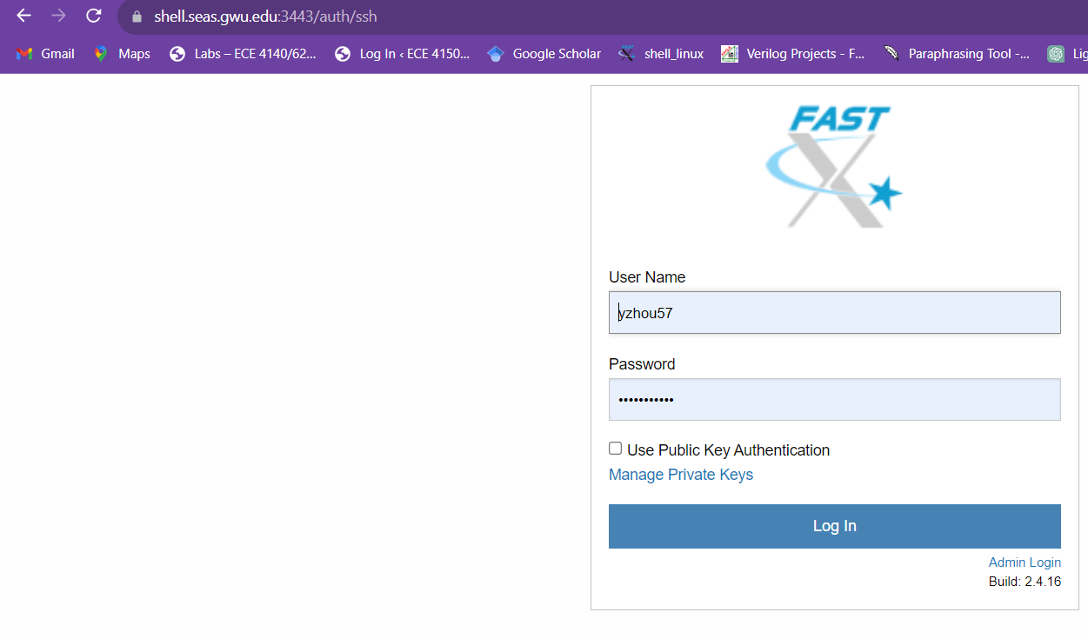
Remote access
Remote access to the Linux in Tompkins 411 with this link:
https://shell.seas.gwu.edu:3443/auth/ssh
Username could be GXXXXXXXX not gXXXXXXXX
Follow this tutorial LAB2 –LAB 10:
https://blogs.gwu.edu/ece4140/labs/
Password: 41406240RF

Slide 5
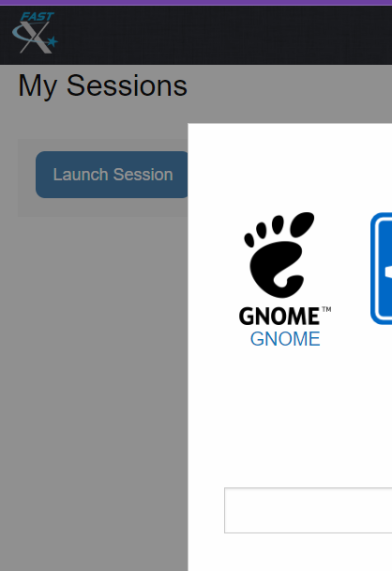
Launch Session ->GNOME

Slide 6
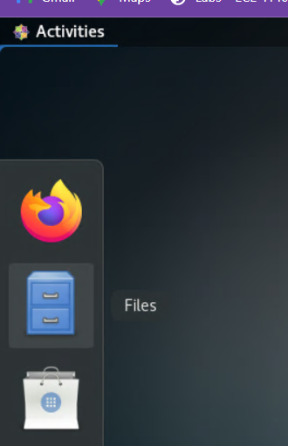
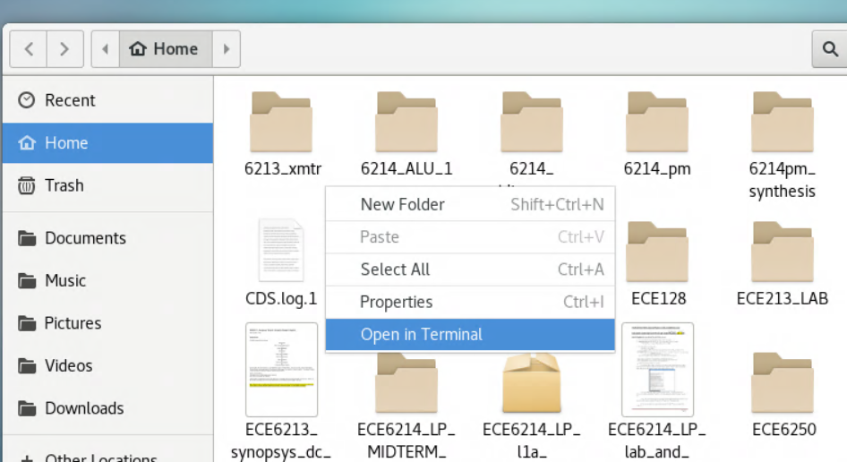
Activities -> Files->Home
Open in terminal

Slide 7
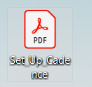

Environment set up for Cadence
Remote access to the Linux in Tompkins 411 with this link:
https://shell.seas.gwu.edu:3443/auth/ssh
2. Set up Cadence: Following this PDF
Check your .profile (show hidden file)
If your .profile is different from the one I uploaded, please delete all lines and copy/paste this one

Slide 8
4. copy/paste same content to .bashrc (ignore if there is no problem)
5. type: . ~/.profile in the terminal
6. type: cd cadence
virtuoso &
Space here

Slide 9

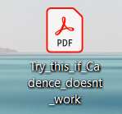
Environment set up for Cadence
5. Try the first lab (Make an inverter)
6. If your cadence does not work, try this

Slide 10
Lab2 —> lab 10
Follow this tutorial:
https://blogs.gwu.edu/ece4140/labs/
Password: 41406240RF

