Slide 1
Arithmetic Blocks
Summary-Chapter 11
Fall 23
ECE4140/6240
Class 6
10/4/23
M.E.Zaghloul

Slide 2
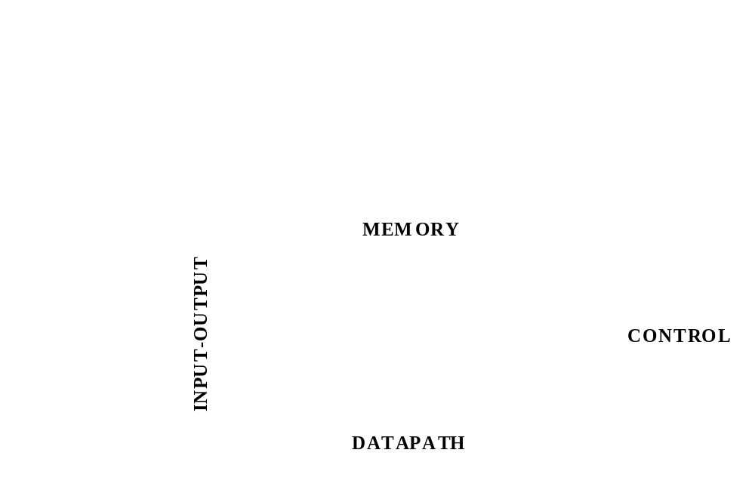
A Generic Digital Processor
M.E.Zaghloul

Slide 3
Building Blocks for Digital Architectures
Arithmetic unit
-
Bit-sliced datapath
(
adder
, multiplier,
shifter, comparator, etc.)
Memory
- RAM, ROM, Buffers, Shift registers
Control
- Finite state machine (PLA, random logic.)
- Counters
Interconnect
- Switches
- Arbiters
- Bus
M.E.Zaghloul

Slide 4
In Preparation for your Project
I will talk about data path selected components
The data path is the core of the processor unit, this is where all computations are performed
Datapaths often arranged in bit sliced organization. Typical 32-64bits wide
M.E.Zaghloul

Slide 5
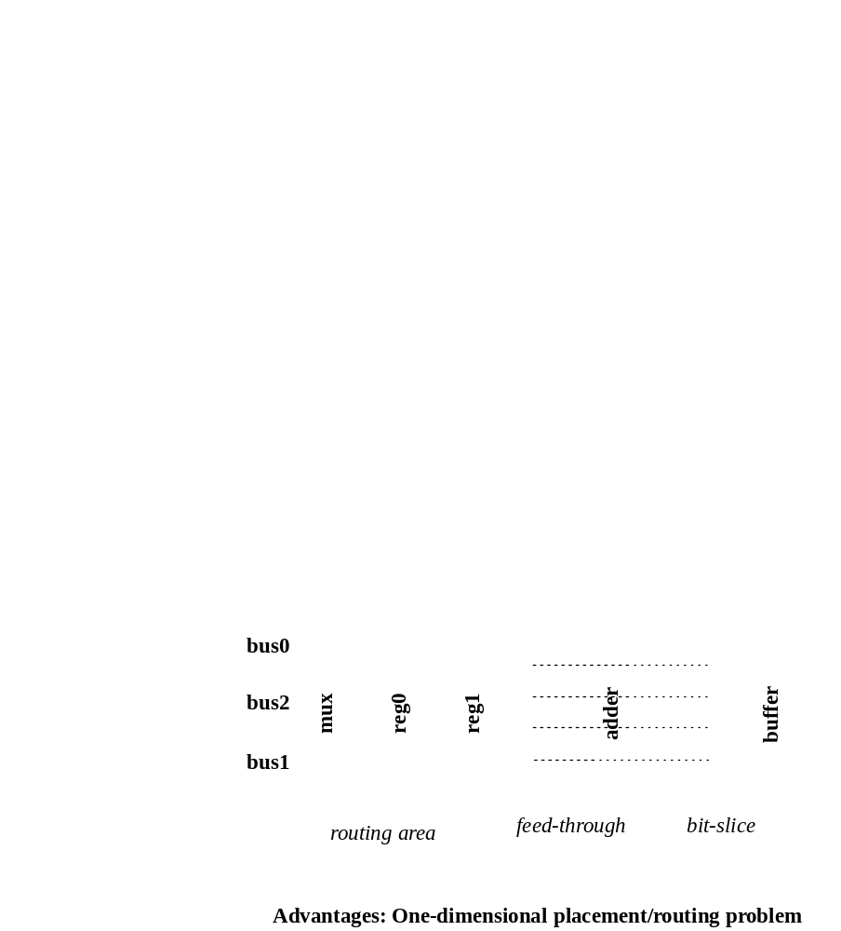
Module Generators —
Compiled Datapath
M.E.Zaghloul

Slide 6
Example Digital Arithmetic Building Blocks
This is covered in chapter 11in the text
This covered in this class to help in project planning
Next week the Project Proposal is due
List of possible Projects was posted.
Review of the important Arithmetic Blocks
M.E.Zaghloul

Slide 7
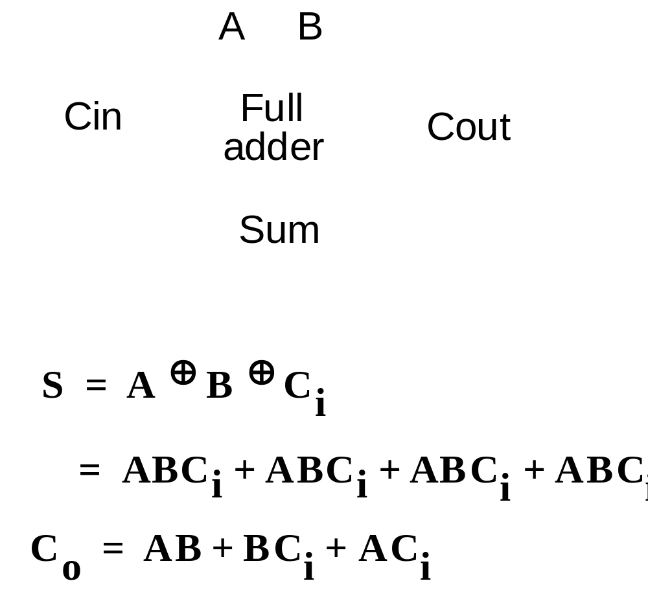
The Binary Adder
M.E.Zaghloul

Slide 8
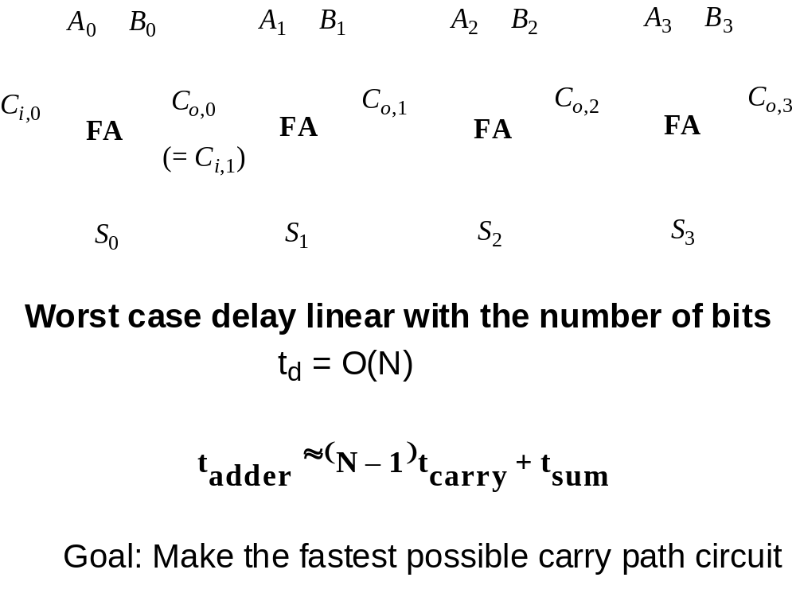
The Ripple-Carry Adder
M.E.Zaghloul

Slide 9
Examples of Full Adders
In the following examples of different adders are presented to show the CMOS-circuit design consideration
Different implementations of full adders are considered
Each is analyzed with respect the delay, and the critical path
M.E.Zaghloul

Slide 10
The Binary Adder
M.E.Zaghloul

Slide 11
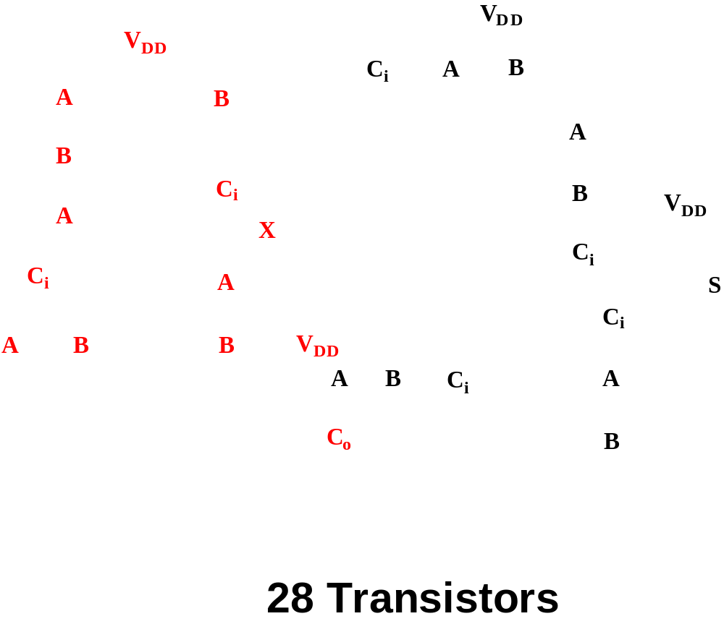
Complimentary Static CMOS Full Adder
From Equation above
Carry Circuit
S = ABC_{i} + bC₀ (A+B+C_{i} )
M.E.Zaghloul

Slide 12
The above adder
Requires 28 transistor ( Large Area)
Slow circuit compared to others
The sum generation requires an extra logic gate
Read the analysis page 565-566 (Rabaey)
M.E.Zaghloul

Slide 13
Critical Path in the Design
What is the critical path?
This is the path through the logic which determines the ultimate speed of the structure ( example the carry path) and consequently the chip speed
Some signals are more critical than others
Not all inputs of a gate arrive at the same time. An input signal to gate is called critical if it is the last signal of all inputs
M.E.Zaghloul

Slide 14
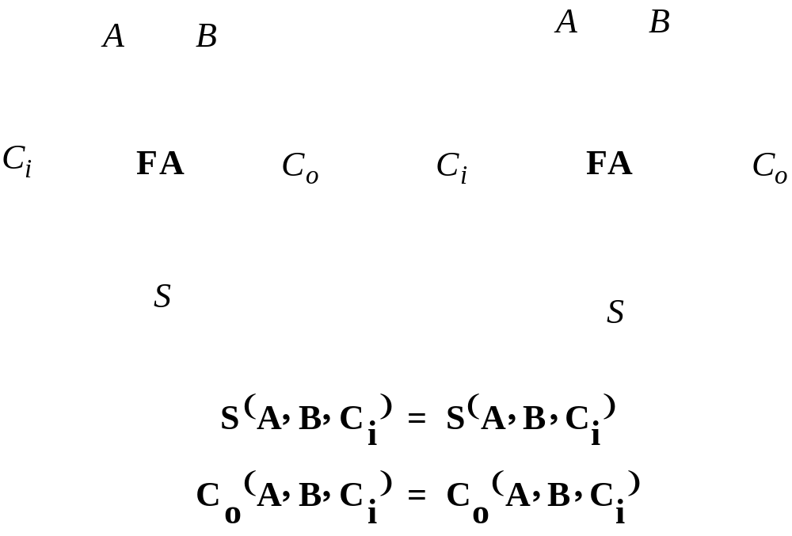
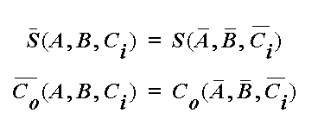
Inversion Property an Improved Adder Design
M.E.Zaghloul

Slide 15
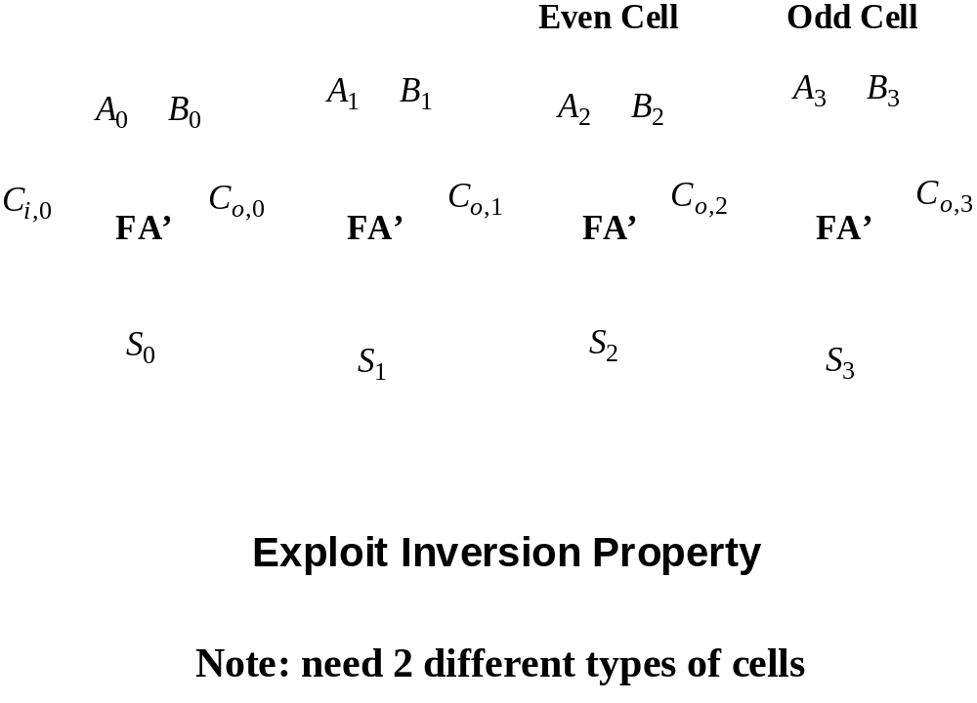
Minimize Critical Path by Reducing Inverting Stages
M.E.Zaghloul

Slide 16
Mirror Adder Design
M.E.Zaghloul

Slide 17
Mirror Adder Design
It is based on the useful implementation of of S and C_{o} as intermediate signals G ( generate) and P ( propagate) , D ( delete)
If G=1 and ensured that carry will be generated at C₀ independent of C_{i}
Read the analysis on page 567 in the text
M.E.Zaghloul

Slide 18
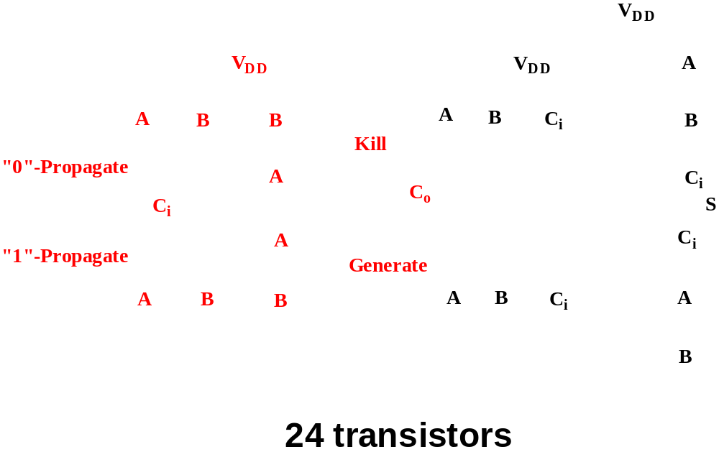
The better structure: the Mirror Adder
Improved structure read Page 566-567-text
M.E.Zaghloul

Slide 19
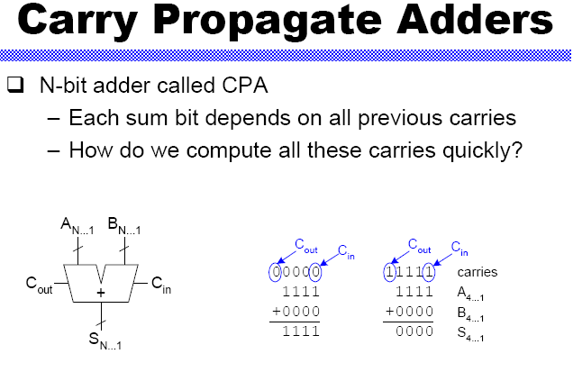
M.E.Zaghloul

Slide 20
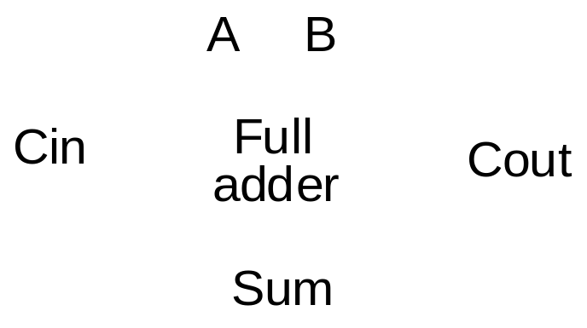
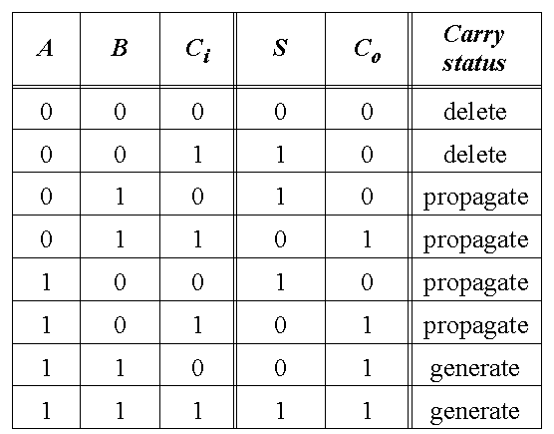
Full-Adder
M.E.Zaghloul

Slide 21
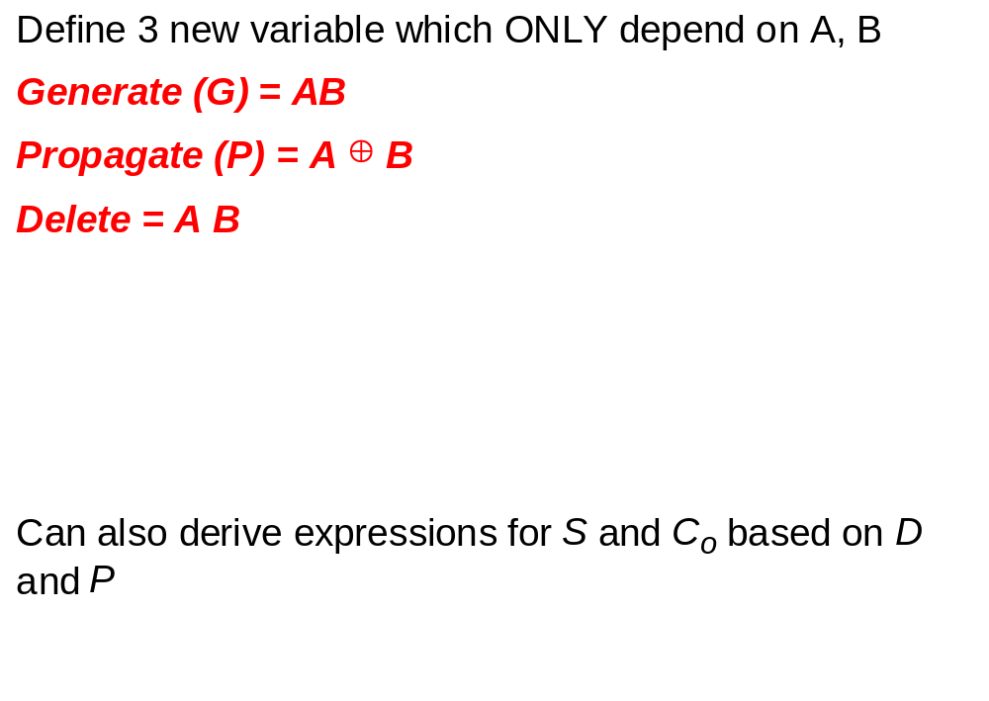
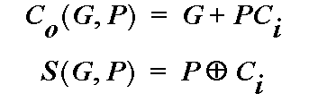
Express Sum and Carry as a function of P, G, D
M.E.Zaghloul

Slide 22
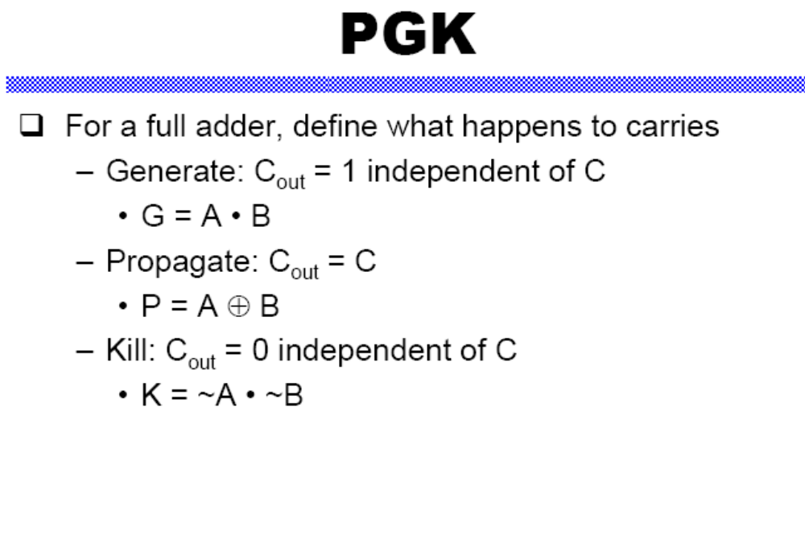
M.E.Zaghloul

Slide 23
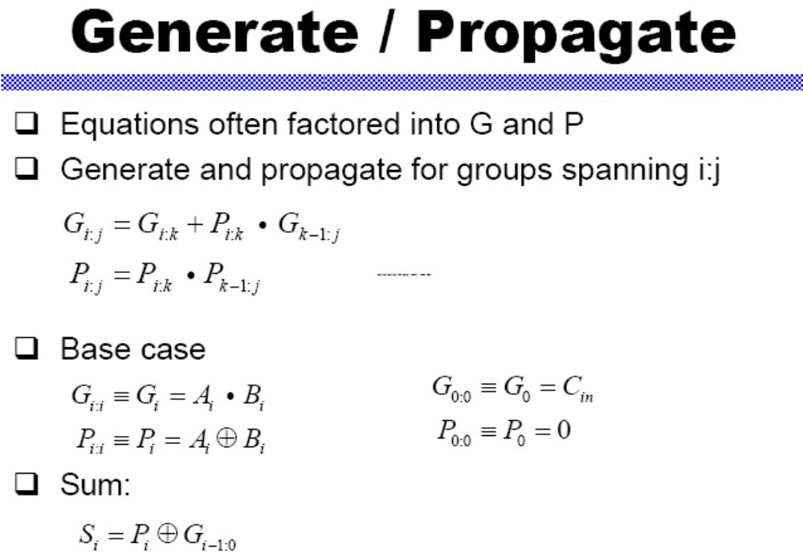
M.E.Zaghloul

Slide 24
Another Way to implement Adder
Consider the Adder Equations
M.E.Zaghloul

Slide 25
Full Adder can be designed
Using MUX’s and XOR
MUX and XOR are implemented in transmission gates
It is based on the propagate-generate equations we listed above
M.E.Zaghloul

Slide 26
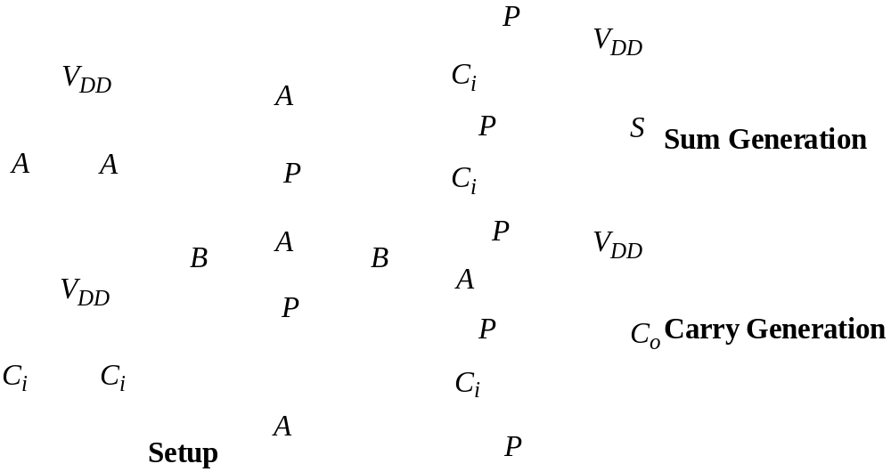
Transmission Gate Full Adder
Using MUX and XOR 24 Transistors
M.E.Zaghloul

Slide 27
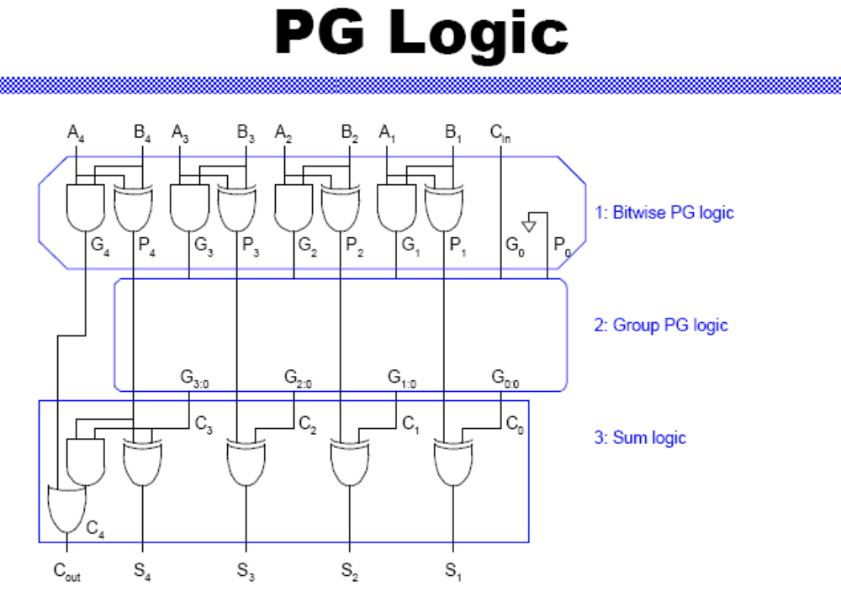
M.E.Zaghloul

Slide 28
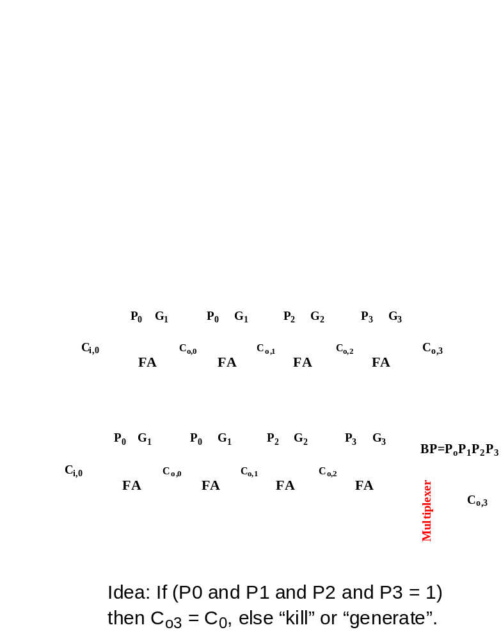
Carry-Bypass Adder
Another example to speed the structure
M.E.Zaghloul

Slide 29
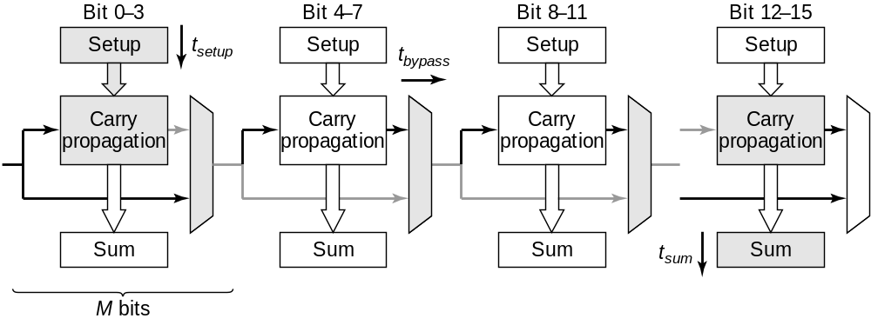
Carry-Bypass Adder (cont.)
Carry –bypass adder composition-
The worst case delay path is shaded area
M.E.Zaghloul

Slide 30
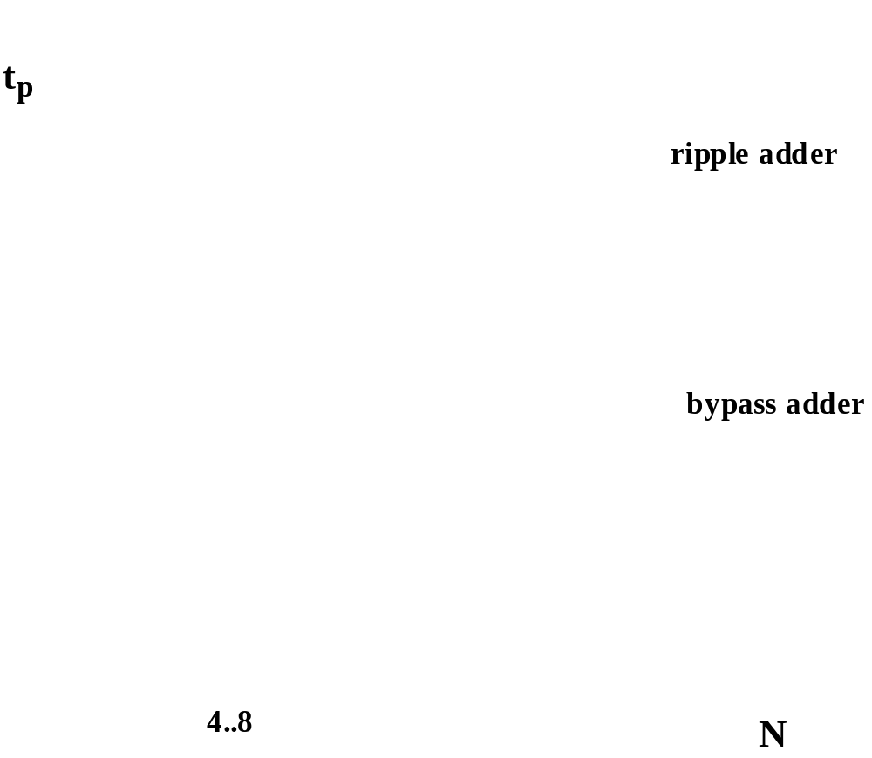
Carry Ripple versus Carry Bypass
M.E.Zaghloul

Slide 31
Adders Structures
There are other Adders structure given in chapter 11
Try to analyze the structure you are proposing and indicate where will be the worst delay.
What will be your plan to minimize this delay in which you think a faster chip will result in the given technology
M.E.Zaghloul

Slide 32
The Multiplier
Multiplication is expensive and slow
The performance of many computation operational problems is determined by the multiplication operation
This promoted the integration of complete multiplication operation unit in recent microprocessor designs
M.E.Zaghloul

Slide 33
Multiplier
This is in effect complex adder arrays
Therefore, to design fast adder is an important starting point
M.E.Zaghloul

Slide 34
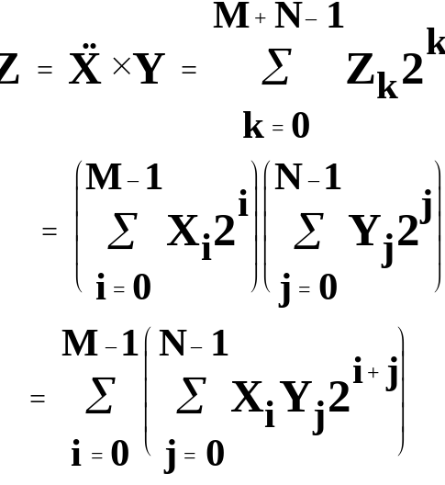

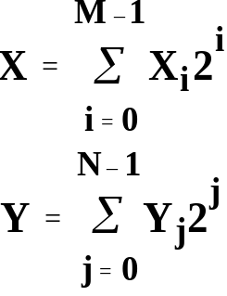
The Binary Multiplication
M.E.Zaghloul

Slide 35
Fast way
Fast way to implement multiplication is to resort to approach similar to manually computing a multiplication
All partial products are generated at the same time and organized in an array
The final product is the sum of all partial products
M.E.Zaghloul

Slide 36
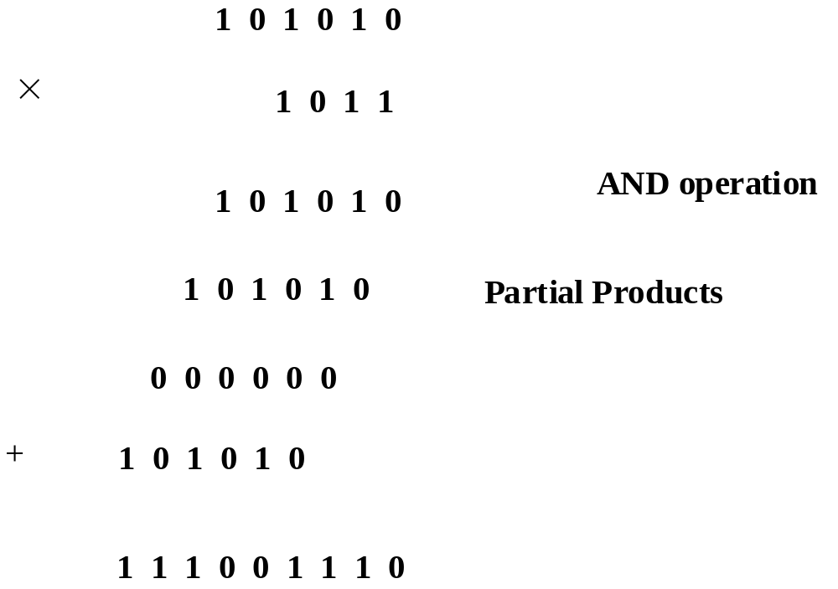
The Binary Multiplication
M.E.Zaghloul

Slide 37
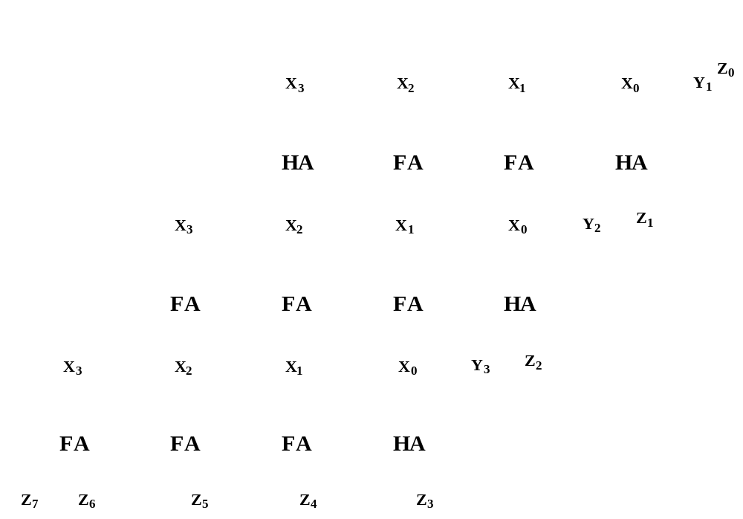
The Array Multiplier
M.E.Zaghloul

Slide 38
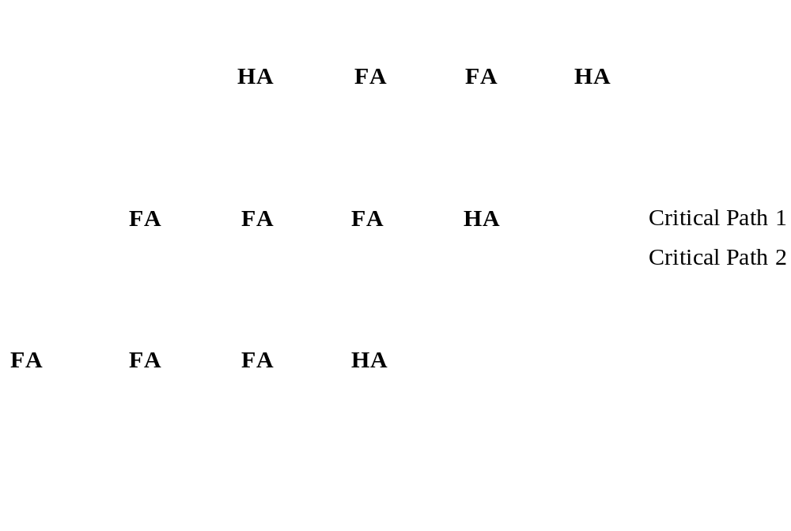
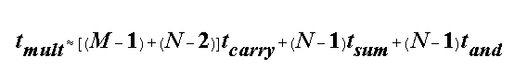
The MxN Array Multiplier
— Critical Path
Critical Path 1 & 2
M.E.Zaghloul

Slide 39
Notice
All critical paths have the same length, speeding one of them by replacing by faster adder does not make sense
All critical paths have to be attacked at the same time
To minimize the total sum delay is to minimize time for carry, and time for individual sum
M.E.Zaghloul

Slide 40
Carry Save Multiplier
Increasing the performance of the previous structure through transistor sizing yield marginal benefit
Another approach is when the output carry bits are passed diagonally downwards instead of only to the right
Extra adder called vector- merging adder to generate the final result are added
M.E.Zaghloul

Slide 41
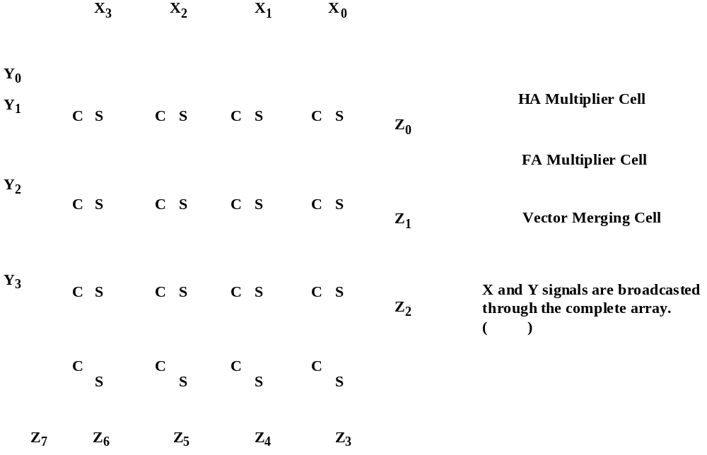
Multiplier Floorplan
M.E.Zaghloul

Slide 42
Tree Multipliers
The partial sum adders can also be rearranged in a tree like fashion
This will reduce the critical path and the number of adder cells needed
Read page 593
M.E.Zaghloul

Slide 43
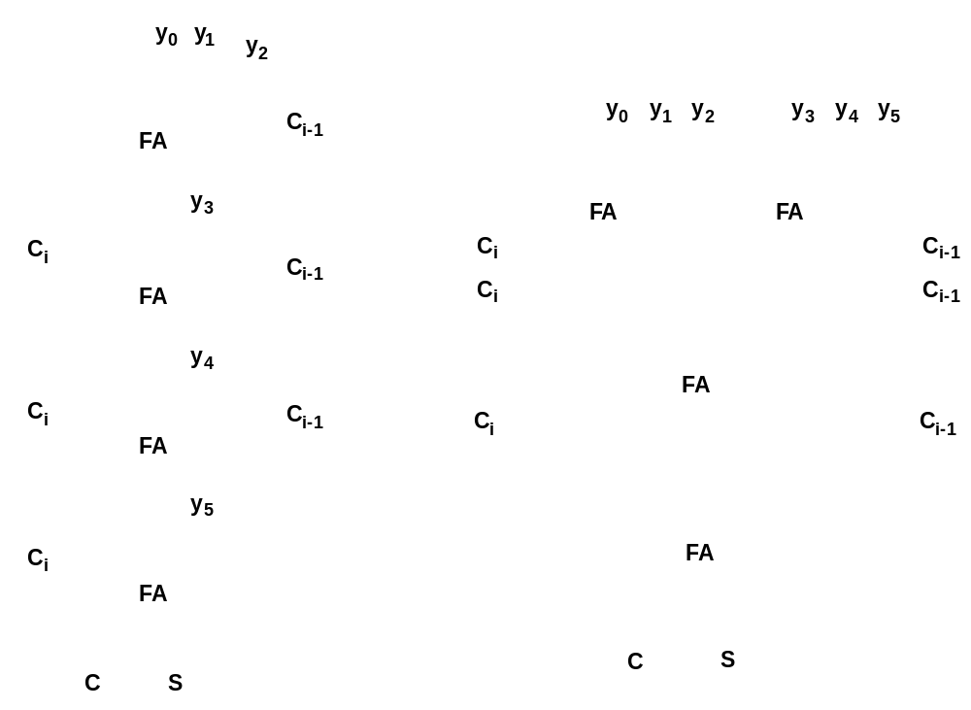
Wallace-Tree Multiplier
M.E.Zaghloul

Slide 44
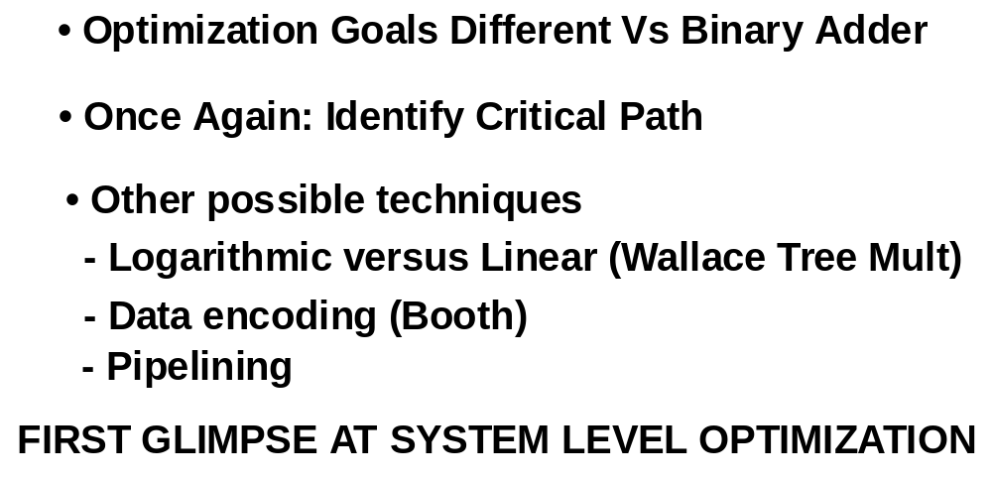
Multipliers —Summary
M.E.Zaghloul

