Slide 1
COMBINATIONAL
LOGIC
Part 2
Fall 23
M. E. Zaghloul
10/18/23
M.E.Zaghloul

Slide 2
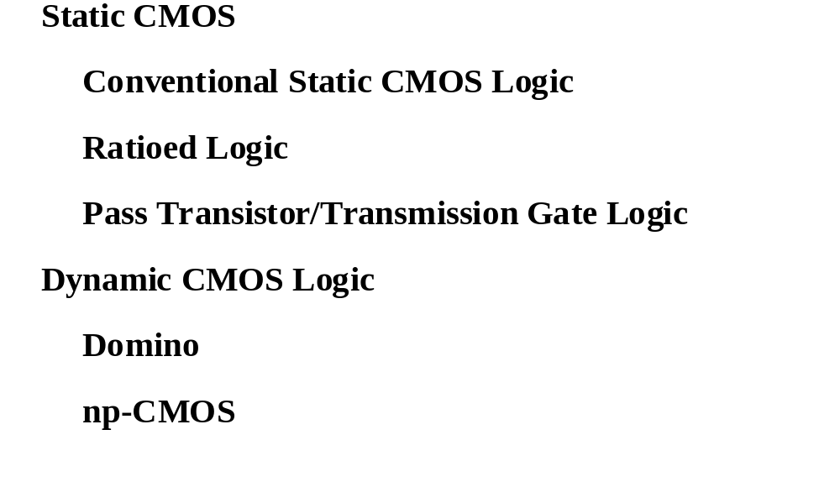
Overview
Part I
Part II
M.E.Zaghloul

Slide 3
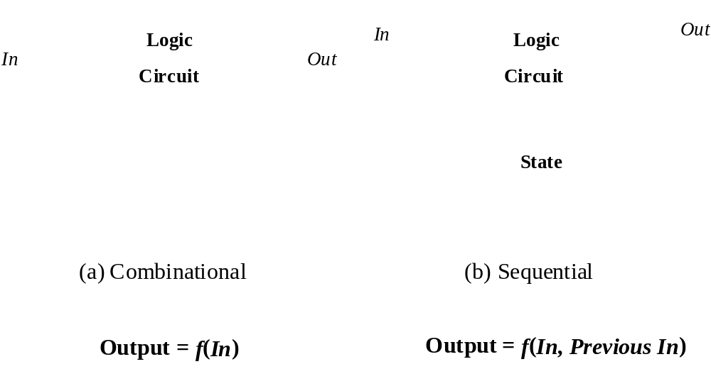
Combinational vs. Sequential Logic
M.E.Zaghloul

Slide 4
Static CMOS Circuit
At every point in time (except during the switching
transients) each gate output is connected to either
V
or
V
via a low-resistive path.
DD
ss
The outputs of the gates assume at all times the value
of the Boolean function, implemented by the circuit
(ignoring, once again, the transient effects during
switching periods).
This is in contrast to the
dynamic
circuit class, which
relies on temporary storage of signal values on the
capacitance of high impedance circuit nodes.
M.E.Zaghloul

Slide 5
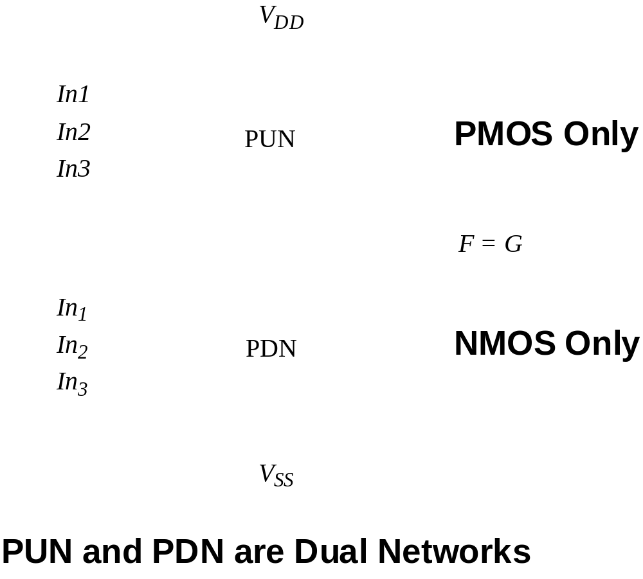
Static CMOS
M.E.Zaghloul

Slide 6
Dynamic CMOS Design
Save area by eliminating PUN or PDN
Less power dissipation
PDN does not have to sink the PUN current
M.E.Zaghloul

Slide 7
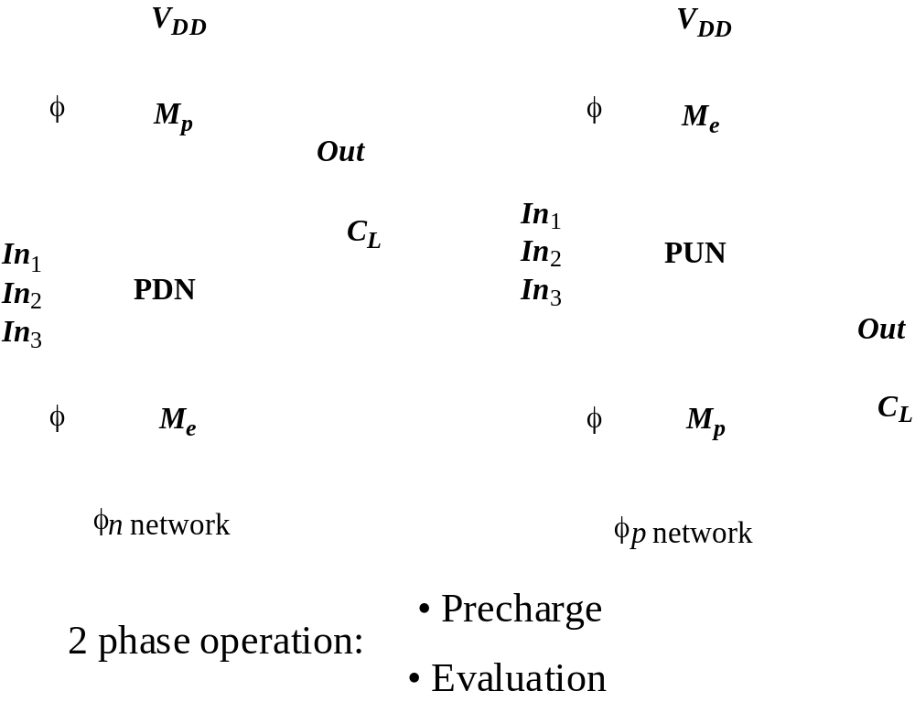
Dynamic Logic
M.E.Zaghloul

Slide 8
Dynamic CMOS
Two Values of clock Phi=0 and Phi = 1
The two Values are ( PDN):
Precharge Phi = 0
Evaluate Phi = 1
M.E.Zaghloul

Slide 9
Clock –Design- Overview
In VLSI “0” and “ 1” are abstract of discharging and charging of a parasitic capacitances
If charging and discharging occur in discrete moments of time with clock…It is called
CLOCKED LOGIC
M.E.Zaghloul

Slide 10
A CLOCK
Basically, It is Square Wave Generation Device
PHI
Period T
One Phase Clock
PHI_B
M.E.Zaghloul

Slide 11
TWO Phase Clocks
Same Period but shifted
1 2 3 4
4 Epochs for data processing
M.E.Zaghloul

Slide 12
Clocked Design on the Chip
Synchronous that is a common clock for the whole chip could be one phase or two phases clock or even more ..4 phases clock
Asynchronous Each part of the circuit has its own clock ( more popular now)-suitable for large system design
Clock can be external( Applied on input pad on the chip) or Build on the chip
M.E.Zaghloul

Slide 13
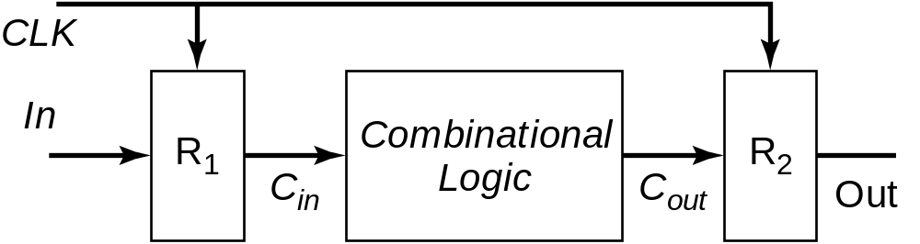
Synchronous logic Timing

Slide 14
Timing Strategies
In design it is easier to design Synchronous chips
Either single phase or two phases in CMOS
Two phases is convenient for Dynamic Logic
Single phase is convenient for static logic
Dynamic logic is possible with single phase but it is difficult
Difficult in case of pipeline to use single phase
M.E.Zaghloul

Slide 15
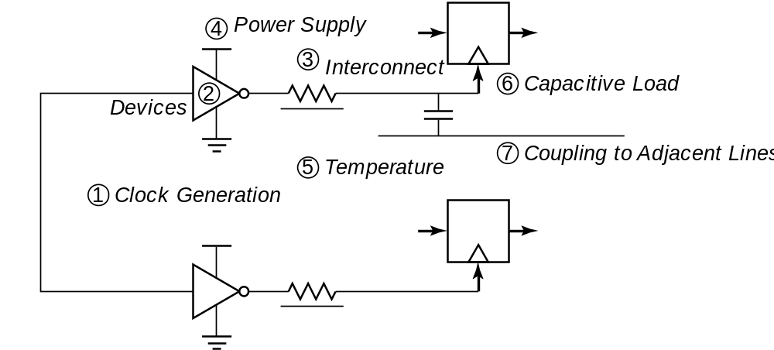
Clock Uncertainties
Sources of clock uncertainty

Slide 16
Clock Nonidealities
Clock skew
  Spatial variation in temporally equivalent clock edges; deterministic + random, t_{SK}
Clock jitter
  Temporal variations in consecutive edges of the clock signal; modulation + random noise
  Cycle-to-cycle (short-term) t_{JS}
  Long term t_{JL}
Variation of the pulse width
  Important for level sensitive clocking

Slide 17
Clock Skew and Jitter
Clk
t_{SK}
Clk
t_{JS}
Both skew and jitter affect the effective cycle time
Only skew affects the race margin

Slide 18
Clock Skew
# of registers
Earliest occurrence
of Clk edge
Nominal – δ/2
Latest occurrence
of Clk edge
Nominal + δ /2
Insertion delay
Clk delay
Max Clk skew
δ

Slide 19
Clock Skew is very Important
If you are designing Pipeline
Positive Skew corresponds to clock routing in the same direction as the data flow. In this case the skew have strictly to follow the equation of the delay of the CMOS design
Negative Skew when the clock is routed in the opposite direction of the data flow it can provide significant immunity to race
M. E. Zaghloul

Slide 20
Clock Skew
The Skew reduces the time available for actual computation so that clock period has to be increased by skew(delta)
Routing the clock in the opposite direction of the data is way to avoid problems but it will affect the performance of the circuit
M. E. Zaghloul

Slide 21
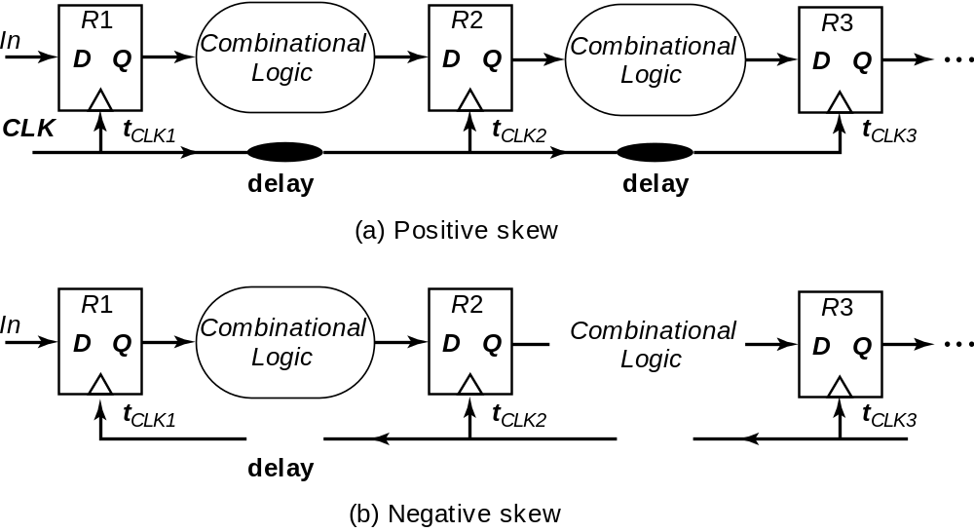
Positive and Negative Skew

Slide 22
Clock and Timing Issues
We will talk more about clocks in the Sequential circuits design
Detailed discussions are in chapter 10 Rabaey (Text-Book)
If you are doing Pipeline design, please consult with me and read chapter 10
M.E.Zaghloul

Slide 23
Dynamic CMOS Design
M.E.Zaghloul

Slide 24
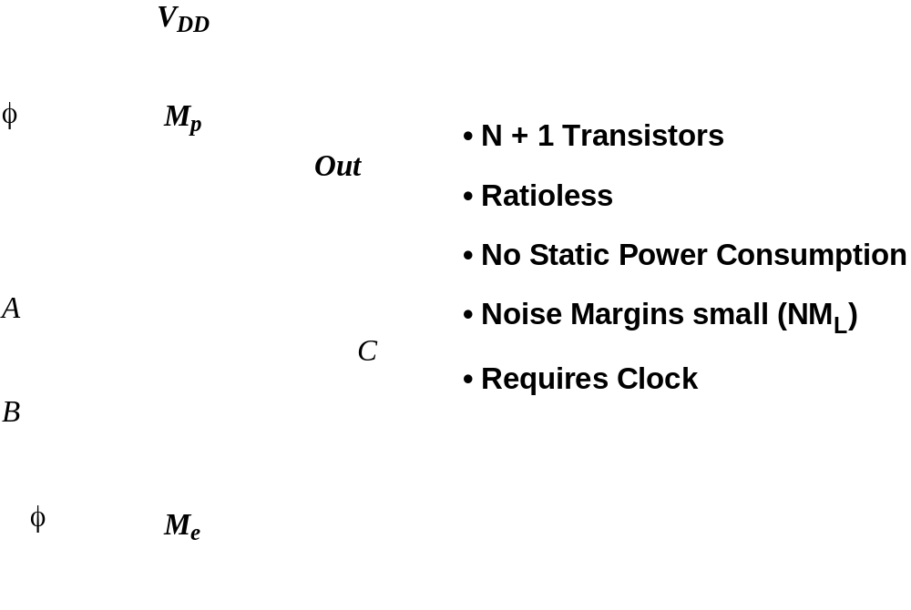
Example
M.E.Zaghloul

Slide 25
Dynamic Basic Principles
Precharge Phase Phi = 0
Output = 1 charging output load capacitance to V_{DD}
no DC current flows regardless of the values of input signal
The input signals are applied wait for all signals to set up
Evaluate Phase Phi = 1 output depends on the values of the input only at most one transition
M.E.Zaghloul

Slide 26
Clock and input signal
Evaluate
Phi
Precharge
Input
Setup Time
M.E.Zaghloul

Slide 27
Advantage of Dynamics
The number of transistors is less N+2 versus 2N smaller area
Non- ratioed
No Static power only dynamic
Due to reduced number of transistors load capacitance is smaller and thus is faster
M.E.Zaghloul

Slide 28
NOTE For your Project
Using Dynamic CMOS
You Must be prepared to invest extra time to insure correct Timing operation
M.E.Zaghloul

Slide 29
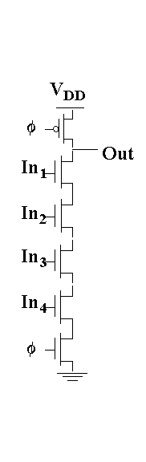

Dynamic 4 Input NAND Gate
V_{DD}
Out
In₁
In₂
In₃
In₄
φ
GND
M.E.Zaghloul

Slide 30
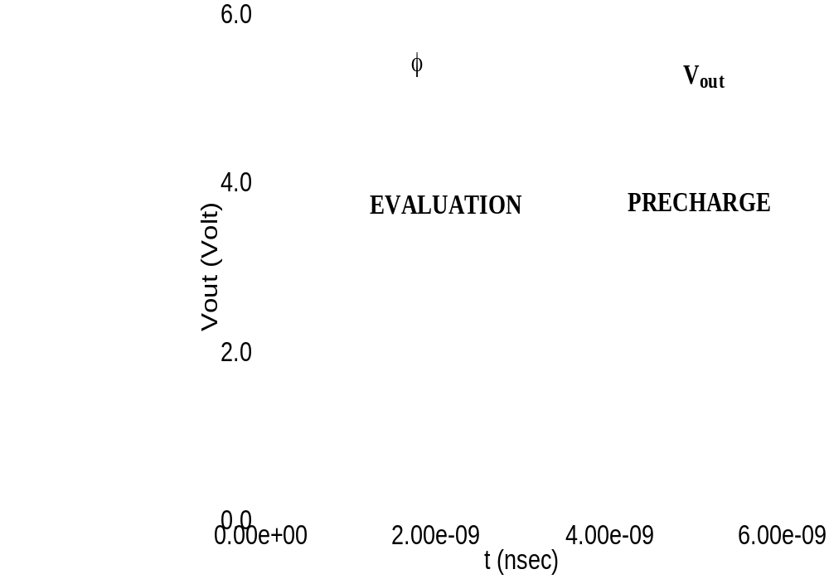
Transient Response
M.E.Zaghloul

Slide 31
Properties of Dynamic Design
Simple circuit which results in fast structure
Reduced robustness with regards to noise
The dynamic gate have inherent deficiencies that aggravate the function of operation of the next gate
The above are Problems with Dynamics Design
M.E.Zaghloul

Slide 32
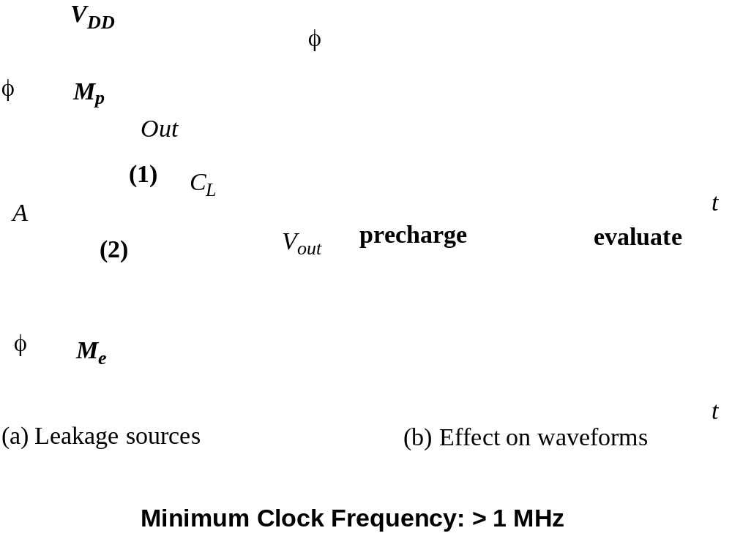
Reliability Problems —
Charge Leakage`
M.E.Zaghloul

Slide 33
Charge Leakage
A source of leakage is subthreshold current that can still flow from drain to source
Charge Leakage can cause degradation of high -level signal
Thus, Dynamic techniques require minimum clock rate
M.E.Zaghloul

Slide 34
Reliability Problems —
Charge Leakage
M.E.Zaghloul

Slide 35
Issues in Dynamic Design 1: Charge Leakage
CLK
Clk
M_{p}
Out
A
C_{L}
V_{Out}
Evaluate
Clk
M_{e}
Precharge
Leakage sources
Dominant component is subthreshold current
M.E.Zaghloul
Notes:
leakage sources are reverse-biased diode and the sub-threshold leakage of the NMOS pulldown device.
Charge stored on CL will leak away with time (input in low state during evaluation)
Requires a minimum clock rate - so not good for low performance products such as watches (or when have conditional clocks)
PMOS precharge device also contributes some leakage due to reverse bias diode and subthreshold conduction that, to some extent, offsets the leakage due to the pull down paths.

Slide 36
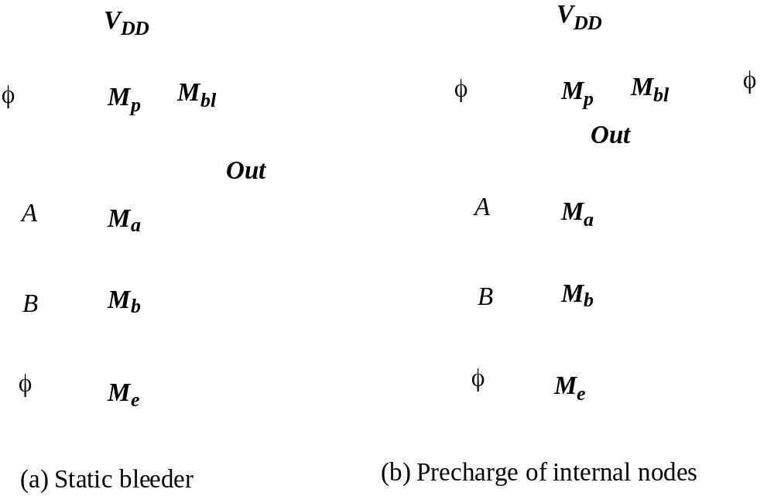
Charge Redistribution - Solutions
M.E.Zaghloul

Slide 37
Solution to Charge Leakage
Keeper
Feedback implementation
of bleeder
Clk
M_{p}
M_{kp}
A
Out
C_{L}
B
Clk
M_{e}
Same approach as level restorer for pass-transistor logic
M.E.Zaghloul
Notes:
During precharge, Out is VDD and inverter out is GND, so keeper is on
During evaluation if PDN is off, the keeper compensates for drained charge due to leakage.
If PDN is on, there is a fight between the PDN and the PUN - circuit is ratioed so PDN wins, eventually
Note Psc during switching period when PDN and keeper are both on simultaneously

Slide 38
Issues in Dynamic Design 2: Charge Sharing
Charge stored originally on C_{L} is redistributed (shared) over C_{L} and C_{A} leading to reduced robustness
Clk
M_{p}
Out
A
C_{L}
B=0
C_{A}
Clk
M_{e}
C_{B}
M.E.Zaghloul
Notes:
CA initially discharged and CL fully charged.

Slide 39
Charge Sharing
It is another important concern in dynamic logic
It is a result of redistributing the charge over the load capacitance C_{L} and parasitic capacitance C_{A}
M.E.Zaghloul

Slide 40
Example Charge Sharing
It is the redistribution of the charges and voltages due to parasitic capacitances
There are two capacitances connected by a switch one is large and the other is small
Large
SWITCH
Small
M.E.Zaghloul

Slide 41
Charge Sharing
When the switch closes the charge is shared and the voltage will distribute depending on the ratio of the capacitances
M.E.Zaghloul

Slide 42
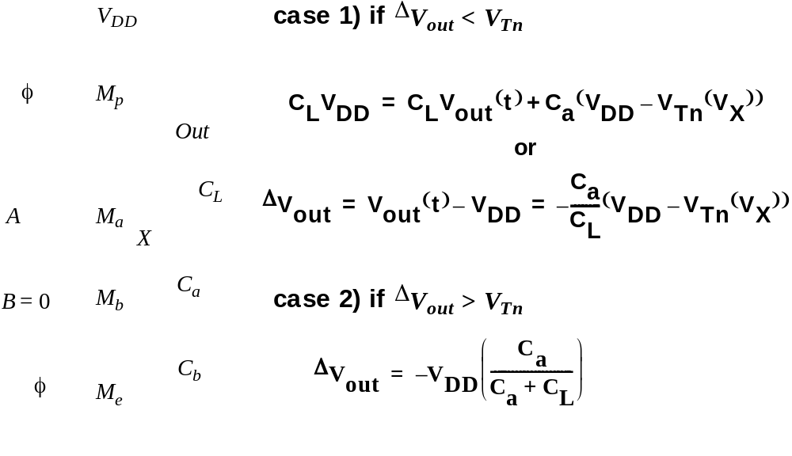
Charge Sharing (redistribution)
V_{out}FINAL
M.E.Zaghloul

Slide 43
Charge Sharing
Assuming that all inputs are set to 0 during precharge and capacitance C_{a} is discharged
Assume that B remains 0 during evaluation while A makes the transition from 0 to 1 turning transistor M_{a} on
The charge stored on capacitor C_{L} is redistributed over C_{L} and C_{a}
This causes a drop in output voltage
M.E.Zaghloul

Slide 44
Charge Sharing (redistribution)
V_{out}FINAL
M.E.Zaghloul

Slide 45
Issues in Dynamic Design 3
Clock Feed through
There is a capacitance coupling between the clock input and the gate-Drain capacitance of the precharge device
This will affect the fast rising and falling edges of the clock
The danger of clock feed through is: it will cause sufficiently above supply voltage that might cause the junction diode forward biased
This will cause electrons to be injected in the substrate, .. noise.. Could be avoided by increasing well contacts
M.E.Zaghloul

Slide 46
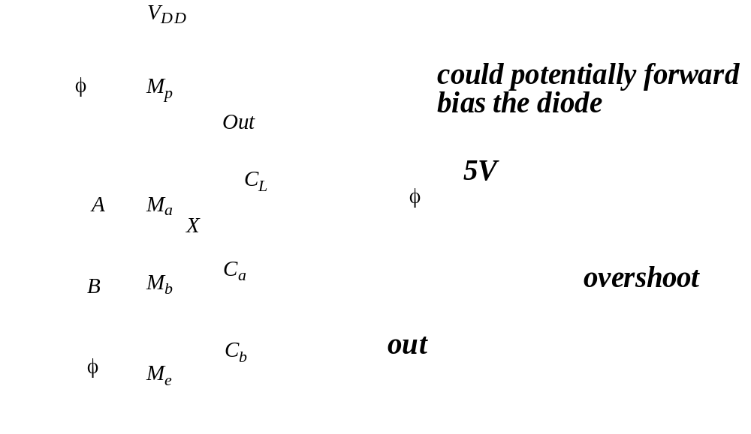
Clock Feed through
Clock feedthroughbetween clock and gate to drain capacitance
M.E.Zaghloul

Slide 47
Issues in Dynamic Design 3: Clock Feed through
Coupling between Out and Clk input of the precharge device due to the gate to drain capacitance. So voltage of Out can rise above V_{DD}. The fast rising (and falling edges) of the clock coupled to the Out.
Clk
M_{p}
Out
A
C_{L}
B
Clk
M_{e}
M.E.Zaghloul
Notes:
Danger is that signal levels can rise enough above VDD that the normally reverse-biased junction diodes become forward-biased causing electrons to be injected into the substrate.

Slide 48
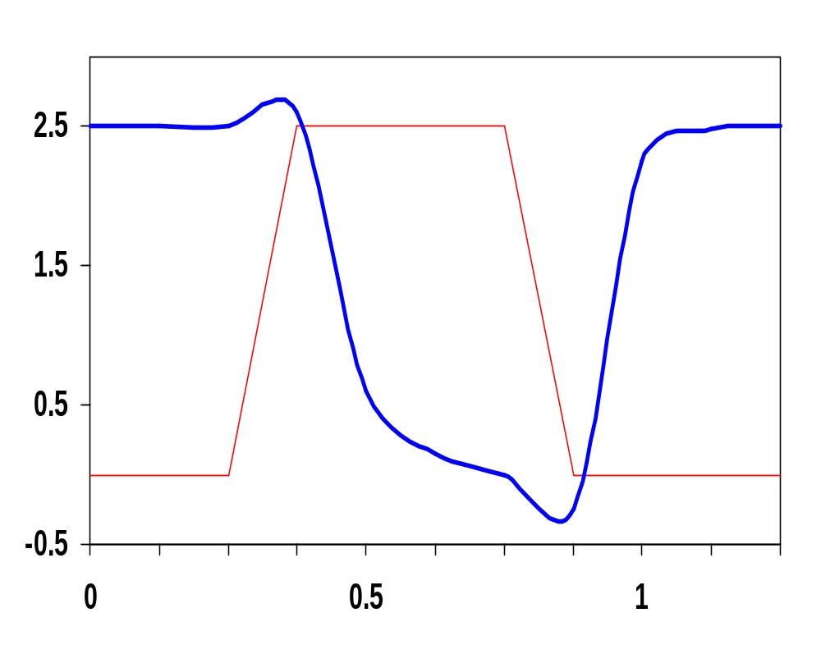
Clock Feed through
Clock feed through
Clk
Out
In₁
In₂
In₃
Voltage
In &
Clk
In₄
Out
Clk
Time, ns
Clock feed through
M.E.Zaghloul

Slide 49
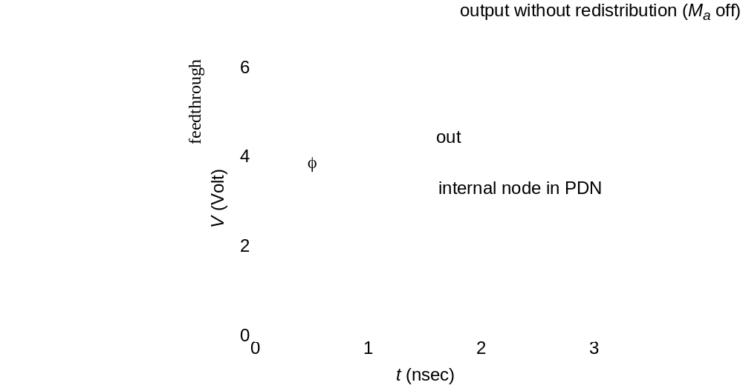
Clock Feed through and Charge Sharing
Could cause the output to rise above VDD
M.E.Zaghloul

Slide 50
Issues in Dynamic Design 4
Conditions on Output
Once the output of a dynamic gate is discharged, it cannot be charged again until the next precharge operation.
Inputs to the gate can make at most one transition during evaluation.
Output can be in the high impedance state during and after evaluation (PDN off), state is stored on C_{L}
M.E.Zaghloul
Notes:
This behavior is fundamentally different than the static counterpart that always has a low resistance path between the output and one of the power rails.

Slide 51
Properties of Dynamic Gates
Logic function is implemented by the PDN only
  number of transistors is N + 2 (versus 2N for static complementary CMOS)
Full swing outputs (V_{OL} = GND and V_{OH} = V_{DD})
Non-ratioed - sizing of the devices does not affect the logic levels
Faster switching speeds
  reduced load capacitance due to lower input capacitance (C_{in})
  reduced load capacitance due to smaller output loading (Cout)
  no I_{sc}, so all the current provided by PDN goes into discharging C_{L}
M.E.Zaghloul
Notes:
CL being lower also contributes to power savings

Slide 52
Properties of Dynamic Gates
Overall power dissipation usually higher than static CMOS
  no static current path ever exists between V_{DD} and GND (including P_{sc})
  no glitching
  higher transition probabilities
  extra load on Clk
PDN starts to work as soon as the input signals exceed V_{Tn}, so V_{M}, V_{IH} and V_{IL} equal to V_{Tn}
  low noise margin (NM_{L})
Needs a precharge/evaluate clock
M.E.Zaghloul

Slide 53
Another Example To Illustrate Back gate coupling
In this design the capacitance coupling causes the output of the dynamic node to rise aboveV_{DD} in the low to high transition
M.E.Zaghloul

Slide 54
Issues in Dynamic Design 5 Back-gate Coupling( dynamic-static)
Clk
M_{p}
Out1
=1
Out2
=0
A=0
In
C_{L1}
C_{L2}
B=0
Clk
M_{e}
If out2 goes low, coupling Static NAND cap could cause out1 to drop
Dynamic NAND
M.E.Zaghloul
Notes:
Due to capacitive backgate coupling between the internal and output node of the static gate and the output of the dynamic gate, Out1 voltage reduces

Slide 55
Other Effects
Capacitive coupling
Substrate coupling
Minority charge injection
Supply noise (ground bounce)
M.E.Zaghloul

Slide 56
Cascading Dynamic Gates
Beside the signal integrity issues, cascading of dynamic gates is not straightforward
The cascading problem arises because the outputs of each gate and thus input to the next stage, must be timed
M.E.Zaghloul

Slide 57
Cascading Dynamic Gates
All of the above illustrate that the design of dynamic CMOS gates is rather tricky
It requires extreme care
It needs high performance design CAD tools
Another major problem that the straightforward cascading to create multilevel logic structure does not work
M.E.Zaghloul

Slide 58
Cascading Dynamic Gates
Problems arise when we try to cascade a number of dynamic gates
We like to use several stages to realize the logic
M.E.Zaghloul

Slide 59
CASCADING Dynamic gates
Consider the design of the circuit shown
M.E.Zaghloul

Slide 60
Cascading Dynamic Gates
V
Clk
Clk
Clk
M_{p}
M_{p}
Out2
Out1
In
In
Clk
Clk
V_{Tn}
M_{e}
M_{e}
Out1
ΔV
Out2
Input can only make transition only during evaluate period
t
In 0-- 1 transitions of In
M.E.Zaghloul
Notes:
Out2 should remain at VDD since Out1 transitions to 0 during evaluation. However, since there is a finite propagation delay for the input to discharge Out1 to GND, the second output also starts to discharge.
The second dynamic inverter turns off (PDN) when Out1 reaches VTn.
Setting all inputs of the second gate to 0 during precharge will fix it.
Correct operation is guaranteed (ignoring charge redistribution and leakage) as long as the inputs can only make a single 0 -> 1 transition during the evaluation period

Slide 61
Example of Cascading Dynamic Gates
The problem is that all outputs are being precharged to 1
Suppose In makes a 0 –1 transition as shown in the next figure
M.E.Zaghloul

Slide 62
Cascade TWO inverters
During Precharge phase CLK = 0, out 1 and out 2 = 1
Assume that In makes change 0--1transition
On the rising edge of the clock out1 starts to discharge, out2 should remain in the precharge V_{DD}, but the finite propagation delay for out1 to discharge to GND, thus out2 starts discharging till out1reach the the threshold voltage
M.E.Zaghloul

Slide 63
Cascading Dynamic Gates
V
Clk
Clk
Clk
M_{p}
M_{p}
Out2
Out1
In
In
Clk
Clk
V_{Tn}
M_{e}
M_{e}
Out1
ΔV
Out2
Input can only make transition only during evaluate period
t
In 0-- 1 transitions of In
M.E.Zaghloul
Notes:
Out2 should remain at VDD since Out1 transitions to 0 during evaluation. However, since there is a finite propagation delay for the input to discharge Out1 to GND, the second output also starts to discharge.
The second dynamic inverter turns off (PDN) when Out1 reaches VTn.
Setting all inputs of the second gate to 0 during precharge will fix it.
Correct operation is guaranteed (ignoring charge redistribution and leakage) as long as the inputs can only make a single 0 -> 1 transition during the evaluation period

Slide 64
Cascading Dynamic Gates
Out₁ starts discharge as long as Out₁ exceeds the switching threshold of the second gate then Out₂ will also discharge
The output of the gate will not be correct
M.E.Zaghloul

Slide 65
Solution
Insert buffer between stages Inverter is inserted
The structure is called Domino design
M.E.Zaghloul

Slide 66
Domino Logic
Clk
M_{p}
Clk
M_{p}
M_{kp}
Out1
Out2
1 -- 1
1 ---0
0 -- 0
0 -- 1
In₁
In₂
PDN
In₄
PDN
In₃
In₅
Clk
M_{e}
Clk
M_{e}
Each gate is followed by static inverter
M.E.Zaghloul
Notes:
Ensures all inputs to the Domino gate are set to 0 at the end of the precharge period. Hence, the only possible transition during evaluation is 0 -> 1

Slide 67
Domino Logic
Consists of an n-type dynamic logic block followed by a static inverter
During precharge, the output of the n-type dynamic gate is V_{DD} and the output of the inverter is set to 0
During evaluate the output of the dynamic gate is conditionally discharged
M.E.Zaghloul

Slide 68
Why Domino?
Clk
In_{i}
PDN
In_{i}
PDN
In_{i}
PDN
In_{i}
PDN
In_{j}
In_{j}
In_{j}
In_{j}
Clk
Like falling dominos!
M.E.Zaghloul

Slide 69
Properties of Domino Logic
Only non-inverting logic can be implemented
Very high speed
  static inverter can be skewed, only L-H transition
  Input capacitance reduced – smaller logical effort
  Very rare design style due to non-inverting logic
M.E.Zaghloul
Notes:
First 32 bit micro (BellMAC 32) was designed in Domino logic
Now a rather rare design style due to non-inverting logic only

Slide 70
Domino Logic
Clk
M_{p}
Clk
M_{p}
M_{kp}
Out1
Out2
1 → 1
1 → 0
0 → 0
0 → 1
In₁
In₂
PDN
In₄
PDN
In₃
In₅
Clk
M_{e}
Clk
M_{e}
Notes:
EE141
Ensures all inputs to the Domino gate are set to 0 at the end of the precharge period. Hence, the only possible transition during evaluation is 0 -> 1

Slide 71
Why Domino?
Clk
In_{i}
PDN
In_{i}
PDN
In_{i}
PDN
In_{i}
PDN
In_{j}
In_{j}
In_{j}
In_{j}
Clk
Like falling dominos!
Notes:
EE141

Slide 72
Properties of Domino Logic
Only non-inverting logic can be implemented
Very high speed
  static inverter can be skewed, only L-H transition
  Input capacitance reduced – smaller logical effort
Notes:
EE141
First 32 bit micro (BellMAC 32) was designed in Domino logic
Now a rather rare design style due to non-inverting logic only

Slide 73
Designing with Domino Logic
V
DD
V
DD
V
DD
Clk
M
p
Clk
M
p
M
r
Out1
Out2
In
1
In
2
PDN
In
PDN
4
In
3
Can be eliminated!
Clk
M
e
Clk
M
e
Inputs = 0
during precharge
Notes:
EE141

Slide 74
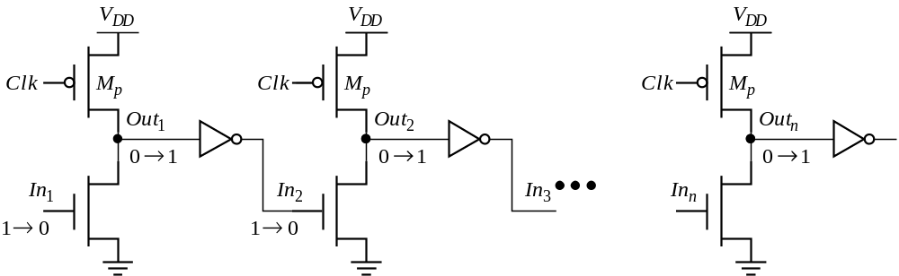
Footless Domino- Eliminating the evaluate transistor
Disadvantages:
Precharge is rippling through the Network
short-circuit current increases
A solution is to delay the clock for each stage
It is good practice to use evaluate device
M.E.Zaghloul

Slide 75
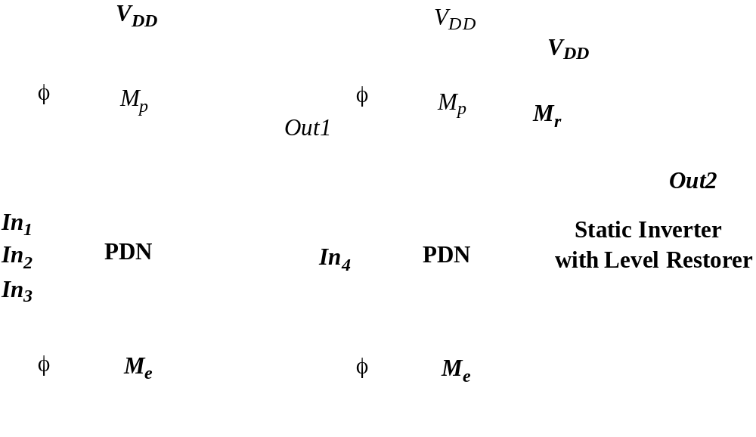
Domino Logic
M.E.Zaghloul

Slide 76
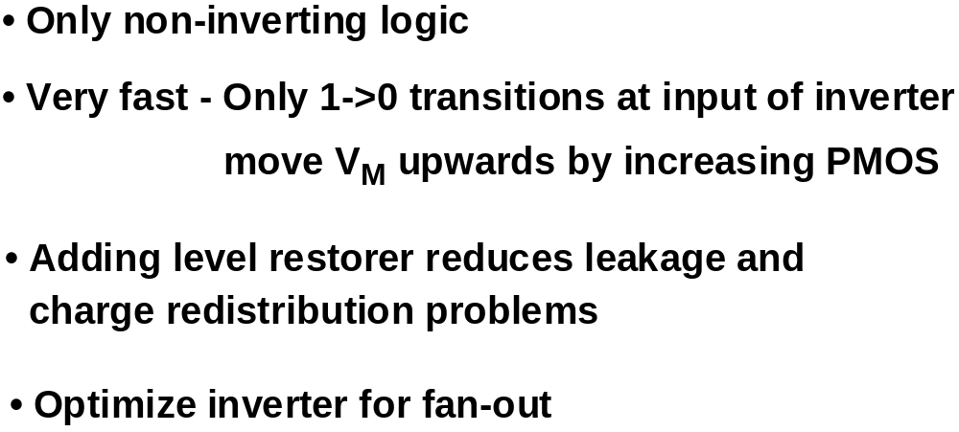
Domino Logic - Characteristics
M.E.Zaghloul

Slide 77
Differential (Dual Rail) Domino
off
on
Clk
M_{p}
M_{kp}
M_{kp}
M_{p}
Clk
Out = AB
Out = AB
1 0
1 0
A
!A
!B
B
Clk
M_{e}
Solves the problem of non-inverting logic
Notes:
EE141
AND/NAND differential logic gate. The inputs and their complements come from other differential DR gates and thus all inputs are low during precharge and make a conditional transition from 0 to 1.
Annotations show state during evaluate cycle (CLK = 1)
Expensive - but can implement any arbitrary function.
Use significant power since they have a guaranteed transition every single clock cycle (regardless of signal statistics, since either Out or !Out will transition from 0 to 1).
Not ratioed (even though have a cross-coupled PMOS pair)

Slide 78
Another Solution for Cascading Dynamics
To switch the n – PDN by P –PDN network
It is slower than all n-network
Larger noise reduced noise margins
M.E.Zaghloul

Slide 79
np-CMOS
An alternative approach to cascading dynamic logic
Uses n-tree and p-tree to avoid extra static inverter in the critical path
Critical path is defined as the longest delay path in the design
M.E.Zaghloul

Slide 80
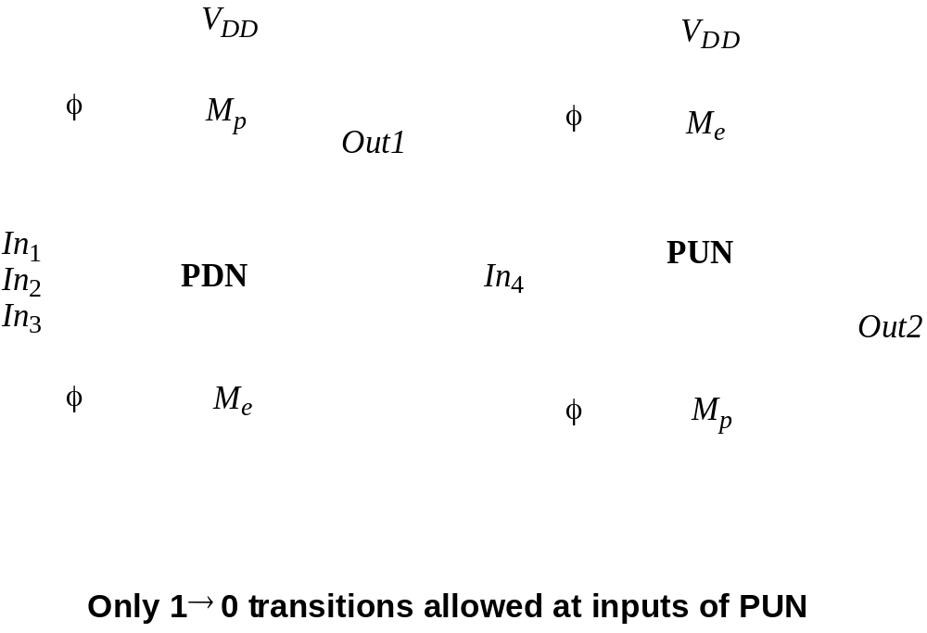
np-CMOS
Notice the clock
M.E.Zaghloul

Slide 81
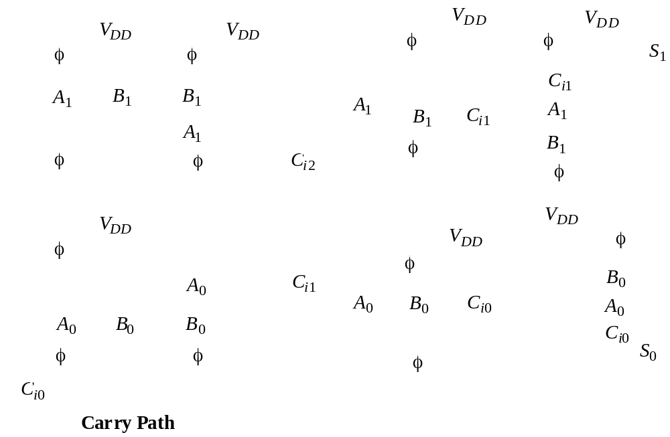
np CMOS Adder
M.E.Zaghloul

Slide 82
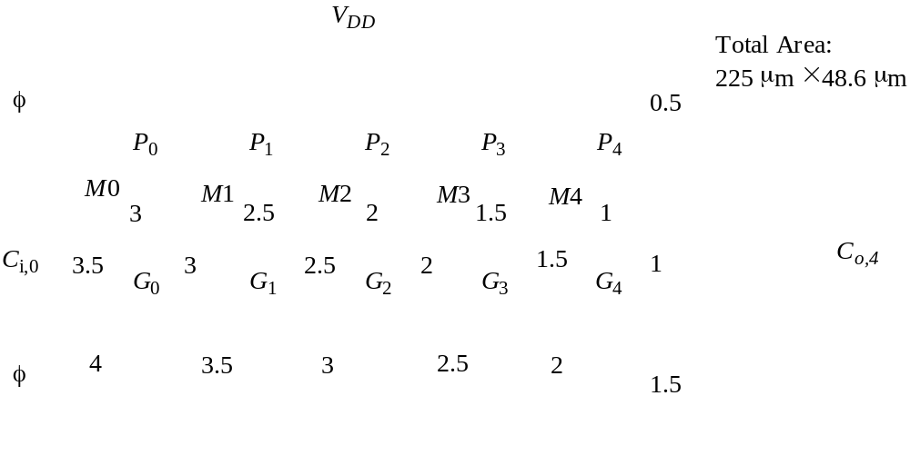
Manchester Carry Chain Adder
M.E.Zaghloul

Slide 83
How to Choose a Logic Style
Static Approach has the advantage of being robust in the presence of noise ..Easy to design
Static is expensive in area and performance alternative static could be used such as Pseudo logic, Pass Transistor Logic
Dynamic is small and fast
The price for Dynamic is parasitic effects such as charge sharing, charge leaking which puts lower bound on clock
Trend is to use more Static because of the design automation and very useful with voltage scaling
M.E.Zaghloul

Slide 84
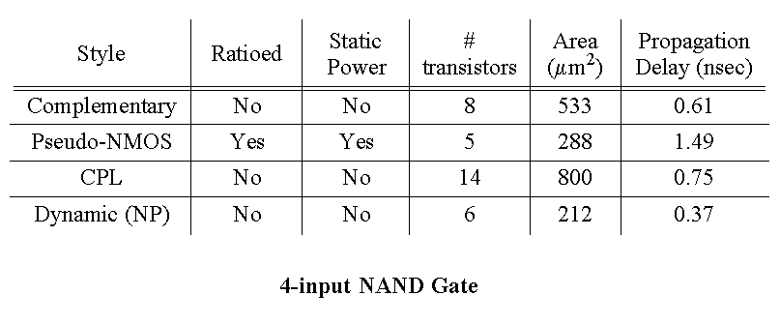
CMOS Circuit Styles – Summary
For Certain design
M.E.Zaghloul

Slide 85
How to simulate and design layout of Complex Logic Gates
Parts C and D
Page 309 ( part c) in the text discuss the steps you have to do to simulate design
Use of VHDL to describe the design, Behvioral level VHDL( higher level VHDL)
Page 319 ( part D) layout techniques we discussed parts of it in our classes
Stick diagram, standard cell approach, Euler paths
Next class we will discuss Sequential Logic circuits
M.E.Zaghloul

