Slide 1
ECE 4150/6250_Lab1 Environment Set Up
Sichen Xin
E-mail: sxin51@gwu.edu
Office Hour: Monday 1 pm to 3 pm
GitHub: https://github.com/DirectorChen/ECE4150-6250

Slide 2
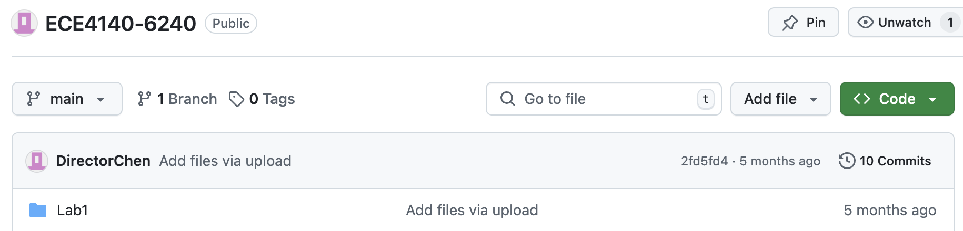
Prerequisites
ECE6213
ECE4140/6240
If not, start with

Slide 3
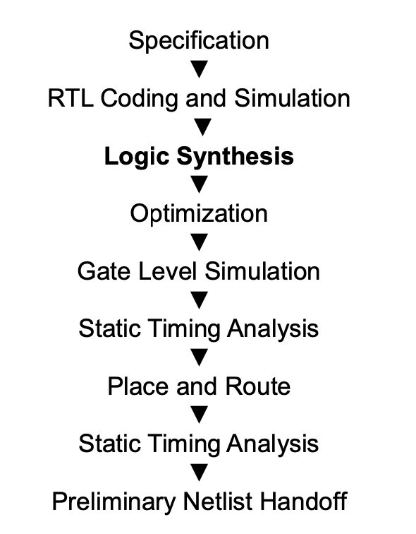
Lab Goal
You will learn some useful tools for synthesizing RTL code.
You will learn place & Route tool to generate IC Layout (You did it manually in ECE6240 ).
You will make a CPU for the final project by the end of this semester.
The Linux system was updated but the tool, library, and scripts were not updated accordingly so that only 80% of the lab can be finished.

Slide 4
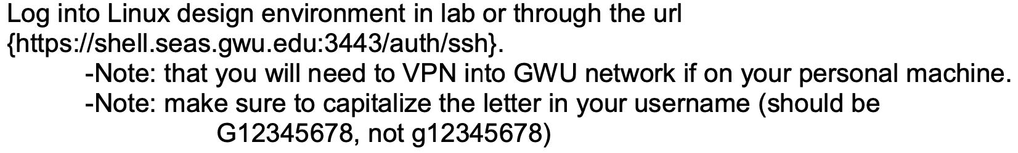
Step 1

Slide 5

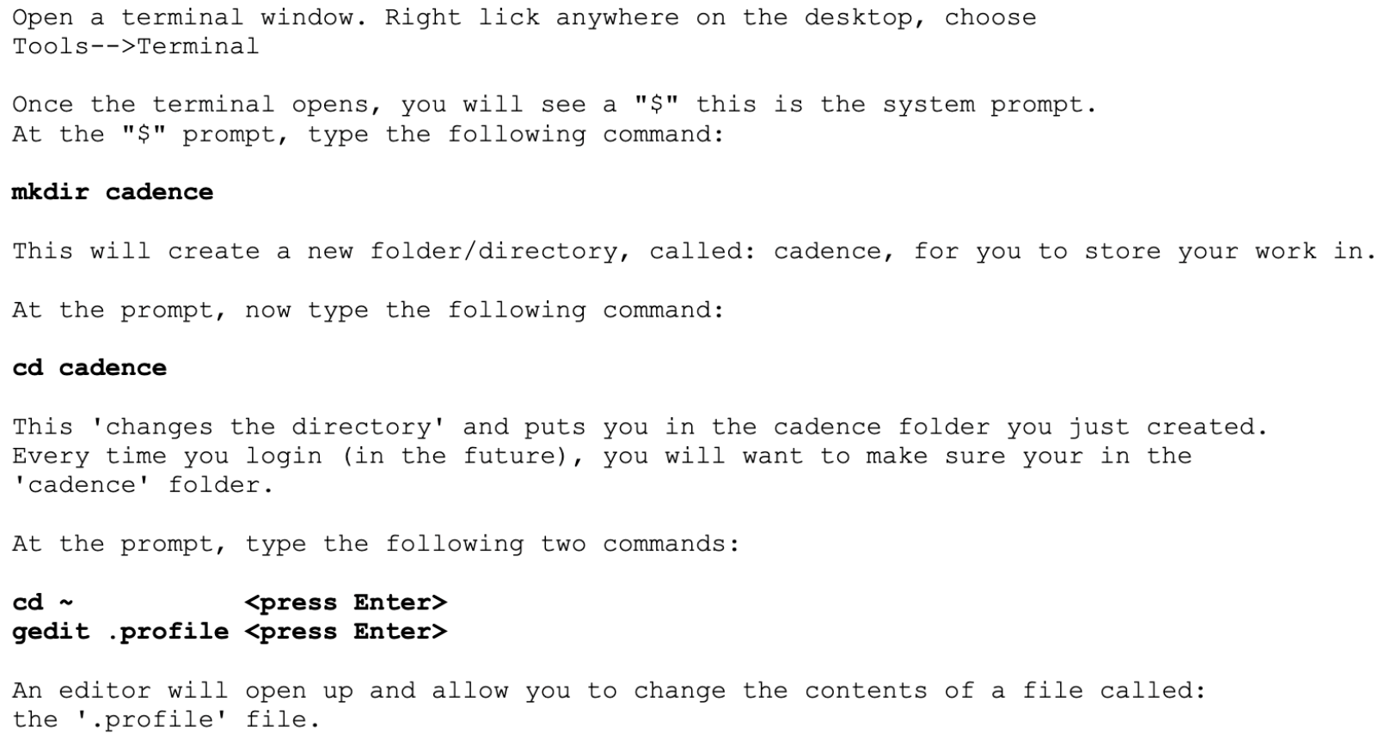
Step 2

Slide 6
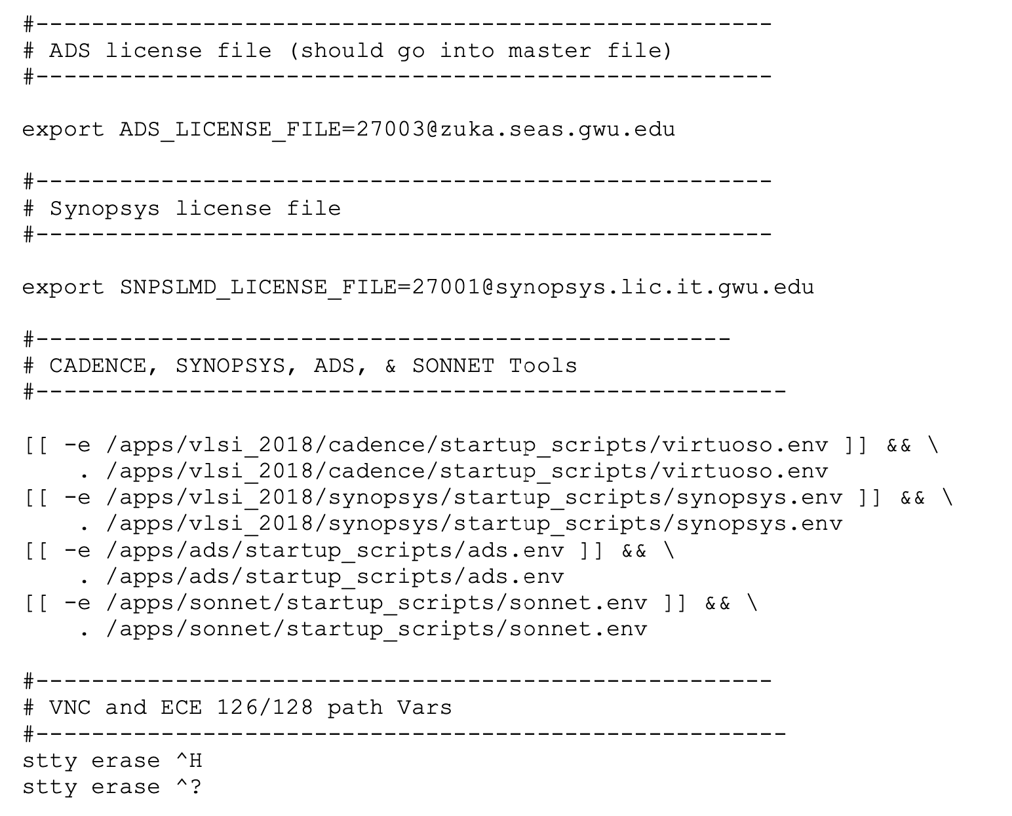
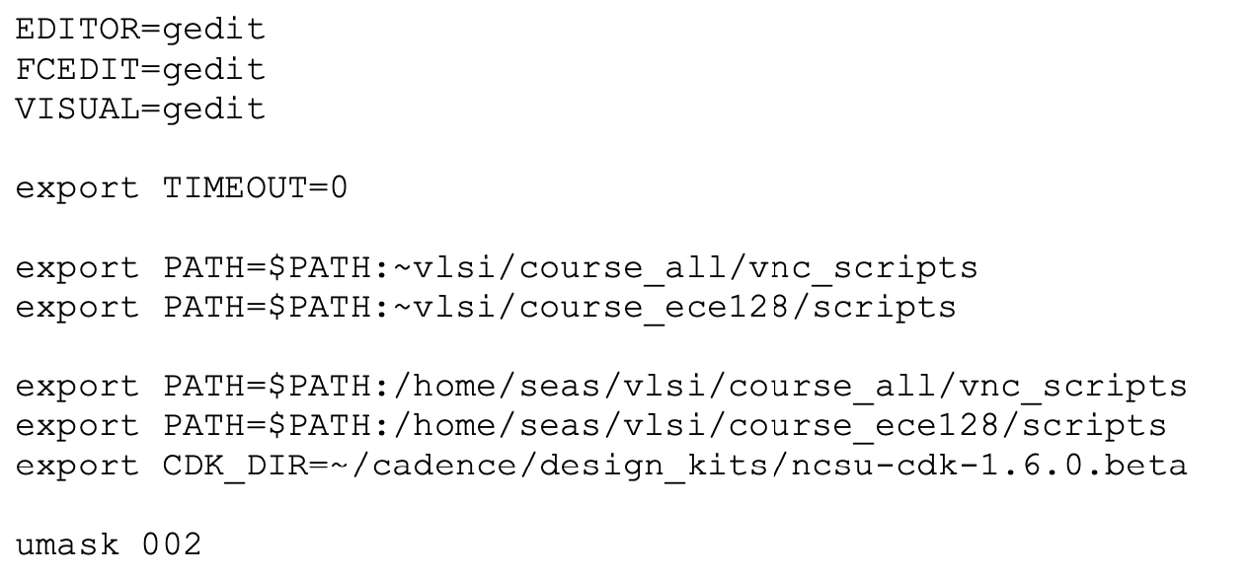
Step 3
Check your .profile, and type: . ~/.profile in the terminal
if it does not work,
Check ~./bashrc
Completely Log out and log in
If next time it does not work,
type . ~/.profile again

Slide 7

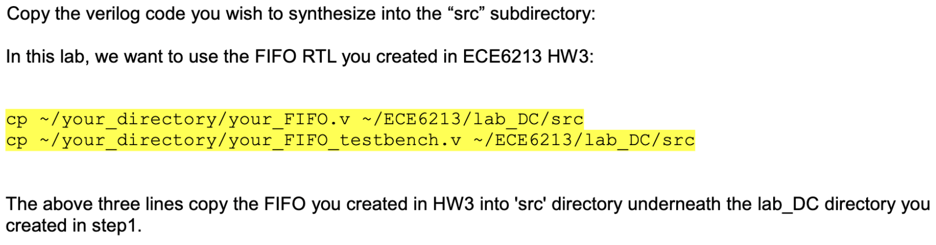

Step 4
Follow
Instead ECE6213 in above file ↑ with ECE6250 or ECE4150
Instead
With the file for your in-class assignment 1.

Slide 8
Final Project
11 students in total
2 students as a team for 4 teams
3 students as a team for 1 team

