Slide 1
ECE 4150/6250_Lab1
Environment Set Up
Sichen Xin
E-mail: sxin51@gwu.edu
Office Hour: Monday 1 pm to 3 pm
https://github.com/DirectorChen/Spring2026_4140-6240

Slide 2
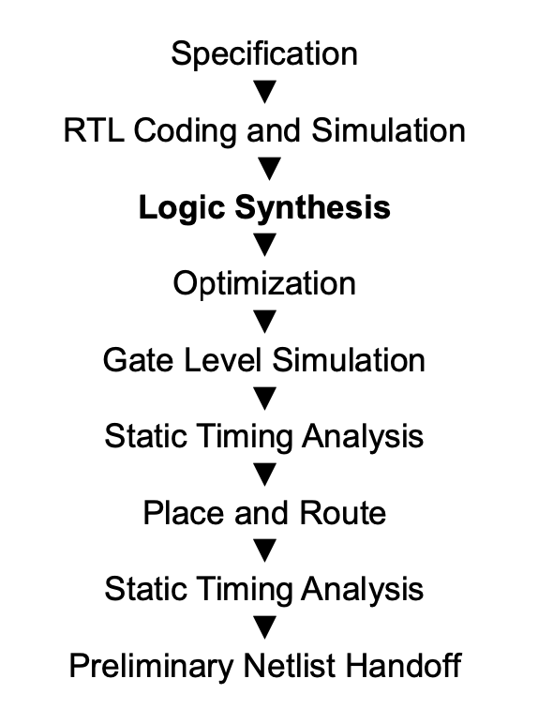
Lab Goal
You will learn some useful tools for synthesizing RTL code.
You will learn place & Route tool to generate IC Layout (You did it manually in ECE6240 ).
You will make a CPU for the final project by the end of this semester.
The Linux system was updated but the tool, library, and scripts were not updated accordingly so that only 80% of the lab can be finished.

Slide 3
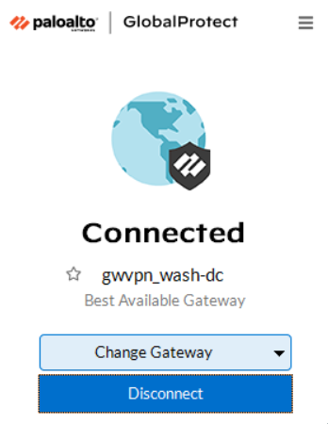
Step 1
USE VPN to connect to shell Linux(Your Personal Devices)
https://ithelp.gwu.edu/en-us/article/1665784

Slide 4
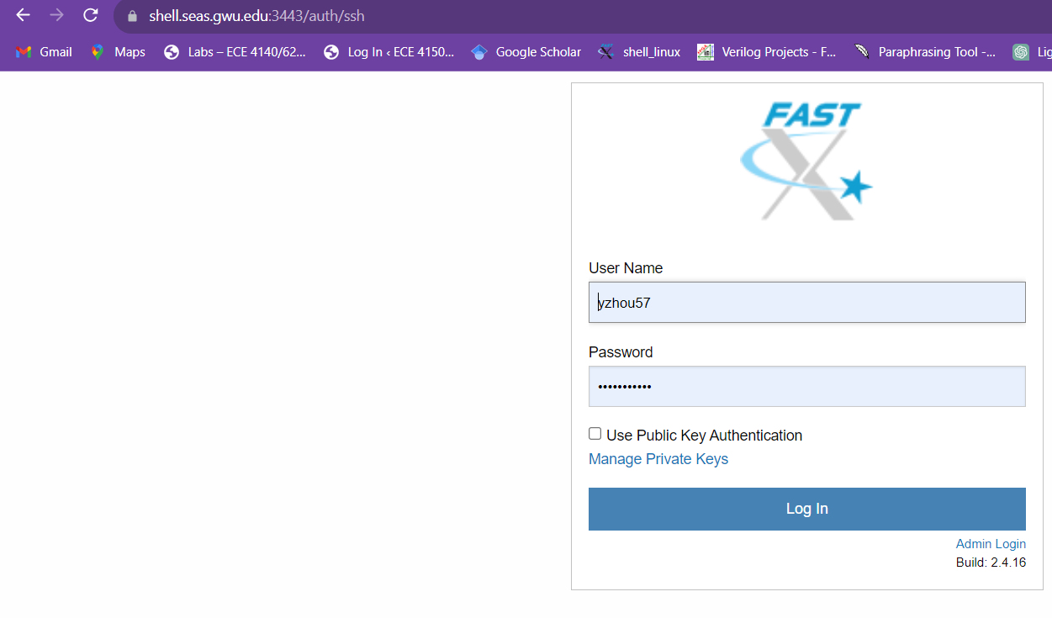
Remote access
Remote access to the Linux in Tompkins 411 with this link:
http://shell.seas.gwu.edu:3300
Username for new students could be:
GXXXXXXXX not gXXXXXXXX
Follow this tutorial LAB2 –LAB 10:
https://blogs.gwu.edu/ece4140/labs/
Password: 41406240RF

Slide 5
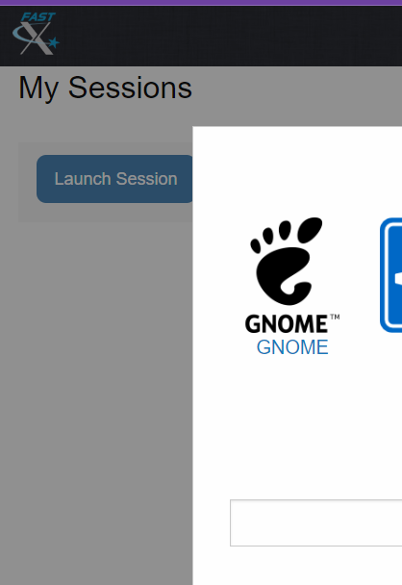
Launch Session ->GNOME

Slide 6
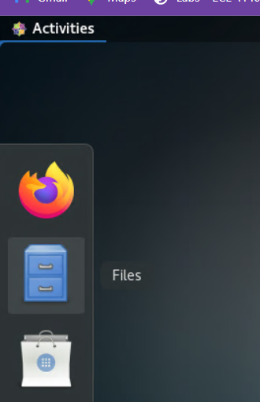
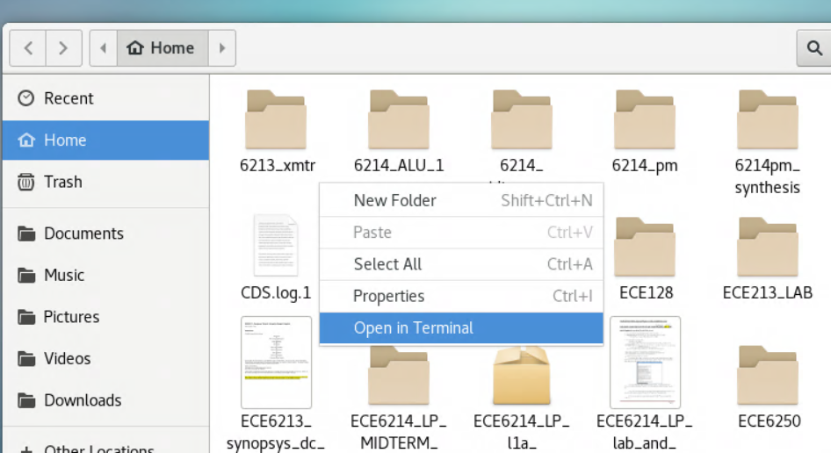
Activities -> Files->Home
Open in terminal

Slide 7
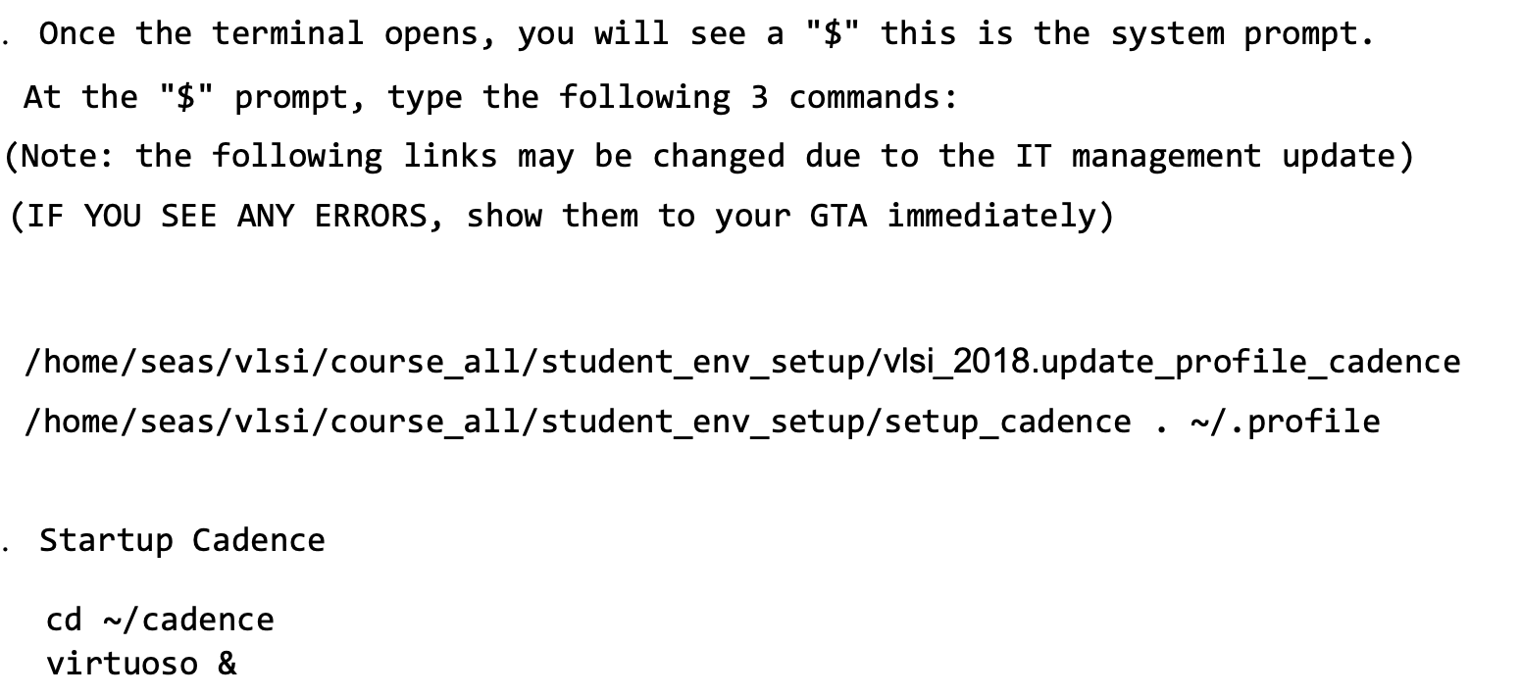
Step 2 (do this if you have not take ECE4140/6240)

Slide 8
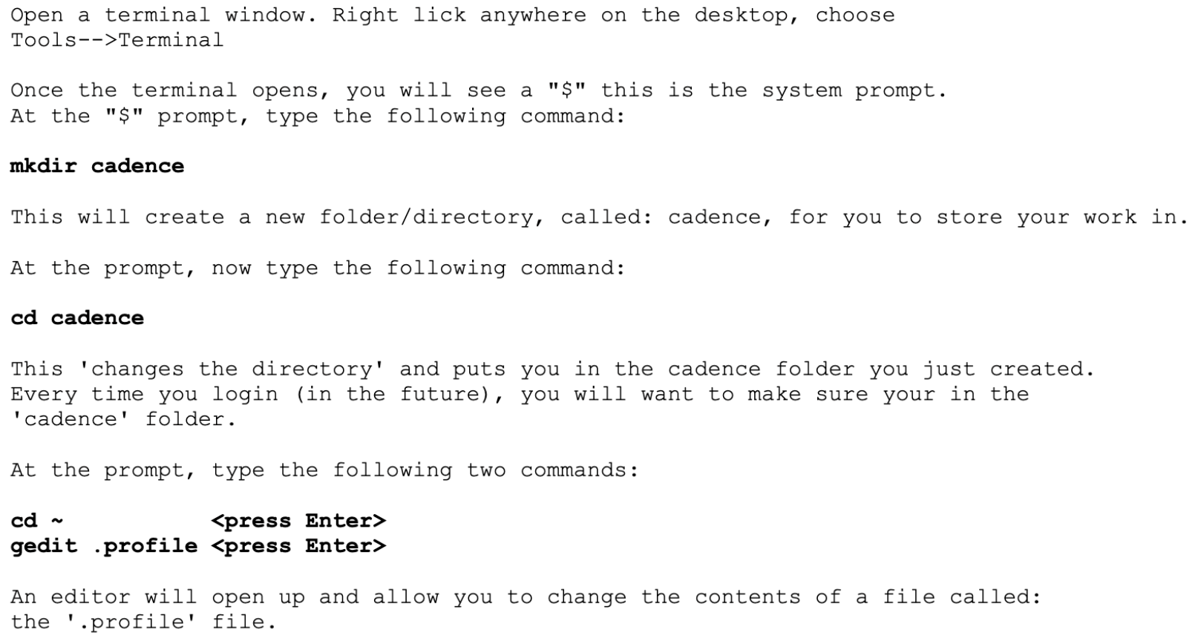
Step 2 (skip this if you have take ECE4140/6240)

Slide 9
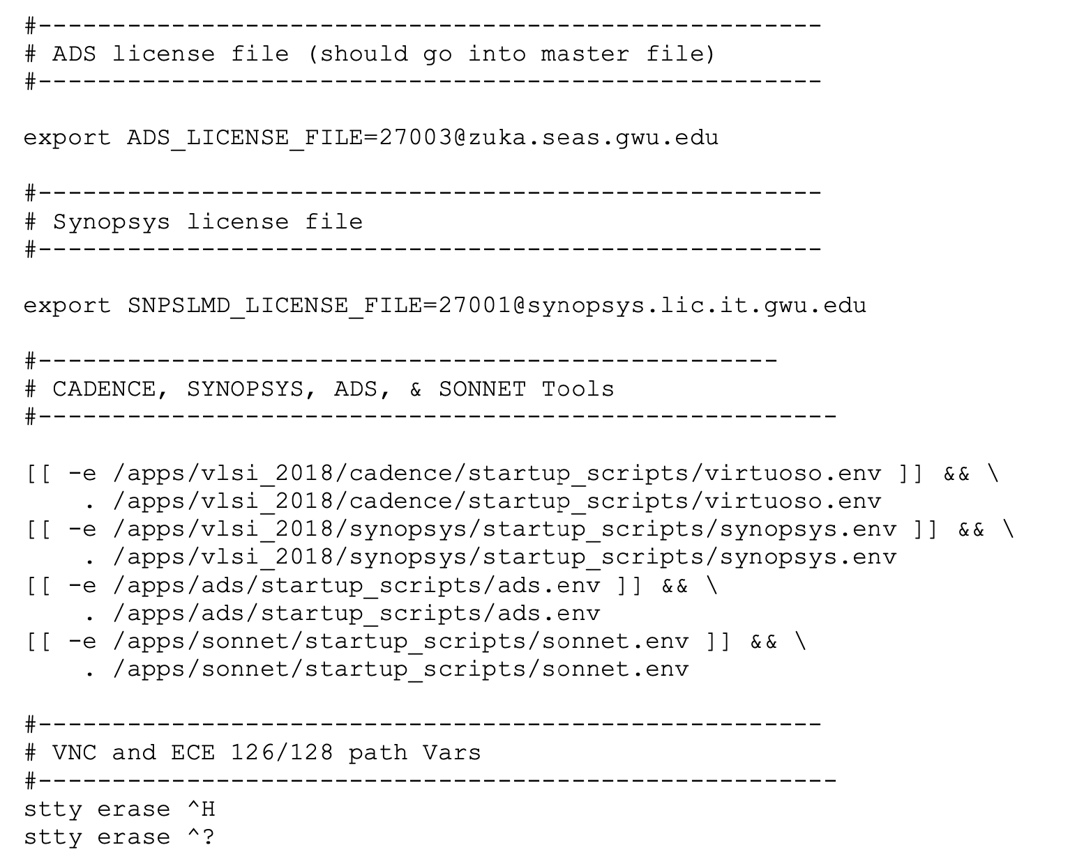
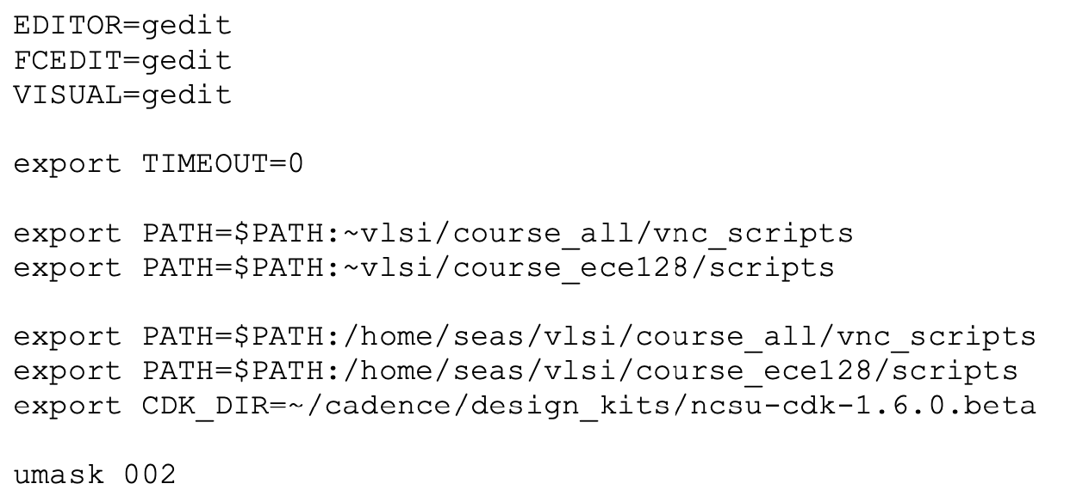
Check your .profile, and type: . ~/.profile in the terminal
Check ~./bashrc
Completely Log out and log in
If next time it does not work,
type . ~/.profile again

Slide 10
Step 3
Create the following directories
(hint: mkdir ~/ece41506250 would be the command to create the first directory
~/ece41506250
~/ece41506250/lab1
~/ece41506250/lab1/source
~/ece41506250/lab1/simulation
~/ece41506250/lab1/simulation/scripts
~/ece41506250/lab1/simulation/testbench
~/ece41506250/lab1/simulation/work

Slide 11
Populate directories with files from blackboard
Download the 2 files(sim-nc, design_files)from blackboard and create 3 files(mux_b.v, mux_s.v, mux_tb.v), then place them in the below directories
~/ece41506250/lab1/source/mux_b.v
~/ece41506250/lab1/source/mux_s.v
~/ece41506250/lab1/simulation/sim-nc
~/ece41506250/lab1/simulation/scripts/design_files
~/ece41506250/lab1/simulation/testbench/mux_tb.v
Open and inspect sim-nc
sim-nc is a simple bash script to simplify compiling and simulating Verilog files using Cadence Xcelcium.
Examine the script and become familiar with the commands
Compile design
Navigate to the /simulation directory and run the command
source sim-nc –compile
to compile all the files listed in /simulation/scripts/design_files. All of these files are
syntax clean so there shouldn’t be any errors/warnings
-Note: type all commands into the terminal, don’t copy/paste it from this
document. The “-“ character doesn’t’ always copy correctly and will cause
an error

Slide 12
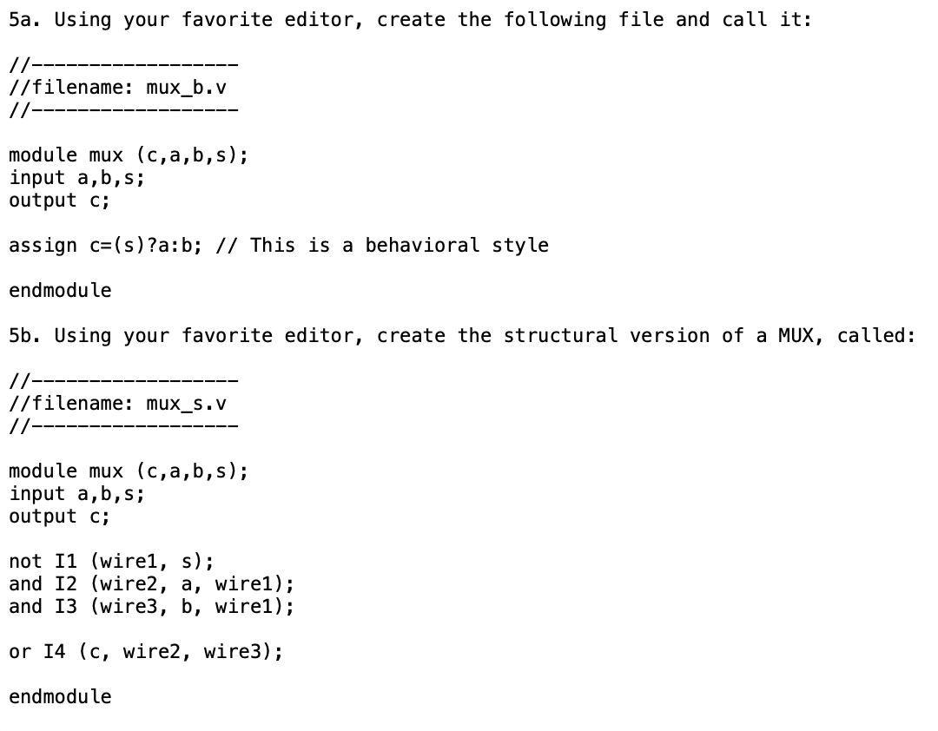

Slide 13
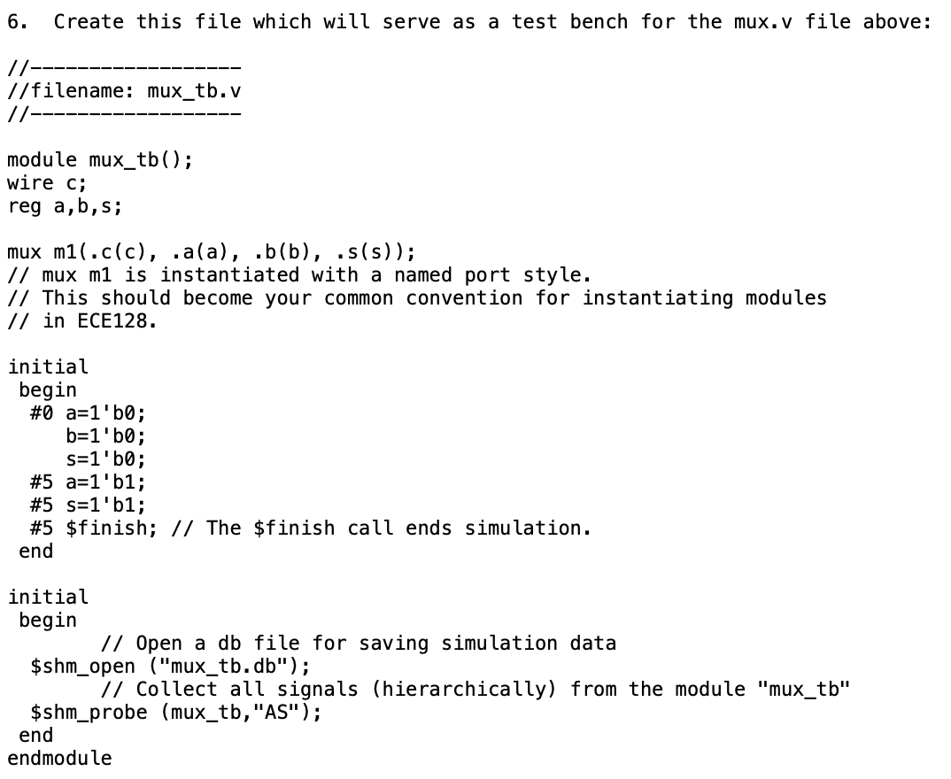

Slide 14
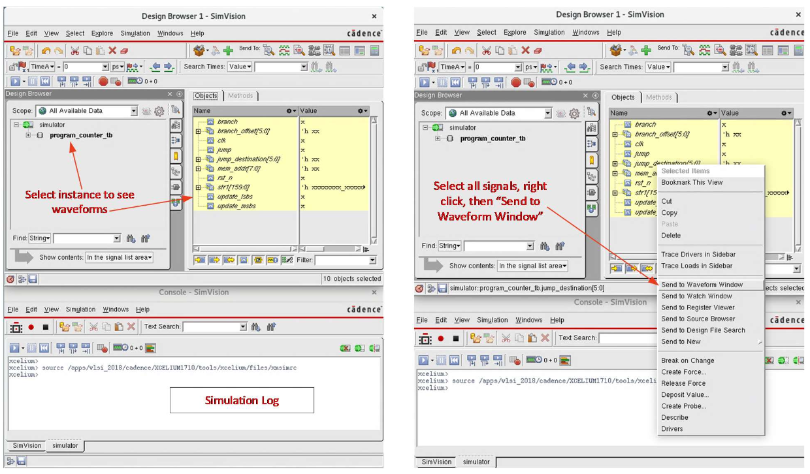
Simulate design
Navigate to the /simulation directory and do the command:
source sim-nc –sim mux_tb -gui
This command will launch a simulation for the testbench
testbench/program_counter_tb.v and bring up the simulation gui.
Send all signals to the waveform window, run the simulation, and zoom out to see the
full waveform

Slide 15
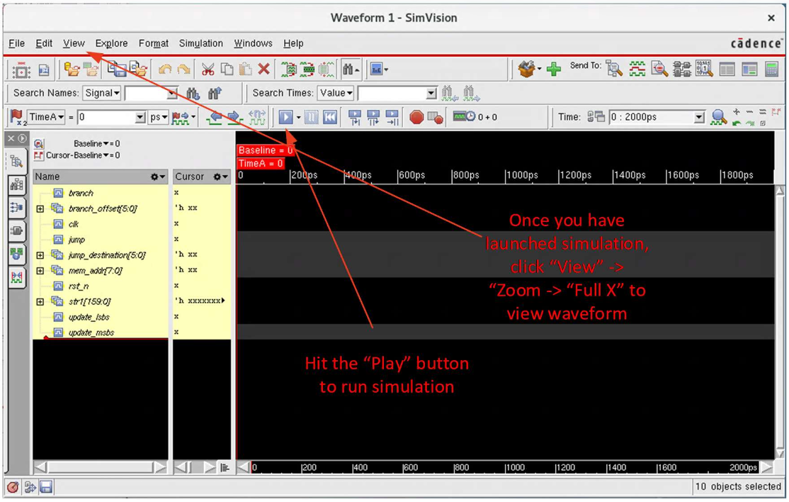

Slide 16
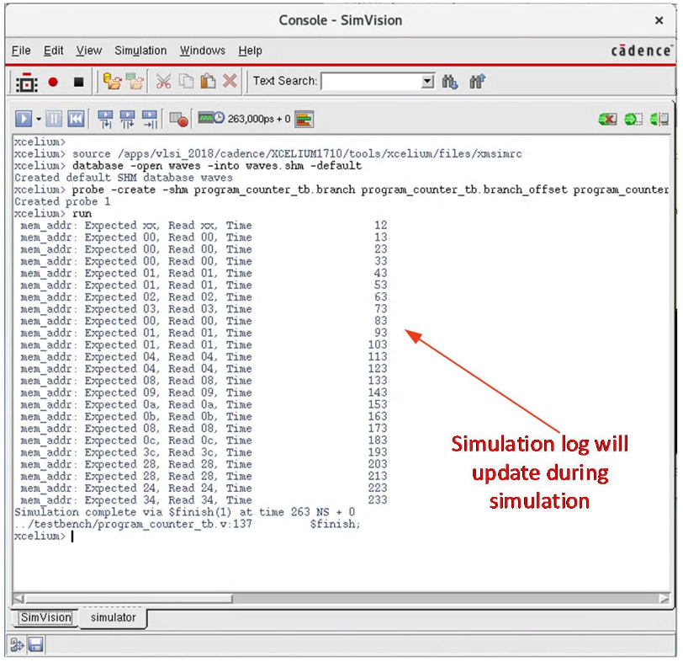

Slide 17
Lab Report 1
Submit screenshots of simulation waveforms for mux_b & mux_s

