Slide 1
Lesson 7
Arrays

Slide 2
Arrays Hold Multiple Values
Array: variable that can store multiple values of the same type
Values are stored in adjacent memory locations. If a variable is the name of a memory location, an array is the name of a group of them.
Declared using [] operator:
int tests[5];

Slide 3

Array - Memory Layout
The definition:
int tests[5];
allocates the following memory:

Slide 4
Array Terminology
In the definition int tests[5];
int is the data type of the array elements
tests is the name of the array
5, in [5], is the size declarator. It shows the number of elements in the array.
The size of an array is (number of elements) * (size of each element)

Slide 5
Array Terminology
The size of an array is:
the total number of bytes allocated for it
(number of elements) * (number of bytes for each element)
Examples:
int tests[5] is an array of 20 bytes, assuming 4 bytes for an int
long double measures[10]is an array of 80 bytes, assuming 8 bytes for a long double

Slide 6
Size Declarators
Named constants are commonly used as size declarators. const int SIZE = 5; int tests[SIZE];
This eases program maintenance when the size of the array needs to be changed.

Slide 7
Accessing Array Elements
Each element in an array is assigned a unique subscript.
Subscripts start at 0
subscripts:

Slide 8
Accessing Array Elements
The last element’s subscript is n-1 where n is the number of elements in the array.
subscripts:

Slide 9
Accessing Array Elements
Array elements can be used as regular variables:
tests[0] = 79;
cout << tests[0];
cin >> tests[1];
tests[4] = tests[0] + tests[1];
Arrays must be accessed via individual elements:
cout << tests; // not legal

Slide 10
Accessing Array Contents
Can access element with a constant or literal subscript:
cout << tests[3] << endl;
Can use integer expression as subscript:
int i = 5;
cout << tests[i] << endl;

Slide 11
Looping Through an Array
Example – The following code defines an array, numbers, and assigns values 1 to n to each element:
const int ARRAY_SIZE = 5;
int numbers[ARRAY_SIZE];
for (int count = 0; count < ARRAY_SIZE; count++)
numbers[count] = count + 1;

Slide 12
Default Initialization
Global array → all elements initialized to 0 by default
Local array → all elements uninitialized by default

Slide 13
No Bounds Checking in C++
When you use a value as an array subscript, C++ does not check it to make sure it is a valid subscript.
In other words, you can use subscripts that are beyond the bounds of the array.
This can corrupt memory and other variables, causing unpredictable results.
When using Visual Studio in “debug” mode, there is some checking, but not like in Java.

Slide 14
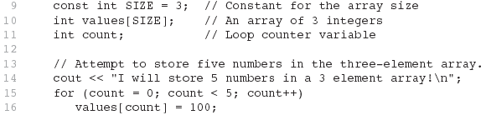
Example of no Bounds Checking
The following code defines a three-element array, and then writes five values to it!
Notes:
Show the program with the memory window overwriting good stuff.

Slide 15
Off-By-One Errors
An off-by-one error happens when you use array subscripts that are off by one.
This can happen when you start subscripts at 1 rather than 0:
// This code has an off-by-one error.
const int SIZE = 100;
int numbers[SIZE];
for (int count = 1; count <= SIZE; count++)
numbers[count] = 0;

Slide 16
Array Initialization
Arrays can be initialized with an initialization list: const int SIZE = 5; int tests[SIZE] = {79,82,91,77,84};
The values are stored in the array in the order in which they appear in the list.
The initialization list cannot exceed the array size.

Slide 17
Common Example
const int MONTHS = 12;
int months[MONTHS] = {31, 28, 31, 30, 31, 30, 31, 31, 30, 31, 30, 31};
if (year % 4 == 0)
months[1] = 29;
months[1] = year % 4 == 0 ? 29 : 28;

Slide 18
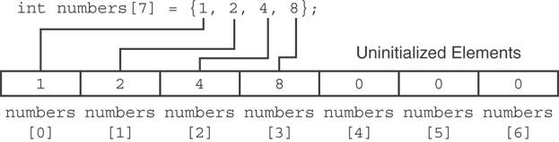
Partial Array Initialization
If array is initialized with fewer initial values than the size declarator, the remaining elements will be set to 0:

Slide 19
Implicit Array Sizing
Can determine array size by the size of the initialization list:
int quizzes[]={12,17,15,11};
Must use either array size declarator or initialization list at array definition

Slide 20
Processing Array Contents
Array elements can be treated as ordinary variables of the same type as the array
When using ++, -- operators, don’t confuse the element with the subscript:
tests[i]++; // add 1 to tests[i]
tests[i++]; // increment i, no
// effect on tests

Slide 21
Array Assignment
To copy one array to another,
Don’t try to assign one array to the other:
newTests = tests; // Won't work
Instead, assign element-by-element:
for (i = 0; i < ARRAY_SIZE; i++)
newTests[i] = tests[i];

Slide 22
Printing the Contents of an Array
You can display the contents of a character array by sending its name to cout: char fName[] = "Henry";
cout << fName << endl;
But, this ONLY works with character arrays!

Slide 23
Printing the Contents of an Array
For other types of arrays, you must print element-by-element:
for (i = 0; i < ARRAY_SIZE; i++)
cout << tests[i] << endl;

Slide 24
Summing and Averaging Array Elements
Use a simple loop to add together array elements:
int tnum;
double average, sum = 0;
for(tnum = 0; tnum < SIZE; tnum++)
sum += tests[tnum];
Once summed, can compute average:
average = sum / SIZE;

Slide 25
Finding the Largest Value in an Array
int count;
int largest;
largest = numbers[0];
for (count = 1; count < SIZE; count++)
{
if (numbers[count] > largest)
largest = numbers[count];
}

Slide 26
Finding the Smallest Value in an Array
int count;
int smallest;
smallest = numbers[0];
for (count = 1; count < SIZE; count++)
{
if (numbers[count] < smallest)
smallest = numbers[count];
}

Slide 27
Partially-Filled Arrays
If you don’t know how much data an array will be holding:
Make the array large enough to hold the largest expected number of elements.
Use a counter variable to keep track of the number of items stored in the array.

Slide 28
Comparing Arrays
To compare two arrays, you must compare element-by-element
const int SIZE = 5;
int firstArray[SIZE] = { 5, 10, 15, 20, 25 };
int secondArray[SIZE] = { 5, 10, 15, 20, 25 };
bool arraysEqual = true; // Flag variable
int count = 0; // Loop counter variable
// Compare the two arrays.
while (arraysEqual && count < SIZE)
{
if (firstArray[count] != secondArray[count])
arraysEqual = false;
count++;
}
if (arraysEqual)
cout << "The arrays are equal.\n";
else
cout << "The arrays are not equal.\n";

Slide 29
Arrays as Function Arguments
To pass an array to a function, just use the array name:
showScores(tests);
To define a function that takes an array parameter, use empty [] for array argument:
void showScores(int []);
// function prototype
void showScores(int tests[])
// function header

Slide 30
Modifying Arrays in Functions
Array names in functions are like reference variables – changes made to array in a function are reflected in actual array in calling function
Need to exercise caution that array is not inadvertently changed by a function

Slide 31
Two-Dimensional Arrays
Can define one array for multiple sets of data
Like a table in a spreadsheet
Use two size declarators in definition:
const int ROWS = 4, COLS = 3; int exams[ROWS][COLS];
First declarator is number of rows; second is number of columns

Slide 32
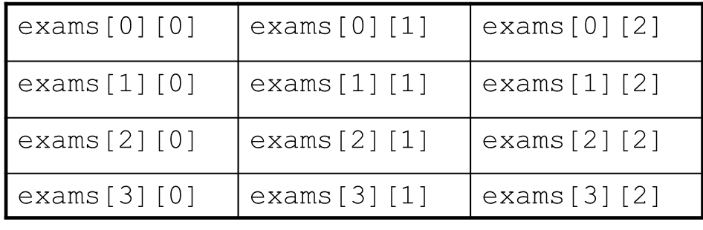
Two-Dimensional Array Representation
Two-Dimensional Array Representation
Use two subscripts to access element:
exams[2][2] = 86;
columns
r
o
w
s

Slide 33
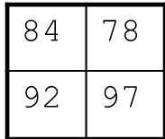
2D Array Initialization
Two-dimensional arrays are initialized row-by-row: const int ROWS = 2, COLS = 2; int exams[ROWS][COLS] = { {84, 78},
{92, 97} };
Can omit inner { }, some initial values in a row – array elements without initial values will be set to 0 or NULL

Slide 34
Two-Dimensional Array as Parameter, Argument
Use array name as argument in function call:
getExams(exams, 2);
Use empty [] for row, size declarator for column in prototype, header: const int COLS = 2; // Prototype void getExams(int [][COLS], int); // Header void getExams(int exams[][COLS], int rows)

Slide 35
Summing All the Elements in a Two-Dimensional Array
Given the following definitions:
const int NUM_ROWS = 5; // Number of rows
const int NUM_COLS = 5; // Number of columns
int total = 0; // Accumulator
int numbers[NUM_ROWS][NUM_COLS] =
{{2, 7, 9, 6, 4},
{6, 1, 8, 9, 4},
{4, 3, 7, 2, 9},
{9, 9, 0, 3, 1},
{6, 2, 7, 4, 1}};

Slide 36
Summing All the Elements in a Two-Dimensional Array
// Sum the array elements.
for (int row = 0; row < NUM_ROWS; row++)
{
for (int col = 0; col < NUM_COLS; col++)
total += numbers[row][col];
}
// Display the sum.
cout << "The total is " << total << endl;

Slide 37
Arrays with Three or More Dimensions
Can define arrays with any number of dimensions:
short rectSolid[2][3][5];
double timeGrid[3][4][3][4];
When used as parameter, specify all but 1st dimension in prototype, heading:
void getRectSolid(short [][3][5]);

Slide 38
Dynamic Arrays
You can allocate an array dynamically. Use this when you don’t know the dimensions at compile time
int* square = new int[order,order];
square[iRow, iCol] = 0;

Slide 39
Introduction to the STL vector
A data type defined in the Standard Template Library (covered more in Chapter 16)
Can hold values of any type:
vector<int> scores;
Automatically adds space as more is needed – no need to determine size at definition
Can use [] to access elements

Slide 40
Declaring Vectors
You must #include <vector>
Declare a vector to hold int element:
vector<int> scores;
Declare a vector with initial size 30:
vector<int> scores(30);
Declare a vector and initialize all elements to 0:
vector<int> scores(30, 0);
Declare a vector initialized to size and contents of another vector:
vector<int> finals(scores);

Slide 41
Adding Elements to a Vector
Use push_back member function to add element to a full array or to an array that had no defined size:
scores.push_back(75);
Use size member function to determine size of a vector:
howbig = scores.size();

Slide 42
Removing Vector Elements
Use pop_back member function to remove last element from vector:
scores.pop_back();
To remove all contents of vector, use clear member function:
scores.clear();
To determine if vector is empty, use empty member function:
while (!scores.empty()) ...

Slide 43
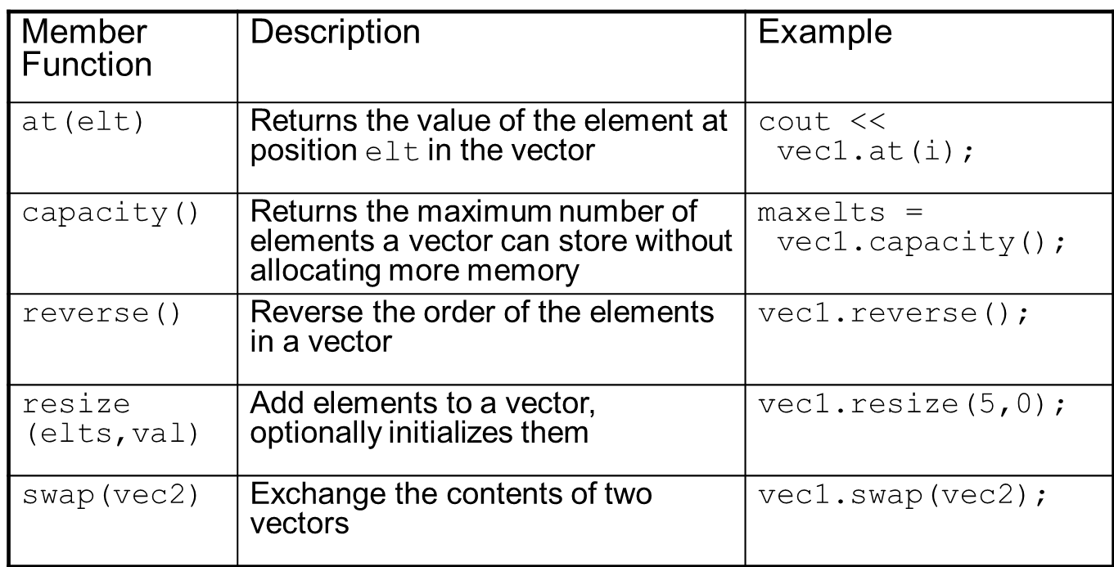
Other Useful Member Functions

