Slide 1
Lesson 10
Characters, C-Strings, and the string Class

Slide 2
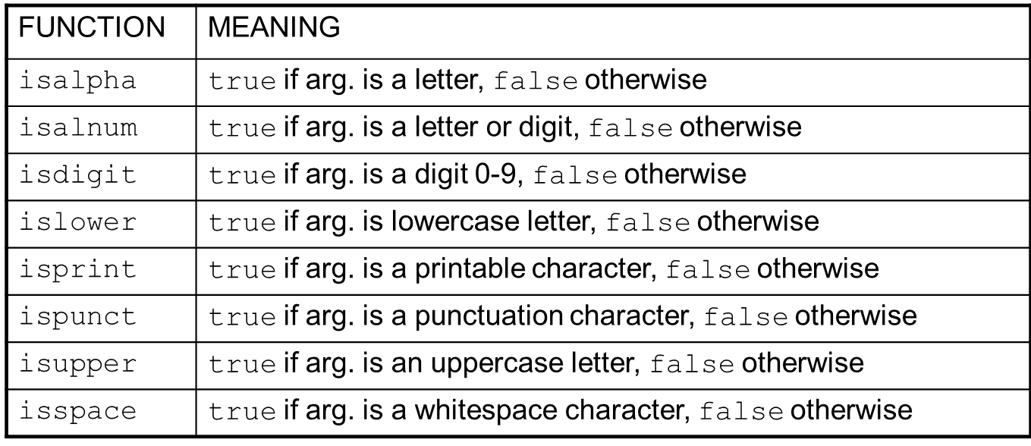
Character Testing
require cctype header file

Slide 3
Character Case Conversion
Functions:
toupper: if char argument is lowercase letter, return uppercase equivalent; otherwise, return input unchanged
char ch1 = 'H'; char ch2 = 'e'; char ch3 = '!';
cout << toupper(ch1); // displays 'H'
cout << toupper(ch2); // displays 'E'
cout << toupper(ch3); // displays '!'

Slide 4
Character Case Conversion
Functions:
tolower: if char argument is uppercase letter, return lowercase equivalent; otherwise, return input unchanged
char ch1 = 'H'; char ch2 = 'e'; char ch3 = '!';
cout << tolower(ch1); // displays 'h'
cout << tolower(ch2); // displays 'e'
cout << tolower(ch3); // displays '!'

Slide 5
C-Strings
C-string: sequence of characters stored in adjacent memory locations and terminated by NULL character
String literal (string constant): sequence of characters enclosed in double quotes " " : "Hi there!"
H
i
t
h
e
r
e
!
\0

Slide 6
C-Strings
Array of chars can be used to define storage for string: const int SIZE = 20; char city[SIZE];
Leave room for NULL at end
Can enter a value using cin or >>
Input is whitespace-terminated
No check to see if enough space
For input containing whitespace, and to control amount of input, use cin.getline()

Slide 7
C-String Library Functions
Require the cstring header file
Functions take one or more C-strings as arguments. Can use:
C-string name
pointer to C-string
literal string

Slide 8
C-String Library Functions
Functions:
strlen(str): returns length of C-string str
char city[SIZE] = "Missoula";
cout << strlen(city); // prints 8
strcat(str1, str2): appends str2 to the end of str1
char location[SIZE] = "Missoula, ";
char state[3] = "MT";
strcat(location, state);
// location now has "Missoula, MT"

Slide 9
C-String Library Functions
Functions:
strcpy(str1, str2): copies str2 to str1 const int SIZE = 20; char fname[SIZE] = "Maureen", name[SIZE]; strcpy(name, fname);
Note: strcat and strcpy perform no bounds checking to determine if there is enough space in receiving character array to hold the string it is being assigned. You’ll get compiler warnings in Visual Studio.

Slide 10
Search Within a C-String
Function:
strstr(str1, str2): finds the first occurrence of str2 in str1. Returns a pointer to match, or NULL if no match.
char river[] = "Wabash";
char word[] = "aba";
cout << strstr(river, word);
// displays "abash"
Why does it display “abash”?

Slide 11
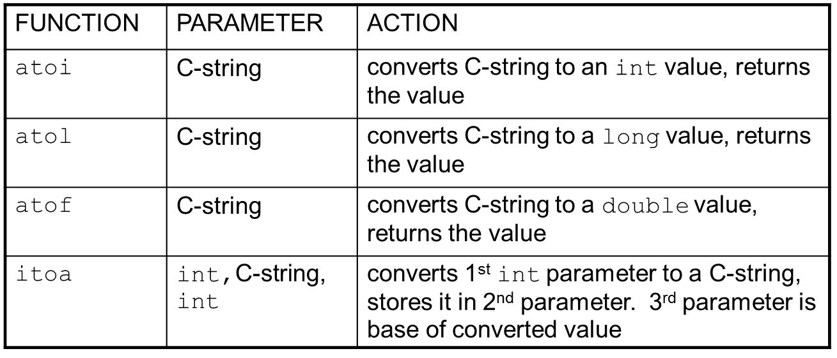
String/Numeric Conversion
require cstdlib header file

Slide 12
String/Numeric Conversion
int iNum;
long lNum;
double dNum;
char intChar[10];
iNum = atoi("1234"); // puts 1234 in iNum
lNum = atol("5678"); // puts 5678 in lNum
dNum = atof("35.7"); // puts 35.7 in dNum
itoa(iNum, intChar, 8); // puts the string
// "2322" (base 8 for 1234₁₀) in intChar

Slide 13
String/Numeric Conversion
if C-string contains non-digits, results are undefined
function may return result up to non-digit
function may return 0
itoa does no bounds checking – make sure there is enough space to store the result. In Visual Studio you’ll get warnings.

Slide 14
Writing C-String Functions
Designing C-String Handling Functions
can pass arrays or pointers to char arrays
Can perform bounds checking to ensure enough space for results
Can anticipate unexpected user input

Slide 15
Substring Function
char * substr(const char *inStr, int start, int len)
{
char *sub = 0;
if (!(start < 0 || len < 0 || inStr == 0 || start + len > strlen(inStr)))
{
sub = new char[len + 1];
strncpy(sub, &inStr[start], len);
sub[len] = '\0';
}
return sub;
}

Slide 16
The C++ string Class
Special data type supports working with strings
#include <string>
Can define string variables in programs:
string firstName, lastName;
Can receive values with assignment operator:
firstName = "George";
lastName = "Washington";
Can be displayed via cout
cout << firstName << " " << lastName;

Slide 17
string Constructors
string name; // Empty string
string name(“John”); // Initializes string
string next(strName); // Also initializes
string sub(strName,2); // Takes first 2 chars

Slide 18
string Comparison
Can use relational operators directly to compare string objects:
string str1 = "George",
str2 = "Georgia";
if (str1 < str2)
cout << str1 << " is less than "
<< str2;
Comparison is performed similar to strcmp function. Result is true or false
This is very different from Java, where you are comparing the references, not the strings.

Slide 19
String Operators
string word1, phrase;
string word2 = " Dog";
cin >> word1; // user enters "Hot Tamale"
// word1 has "Hot"
phrase = word1 + word2; // phrase has
// "Hot Dog"
phrase += " on a bun";
for (int i = 0; i < 16; i++)
cout << phrase[i]; // displays
// "Hot Dog on a bun"

Slide 20
string Member Functions
Are behind many overloaded operators
Categories:
assignment: assign, copy, data
modification: append, clear, erase, insert, replace, swap
space management: capacity, empty, length, resize, size
substrings: find, substr
comparison: compare
See Table 10-7 for a list of functions

Slide 21
string Member Functions
string word1, word2, phrase;
cin >> word1; // word1 is "Hot"
word2.assign(" Dog");
phrase.append(word1);
phrase.append(word2); // phrase has "Hot Dog"
phrase.append(" with mustard relish", 13);
// phrase has "Hot Dog with mustard"
phrase.insert(8, "on a bun ");
cout << phrase << endl; // displays
// "Hot Dog on a bun with mustard"

