Slide 1
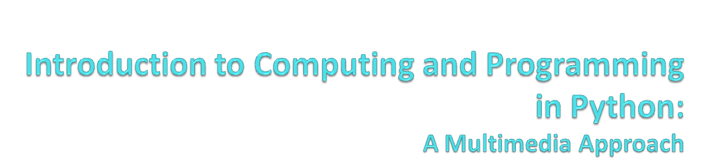
Chapter 1: Introduction to Computer Science and Media Computation

Slide 2
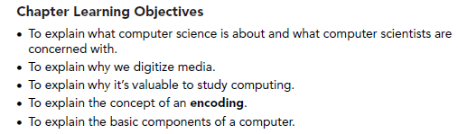
Story
What is computer science about?
What computers really understand,
and where Programming Languages fit in
Media Computation: Why digitize media?
  How can it possibly work?
Computer Science for Everyone
  It’s about communications and process

Slide 3
What’s computation good for
Computer science is the study of recipes
Computer scientists study…
  How the recipes are written (algorithms, software engineering)
  The units used in the recipes (data structures, databases)
  What can recipes be written for (systems, intelligent systems, theory)
  How well the recipes work (human-computer interfaces)

Slide 4
Specialized Recipes
Some people specialize in crepes or barbeque
Computer scientists can also specialize on special kinds of recipes
  Recipes that create pictures, sounds, movies, animations (graphics, computer music)
Still others look at emergent properties of computer “recipes”
  What happens when lots of recipes talk to one another (networking, non-linear systems)

Slide 5
Key concept:
The COMPUTER does the recipe!
Make it as hard, tedious, complex as you want!
Crank through a million genomes? No problem!
Find one person in a 30,000 campus? Yawn!
Process a million dots on the screen or a bazillion sound samples?
  That’s media computation

Slide 6
What computers understand
It’s not really multimedia at all.
  It’s unimedia (said Nicholas Negroponte, founder of MIT Media Lab)
  Everything is 0’s and 1’s
Computers are exceedingly stupid
  The only data they understand is 0’s and 1’s
  They can only do the most simple things with those 0’s and 1’s
    Move this value here
    Add, multiply, subtract, divide these values
    Compare these values, and if one is less than the other, go follow this step rather than that one.
  Done fast enough, those simple things can be amazing.

Slide 7
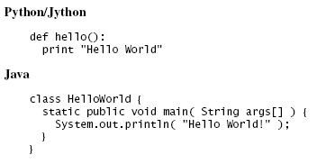
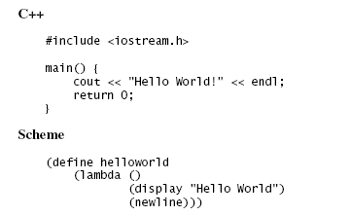
Programming Languages
Different programming languages are different ways (encodings) that turn into (same/similar) commands for the computer

Slide 8
A word about Jython
Jython is Python
Python is a language implemented in C.
Jython is the same language implemented in Java.
  Is the pizza different if a different company makes the flour? If so, not by much.

Slide 9
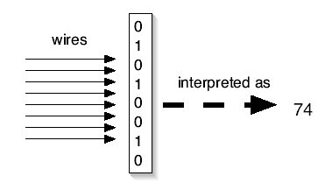
Key Concept: Encodings
We can interpret the 0’s and 1’s in computer memory any way we want.
  We can treat them as numbers.
  We can encode information in those numbers
Even the notion that the computer understands numbers is an interpretation
  We encode the voltages on wires as 0’s and 1’s,
  eight of these defining a byte
  Which we can, in turn, interpret as a decimal number

Slide 10
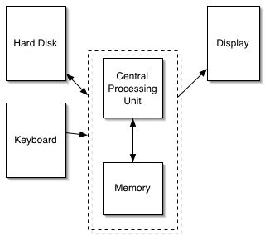
How a computer works
The part that does the adding and comparing is the Central Processing Unit (CPU).
The CPU talks to the memory
  Think of it as a sequence millions of mailboxes, each one byte in size, each of which has a numeric address
The hard disk provides 10 times or more storage than in memory (20 billion bytes versus 128 million bytes), but is millions of times slower
The display is the monitor or LCD (or whatever)

Slide 11
Layer the encodings as deep as you want
One encoding, ASCII, defines an “A” as 65
  If there’s a byte with a 65 in it, and we decide that it’s a string, POOF! It’s an “A”!
We can string together lots of these numbers together to make usable text
  “77, 97, 114, 107” is “Mark”
  “60, 97, 32, 104, 114, 101, 102, 61” is
  “<a href=“ (HTML)
Notes:
Notice that lowercase “a” is different than uppercase “A”

Slide 12
What do we mean by layered encodings?
A number is just a number is just a number
If you have to treat it as a letter, there’s a piece of software that does it
  For example, that associates 65 with the graphical representation for “A”
If you have to treat it as part of an HTML document, there’s a piece of software that does it
  That understands that “<A HREF=“ is the beginning of a link
That part that knows HTML communicates with the part that knows that 65 is an “A”

Slide 13
Multimedia is unimedia
But that same byte with a 65 in it might be interpreted as…
  A very small piece of sound (e.g., 1/44100-th of a second)
  The amount of redness in a single dot in a larger picture
  The amount of redness in a single dot in a larger picture which is a single frame in a full-length motion picture

Slide 14
Software (recipes) defines and manipulates encodings
Computer programs manage all these layers
  How do you decide what a number should mean, and how you should organize your numbers to represent all the data you want?
  That’s data structures
If that sounds like a lot of data, it is
  To represent all the dots on your screen probably takes more than 3,145,728 bytes
  Each second of sound on a CD takes 44,100 bytes
Notes:
We’ll explain more about layers next time

Slide 15
Thank God for Moore’s Law
Gordon Moore, one of the founders of Intel, made the claim that (essentially) computer power doubles for the same dollar every 18 months.
This has held true for over 30 years.
Go ahead! Make your computer do the same thing to everyone of 3 million dots on your screen! It doesn’t care! And it won’t take much time either!

Slide 16
Why digitize media?
Digitizing media is encoding media into numbers
  Real media is analogue (continuous).
  To digitize it, we break it into parts where we can’t perceive the parts.
By converting them, we can more easily manipulate them, store them, transmit them without error, etc.

Slide 17
How can it work to digitize media?
Why does it work that we can break media into pieces and we don’t perceive the breaks?
We can only do it because human perception is limited.
  We don’t see the dots in the pictures, or the gaps in the sounds.
We can make this happen because we know about physics (science of the physical world) and psychophysics (psychology of how we perceive the physical world)

Slide 18
Why should you need to study “recipes”?
To understand better the recipe-way of thinking
  It’s influencing everything, from computational science to bioinformatics
  Eventually, it’s going to become part of everyone’s notion of a liberal education
  That’s the process argument
  BTW, to work with and manage computer scientists
AND…to communicate!
  Writers, marketers, producers communicate through computation
We’ll take these in opposite order

Slide 19
Computation for Communication
All media are going digital
Digital media are manipulated with software
You are limited in your communication by what your software allows
  What if you want to say something that Microsoft or Adobe or Apple doesn’t let you say?

Slide 20
Programming is a communications skill
If you want to say something that your tools don’t allow, program it yourself
If you want to understand what your tools can or cannot do, you need to understand what the programs are doing
If you care about preparing media for the Web, for marketing, for print, for broadcast… then it’s worth your while to understand how the media are and can be manipulated.
Knowledge is Power,
Knowing how media work is powerful and freeing

Slide 21
We’re not going to replace PhotoShop
Nor ProAudio Tools, ImageMagick and the GIMP, and Java and Visual Basic
But if you know what these things are doing, you have something that can help you learn new tools

Slide 22
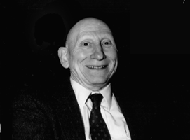
Knowing about programming is knowing about process
Alan Perlis
  One of the founders of computer science
  Argued in 1961 that Computer Science should be part of a liberal education: Everyone should learn to program.
    Perhaps computing is more critical to a liberal education than Calculus
    Calculus is about rates, and that’s important to many.
    Computer science is about process, and that’s important to everyone.
  Automating process
  changes everything.

Slide 23
A Recipe is a Statement of Process
A recipe defines how something is done
  In a programming language that defines how the recipe is written
When you learn the recipe that implements a Photoshop filter, you learn how Photoshop does what it does.
And that is powerful.

Slide 24
Finally: Programming is about
Communicating Process
A program is the most concise statement possible to communicate a process
  That’s why it’s important to scientists and others who want to specify how to do something understandably in as few words as possible

Slide 25
Python
The programming language we will be using is called Python
  http://www.python.org
  It’s used by companies like Google, Industrial Light & Magic, Pixar, Nextel, and others
The kind of Python we’re using is called Jython
  It’s Java-based Python
  http://www.jython.org
Notes:
URL to look at what companies use Python is in the book.

