Slide 1
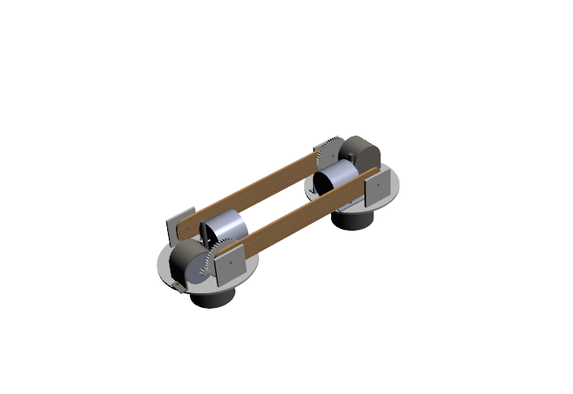
Development and design of a wall climbing robot

Slide 2
Development and design of a wall climbing robot
Project by
Jithin George - 2011A4PS 291H
Jaideep Singh Chavan - 2010B5A4 412H
Sarthak Ghosh - 2010A3PS 211H

Slide 3
Objective :
To be able to traverse a vertical perpendicular wall
To remain stationary on a vertical perpendicular wall

Slide 4
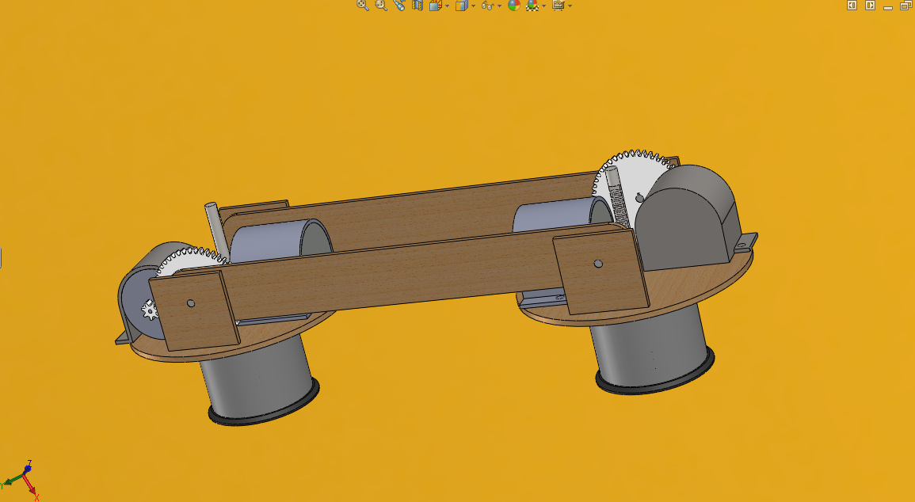
The final design selected
The flipping robot

Slide 5
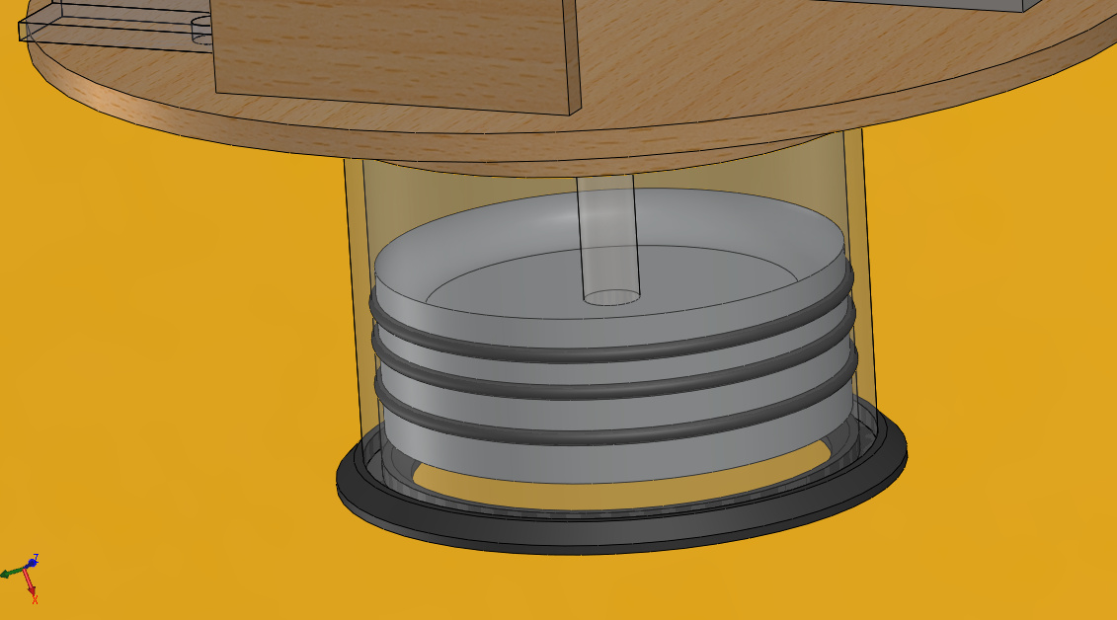
The suction mechanism

Slide 6
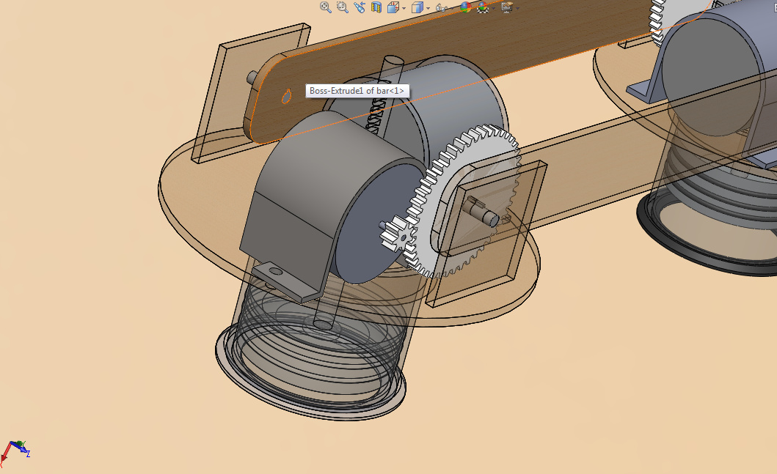
Locomotion Mechanism

Slide 7
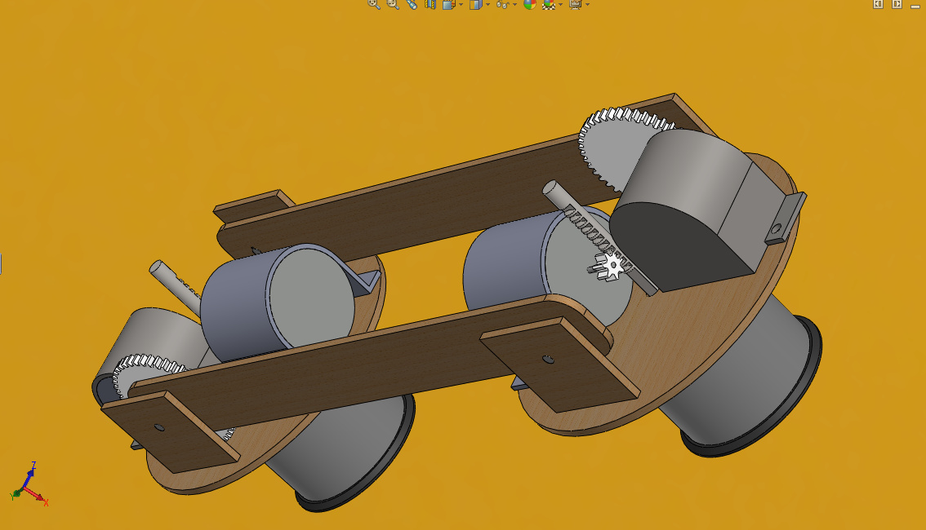
Final product

Slide 8
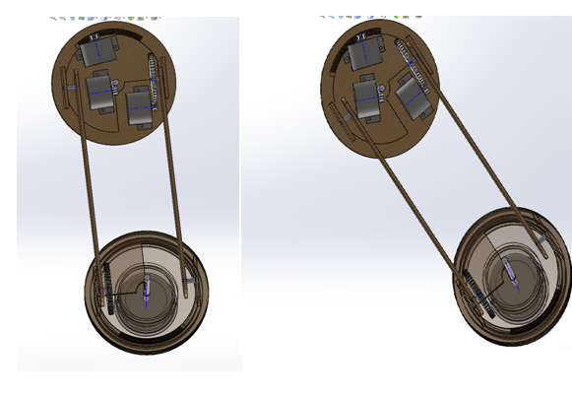
New mechanism for turnning

Slide 9
Control of the robot
R
S
X
Y
Let R and S represent the signals used to represent the rotation of the 2 motors used for the shaft movement.
Let X and Y represent the signals used for the motors controlling the piston movement

Slide 10
State diagram
S0
(Idle)
On/0011
S1
S3
Counter/0011
On,Counter/1101
On,counter/001’1
S2

Slide 11
R S X Y
0 0 1 1
0 0 1’ 1
1 1 0 1
0 0 1 1
Pistons moved up
X piston moves down, Y still up
R and S both rotate and Y is still up
X and Y pistons are moved up

Slide 12
S
R
Y
X
Exchange the signals of X and Y , R and S.
We go back to the start.

Slide 13
Integrating the turning possibility
S0(Idle)
On/0011
T=0/1101
S1
S3
Counter/0011
T=1/Turn=1 and 1101
On,counter/001’1
T=0/1101
On,Counter/1101
S2
S4

Slide 14
Detecting Adjacent Walls
Assumptions: Most walls adjacent to vertical walls (the ceiling) are almost always at 90 degree to the vertical wall.
Use of proximity sensor to detect a right angled wall which is sufficiently close.

Slide 15
Proximity Sensor
A proximity sensor often emits an electromagnetic field or a beam of
electromagnetic radiation (infrared, for instance), and looks for
changes in the field or return signal.

Slide 16
Infrared Proximity Sensor

Slide 17
Detection of Right Angled Walls
Let Motor X is fixed to the Wall and Let Motor Y be free.
Thus Motor X is responsible for the rotation of the arm and Motor Y is responsible for the rotation of the suction cup at the other end.
We rotate Motor Y at a speed double of Motor X.
By the time Motor X completes 90 degree, suction cup has rotated 180.

Slide 18
Detection of Right Angled Walls
So the current situation is this :
X
Y
Now we stop the motor X and start polling the proximity sensors to see if the wall at front is lesser than L distance away.
If not we carry on regularly, otherwise we align the suction cup Y.

Slide 19
Detection of Right Angled Walls
So the next desired snapshot can be :
Regular motion
Desired Motion

Slide 20
Detection Of Right Angled Walls
After the detection of the wall takes place, for every degree anticlockwise rotation of the motor X, Motor Y rotates equally in an anti-clockwise direction.
This ensures that attaching surface of the cup remains parallel to the perpendicular wall.

Slide 21
Obtuse Angled Walls
Start polling the sensor when the arm is at 90 degree to the current wall.
Do not rotate the motor handling the suction cup until a wall is detected.
Detect the adjacent wall which is close enough
Stop the motor that is fixed to the current wall
Rotate the suction cup till both the sensors attached to it start giving equal values.
Once equal values are returned, for every degree rotation of the motor fixed to the wall, the motor handling the suction cup rotates the same amount in the opposite direction. This ensures that the relative orientation is maintained.
Repeat step 6 until the cup holds on to the adjacent wall.

Slide 22
Obtuse Angled Walls
Aligns by checking if both sensor values are same.
Detects wall in this position

Slide 23
State Diagram with Right angled wall detection
T=0/1101
S0(Idle)
On/0011
T=1/Turn=1 and 1101
S4
S3
S1
W=0,Counter/0011
T=0/1101
On,counter/001’1
W=1/11’01
On,Counter/1101
S2
S5
W=0/0011

Slide 24
Problems with fabrication
Lack of concise and cheap motors.
Material required couldn’t be found and used easily.
Time constraint

Slide 25
Conclusion
We have designed our own unique wall-climbing robot with mechanisms for suction, rotation and turning. We implemented techniques for its control as well.
In future, we believe we can fabricate this efficient prototype.

Slide 26
Thank you!

