Slide 1
Design of a novel recirculation system using COMSOL
Jithin George- 2011A4PS291H

Slide 2
Objective
To model a novel recirculation system on COMSOL and input physical constraints on it.
To generate Velocity , Pressure and other output results on COMSOL.

Slide 3
Literature Review
Design of a novel recirculating system for slow reacting assays in microfluidic domain. N.N. Sharma
Electro-osmotic mixer- Comsol manual

Slide 4
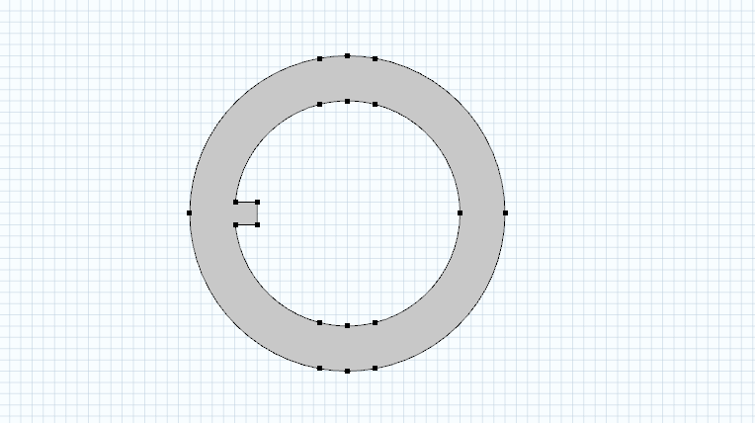
Geometry

Slide 5
Theory
Electro-osmotic flow is caused by the movement of the electric double layer in the direction of an applied electric field. The direction as well as speed of flow is dependent upon the Zeta Potential of the electric double layer.
The end outcome of this coupled electrostatic and fluid flow phenomena is the movement of the shear layer in along the applied electric field.
This results in a ‘slip’ boundary condition at the electro-osmotically active walls, with a non-zero velocity tangential to the wall.
Electro-osmotic flow is suppressed in the left side of the loop.
The net effect of such an arrangement is that there is a continuous flow of fluid in a closed circle,

Slide 6
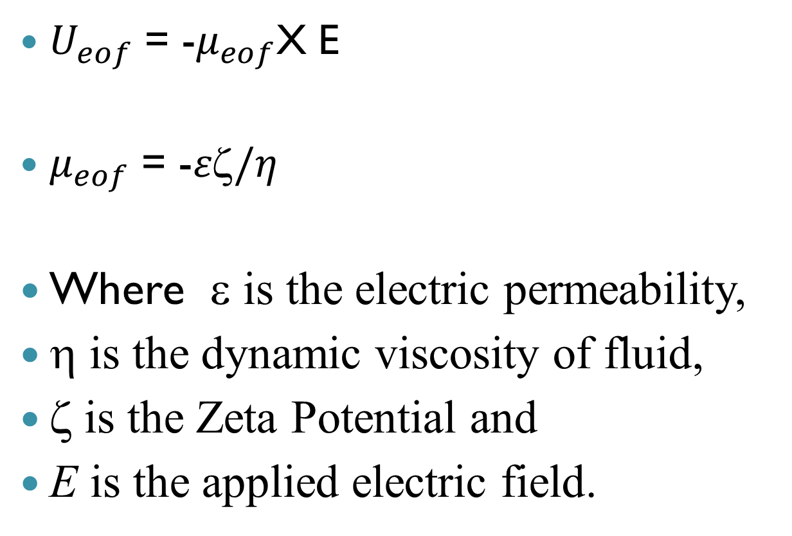
Formulae Involved
$U_{eof}$ = -$μ_{eof}$X E
$μ_{eof}$ = -$ε\text{z}/η$
Where ε is the electric permeability,
η is the dynamic viscosity of fluid,
ζ is the Zeta Potential and
E is the applied electric field.

Slide 7
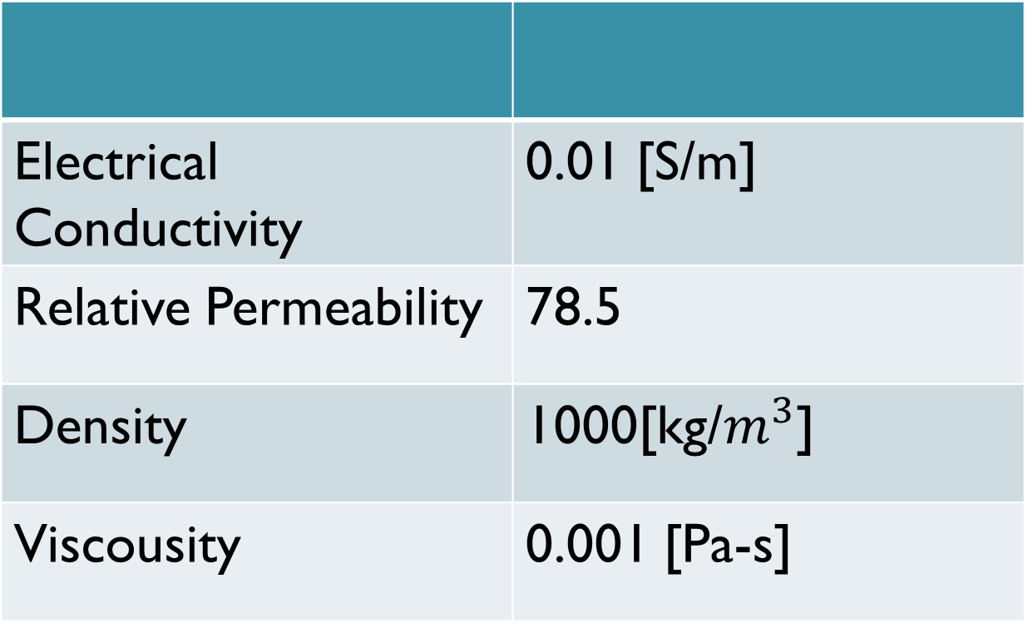
Material Properties
Electrical Conductivity | 0.01 [S/m]
Relative Permeability | 78.5
Density | 1000[kg/$m^{3}$]
Viscousity | 0.001 [Pa-s]

Slide 8
Boundary Conditions
Applied Voltage [V0] | 12 [V]
Back Pressure at Outlet [p0] | 0 [Pa]
Electroosmotic Mobility [mu_eo] | 0.06 [mm2/V.s]
Device Thickness in third dimension [d] | 20 [μm]

Slide 9
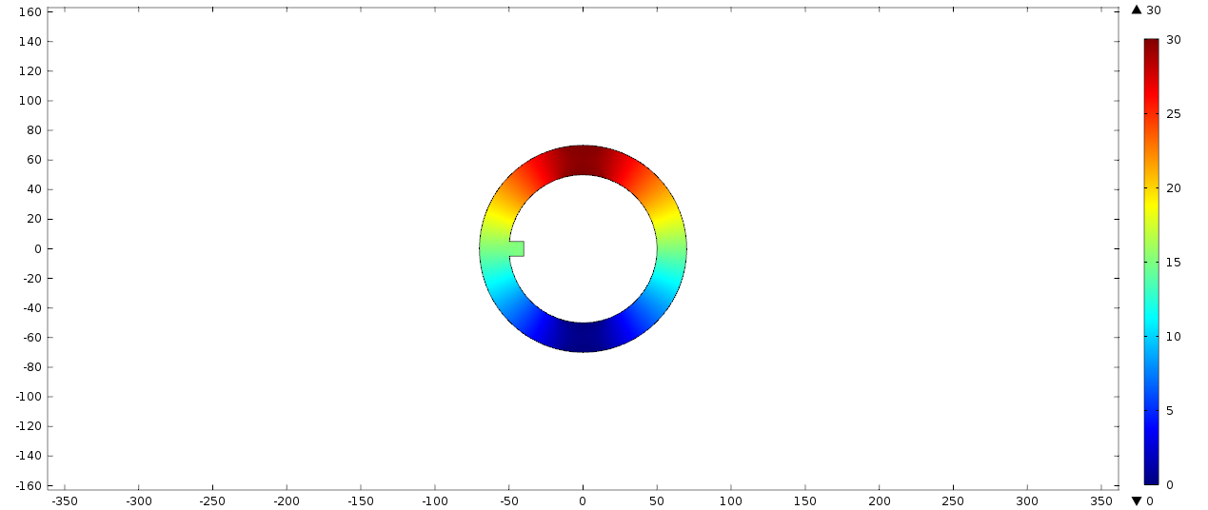
Results
Electric Potential

Slide 10
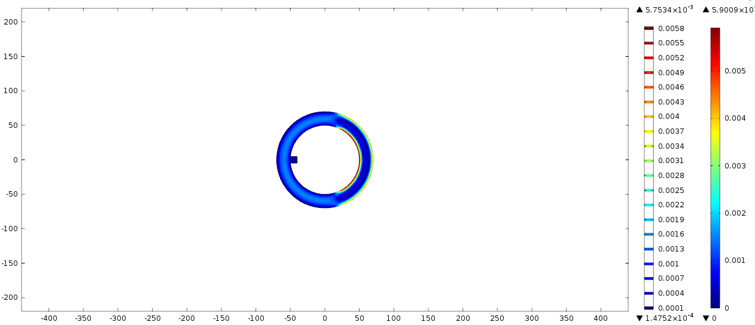
Results
Velocity Contour

Slide 11
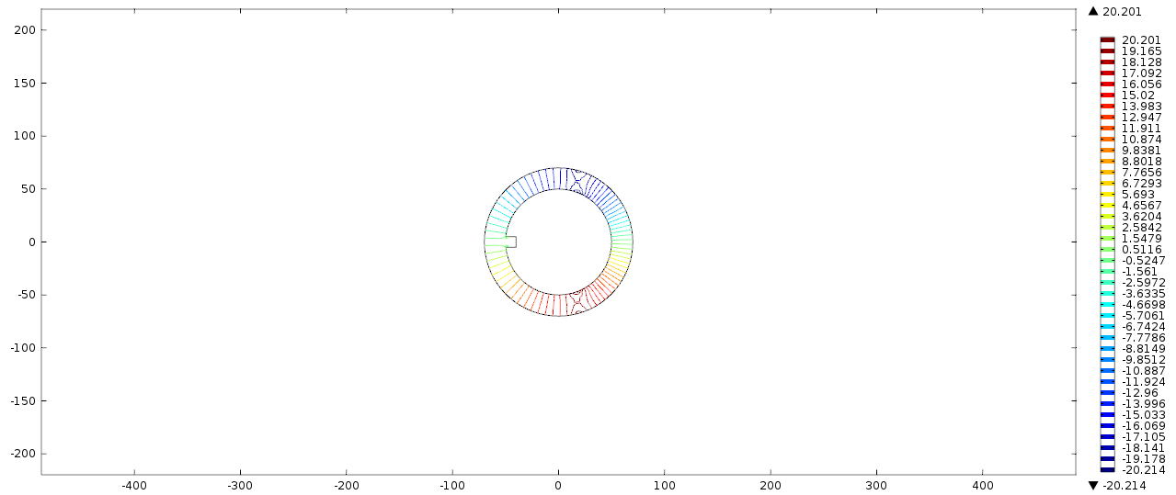
Results
Pressure distribution

Slide 12
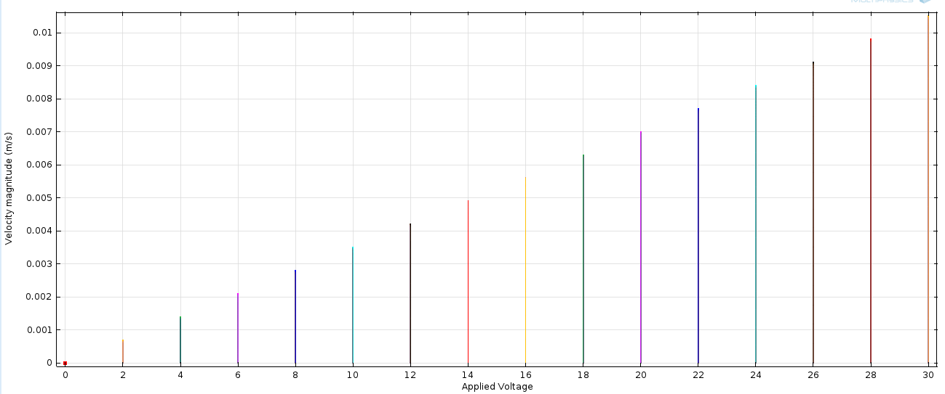
RESULTS
Velocity Variation with Applied Voltage

Slide 13
Thank You

