Slide 1
Image Scanning Microscopy
Dirk Hähnel - Group Seminar 30.04.2013
III. Institute of Physics – Biophysics
Georg-August-University Göttingen

Slide 2
Introduction

Slide 3
Introduction

Slide 4
Conclusion

Slide 5
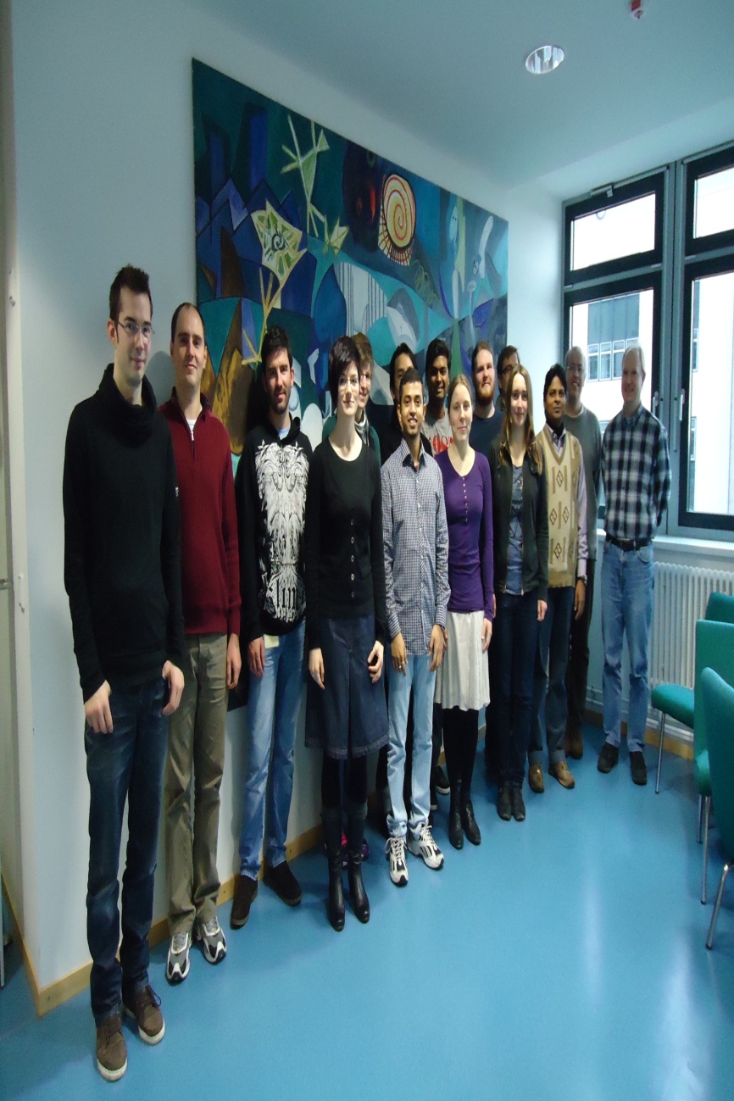
Acknowledgements
People
Funding

Slide 6
Thank you, for your kind attention!

