Slide 1
Bookmarks help

Slide 2
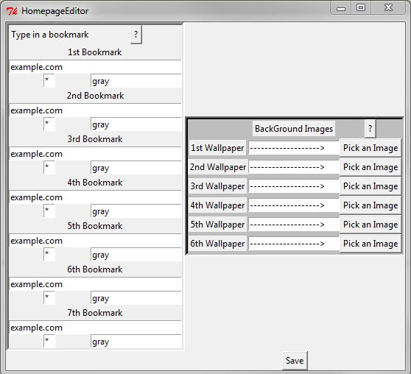

Slide 3
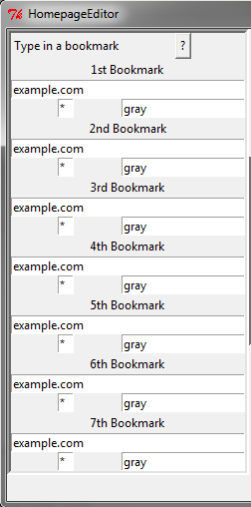
Replace example.com with your favorite website( ie. Facebook.com)
Replace * with a letter of your choosing
Enter in a color of your choosing( ie. pink, blue, red)
Repeat for up to seven different unique bookmarks.
Press Save when done with both bookmarks and Wallpapers

Slide 4
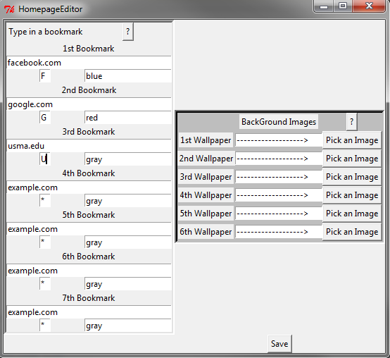
Example

